Slide 1
Contact Lens Review
Susan B. Janik, OD

Slide 2
Disclosures and contact information
SUSAN B. JANIK, OD
SPEAKER FOR PRN, Advisory Board for Tarsus
Sjanik@solinskyeyecare.com

Slide 3
Course Objectives
To review recent advances in contact lenses and the prevention and treatment of contact lens induced infections.

Slide 4
In the United States alone, an estimated 197.6 million adults need some form of vision correction—that’s almost 77% of the adult population.¹ According to the Centers for Disease Control and Prevention (CDC), only 45 million, or roughly 22%, of them wear contact lenses.
According to one literature review, on average, 22% of contact lens wearers drop out or discontinue contact lens wear at some point, but those patients can resume wear safely about 74% of the time.³ However, dropout rates mean an estimated loss of revenue of up to $24,000 per patient over their lifetime—not to mention a less-than-happy patient.⁴
For the majority of our respondents, their go-to initial modality for first-time contact lens wearers was daily disposables, with 74.6% reaching for daily lenses.
Pucker AD, Tichenor AA. A Review of Contact Lens Dropout. Clin Optom (Auckl). 2020;12:85-94.

Slide 5
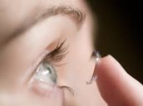
Modern Theories in Contact Lenses
DEMAND FOR EYE CARE SERVICES continued:
There are currently 41.2 million adults wearing contact lenses – or 22% of the vision correction population.
By 2025 this is expected to rise to 24%.
Reference: Mark Wright, Review of Optometric Business, 11/28/17

Slide 6
Modern Theories in Contact Lenses
TRENDS:
2016 by the Numbers
88% Number of practitioners recommending specific brands of contact lens care systems.
76% Number of practitioners who strongly prefer prescribing multifocal lenses vs. monovision.
67% Number of patients who purchased contact lenses from their practitioners’ locations.
32% Gross profit attributed to contact lenses by most practitioners.
Reference: “Contact Lenses 2016,”
Contact Lens Spectrum, January 2017

Slide 7
Modern Theories in Contact Lenses
TRENDS CONTINUED:
2016 by the Numbers
27% Net profit attributed to contact lenses by most practitioners.
20% Number of fits of hydrogel contact lenses.
18% Patients who purchased contact lenses online.
13% Patients who purchased contact lenses via third-party retailer, independent of practice.
10% Number of fits of GPs
Reference: “Contact Lenses 2016,”
Contact Lens Spectrum, January 2017

Slide 8
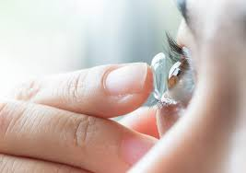
Modern Theories in Contact Lenses
TRENDS CONTINUED:
Optometric Management 11/17
1. Daily disposables comprise 44% of the CTL market
2. 55.6% of vision correction still with eyeglasses
3. Contact lens purchases grew 1.9% in 2016 with 3.1% increase in revenue

Slide 9
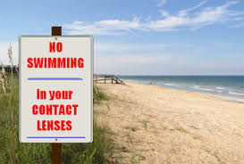
Modern Theories in Contact Lenses
TRENDS/DEMOGRAPHICS:
85% of adolescent patients report habits that increase risk of infection including:
-sleeping in contact lenses
-delaying “routine” exams
-swimming in contact lenses
Reference: Contact Lens Spectrum 9/17

Slide 10
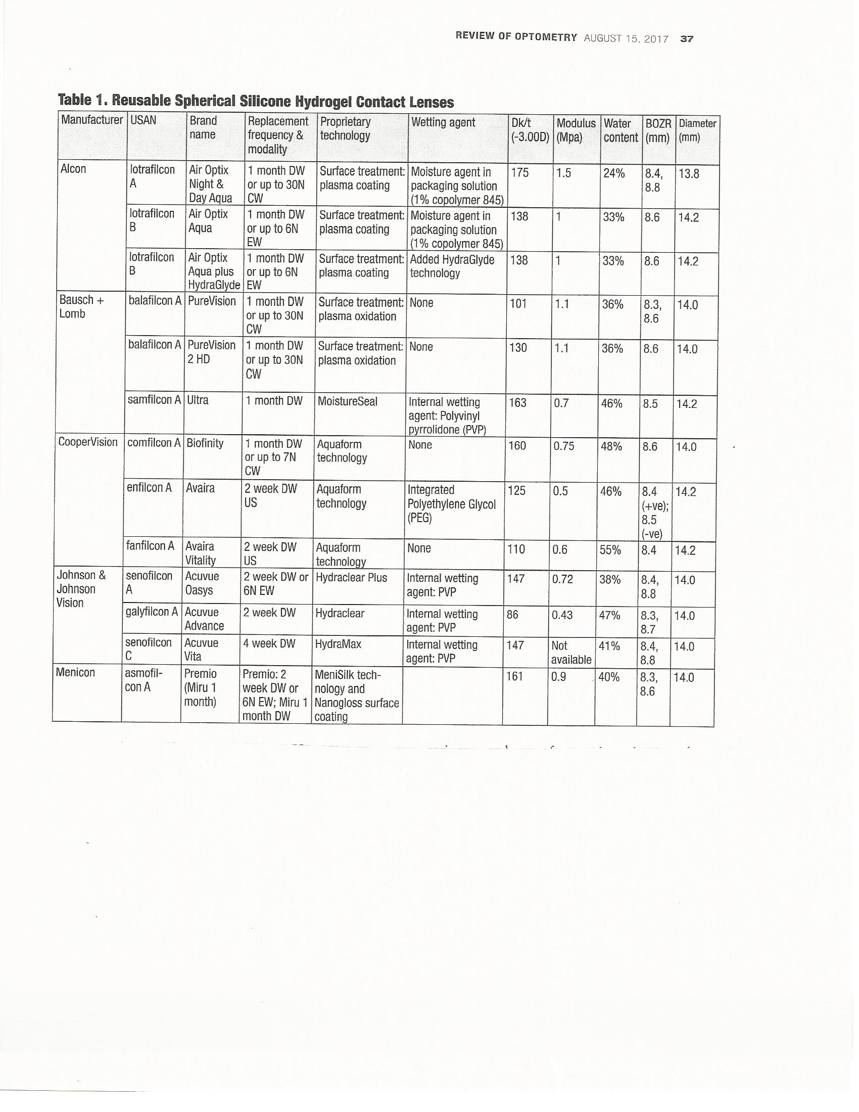
Modern Theories in Contact Lenses

Slide 11
Modern Theories in Contact Lenses
TRENDS/DEMOGRAPHICS CONTINUED:
81% of patients age 18 – 24 and 87% of patients age 25+ report:
-not adhering to replacement schedule
-not replacing CL cases
-sleeping in contact lenses
Referenceerence: Contact Lens Spectrum 9/17

Slide 12
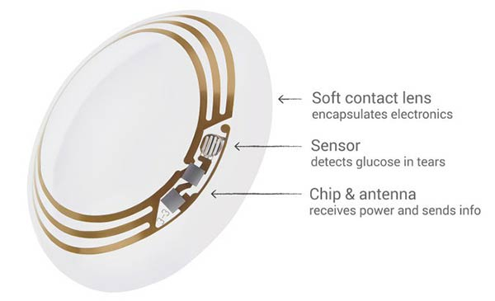
Modern Theories in Contact Lenses
INNOVATIONS
Accommodating Optics:
Johnson & Johnson, Novartis using electrically modulated lenses.
Health Monitoring – glucose and heartrate
Glaucoma Monitoring:
Triggerfish (Sensimed) contains a microsensor to detect minute fluctuations in eye volume – indirect IOP relationship.
Reference: Review of Optometry 2/15/17

Slide 13
Modern Theories in Contact Lenses
INNOVATIONS CONTINUED
Augmented reality:
Inno Vega – 1 Optek uses linear polarization in distance optic zone and 1 mm central “micro lens” to project a wide field of view onto associated eye glasses to allow large, high resolution, real world viewing. Currently testing for use in low vision.
Night Vision Contact Lenses using graphene = 1 atom thick layer of carbon to detect in the infra-red spectrum. Being developed by MIT and University of Michigan.

Slide 14
Modern Theories in Contact Lenses
MATERIALS
Re-usable Spherical Silicone Hydrogel:
· Virtually all “main stream” soft contact lenses with higher DK/T use silicone
· SiHy tend to be ionic and hydrophobic, lipophilic and have higher coefficient of friction.
· According to the Tear Film and Ocular Surface Society, the only contact lens material related factor demonstrating a correlation with contact lens discomfort is coefficient of friction.
Reference: Review of Optometry 8/15/17

Slide 15
Modern Theories in Contact Lenses
MATERIALS CONTINUED
Re-usable Spherical Silicone Hydrogel:
A prime motivation for using SiHy lenses is it’s demonstrated increased oxygen transmissibility.
This promised to reduce the rate of corneal infections, but research shows the risk of infections is the same or higher with SiHy.
Other complications of SiHy include dryness, mucin balls, papillary conjunctivitis, SEI’s.

Slide 16
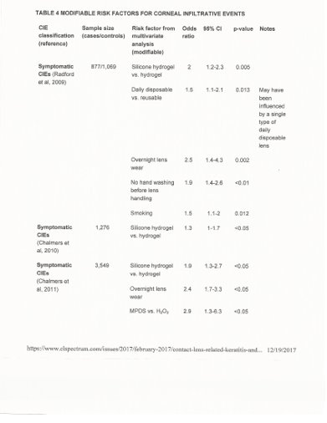
Modern Theories in Contact Lenses

Slide 17
Modern Theories in Contact Lenses
MATERIALS CONTINUED
Newer generation SiHy lenses are incorporating lens coatings and “blocking agents” to reduce the exposure to these silicone polymers
Alcon uses HydraGlyde Moisture Matrix and Smart Shield Technology
J & J uses Hydraluxe Technology to do a similar job
Bausch & Lomb uses Moisture Seal technology
All of these strategies work in reducing the disadvantages of SiHy but do not eliminate them.

Slide 18
Modern Theories in Contact Lenses
MATERIALS CONTINUED
Polymerization
Is the result of joining a large number of “repeating units” or monomers that contain a reactive bond between two carbon atoms (a vinyl group).
This creates polymer chains of thousands of monomers loosely tangle together.
Varying the monomer groups will change the properties of the resulting polymer.
Reference: Contact Lens Spectrum; Special Edition 2017

Slide 19
Modern Theories in Contact Lenses
MATERIALS CONTIUED
Early Contact lenses
--non-ionic
--low DK
These were among the most stable polymers and were typically used daily and worn for months or longer per pair.

Slide 20
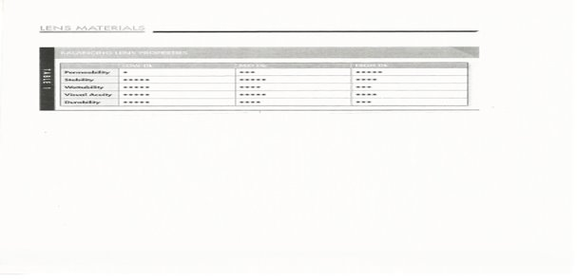
Modern Theories in Contact Lenses
MATERIALS CONTINUED
Balancing Lens Properties
References: Contact Lens Spectrum; Special Edition 2017, page 27

Slide 21
Modern Theories in Contact Lenses
CONTACT LENS RELATED MICROBIOLOGY
Most common microbes isolated from events of microbial keratitis 2011 – 2016
United States
Most Common:
Gram Positive = staph
Gram Negative = pseudomonas
Fungi = Fusarium
Reference Contact Lens Spectrum 2/17 Mark Wilcox, PHD

Slide 22
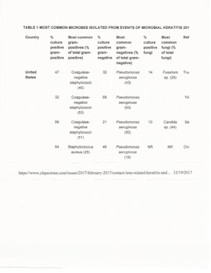
Modern Theories in Contact Lenses
CONTACT LENS RELATED MICROBIOLOGY
Most common microbes isolated from events of microbial keratitis 2011 – 2016

Slide 23
Modern Theories in Contact Lenses
CONTACT LENS RELATED MICROBIOLOGY CONTINUED
Anti-Microbial Resistance:
S. Aureus – Methicillin resistant = up to 32%
This resistance also associated with high level of resistance to Fluoroquinolones
Pseudomonas Aeruginosa seems to still be sensitive to fluoroquinolones and aminoglycosides.

Slide 24
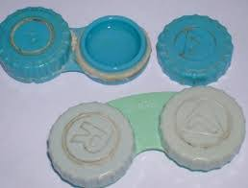
Modern Theories in Contact Lenses
CONTACT LENS RELATED MICROBIOLOGY CONTINUE
Contact Lens Usage Listed as one of the most common pre-disposing factors
Risk factors for contact lens related microbial keratitis:
Hygiene
Sleeping in lenses
Over wearing lenses
Not adhering to a disposal schedule
Not replacing contact lens cases
Purchasing via internet or mail order
Using multipurpose disinfecting solution vs. hydrogen peroxide

Slide 25
Modern Theories in Contact Lenses
RISK FACTORS FOR CONTACT LENS RELATED INFILITRATIVE EVENTS
This is associated with redness, possible pain and sub-epithelial infiltrates without frank infection
BUT
The contact lenses are do have microbial colonization. It is generally the by products produced by this colonization that creates non-infectious infiltration.
Risks are generally the same as with microbial keratitis.

Slide 26
Modern Theories in Contact Lenses
Modifiable Risk Factors for Corneal Infiltrative Events
Microbiota in the Tear Film:
· It is estimated that we are only able to culture 50% of the microbes in our eyes
· This is due to the limited nature of culture media and methods
· This necessarily leads to under estimating microbes
Example: Huang et al (2016) showed the most common microbial types in microbiome investigations on the ocular surface were Corynebacterium and pseudomonas using 16S and RNA technique versus cultures.

Slide 27
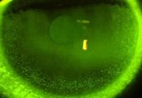
Modern Theories in Contact Lenses
DRY EYE
The Impact of Dry Eye on Modern Contact Lens Wearers
Results of the National Eye C.A.R.E. Survey
See Figure One
Contact Lens Spectrum; July 2017

Slide 28
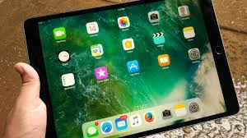
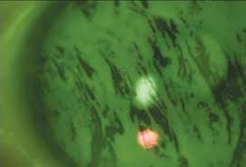
Modern Theories in Contact Lenses
DRY EYE CONTINUED
Contact lens wearing ranks number 3 as the most common contributor to dry eye.
Dry Eyes are being reported at younger ages now by ECP’s versus 10 years ago.
89% of ECP’s polled believe increased screen time is largely responsible.
DRY EYE CONTINUED
Contact lens wearing ranks number 3 as the most common contributor to dry eye.
Dry Eyes are being reported at younger ages now by ECP’s versus 10 years ago.
89% of ECP’s polled believe increased screen time is largely responsible.

Slide 29
Modern Theories in Contact Lenses
Contact Lens Associated Red Eye (CLARE)
Sub-Epithelial Infiltrates:
-Inflammatory
-Associated with hypoxia and Gram-Negative bacteria leading to inflammatory response.
-There is approximately a doubling of corneal infiltrative events with SiHy lenses compared to traditional hydrogel lenses.

Slide 30
Modern Theories in Contact Lenses
Contact Lens Associated Red Eye (CLARE) CONTINUED
Symptoms:
Discomfort
Contact lens intolerance
Unilateral or bilateral
Conjunctival hyperemia
Usually no associated epithelial defect

Slide 31
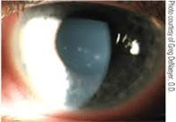
Modern Theories in Contact Lenses
Contact Lens Associated Red Eye (CLARE) CONTINUED
Risk Factors for Inflammatory CLARE
Extended wear contact lenses
Poor Hygiene
History of H. Influenza (gram-negative bacteria)
Dry eyes

Slide 32
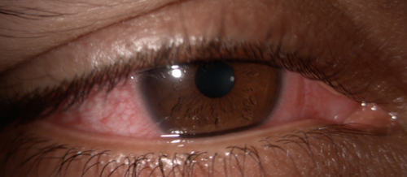
Modern Theories in Contact Lenses
CLARE CONTINUED
Associated Causes:
Lens over wear
SiHy lenses
Dry Eye
Solution incompatibility

Slide 33
Modern Theories in Contact Lenses
CLARE CONTINUED:
Some reduction in hypoxia associated with SiHy
Nearly double Corneal Infiltrative Events with SiHy lenses UNLESS fit in one day modality
Treatment:
Steroid needed!
Topical prednisolone acetate 1% QID (dosage varies with the severity) x 1week (in the absence of epithelial defects).

Slide 34
Modern Theories in Contact Lenses
Contact Lens Induced Peripheral Ulcer (CLPU)
Occurs as the body responds to bacterial exotoxins – usually staph
Not a true infection
Bowman’s Layer remains intact
Epithelial defect is smaller than infiltrated area
Typically not associated with photophobia or conjunctival hyperemia

Slide 35
Modern Theories in Contact Lenses
Contact Lens Induced Papillary Conjunctivitis (CLPC) Continued
Considered largely an inflammatory condition initiated by protein deposits on the lens surface.
Remember: High H2O lenses/Highly Ionic lenses = more lipophilic

Slide 36
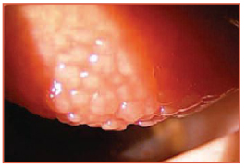
Modern Theories in Contact Lenses
Contact Lens Induced Papillary Conjunctivitis (CLPC) Continued
Symptoms:
Lens intolerance
Blur
Discharge
Papillae
Contact lens movement
Symptoms INCREASE on lens removal

Slide 37
Modern Theories in Contact Lenses
Contact Lens Induced Infections
Bacterial
Fungal
Protozoan

Slide 38
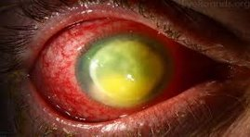
Modern Theories in Contact Lenses
Contact Lens Induced Infections
Bacterial Infections Pseudomonas Aeruginosa
Mimics CLPU in early stages
Unilateral
Photophobia
Poor vision
History of poor hygiene and/or lens over wear

Slide 39
Modern Theories in Contact Lenses
Contact Lens Induced Infections
Bacterial Infections Pseudomonas Aeruginosa
Signs
Anterior chamber reaction
Hyperemia
Possible corneal ulceration located centrally and of equal size to the SEI and irregularly shaped
Possible satellite lesions
Corneal edema

Slide 40
Modern Theories in Contact Lenses
Contact Lens Induced Infections
Bacterial Infections Pseudomonas Aeruginosa
Treatment:
First culture
Topical fluoroquinolone every 30 minutes to hourly while awake and q2h at night.
In severe cases, a fortified antibiotic, such as tobramycin 12.5mg/ml should be alternated with the fluoroquinolone.
Cycloplegic agents to minimize pain and photophobia.
After the first 24 hours of treatment, tobramycin ointment may be applied overnight.
Consider Prokera

Slide 41
Modern Theories in Contact Lenses
Contact Lens Induced Infections
Fungal Infections
Typically Aspergillus, Candida or Fusarium
Associated with vegetative injury or abrasion
May be associated with contact lens over wear

Slide 42
Modern Theories in Contact Lenses
Contact Lens Induced Infections
Fungal Infections
Symptoms:
Photophobia
Blur
Symptoms gradually increase over days to weeks due to slow rate of fungal growth

Slide 43
Modern Theories in Contact Lenses
Contact Lens Induced Infections
Fungal Infections
Signs:
Corneal infiltrate with “feathery borders”
Satellite infiltrates
Epithelium may be intact over the lesion versus ulcerated

Slide 44
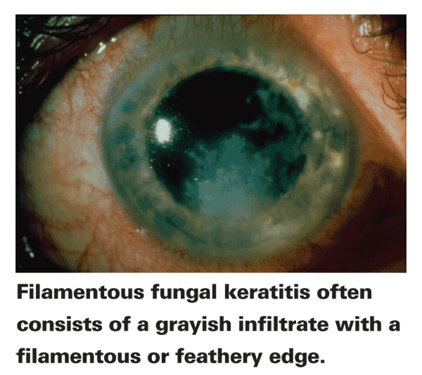
Modern Theories in Contact Lenses
Contact Lens Induced Infections
Fungal Infections
Difficult to Treat!
· Natamycin = one commercially available drug
· Referral and co-management may be prudent
Incidence increasing steadily over the past 20 years

Slide 45
Modern Theories in Contact Lenses
Contact Lens Induced Infections
ACANTHAMOEBA
Due to risk of permanent vision loss it is wise to rule this out
Reported less now than in years past
Risks:
· Poor hygiene
· Rinsing contact lenses in tap water
· Swimming while wearing contact lenses

Slide 46
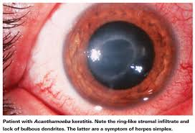
Modern Theories in Contact Lenses
Contact Lens Induced Infections
ACANTHAMOEBA
Signs:
Typically with symptoms greater than signs
SEVERE ocular pain
Moderate hyperemia
Possible dendritiform epithelial lesion

Slide 47
Modern Theories in Contact Lenses
Contact Lens Induced Infections
ACANTHAMOBEA
Treatment:
Polyhexamethylene biguanide and Chlorhexidine--topical cationic antiseptic agent that can treat both the trophozoites and cyst forms.
-- Topical antimicrobials administered q1 hour immediately after corneal debridement
or first several days of therapy
--Continued hourly during waking hours for 3 days (at least 9 times/day is recommended) depending on clinical response.
--Then reduced to every 3 hours
--Two weeks may be required before a response is observed, total duration of therapy is at least 3-4 weeks.
Some advocate treating for 6-12 months. When therapy is discontinued, close observation is warranted to rule out recurrent disease.
Follow up 1 day and then every 2 days
Fortified Tobramycin or Vancomycin may be necessary

Slide 48
Modern Theories in Contact Lenses
CONTACT LENS MODALITITES
Extended Wear
5% of new fits
Approved for up to 30 days of continuous wear
FDA requires DK/T of 125 x 109
Still the largest risk factor in Microbial Keratitis
Reference: Review of Cornea and Contact Lens; Extended Wear: Still an Option?; 11/17

Slide 49
Modern Theories in Contact Lenses
THE GOOD
Many SiHy lenses largely meet FDA requirements
The increased O2 that is allowed to get through to the epithelium has been shown to:
· Reduce corneal edema
· Reduce limbal hyperemia
· Reduce corneal neovascularization
· Reduce myopic shifts

Slide 50
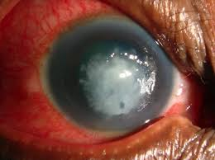
Modern Theories in Contact Lenses
THE BAD
More prone to increase dryness
Associated with more Microbial Keratitis
Long term leads to corneal thinning
Increased incidence of papillary conjunctivitis

Slide 51
Modern Theories in Contact Lenses
CONTACT LENS SOLUTIONS:
Causes of Contact Lens Contamination
Handling the Lens. Micro-organisms count as low as 100 when coming out of solution but 1000+ after being touched.
Solutions do not sterilize the lens
Even Hydrogen Peroxide is not 100% effective due to the ability of some organisms to produce an enzyme that reduces peroxide efficiency.
One study showed average yearly purchase of multi-purpose solutions to be 3.6 to 3.8 bottles. These solutions are designed to be used 1 bottle per month.
Reference: Review of Cornea and Contact Lens; Contact Lens Care: Advice from an Expert; Christine Sindt, OD 11/17

Slide 52
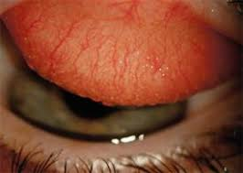
Modern Theories in Contact Lenses
TAKE AWAYS
Polymers:
Market preponderance favoring SiHy
SiHy offers higher DK/T with associated benefits
Down side is more dryness, papillary conjunctivitis, necessarily shorter lens life span

Slide 53
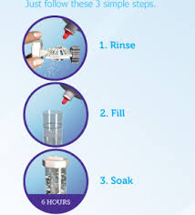
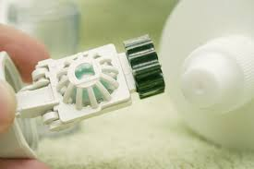
Modern Theories in Contact Lenses
SOLUTIONS:
Only Peroxide systems offer the potential of Contact Lens sterilization and still isn't 100%

Slide 54
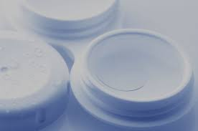
Modern Theories in Contact Lenses
MODALITIES:
Riskiest: Extended Wear
Safest: Daily Disposable

Slide 55
Modern Theories in Contact Lenses
TRENDS:
Contact lens market shows greater growth potential than other markets
Contact lens innovations may out pace refractive/medical innovations:
Drug delivery
Low vision
Night vision
Virtual reality

Slide 56
Modern Theories in Contact Lenses
Thank you!

