Slide 1

Pharmacology update
Maria Pribis, OD, FAAO, Diplomate ABO

Slide 2
Financial Disclosures
Novartis Advisory Board (Xiidra)
RVL pharmaceuticals – speaker, advisory boards (Upneeq)
Alcon contact lenses – speaker, advisory boards
Santen pharmaceuticals – speaker, advisory boards (TobraDex ST, Flarex, Zerviate)
Tarsus – speaker (xdemvy)
Viatris – speaker (Tyrvaya)

Slide 3
“Upon the subject of education…I can only say that I view it as the most important subject which we as a people can be engaged in” - Abraham Lincoln

Slide 4
“You cannot escape the responsibility of tomorrow by evading it today.” – Abraham Lincoln

Slide 5
“Tell me and I forget, teach me and I may remember, involve me and I learn.” - Benjamin Franklin

Slide 6
Autonomic Review
 | M1 | EXCITATORY
 | M2 | INHIBITORY
MUSCURINIC | M3 | EXCITATORY
 | M4 | INHIBITORY
 | M5 | EXCITATORY

Slide 7
PARASYMPATHETIC ACTIVITY
SALIVATION
LACRIMATION
URINATION
DEFECATION
GI PAIN
EMESIS
REST AND DIGEST
VASODILATION
BRONCHOCONSTRICTION

Slide 8
CHOLINERGIC AGONISTS
MIOSIS
ACCOMMODATION
DECREASED IOP
ACETYLCHOLINE

Slide 9
PILOCARPINE
ANGLE CLOSURE GLAUCOMA
ADIE’S TONIC PUPIL
PRESBYOPIA MANAGEMENT

Slide 10
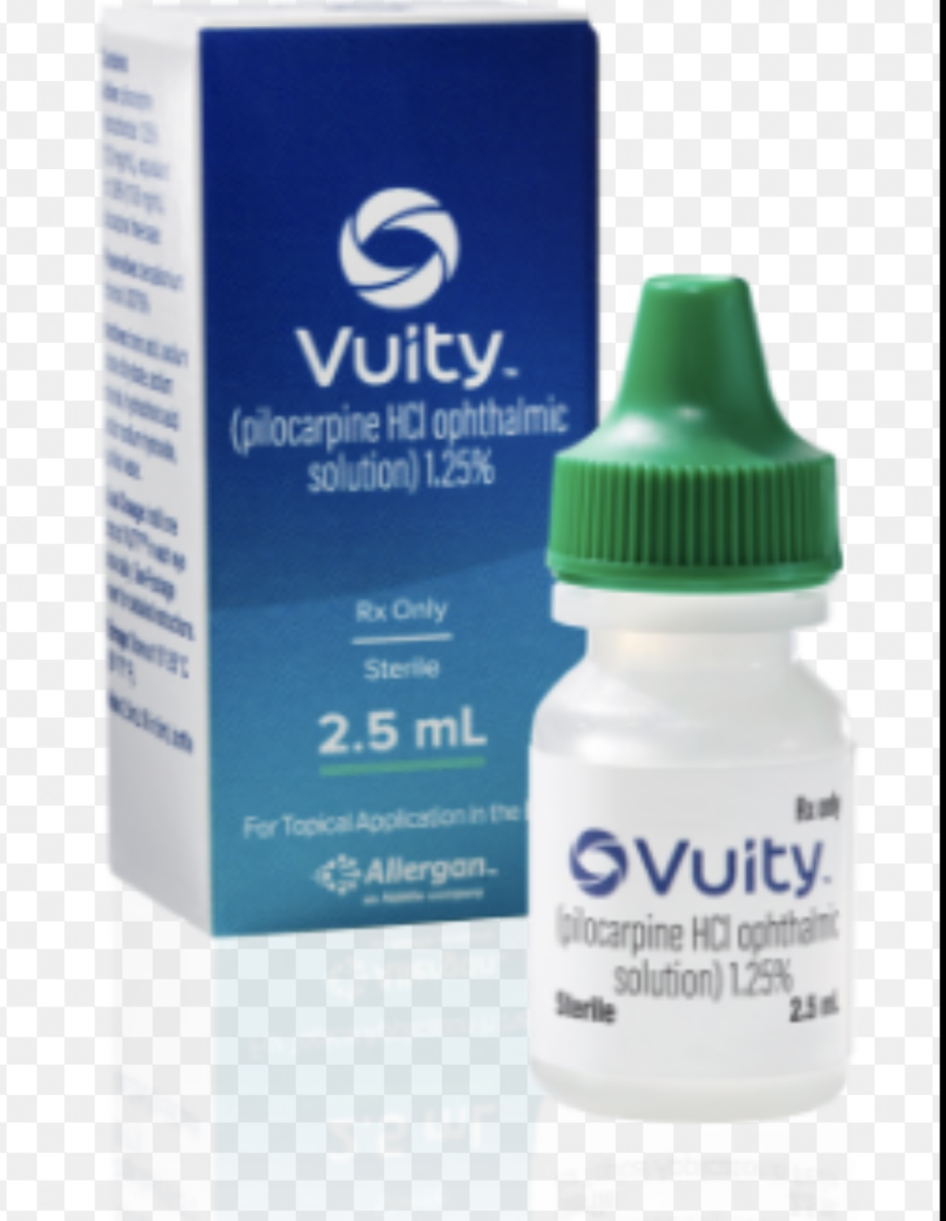
Vuity (pilocarpine 1.25% HCL)
Vuity is a cholinergic muscarinic agonist that stimulates muscarinic receptors in smooth muscles such as the iris sphincter and ciliary muscle
The mechanism of action involves contraction of the iris sphincter muscle, which constricts the pupil to improve near and intermediate vision acuity while maintaining some pupillary responsiveness to light.
The drug also contracts the ciliary muscle, which may make the eye more myopic.

Slide 11
PILOCARPINE
HEADACHES
BROW ACHE
MYOPIC SHIFT
CATARACTS
RETINAL DETACHMENT

Slide 12
SYMPATHETIC ACTIVITY
MYDRIASIS
VASOCONSTRICTION
FIGHT OR FLIGHT
BRONCHODILATION
DRYNESS

Slide 13
CHOLINERGIC ANTAGONISTS
MYDRIASIS – CAUTION IN NARROW ANGLES
DRY EYE

Slide 14
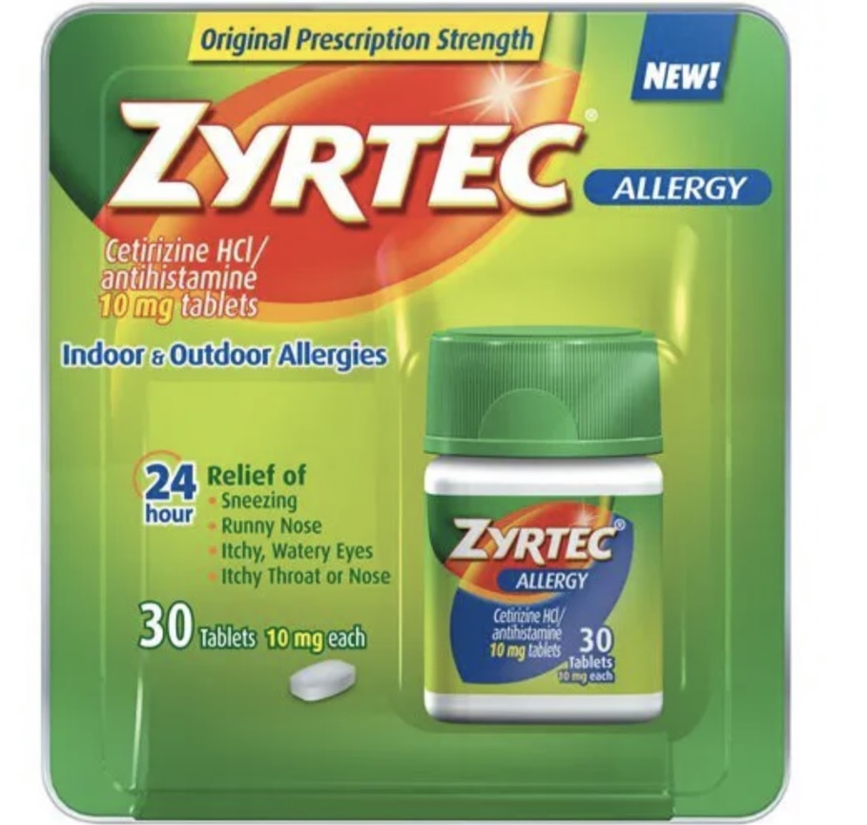
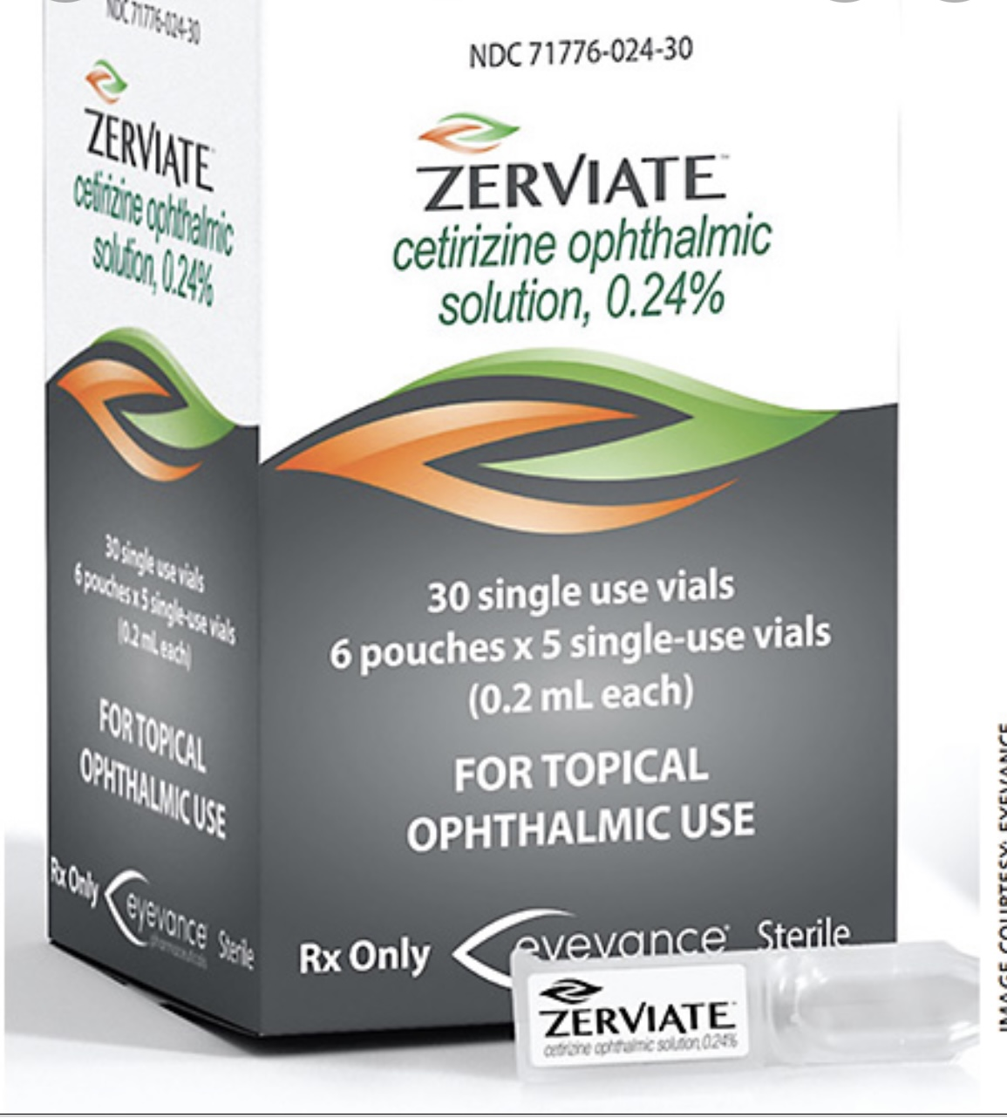
ANTI-HISTAMINES
1ST GENERATION VS 2ND GENERATION
SYSTEMIC VS TOPICAL

Slide 15
ANTI-PSYCHOTICS
CHLORPROMAZINE
THIORIDAZINE
PROMETHAZINE (ANTI-HISTAMINE)
PIGMENTATION EFFECTS

Slide 16
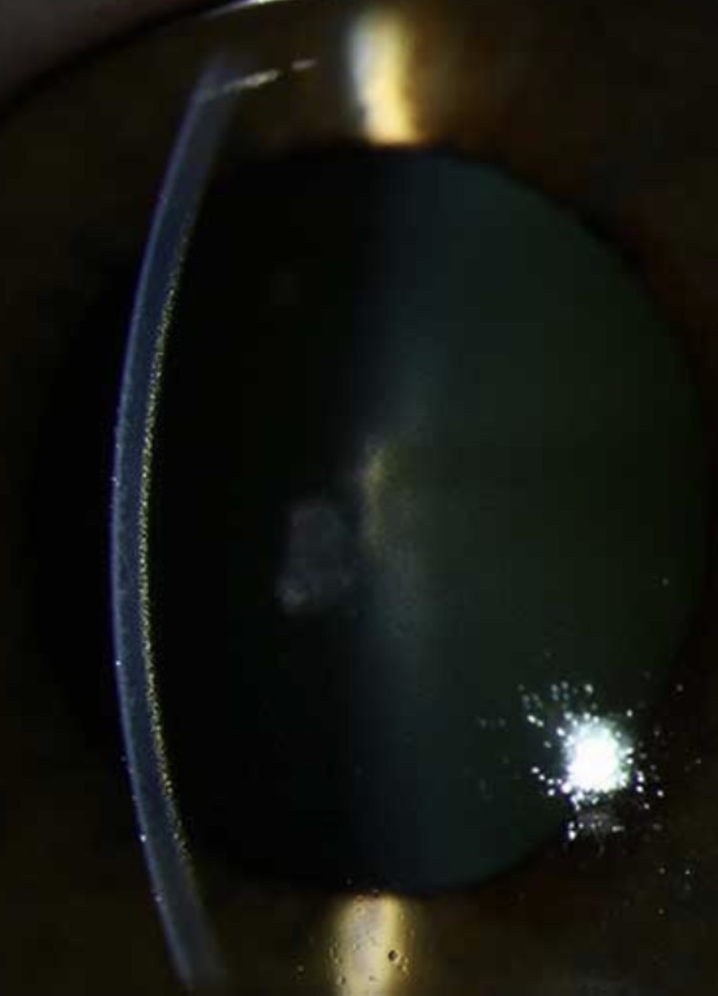

Slide 17
Autonomic Review
 | ALPHA 1 | EXCITAROY
ADRENERGIC | ALPHA 2 | INHIBITORY
 | BETA 1 | EXCITATORY
 | BETA 2 | EXCITATORY

Slide 18
ADRENERGIC ACTIVITY
ALPHA 1 – LOCATED ON IRIS DILATOR MUSCLE
VASOCONSTRICTION
ALPHA 2 - CONSTRICT CILIARY VASCULARATURE TO REDUCE AQUEOUS PRODUCTION
VASOCONSTRICTION
MUELLER’S MUSCLE
BETA 2 – LOCATED ON NPCE, ENHANCES AQUEOUS SECREATION VIA ACTIVE SECRETION

Slide 19
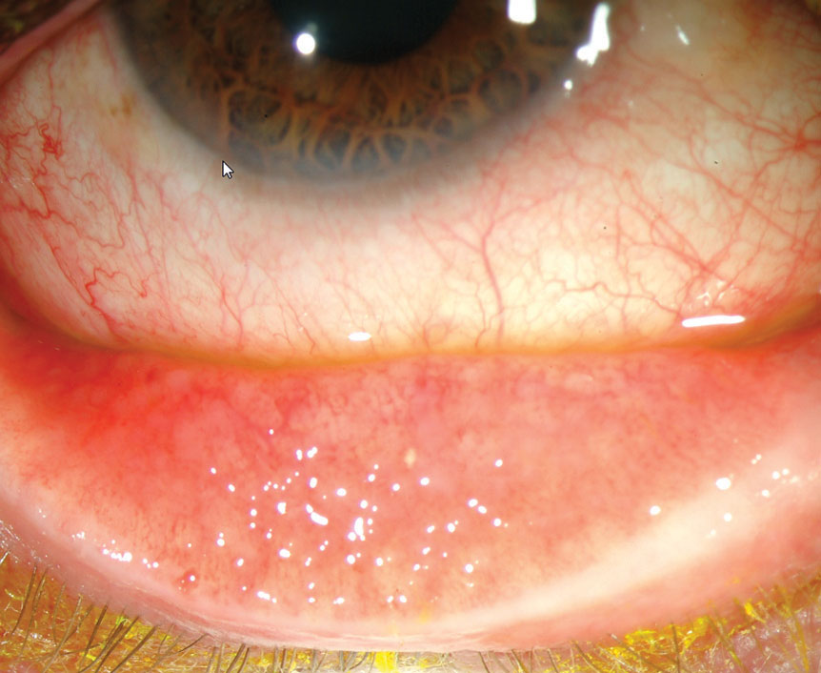
ALPHA 2 AGONIST
APRACLONIDINE
  TACHYPHYLAXIS
BRIMONIDINE
  FOLLICULAR CONJUNCTIVITIS

Slide 20
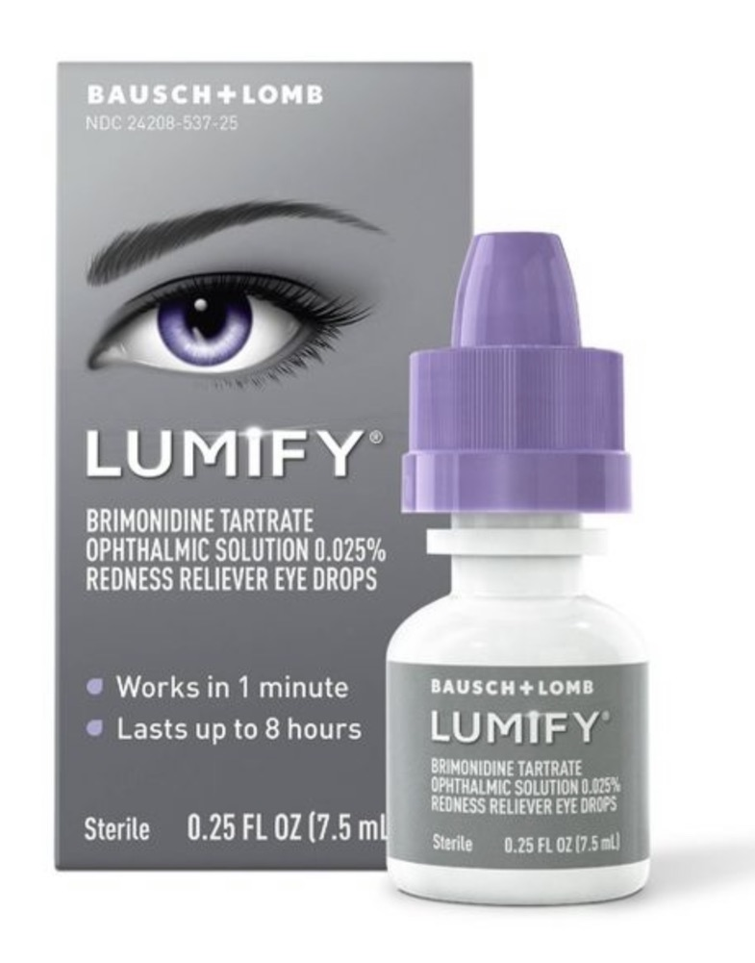
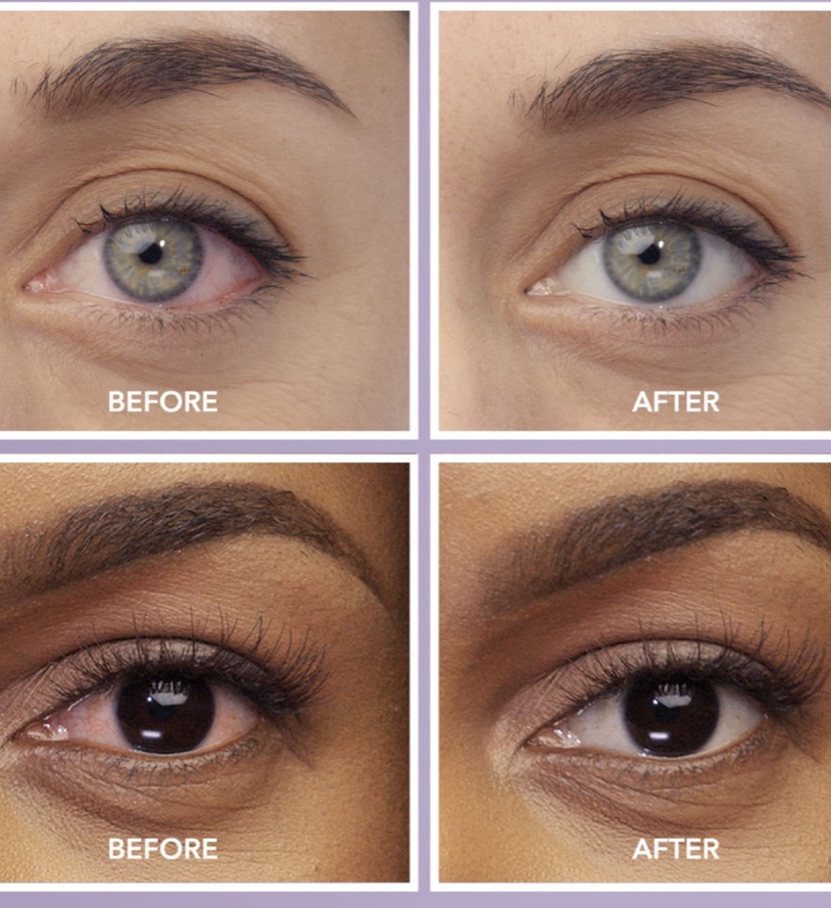

Slide 22
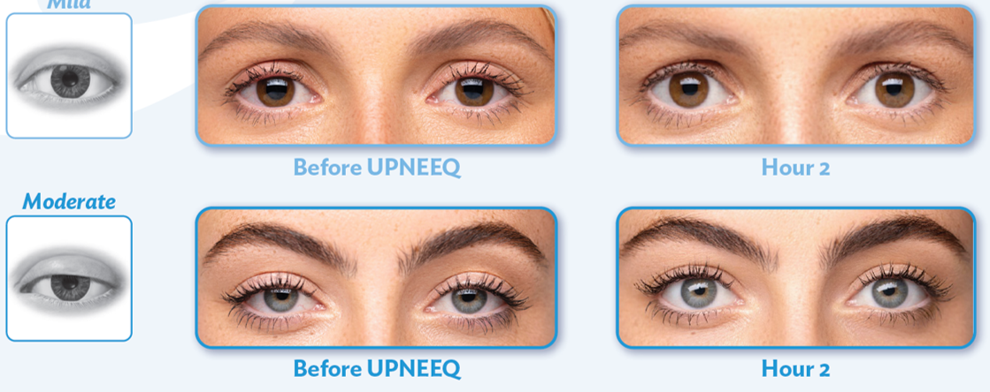
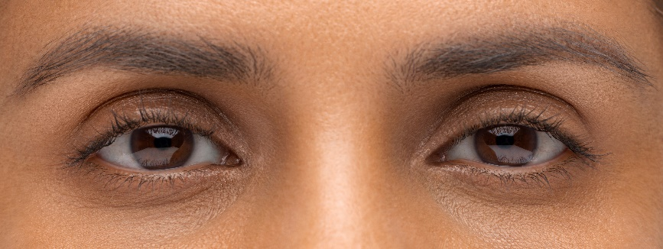
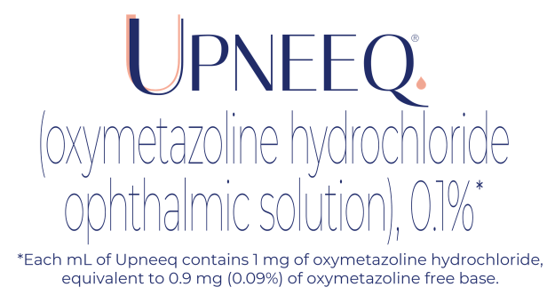
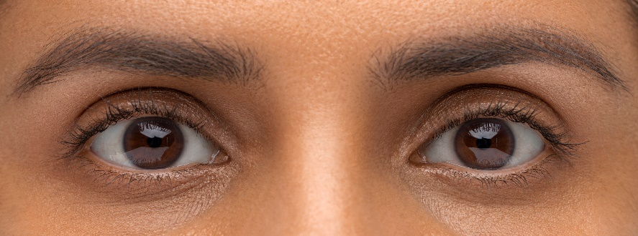
Upneeq® Lifts the Upper Eyelids*
Mild
Before Upneeq instillation
After Upneeq instillation (2 hr)
  *Individual results may vary. Images are of an actual patient. Average upper eyelid lift with Upneeq in clinical trials was 1mm.¹
  Patients should not touch the tip of the single patient-use container to their eye or to any surface, in order to avoid eye injury or contamination of the solution.
1. RVL Pharmaceuticals, Inc. Data on file. 2019 2. Upneeq® (oxymetazoline hydrochloride ophthalmic solution), 0.1%. [Prescribing Information]. RVL Pharmaceuticals, Inc. 2020.

Slide 23
Upneeq® Lifts the Upper Eyelids*
Moderate
Before Upneeq instillation
After Upneeq instillation (2 hr)
  *Individual results may vary. Images are of an actual patient. Average upper eyelid lift with Upneeq in clinical trials was 1mm.¹
  Patients should not touch the tip of the single patient-use container to their eye or to any surface, in order to avoid eye injury or contamination of the solution.
1. RVL Pharmaceuticals, Inc. Data on file. 2019 2. Upneeq® (oxymetazoline hydrochloride ophthalmic solution), 0.1%. [Prescribing Information]. RVL Pharmaceuticals, Inc. 2020.

Slide 24
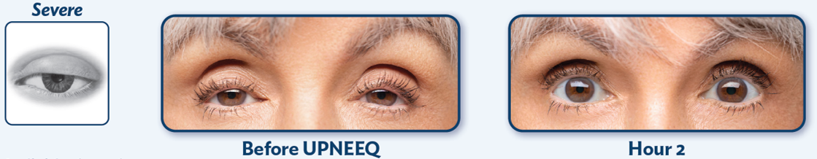
Upneeq® Lifts the Upper Eyelids*
Severe
Before Upneeq instillation
After Upneeq instillation (2 hr)
  *Individual results may vary. Images are of an actual patient. Average upper eyelid lift with Upneeq in clinical trials was 1mm.¹
  Patients should not touch the tip of the single patient-use container to their eye or to any surface, in order to avoid eye injury or contamination of the solution.
1. RVL Pharmaceuticals, Inc. Data on file. 2019 2. Upneeq® (oxymetazoline hydrochloride ophthalmic solution), 0.1%. [Prescribing Information]. RVL Pharmaceuticals, Inc. 2020.

Slide 25
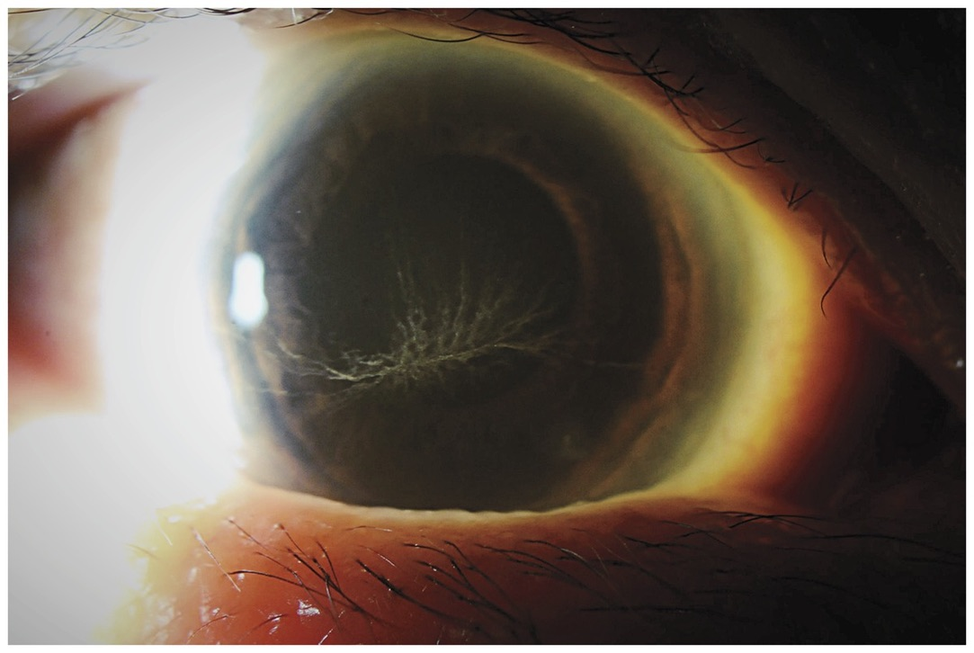
WHORL KERATOPATHY
CHAI T
CHLOROQUINE
HYDROXYCHLOROQUINE
AMIODARONE
INDOMETHACIN
TAMOXIFEN

Slide 26
HYDROXYCHLOROQUINE
HYDROXYCHLOROQUINE (HCQ) (I.E., PLAQUENIL®) INHIBITS THE ENZYME PHOSPHOLIPASE A2 IN ORDER TO REDUCE INFLAMMATION
USED TO TREAT
  MALARIA
  SYSTEMIC LUPUS ERYTHEMATOSUS
  RHEUMATOID ARTHRITIS
  INFLAMMATORY AND DERMATOLOGICAL CONDITIONS
TRADITIONALLY PRESCRIBED IN 200 OR 400 MG TABLETS WITH TOTAL DOSE BASED ON IDEAL BODY WEIGHT (IBW) TO REDUCE TOXICITY

Slide 28
KEY TAKEAWAY:
THE AMERICAN ACADEMY OF OPHTHALMOLOGY (AAO) RECENTLY REVERSED THIS RECOMMENDATION BASED ON EVIDENCE THAT DOSING BASED ON ACTUAL BODY WEIGHT (ABW), WITH A MAXIMUM DOSE OF < 5 MG/KG/DAY, IS MORE PREDICTIVE OF RETINAL TOXICITY AND IS MORE ACCURATE ACROSS A WIDER RANGE OF BODY TYPES

Slide 29
LESS THAN 135 POUNDS IF TAKING THE STANDARD 400 MG/DAY DOSAGE OF PLAQUENIL®.
THE OVERALL PREVALENCE OF BULL’S-EYE MACULOPATHY IN PATIENTS TAKING HCQ FOR AT LEAST 5 YEARS IS 7.5%
FOR PATIENTS TAKING 4-5 MG/KG/DAY (BASED ON ABW), THE PREVALENCE OF RETINAL TOXICITY
REMAINED LESS THAN 2% WITHIN THE FIRST 10 YEARS
INCREASED TO 20% AFTER 20 YEARS
THE RISK OF MACULAR TOXICITY EXCEEDED 50% AT 20 YEARS IN PATIENTS TAKING > 5.0 MG/KG/DAY BASED ON ABW

Slide 30
RISK FACTORS FOR MACULAR TOXICITY
DOSE > 5.0 MG/KG ABW PER DAY
TREATMENT DURATION > 5 YEARS
ABNORMAL KIDNEY FUNCTION
CONCURRENT USE OF TAMOXIFEN
PRE-EXISTING MACULAR DISEASE

Slide 31
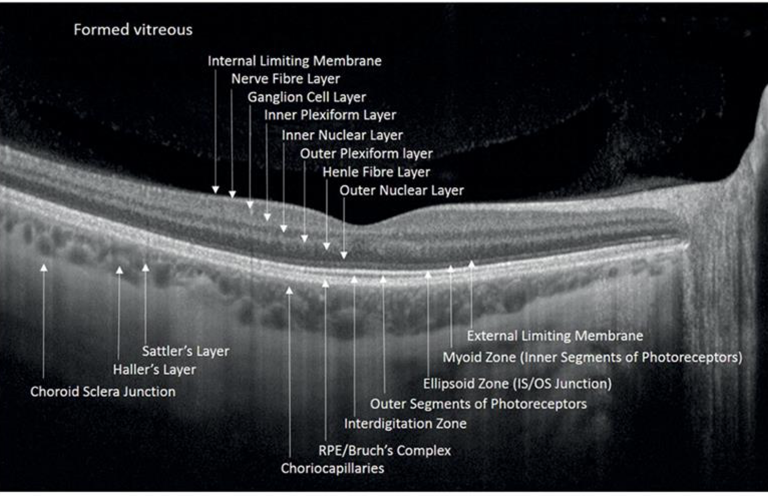

Slide 32
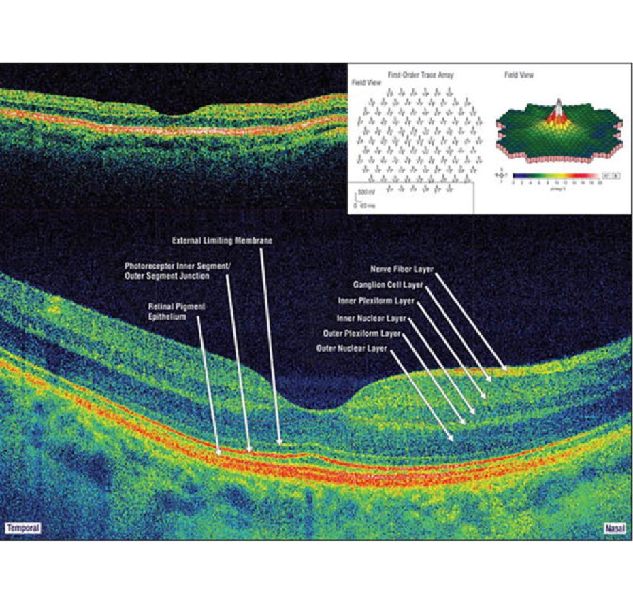
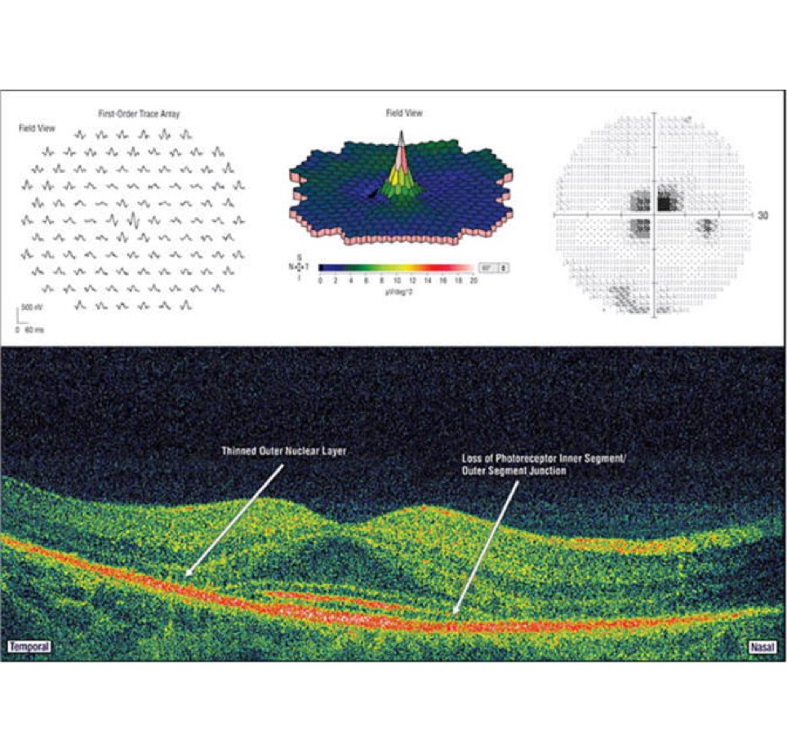

Slide 33
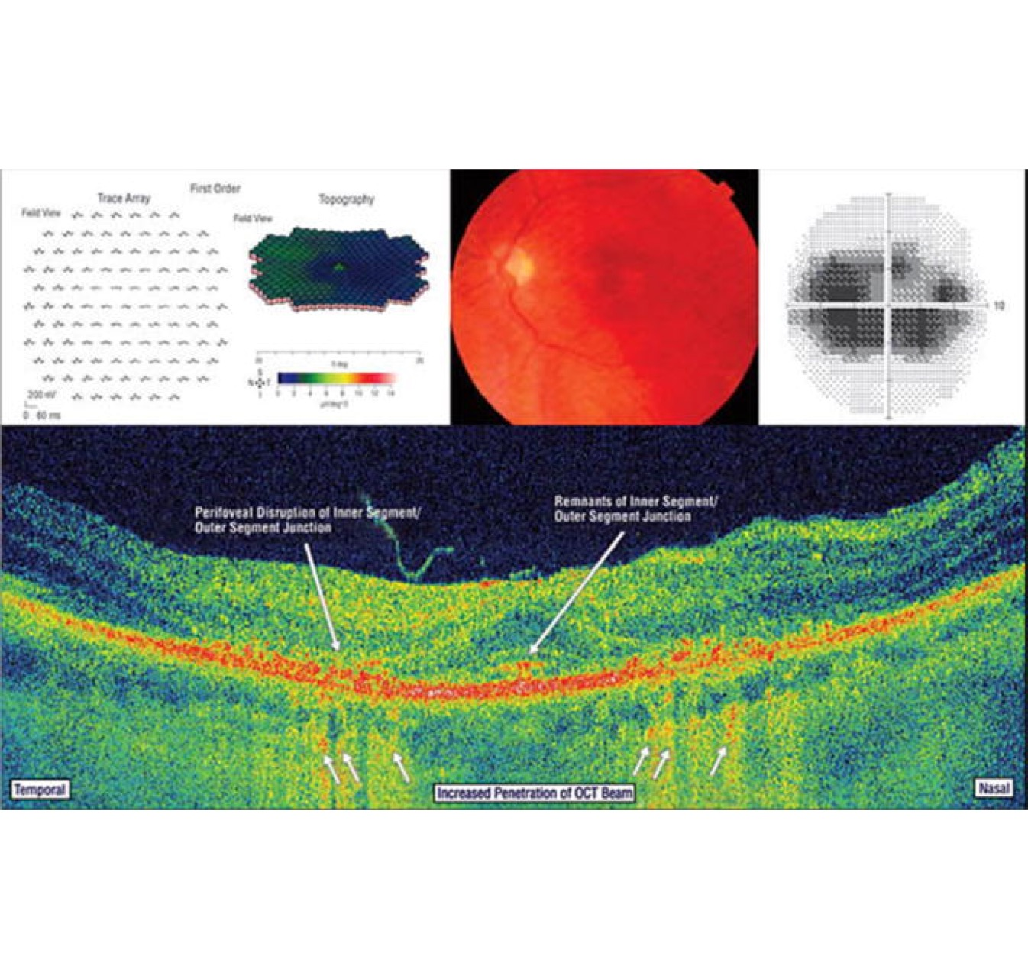

Slide 34
BEGIN ANNUAL EXAMS AFTER 5 YEARS OF HCQ USE UNLESS THE PATIENT HAS RISK FACTORS FOR MACULAR TOXICITY OR TAKING A HIGHER THAN RECOMMENDED DOSE
10-2 AUTOMATED VF
CONSIDER ALSO 24-2 OR 30-2 IN ASIANS
SD-OCT OF MACULA
ADDITIONAL TESTS TO CONSIDER
FUNDUS AUTOFLUORESCENCE
EARLY: HYPERFLUORESCENCE
LATE: MOTTLED HYPOFLUORESCENCE (RPE ATROPHY)
MULTIFOCAL ERG

Slide 35
60 YEAR OLD MALE
WOKE UP WITH DECREASED VISION IN THE LEFT EYE

Slide 36
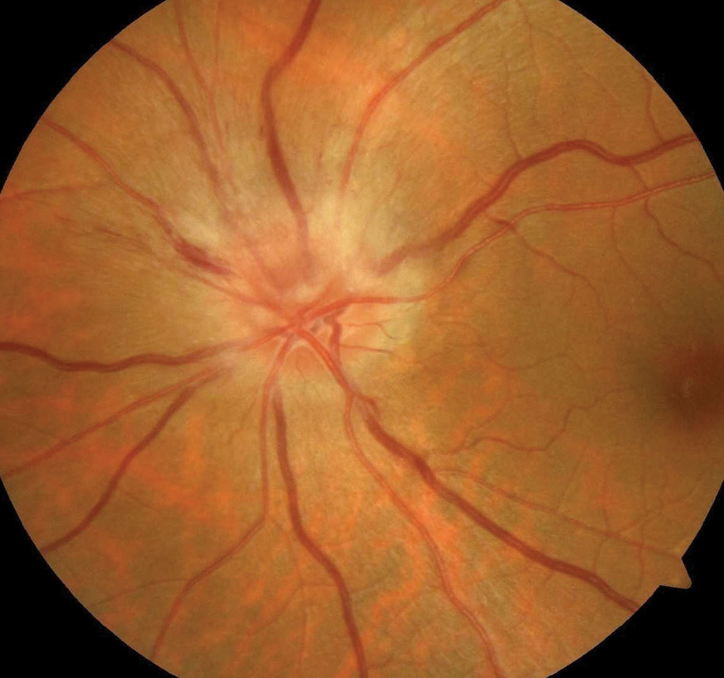

Slide 37
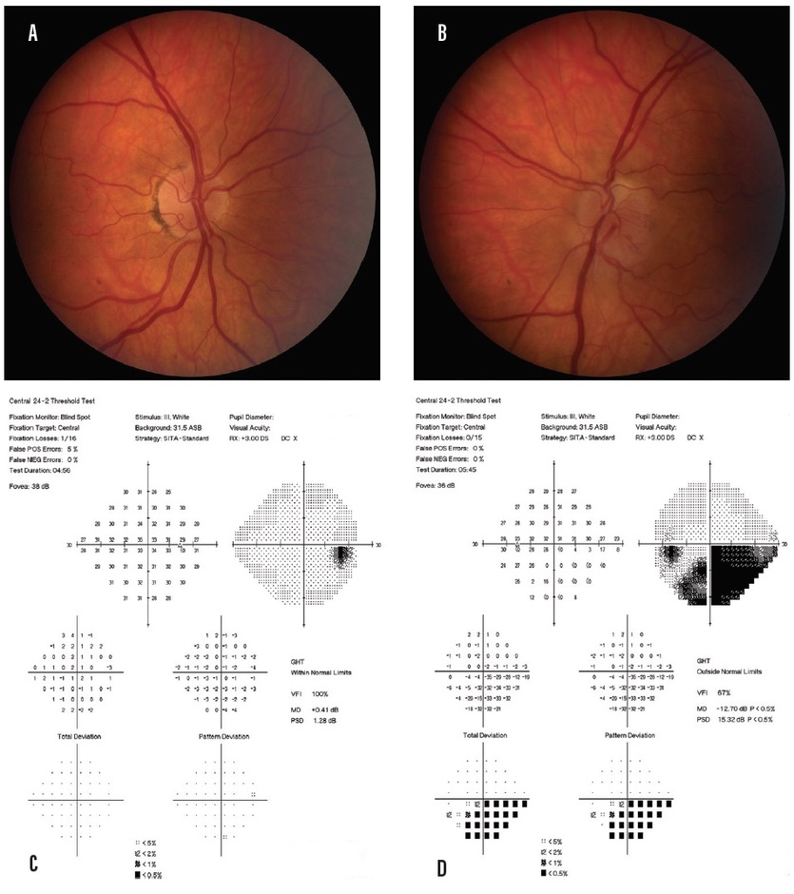
NAION

Slide 38
DRUG INDUCED NAION
VIAGRA
LEVITRA
AMIODARONE
IMITREX
SEMAGLUTIDE (OZEMPIC/WEGOVY)
HYPERTENSION AND SLEEP APNEA –NOCTURAL HYPOTENION

Slide 39
GLAUCOMA
INCREASE OUTFLOW
DECREASE PRODUCTION

Slide 40
PROSTAGLANDINS
LATANOPROST
BIMATOPROST
TRAVOPROST
(NON BAK) PRESERVATIVE FREE OPTIONS…
IYUZEH, ZIOPTAN,(TAFLUPROST), COSOPT PF, TIMOPTIC IN OCUDOSE
XELPROS – CONTAINS POTASSIUM SORBATE

Slide 41
PROSTOGLANDINS
INCREASE OUTFLOW THROUGH UVEOLSCLERAL PATHWAY
PIGMENTATION EFFECTS
LASH LENGTHENING
CONJUNCTIVAL HYPEREMIA
CAUTION IN ACTIVE INFLAMMATION (UVEITIS, CME, HERPES)

Slide 42
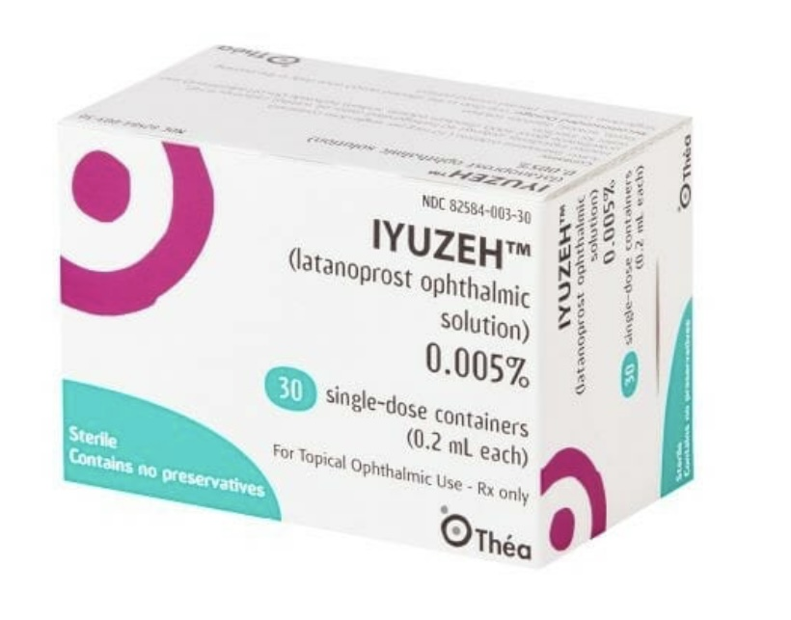

Slide 43


Slide 44
CARBONIC ANHYDROSE INHIBITORS
BRINZOLAMIDE
DORZOLAMIDE

Slide 45
CARBONIC ANHYDRASE INHIBITORS
DECREASE AQUEOUS PRODUCTION
BURNING, METALLIC TASTE
SULFA ALLERGY

Slide 46
BETA BLOCKERS
BETA 2 – LOCATED ON NPCE, ENHANCES AQUEOUS SECREATION VIA ACTIVE SECRETION – BLOCKING THIS REDUCES AQUEOUS PRODUCTION
TIMOLOL .25% DAILY

Slide 47
BETA BLOCKERS
SIGNIFICANT RISK OF SYSTEMIC SIDE EFFECTS
CNS – MOST COMMON
HEADACHES
DEPRESSION
WEAKNESS
CARDIOVASCULAR (SECOND MOST COMMON)
BRADYCARDIA
HYPOTENSION
SYNCOPE

Slide 48
BETA BLOCKERS
RESPIRATORY
  BRONCHOSPASM
  CONTRAINDICATED COPD AND ASTHMA

Slide 49
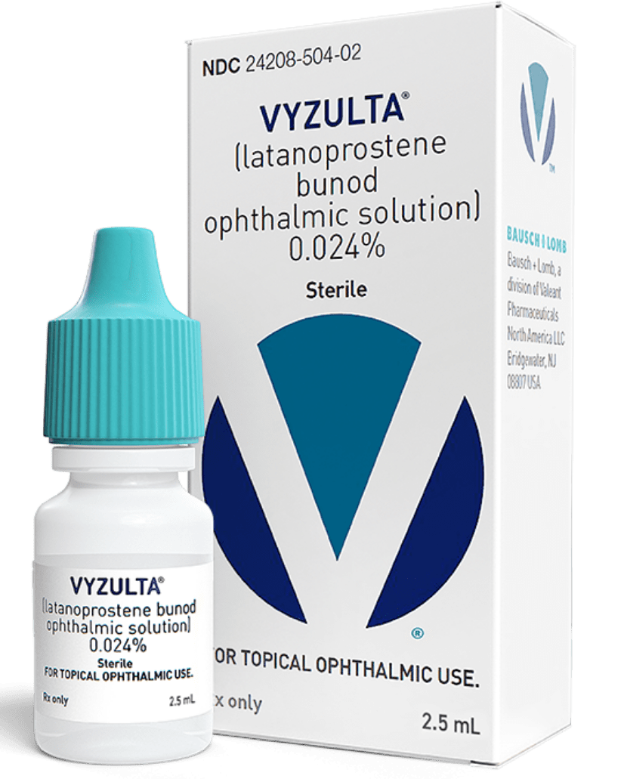
Dual Outflow MOA:
VYZULTA (LATANOPROSTENE BUNOD)
  PROSTOGLANDIN PLUS NITRIC OXIDE – IMPROVES TM PERMEABILITY

Slide 50
Rock inhibitors
RHOPRESSA (NETARSUDIL)
  RHO KINASE INHIBITOR – INCREASES OUTFLOW THROUGH TRABECULAR MESHWORK
  ROCK INHIBITORS RELAX ACTINMYSIN WITHIN TM AND INNER WALLS OF SCHLEMM’S CANAL
  INCREASES VASODILATION WITHIN EPISCLERAL VENOUS SYSTEM
  WHORL K
  CONJUNCTIVAL HYPEREMIA
  SUBCONJUNCTIVAL HEMORRHAGE

Slide 51
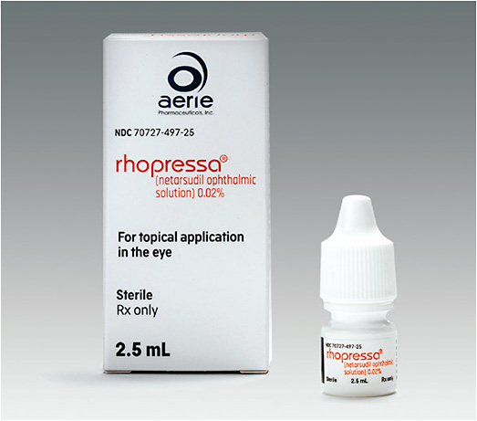

Slide 52
Combination:
ROCKLATAN (NETARSUDIL AND LATANOPROST)
  COMBO MEDICATION
  WHORL K
  SUBCONJUNCTIVAL HEME (WARFARIN?)
  CONJUNCTIVAL INJECTION

Slide 53
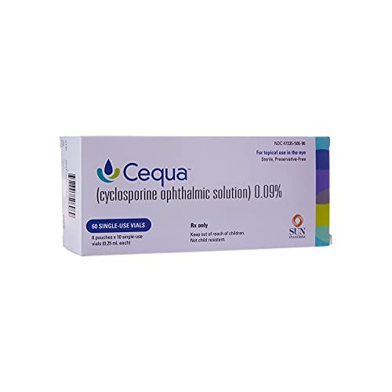
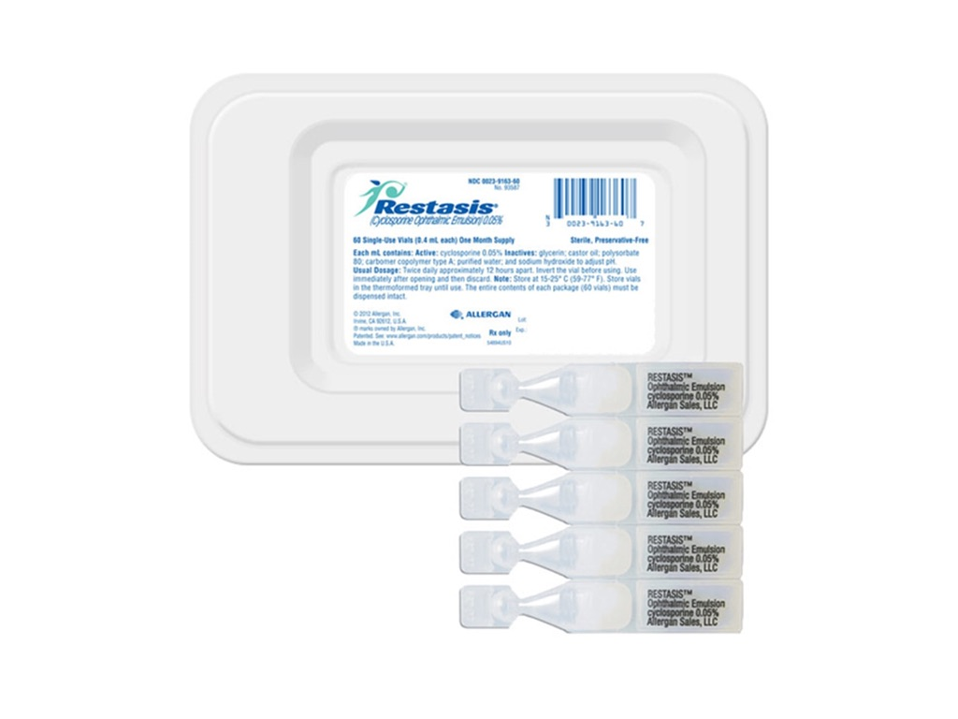
DRY EYE UPDATE:
T CELL INBHIBITORS

Slide 54
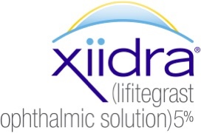
DRY EYE UPDATE:
PREVENTS ADHESION, ACTIVATION, MIGRATION AND PROLIFERATION OF LYMPHOCYTES

Slide 55
DRY EYE UPDATE:
TYRVAYA nasal spray contains varenicline which is a partial nicotinic acetylcholine receptor agonist(cholinergic agonis
- binding produces agonist activity and activates the trigeminal parasympathetic pathway resulting inincreased production of basal tear film

Slide 56
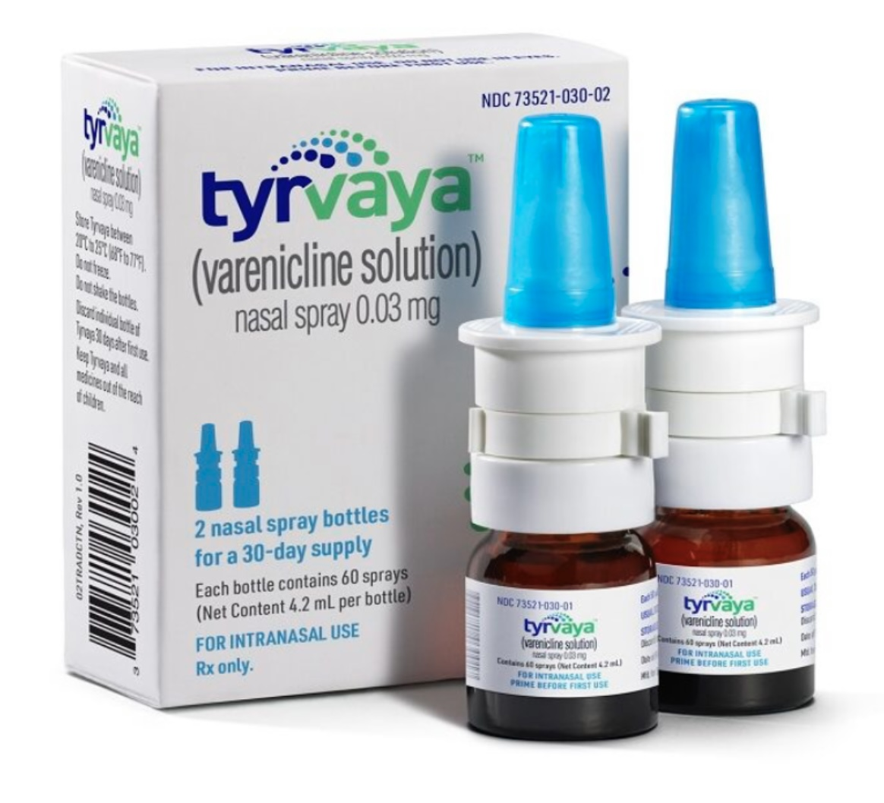

Slide 57
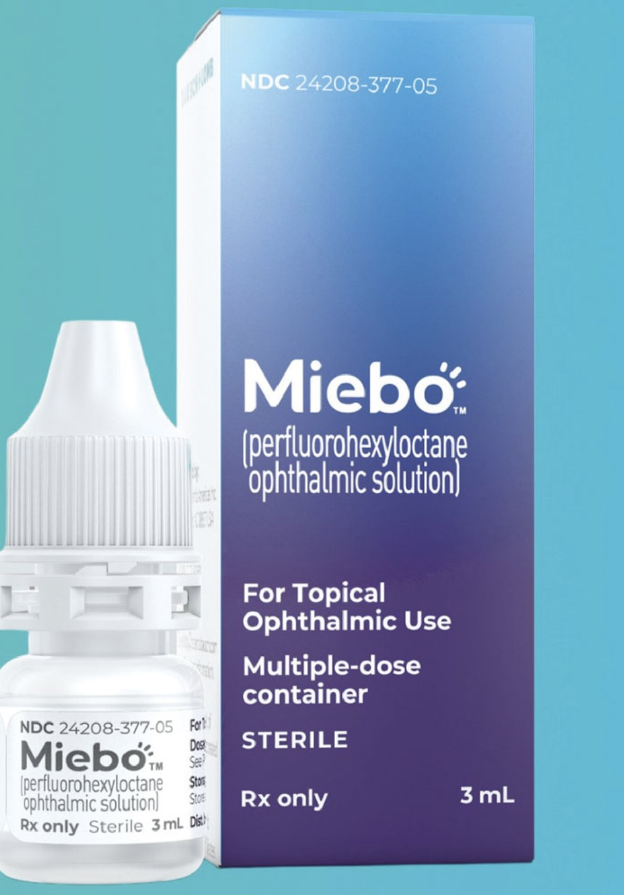
First for evaporative dry eye

Slide 58
MIEBO MOA
NOT CLEAR BUT THOUGHT TO WORK BY MIMICKING THE ANTI-EVAPORATIVE PROPERTIES OF MEIBUM
SPREADS UNIFORMLY OVER THE OCULAR SURFACE FORMING A PROTECTICE SURFACTANT LAYER OVER THE TEAR FILM WHICH PREVENTS EVAPORATION
QID DOSAGE, 3ML BOTTLE
MILDLY DECREASED VA
NO BURNING

Slide 59
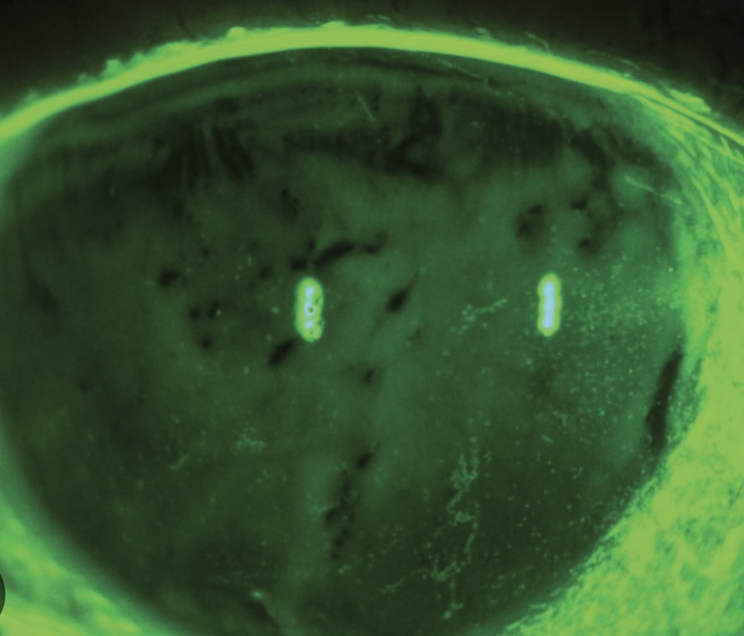
BEFORE MIEBO:

Slide 60
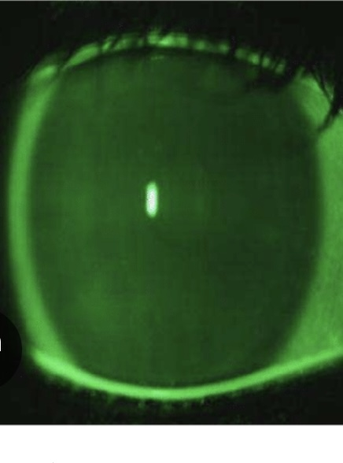
10 MINUTES AFTER MIEBO

Slide 61
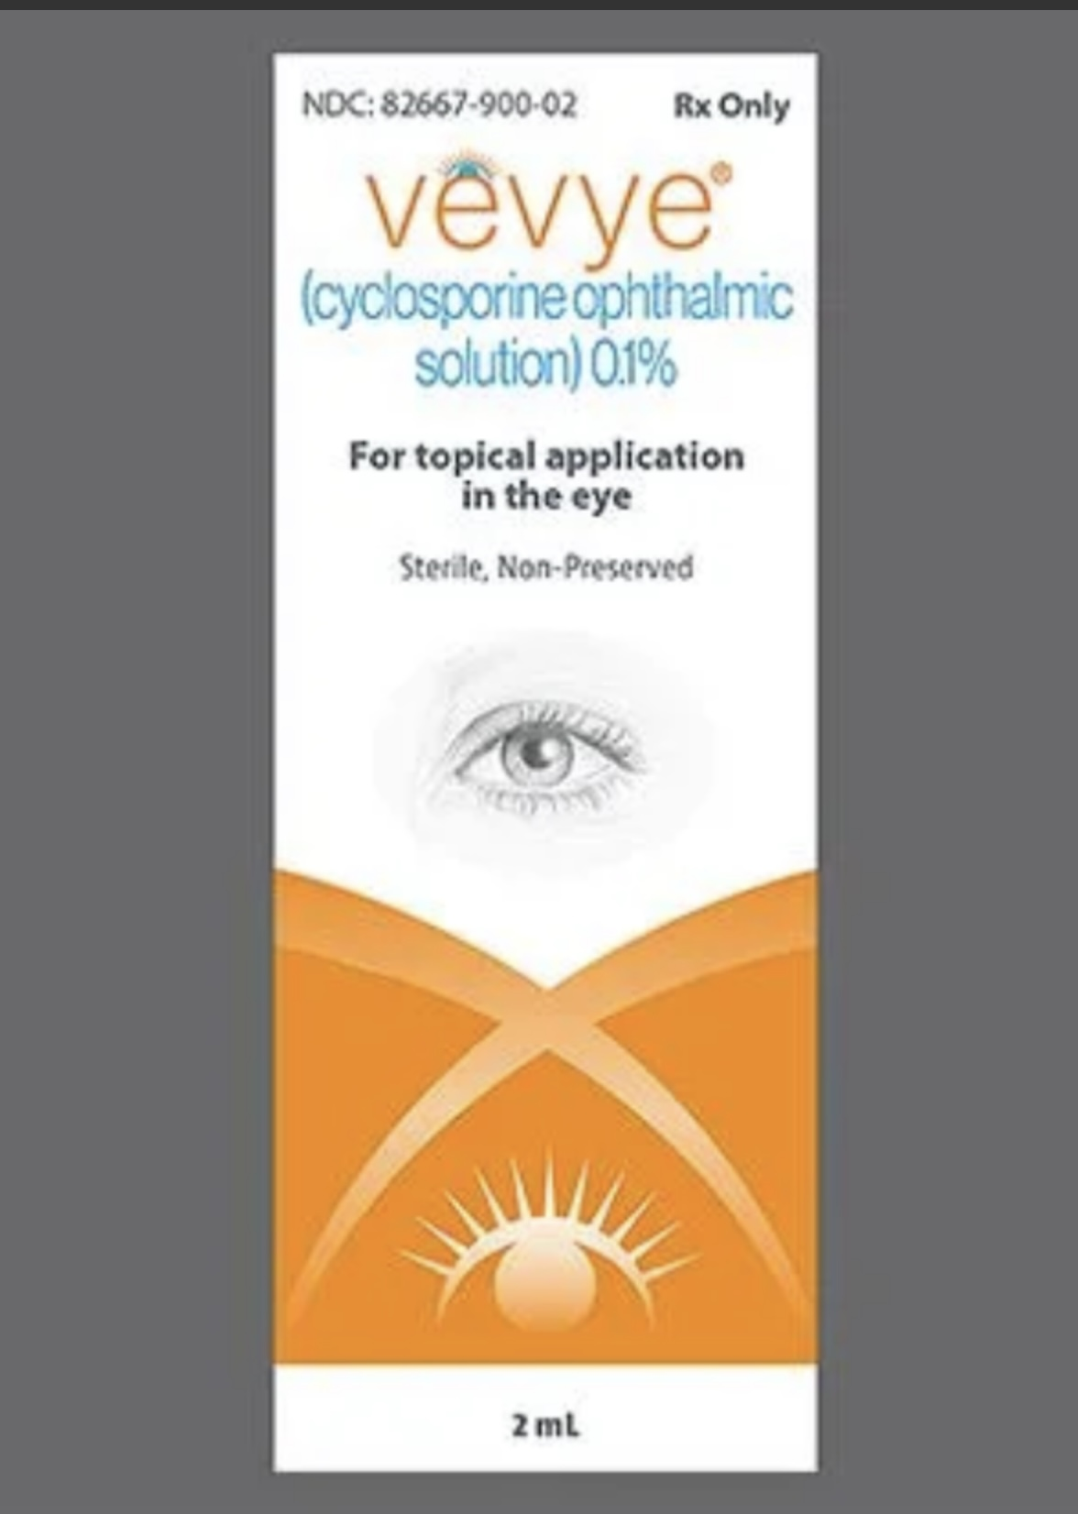
CYCLOSPORINE 0.1%

Slide 62
VEVYE
*SIDE EFFECTS: EYE IRRITATION, TEMPORAY BLUR
*SIGNS AND SYMPTOMS OF DRY EYE IMPROVE IN 15 DAYS

Slide 63
IS IT REALLY DRY EYE?
Decreased corneal sensation
Non healing epithelial defect
Stain without pain
Ulceration

Slide 64
NEUROTROPHIC RISK FACTORS:
DIABETES
HERPES SIMPLEX
HERPES ZOSTER
LASIK
CONTACT LENS WEAR

Slide 65
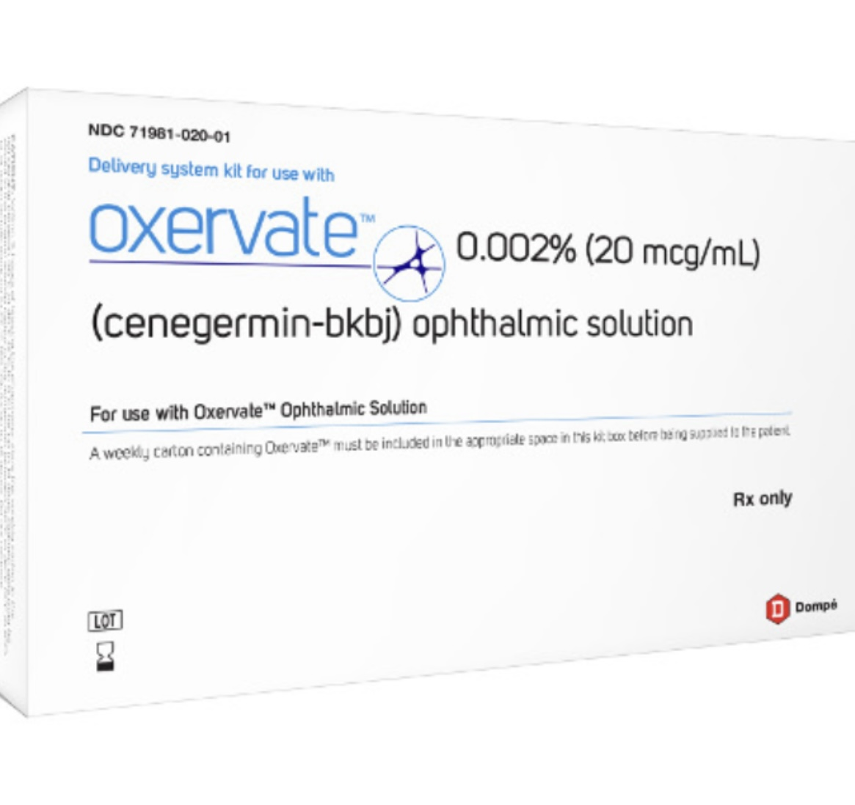

Slide 66
OXERVATE
FIRST TOPICAL BIOLOGIC MEDICATION
HUMAN NERVE GROWTH FACTOR
POTENTIAL TO COMPLETELY HEAL NEUROTROPHIC KERATITIS
Q2H X 8 WEEKS

Slide 67
BLEPHARITIS
ITCHING
DISCHARGE
BURNING
MGD
COLLARETTES

Slide 68
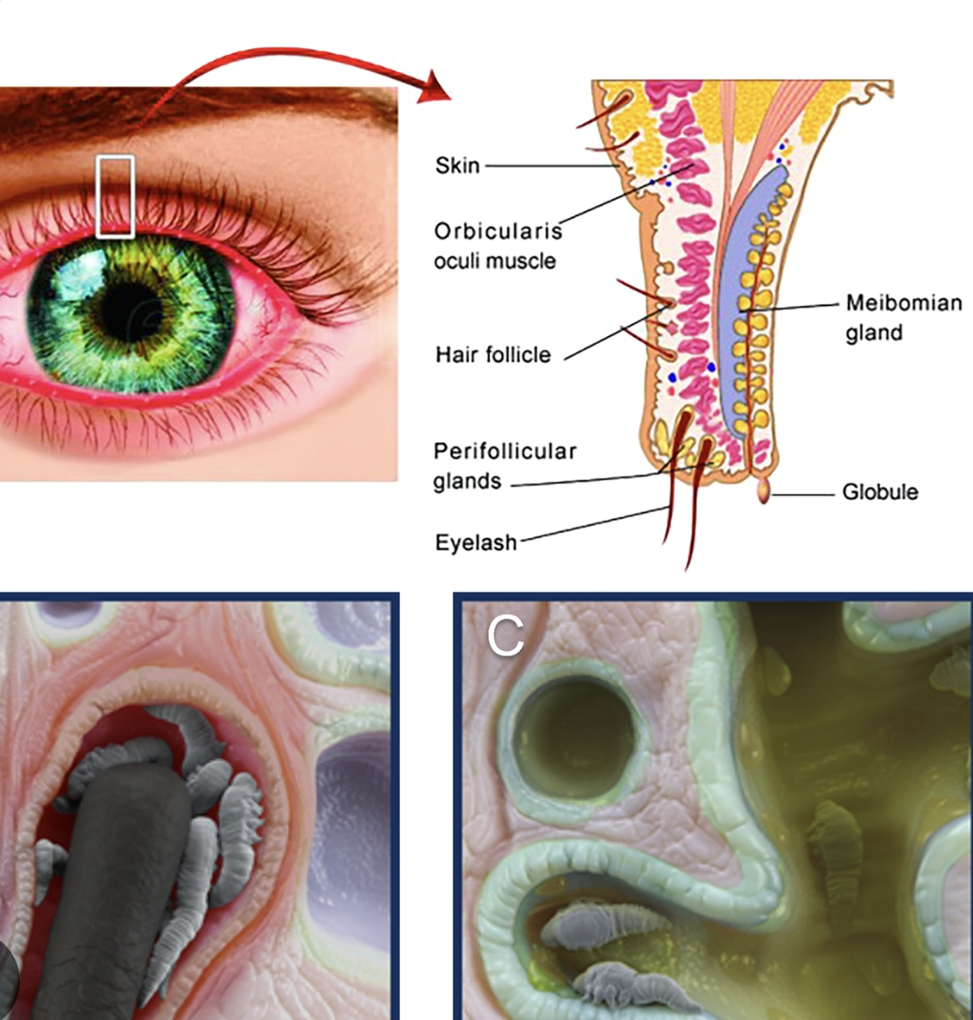

Slide 69
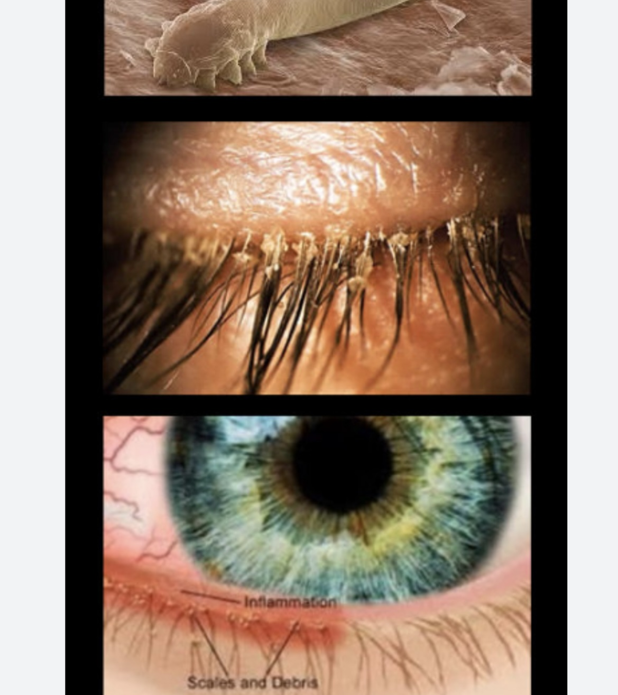
JUST LOOK DOWN
RECURRENT CHALAZION
RECURRENT HORDEOLUM
ROSACEA

Slide 70
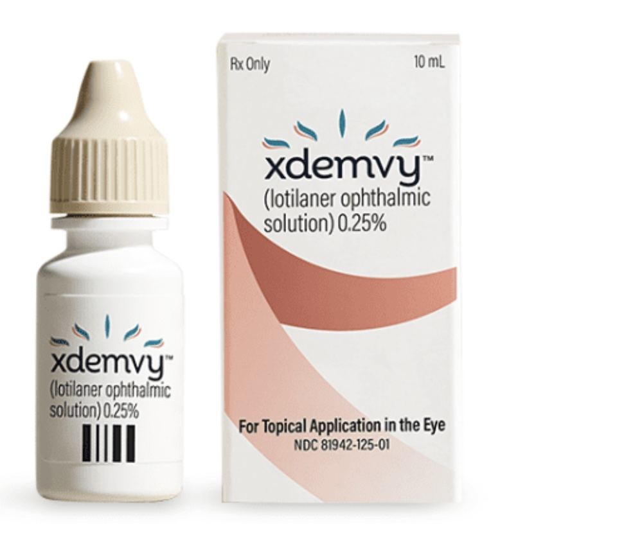
XDEMVY

Slide 71
XDEMVY
XDEMVY (LOTILANER) IS AN ANTIPARASITIC AGENNT APPROVED FOR DEMODEX BLEPHARITIS
PARALYZES AND ERADICATES MITES – SELECTIVELY INHIBITS PARASITE SPECIFIC Y-AMINOBUTYRIC ACID CHLORIDE CHANNELS
1 DROP BID X 6-12 WEEKS
REPEATABLE?

Slide 72

THANK YOU!
QUESTIONS? DRMARIA@OCULARPRIME.COM

