Slide 1
Neuro-Ophthalmic Red Flags in Eye Care: Identifying When MRI is Warranted
Eric Chang, OD
Solinsky Eyecare
04/11/26

Slide 2
Disclaimers
I have no financial endorsements to enclose.
I am not a neurologist or radiologist.

Slide 3
Learning Objectives
Understanding possible neurological etiologies resulting in visual symptoms
Exploring different sources of compressive optic neuropathy
Detecting red flags that would warrant magnetic resonance imaging (MRI)
Treatment and management of certain neurological compressive lesions

Slide 4
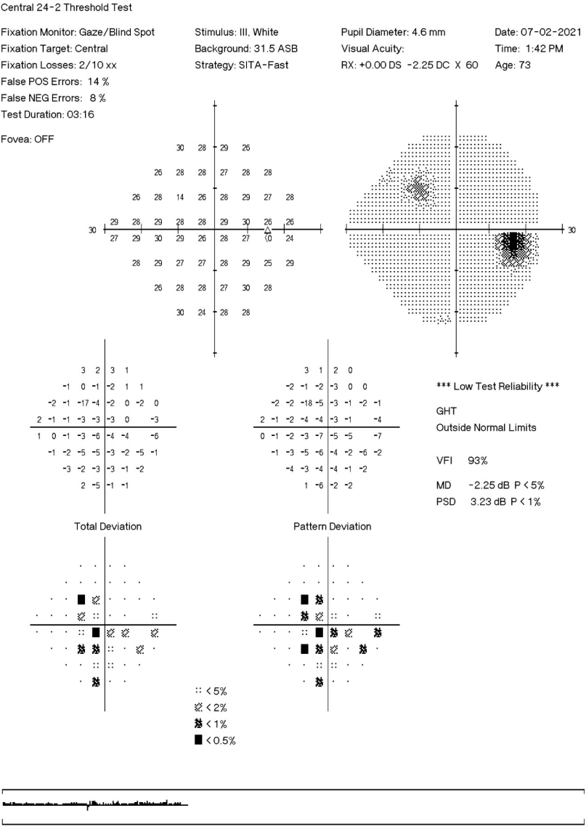
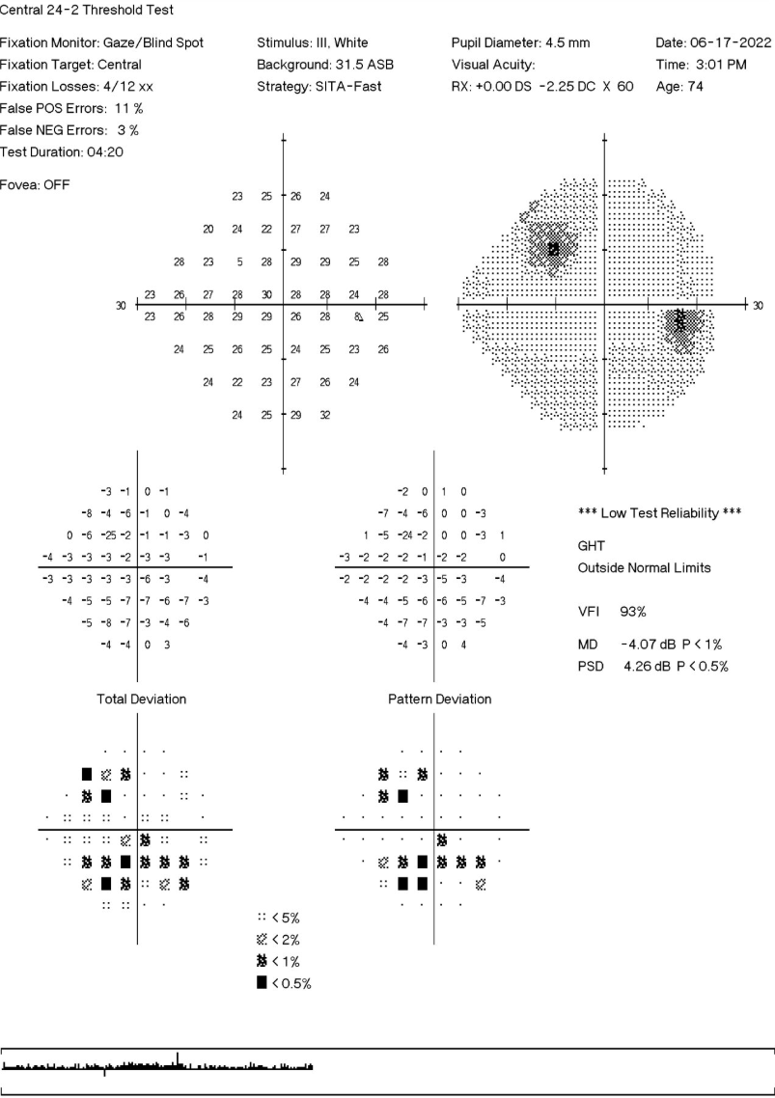
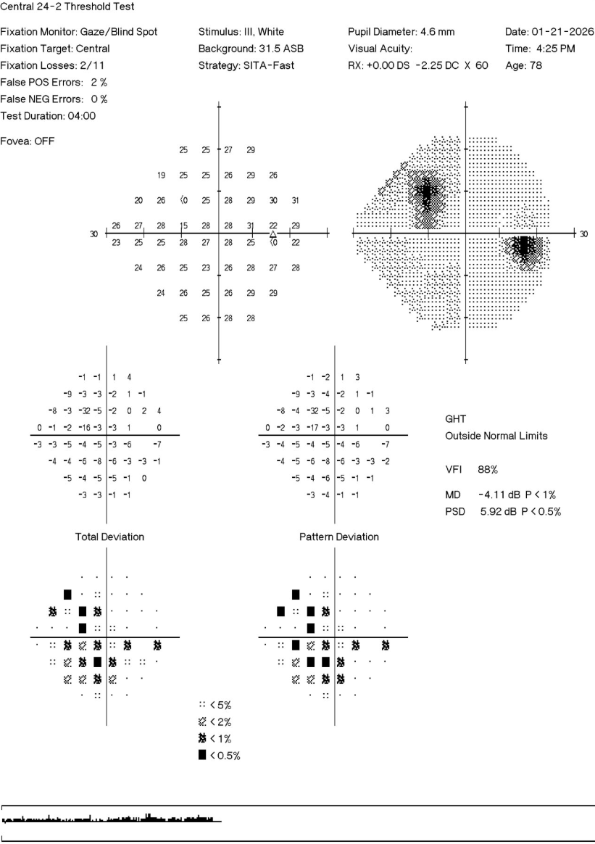
Would you do an MRI on this patient?
2021
2022
2026

Slide 5
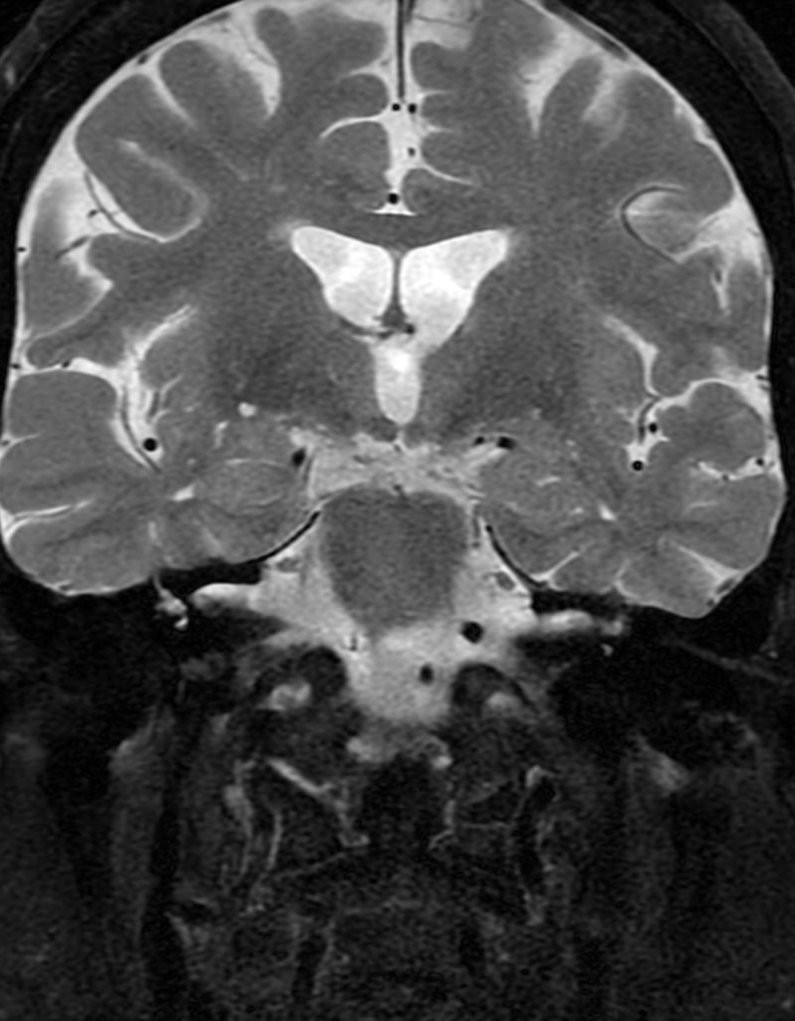
Anatomy

Slide 6
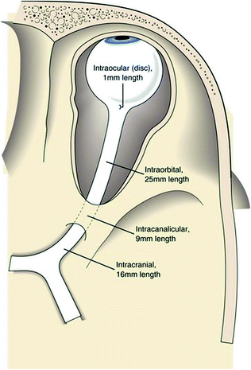
Optic nerve
The optic nerve averages 50 mm in length contains over 1 million axons of retinal ganglion cells
Intraocular (1 mm)
Intraorbital (25 mm)
  Cavernous hemangiomas, optic nerve sheath meningiomas, gliomas
Intracannicular (4-9mm)
  Nerve constricted by the bone = very sensitive to expansion
  Trauma, meningioma
Intracranial (16mm)
  Most commonly affected by lesions in the suprasellar region
  Pituitary adenomas, craniopharyngiomas, sellar meningiomas.
Rodriguez-Beato, Freddie Y., and Orlando De Jesus. “Compressive Optic Neuropathy.”
Image from: “Optic Nerve, Visual Pathways, Oculomotor System, and Consequences of Intracranial Injury.” Ento Key, 12 July 2017, entokey.com/optic-nerve-visual-pathways-oculomotor-system-and-consequences-of-intracranial-injury/.
Notes:
Intraocular (1mm): this is within the eye itself. Where axons from retinal ganglion cells converge to leave the eyeball.
Intraorbital (25mm): This is within the eye socket and surrounded by connective tissue sheaths.
Intracanicular (4-10 mm) (within the optic canal)
Intracranial (16mm): inside the scull: The final segment, extending to the optic chiasm where nerves from both eyes meet.

Slide 7
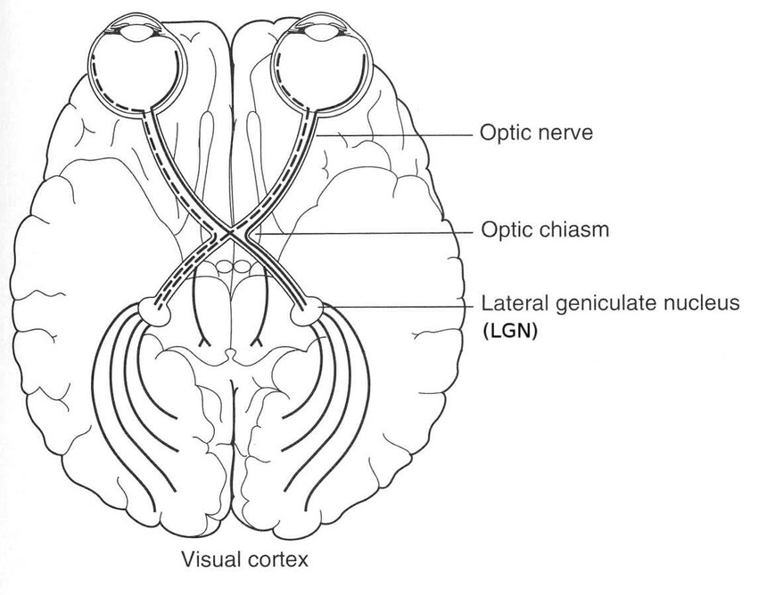
Optic chiasm
Pituitary Adenomas
  Benign tumors of the pituitary gland
  Pituitary apoplexy
Craniopharyngiomas
  Childhood (5-14 years), or adult (50-74 years)
  Outgrowth of Rathke’s pouch
Meningiomas
  Most common, usually benign
  Neoplasm of arachnoid cells
Anterior communicating artery aneurysm
  Rare
1
2
3
4
Notes:
Put bitemporal field loss photos.
Craniopharyngioma: these arise from embryologic cells (from children) likely from the Craniopharyngeal duct or Rathke’s pouch, that grow irregularly, causing compression.

Slide 8
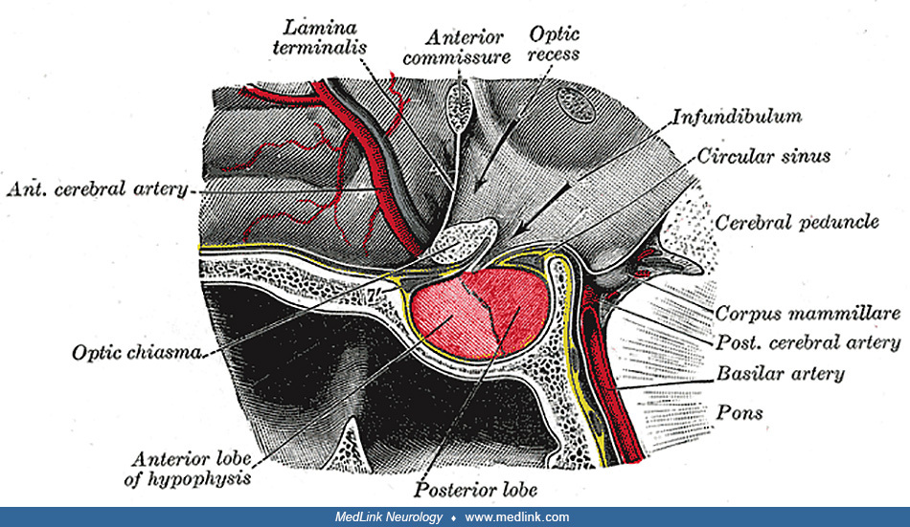
Sella
The Sella (Sella Turcica): bony depression contains the pituitary gland
Anterior lobe, posterior lobe, intermediate lobe → tubular infundibulum to brain
Anterior pituitary gland:
  ACTH, PRL, LH, FSH, GH, TSH
Posterior pituitary gland:
  Oxytocin, Vasopressin, Antidiuretic hormone
Pituitary gland within 10mm below optic chiasm.
Ganapathy, Muthu Kuzhali, and Prasanna Tadi. “Anatomy, Head and Neck, Pituitary Gland.”
Image taken from: “Sagittal Section through the Sella Turcica | MedLink Neurology.”
Notes:
Hormones released by the Anterior lobe: FLAT PEG. Endorphines.
Intermediate lobe: pars intermedia: More for pediatric development of melanin when younger. More vestigial in adults.
Surrounding structures: third ventrical and surrounding loop of arteries in Circle of Willis.

Slide 9
Compressive Optic Neuropathy (CON)

Slide 10
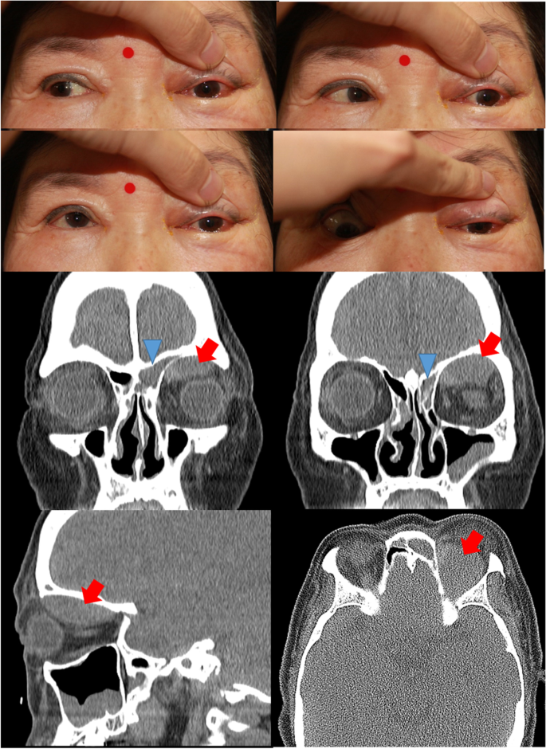
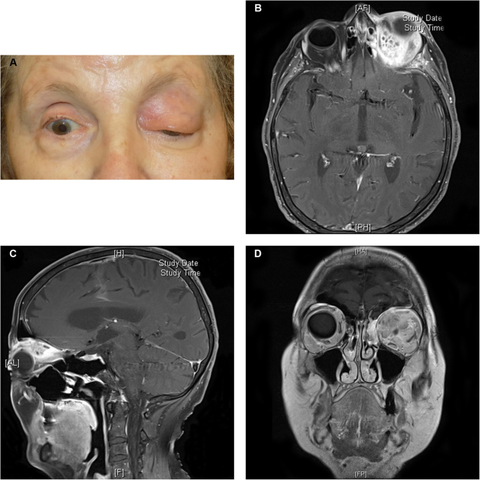
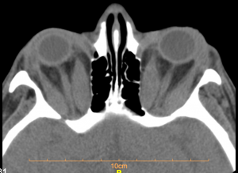
Etiology
CON is the manifestation of sustained mechanical pressure on the optic nerve or its surrounding structures.
Chronic compression can cause disruption of axonal transport and loss of vascular perfusion → axonal degeneration, demyelination, progressive visual loss
Infectious causes:
  Fungal infections (Aspergilloma – immunocompromised), fungal sinusitis, tuberculomas (TB)
Inflammatory causes:
  Thyroid-associated orbitopathy (Graves disease), Idiopathic orbital inflammation
Vascular causes
  Intracranial aneurysms (ICA, ANCA, OA), fistulas
Traumatic causes:
  Orbital fractures with bony displacement, orbital hematomas
Neoplastic causes:
  Meningiomas (usually benign), Optic glioma (NF-1), pituitary adenoma, craniopharyngiomas, metastatic cancers
Bone Causes
  Paget’s disease, osteopetrosis
Rodriguez-Beato, Freddie Y., and Orlando De Jesus. “Compressive Optic Neuropathy.”
Image taken from: Lever, Mael, et al. “Orbital Aspergillosis: A Case Report and Review of the Literature.”
Image taken from: Kim, Jonghyun, et al. “Orbital Subperiosteal Hematoma Associated with Frontal and Ethmoidal Sinusitis.”
Image taken from: Pakdel, Farzad, and Gangadhara Sundar. “Dysthyroid Optic Neuropathy - EyeWiki.”
Notes:
Infectious causes can progress rapidly and require urgent antimicrobial and sometimes surgical decompression.
Osteopetrosis: “marble bone disease”: brittle and fracture-prone bones.
Graves disease: Orbital apex crowding – Eyewiki
Orbital subperiosteal hematoma associated with frontal and ethmoidal sinusitis

Slide 11
Pathophysiology
Mammalian CNS lacks the ability for regeneration and axonal growth
Compression in the axoplasmic flow → axonal swelling and stasis → visual field defects → progressive degeneration
Weak points:
  Optic Canal
  Orbital Apex
Early symptoms:
  Dyschromatopsia
  Relative afferent pupillary defect (RAPD)
  Subtle visual field loss
Severe symptoms:
  Visual decline
  Optic disc pallor/atrophy
Rodriguez-Beato, Freddie Y., and Orlando De Jesus. “Compressive Optic Neuropathy.”
Notes:
“Time is not your friend”.
The areas most susceptible to compression are located where the nerve passes through small bone structures, eg, the orbital apex and the optic canal. Graves disease is an example of this: extraocular muscle hypertrophy (especially inferior and superior recti) can compress the optic nerve at the orbital apex, which is one of the most common causes of CON worldwide.
Discrepancies in Color vision between the eyes.

Slide 12
History and Physical
Extensive and detailed clinical history is paramount
Questions to ask:
  1 or 2 eyes?
  Headaches, nausea, recent trauma?
  Diplopia? Color vison loss?
  Photophobia, red eye
  Unexplained weight loss? Numbness on one side?
Tests to include:
  Color vision
  Visual field
  Exophthalmeter
  Cranial nerve testing
  Palpation of the orbit
  Look-over: goiter, café-au-lait spots
Rodriguez-Beato, Freddie Y., and Orlando De Jesus. “Compressive Optic Neuropathy.”
Notes:
Photophobia: red eye: infectious causes like TB? Aspergillis? Versus other optic neuropathies like inflammatory, ischemic, or toxic etiologies.
Weight loss: Pituitary gland, feeling of unwell?
Trauma, walking up stairs, seeing two faces?

Slide 13
Evaluation
Laboratory Studies:
  CBC, Metabolic panel, Lipid panel
  TSH, T3, T4, TRH
  FSH, LH
  Prolactin
  ACTH, GF
  ACE – sarcoidosis
Imaging studies:
  OCT (ganglion and retina)
  Visual field testing
  MRI (brain and orbit) is the preferred modality with contrast.
  CT for head and orbit for lesions involving bones – fractures, osteopetrosis
    Indicated for when MRI is contraindicated
Refer to neurologist, endocrinologist, or neuro-ophthalmologist
Rodriguez-Beato, Freddie Y., and Orlando De Jesus. “Compressive Optic Neuropathy.”
Notes:
After getting their history, what are you going to do to rule out the etiology of their symptoms?
Never hesitate to refer to a specialist for triangulation of care.
CT contraindications: Pregnancy (due to radiation) and contrast allergies
MRI: metallic implants, pacemakers, and severe claustrophobia.

Slide 14
Red Flags to Consider an MRI?

Slide 15
Red Flags
Indications for Neuroimaging:
  Ptosis: CN3, Horner’s syndrome
  Proptosis: Thyroid eye disease, meningioma, lymphoma
  Ophthalmoplegia: Brainstem lesions, Demyelinating diseases (MS)
  Nystagmus: Inner ear disease (Meniere’s disease), Stroke
  Optis nerve abnormalities: compressive etiology
Careful considerations:
  Visual field defects: Glaucoma, membrane peel
  Visual loss: ACG, amaurosis fugax, RD
  Pupillary defects/ anisocoria: physiological anisocoria, medications (scopolamine patches, brimonidine), traumatic iritis
Consult to neuro-ophthalmologist
DelGiodice, Michael, and Christopher Suhr. “Neuroimaging 101 for the Optometrist.”
Notes:
Ophthalmoplegia: weakness or paralysis of eye muscles: Can cause diplopia. Thinking about Graves disease, MS, traumatic nerve.
Meniere’s disease: Sudden attacks of vertigo.
Pupillary defects: asthmatic puffer: anticholingergic – inhibit parasympathetic pathway by binding to acetylcholine receptors. Dry mouth, sore throat, constipation, blurred vision and light sensitivity.

Slide 16
Magnetic Resonance Imaging
MRI analyzes biological tissues using magnetic fields and radio waves.
Advantage:
  Enhancement between different soft tissues – ideal for brain and orbit.
  Not contraindicated for pregnant patients or children
  Like CT: Axial, Sagittal, Transverse 3-dimentionall scans
Techniques:
  Proton density
  T1: How quickly protons realign with the magnetic field
    Fluid is extremely dark (long T1); Lipid based tissues are bright (short T1)
    Fast T1 means the tissue is already magnetized when it is sampled
    Great for anatomical detail (fat bright; water dark)
  T2: How quickly protons lose coherence with each other
    Fluid is bright (slow decay), lipids are dark (fast decay)
    Slow T2 recovery means the transverse magnetization last longer, yielding higher signal
    Great for pathology/edema (fluid is very bright)
Townsend, Kelly A., et al. “Clinical Application of MRI in Ophthalmology.”
DelGiodice, Michael, and Christopher Suhr. “Neuroimaging 101 for the Optometrist.”
Notes:
T1 (ANATOMY): Best for looking at normal structure: it makes fat look bright and water look dark
T2 (PATHOLOGY): best for finding abnormalities (swelling, infection). It makes water/fluids look bright and fat look dark.

Slide 17
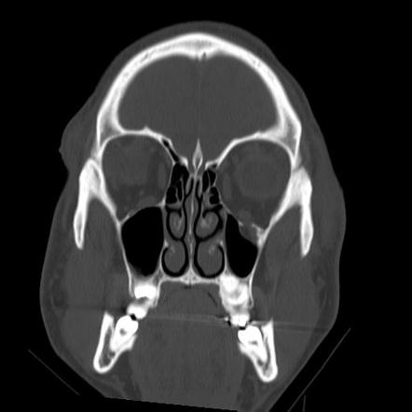
Computed Tomography (CT)
Bones are seen as white; air-filled spaces appear black; soft tissue appear grey
Benefit: cost and time efficient
  Acute hemorrhage
  Bony abnormalities
  Less sensitive to patient movement
  Can be performed on patients with implanted medical devices – unlike MRI
Disadvantages:
  Ionizing radiation
  Pregnant women and children is contraindicated
  Limited soft tissue depiction
Ocular trauma: resistance to forced duction, diplopia, enophthalmos
  Determine status of Maxillary division of trigeminal nerve (V2)
  Orbital floor fracture: inability to look up, ophthalmoplegia.
Image from: Gai, Dayu. “Left Orbital Floor Fracture with Herniation.”
Notes:
X-rays and sensors
Benefit: cost and time efficient to provide valuable information to the brain, orbit and bone

Slide 18
Case 1:
It Wasn’t Because of Cataracts

Slide 19
Chief Complaint
55-year-old Hispanic Female
CC: Progressive visual decline worse in the left eye than the right eye. Images in the left eye appear “cut in half”. Referral from optometrist for cataract and further evaluation
Additional information: Denies any stroke symptoms, trouble walking, trouble speaking, nausea, vomiting, or weakness on one side of body. Reports recent headaches, trouble walking up stairs, and generalized feeling of unwell

Slide 20
History
POH: lattice degeneration OS, nuclear cataracts OU, hyperopia OU, visual field defect OS
  No h/o ocular surgery
PMH: Hypothyroidism, asthma, Prediabetes
  Meds: levothyroxine
  No h/o surgeries
No allergies
Never smoker
Family history of unknown cancer

Slide 21
Clinical Findings
BCVA:
  OD: 20/20-
  OS: 20/70
Visual field:
  Bitemporal loss upon finger counting fields
IOP:
  OD: 20
  OS: 19
Dilated fundus exam:
  OU: Mild senile cataracts
  OS: Lattice degeneration inferiorly
  No nerve pallor/ swelling OU

Slide 22
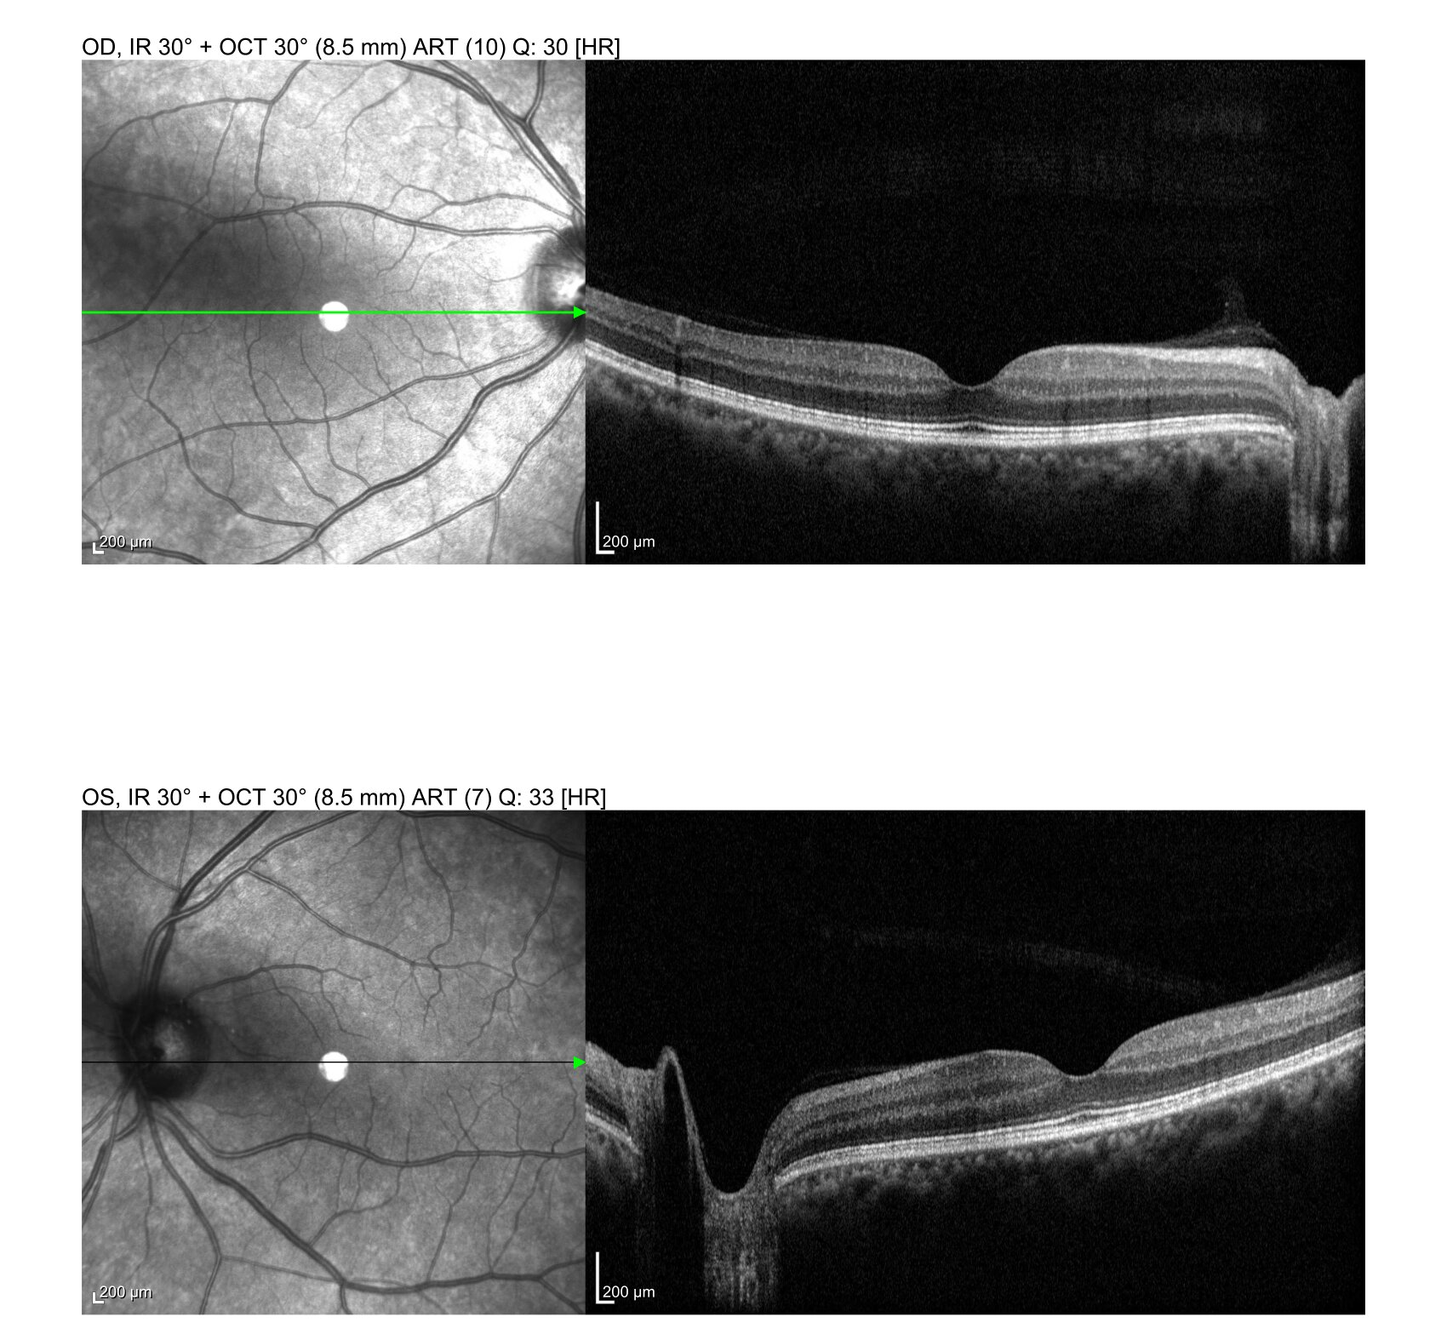
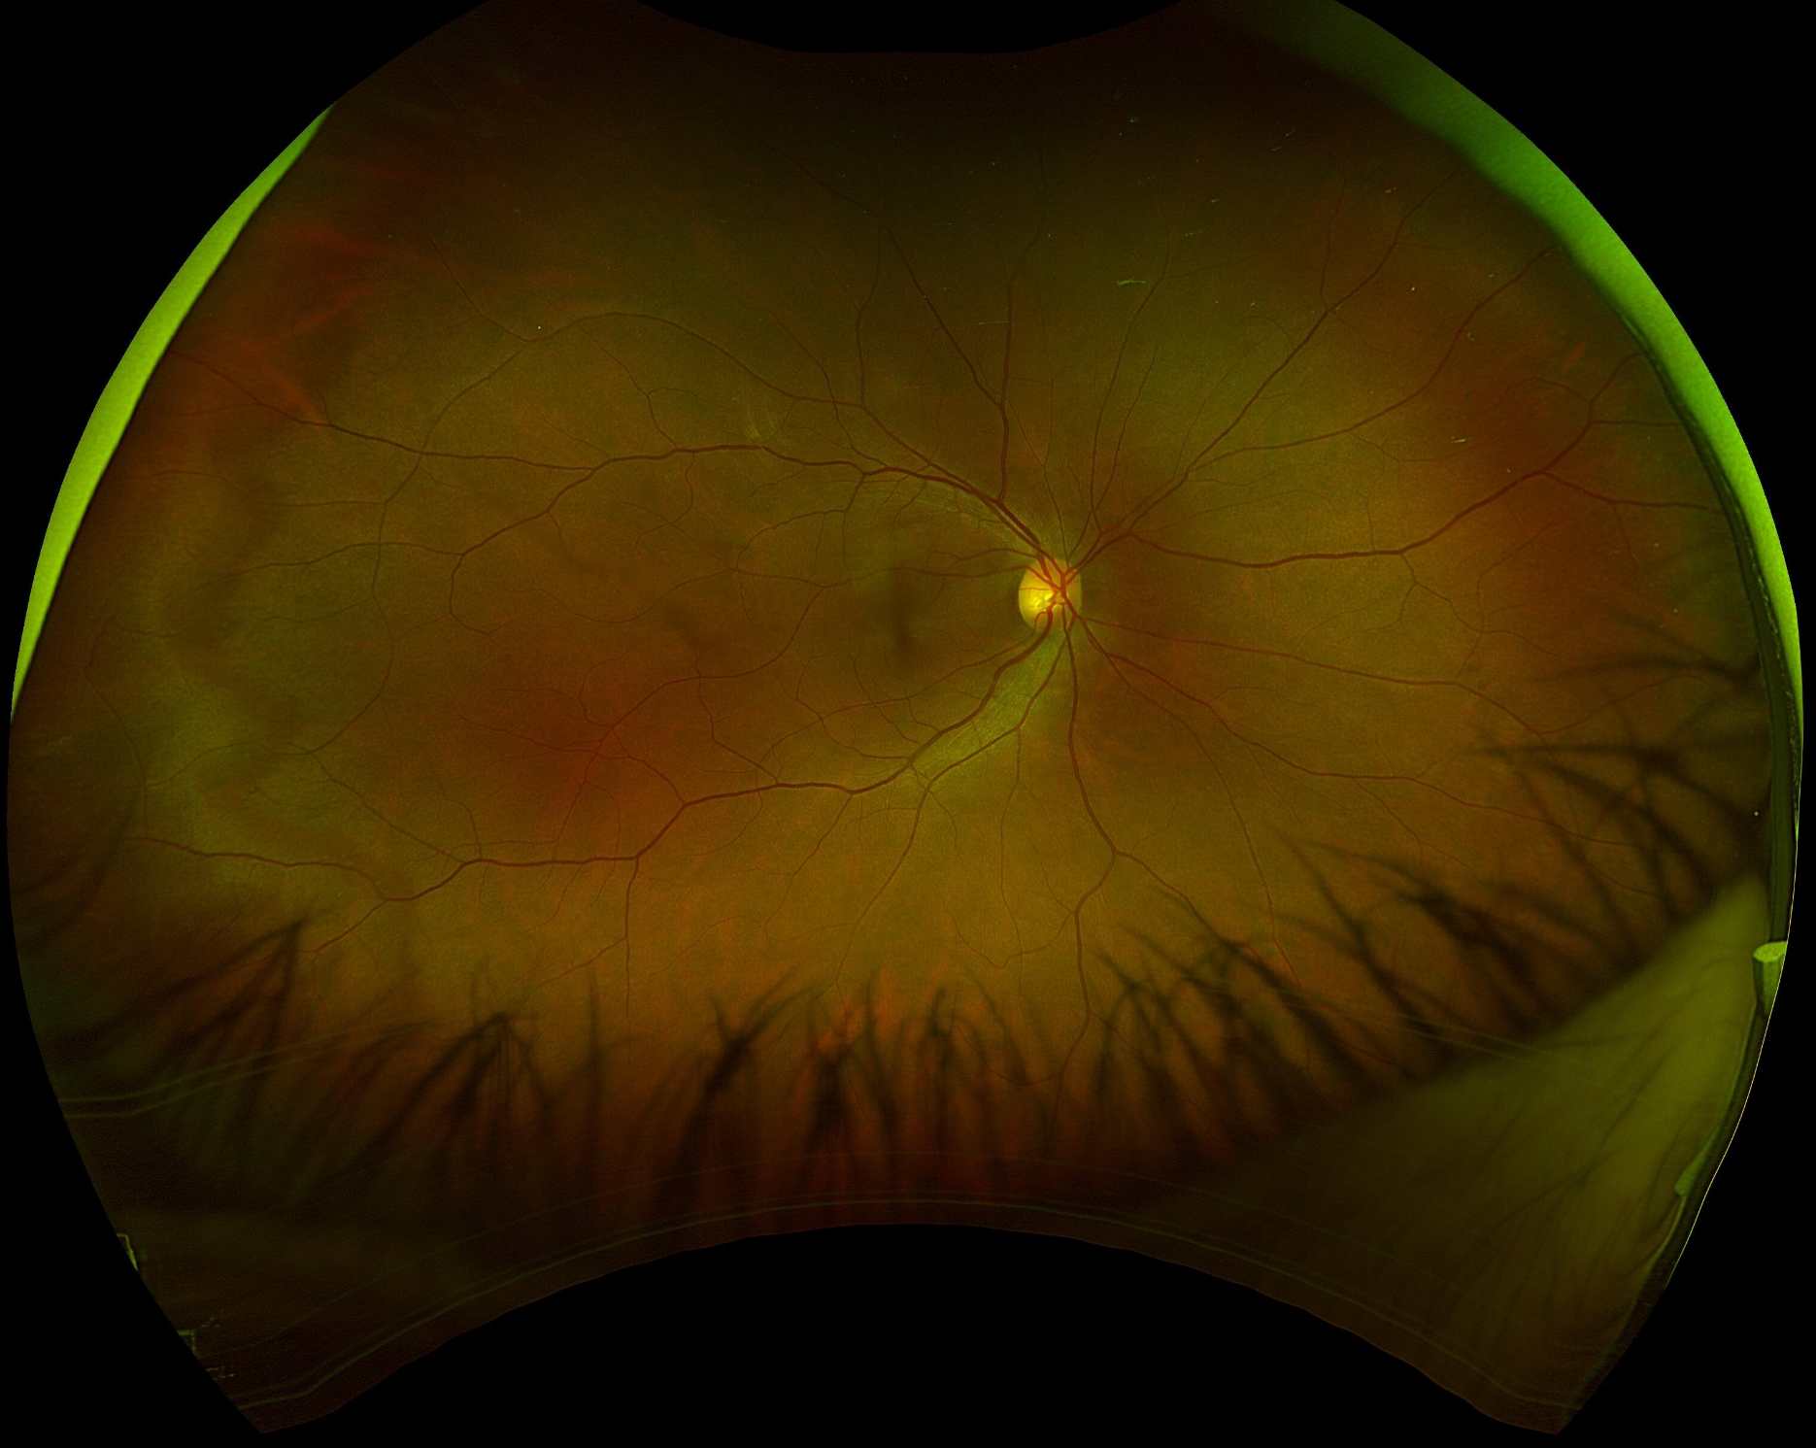
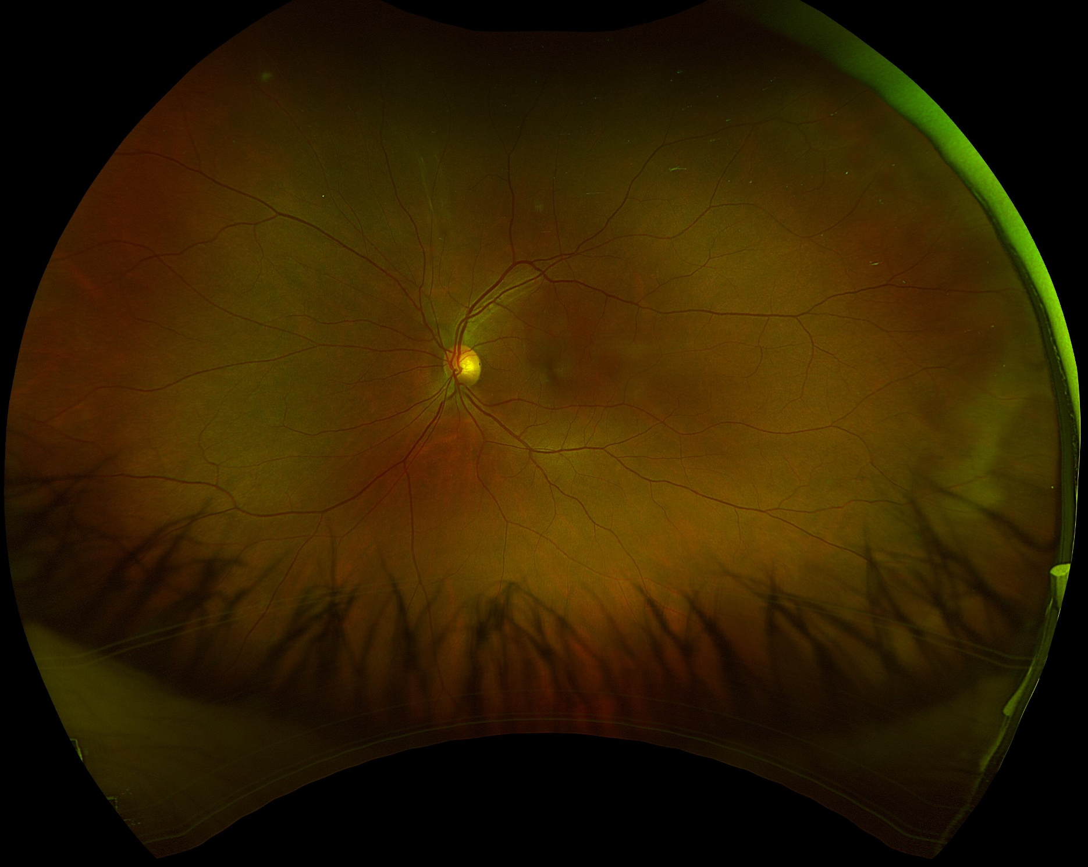
Ancillary Testing
Fundus Photos (left): Slightly enlarged cupping OS vs OD. Otherwise, unremarkable.
OCT-R (right): Fovea OU unremarkable.

Slide 23
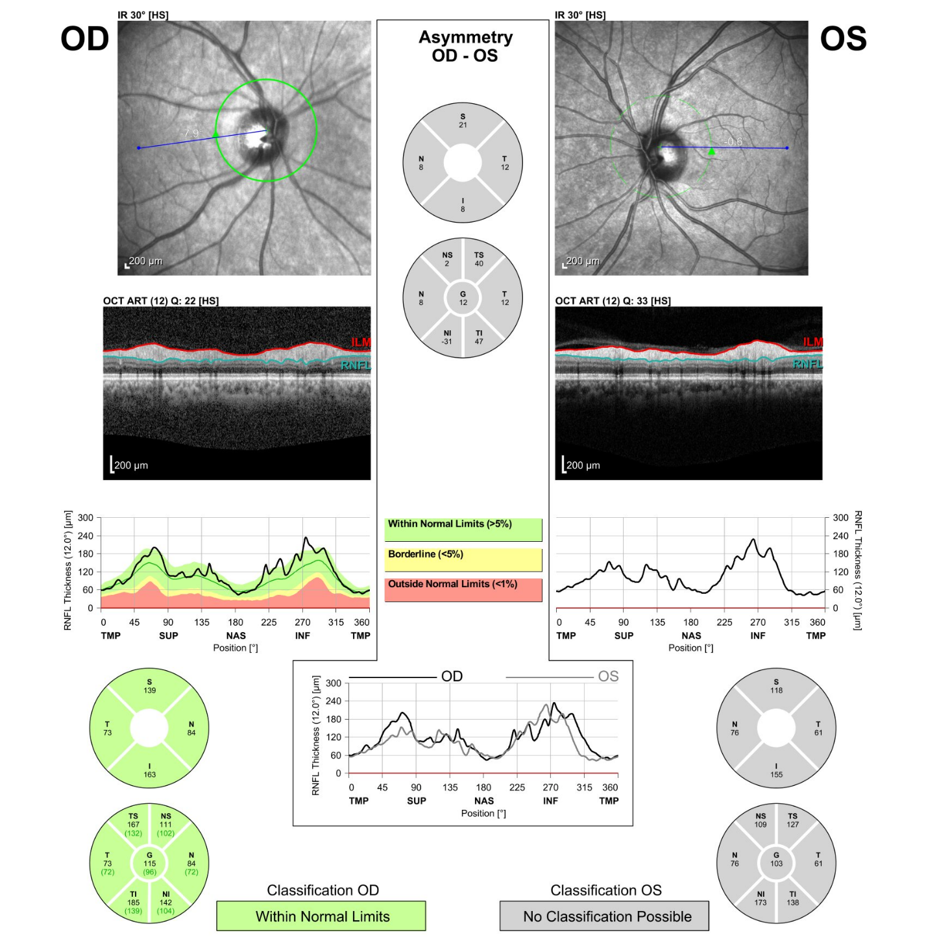
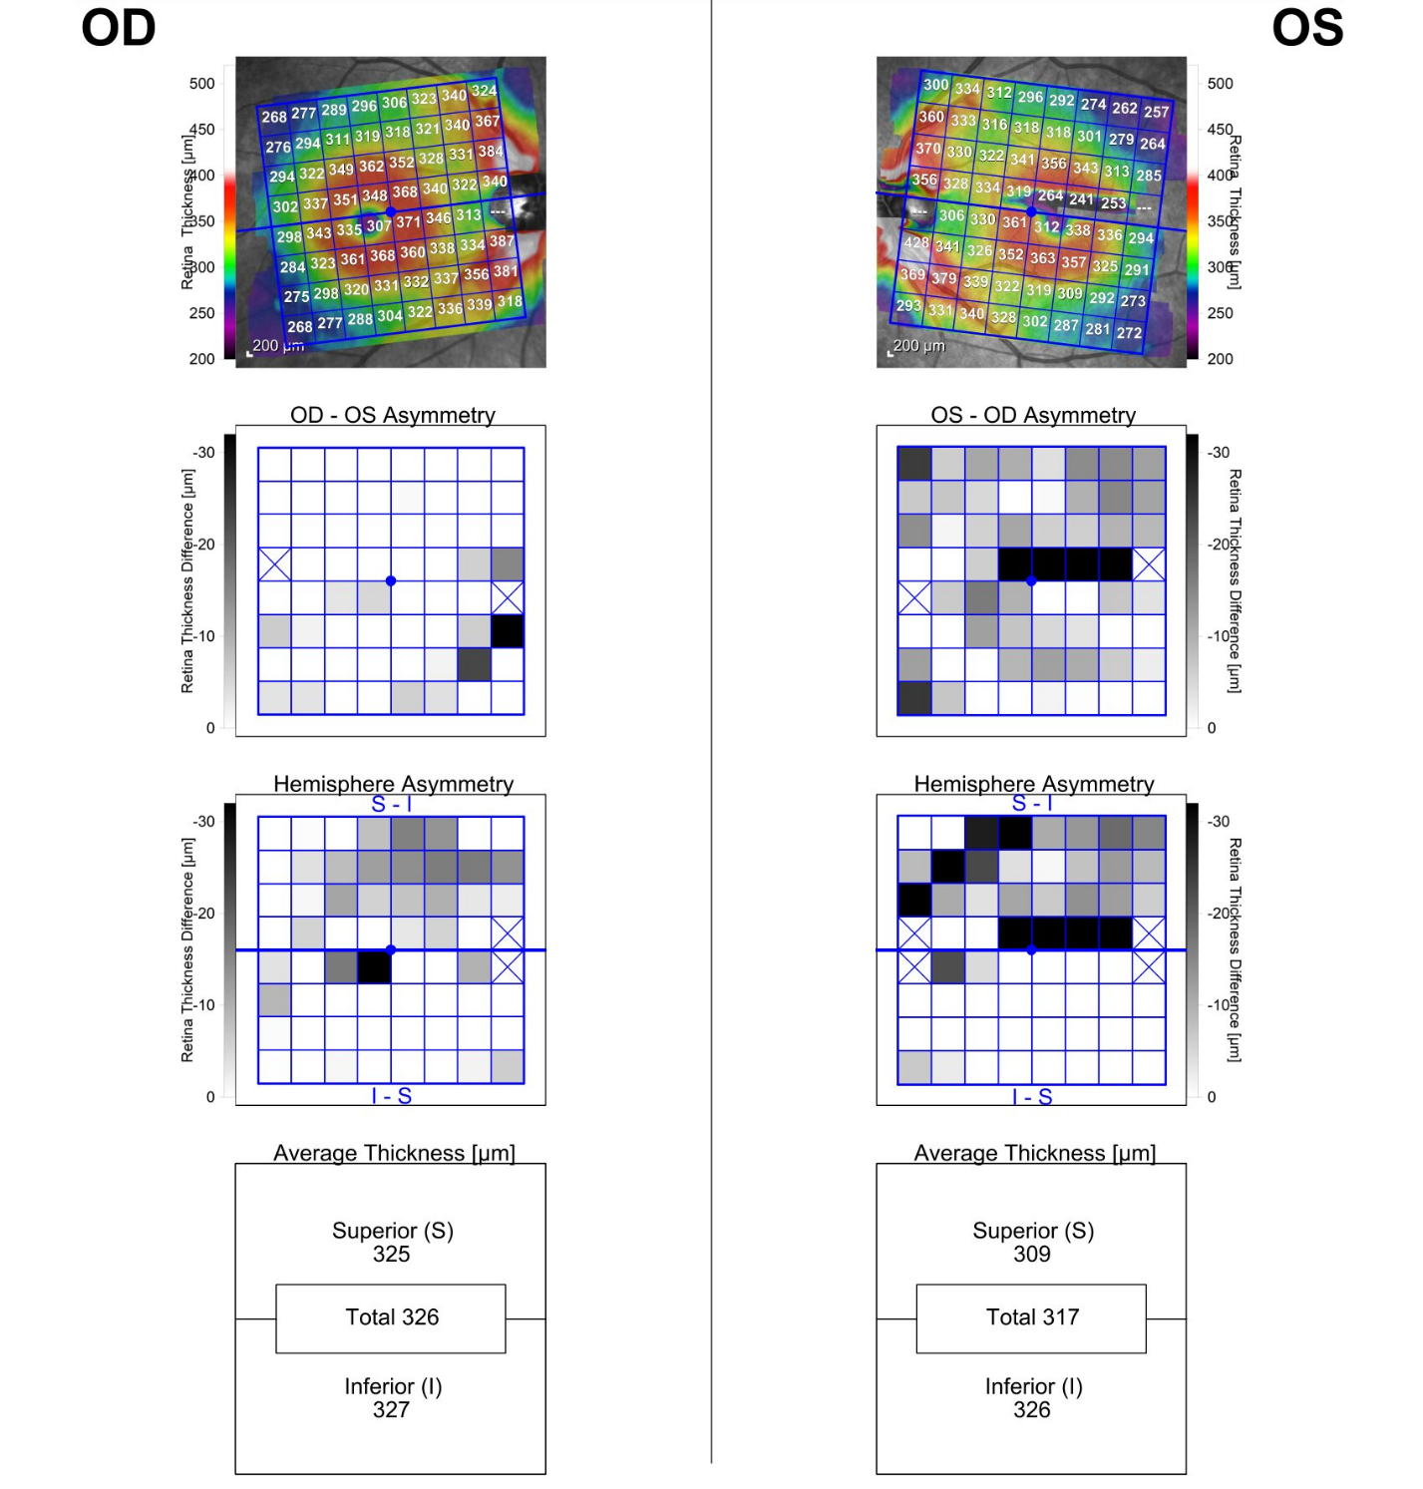
Ancillary Testing cont.
OCT-RNFL (left): Robust, symmetrical retinal nerve fiber layer OU.
Hemisphere asymmetry (right): Symmetrical hemisphere OD; OS superior hemisphere shows moderate decrease 2’ artifact

Slide 24
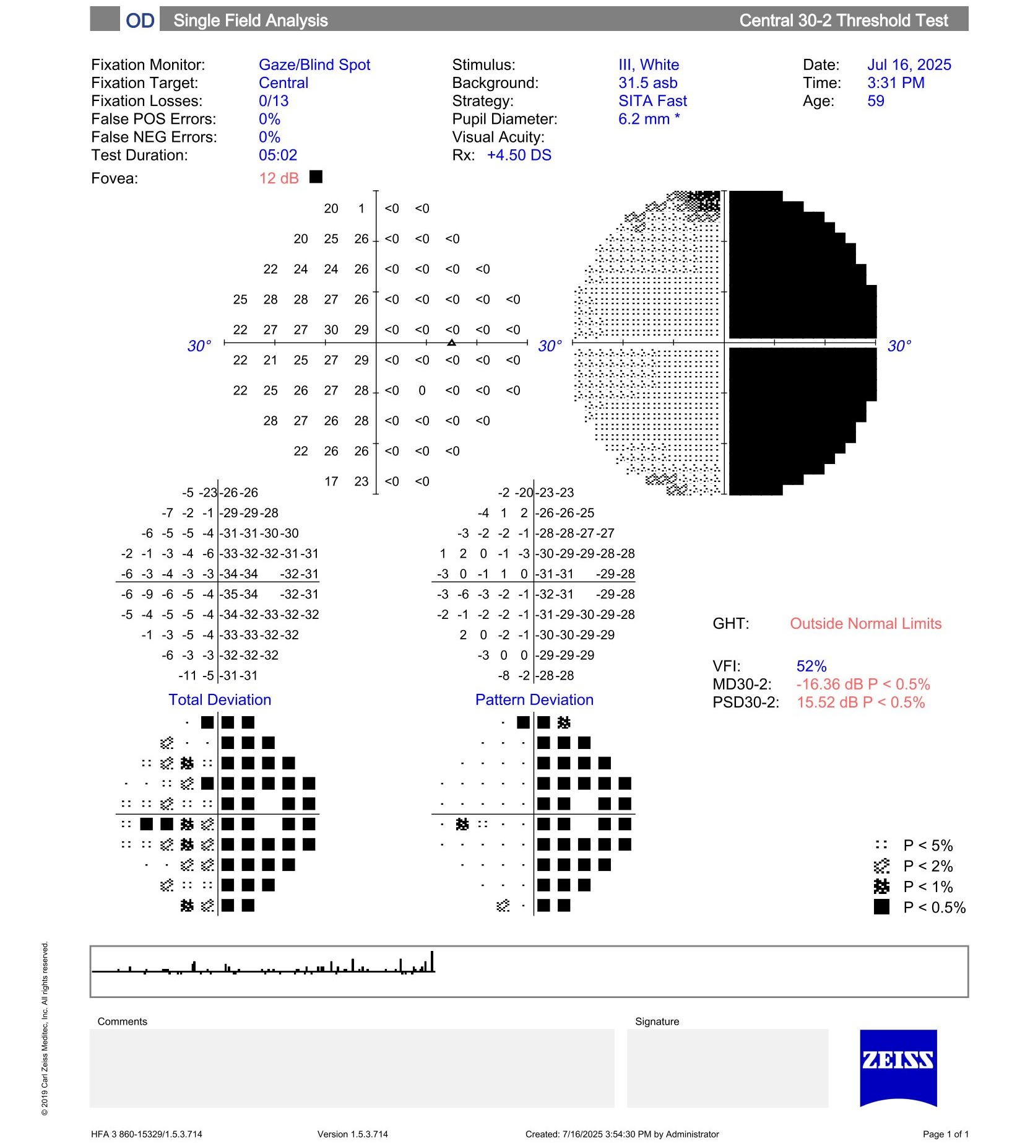
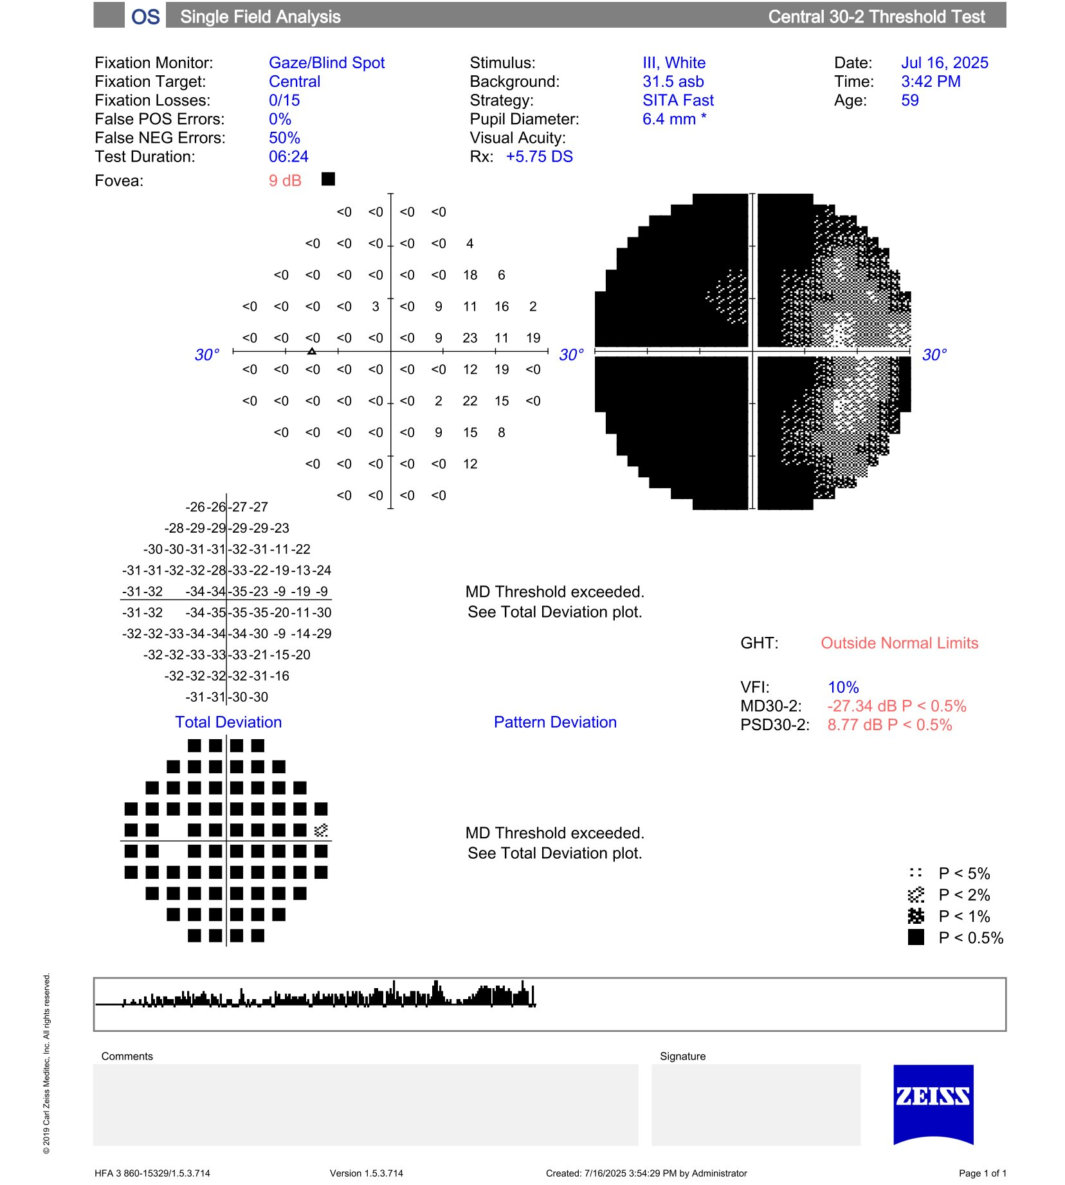
Ancillary Testing cont.
HVF 30-2: right eye temporal hemianopia respecting midline. Left eye devastating visual field loss temporally extending nasally.

Slide 25
Red flags?
Bitemporal visual field loss
  Optic chiasm compression or something else?
BCVA in OS significantly worse than OD
  OD: 20/20, OS 20/70
Recent onset headaches and feeling of unwell
Trouble walking up stairs
Cataracts equal between both eyes
No optic nerve pallor OU

Slide 26
MRI

Slide 27
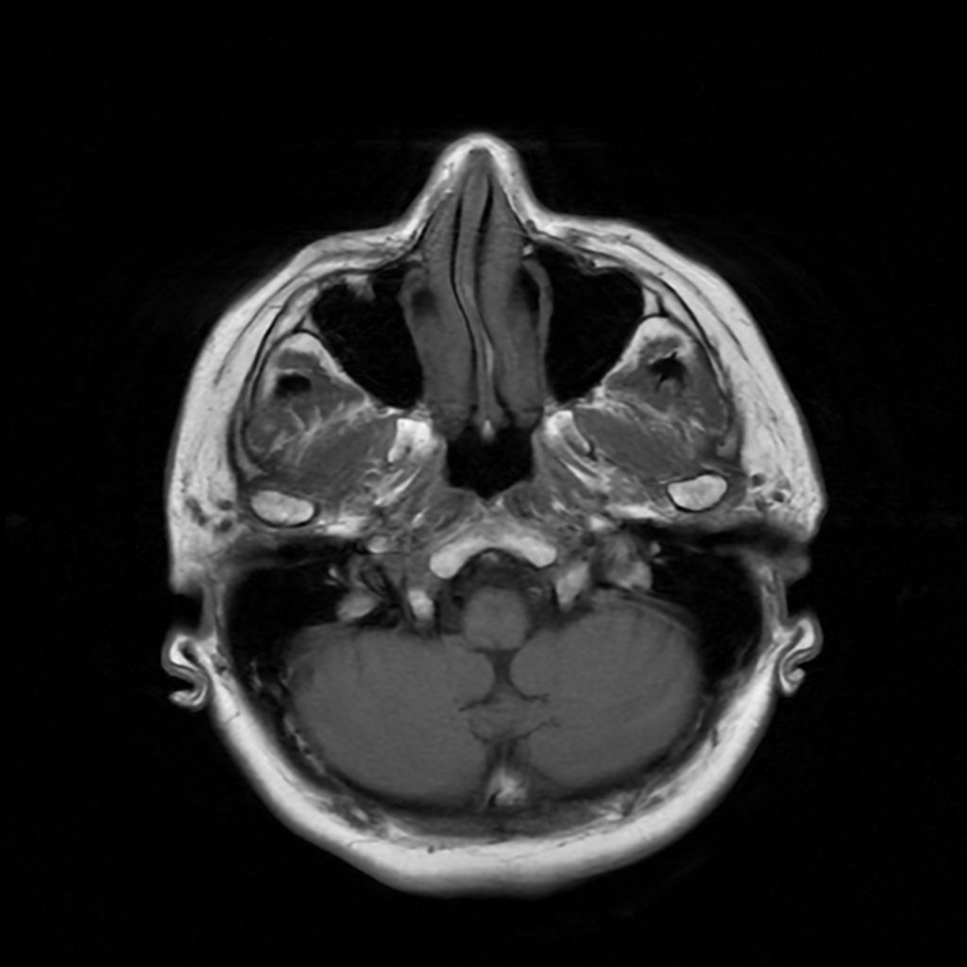
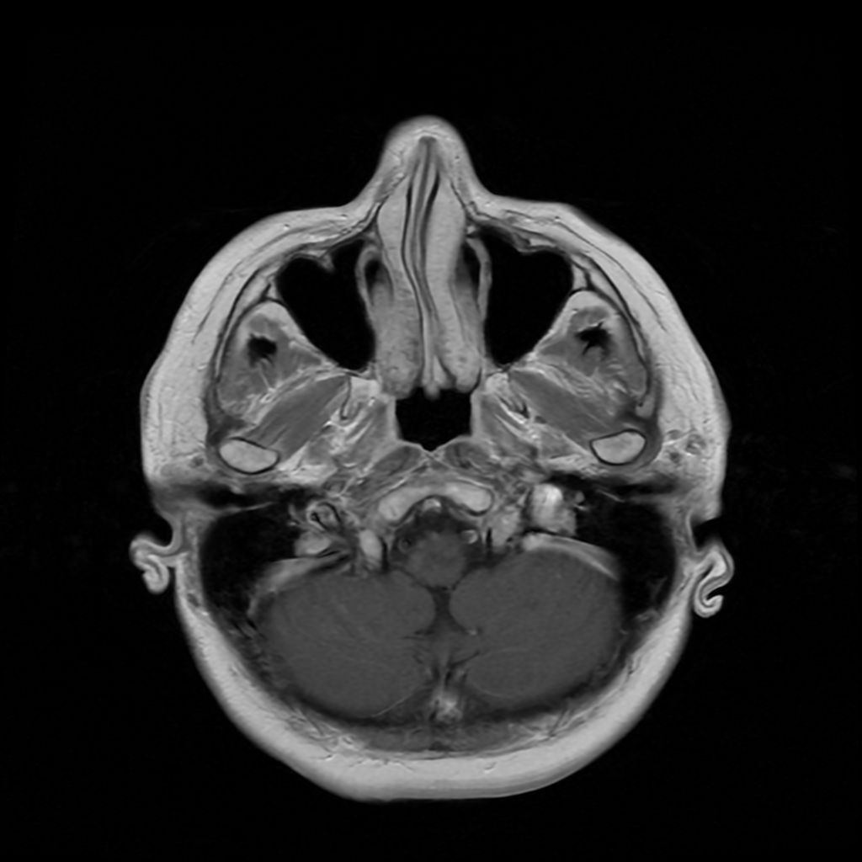
T1 Axial (Pre vs with Contrast)
5

Slide 28
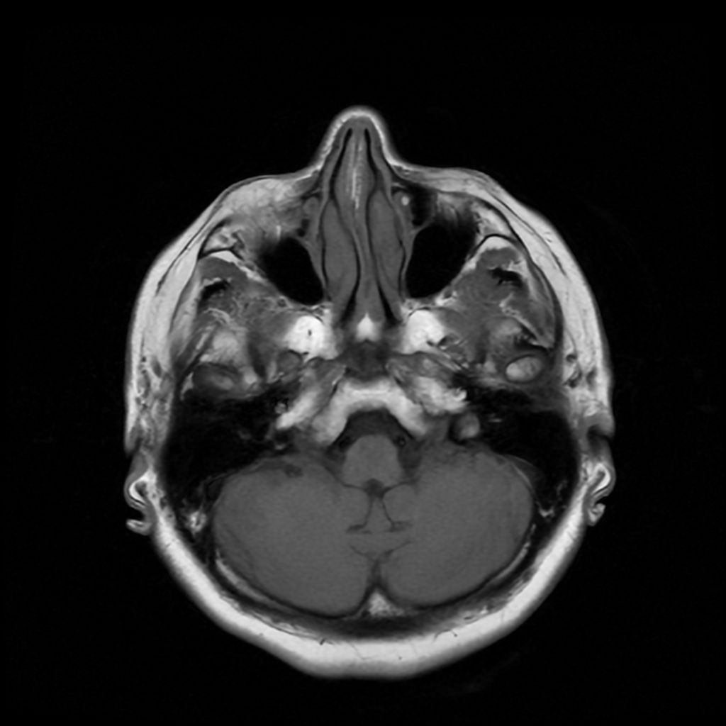
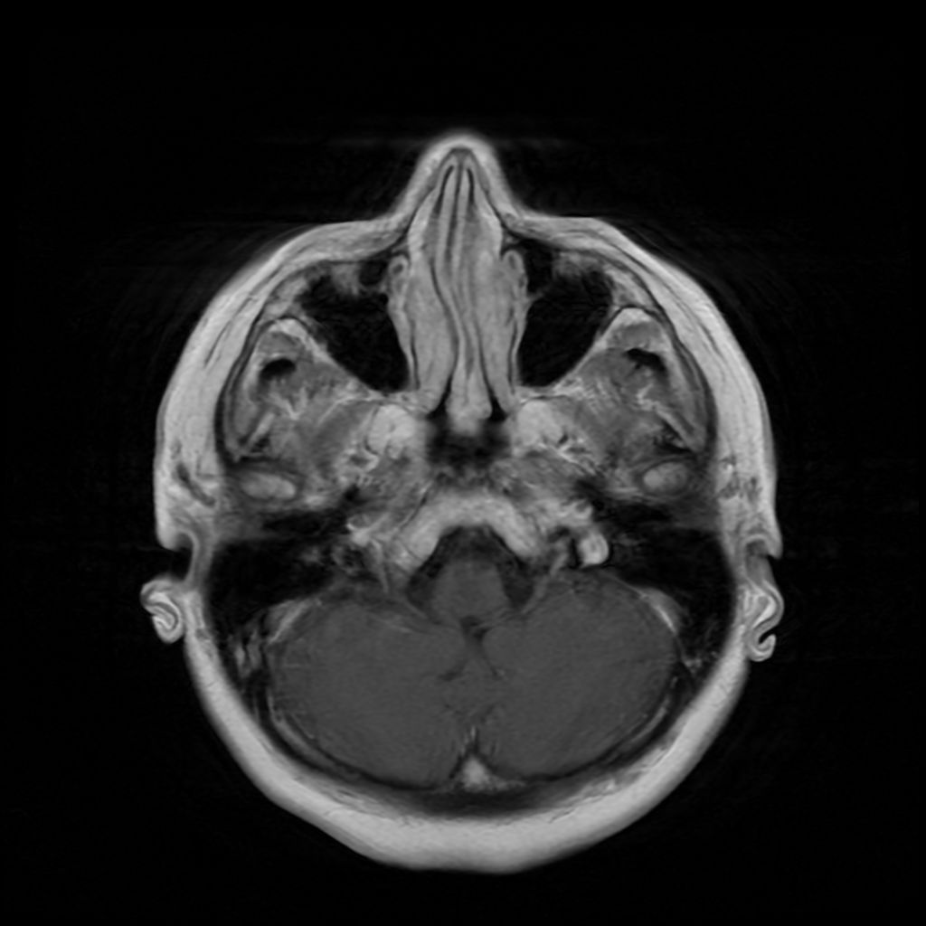
T1 Axial (Pre vs with Contrast)
6

Slide 29
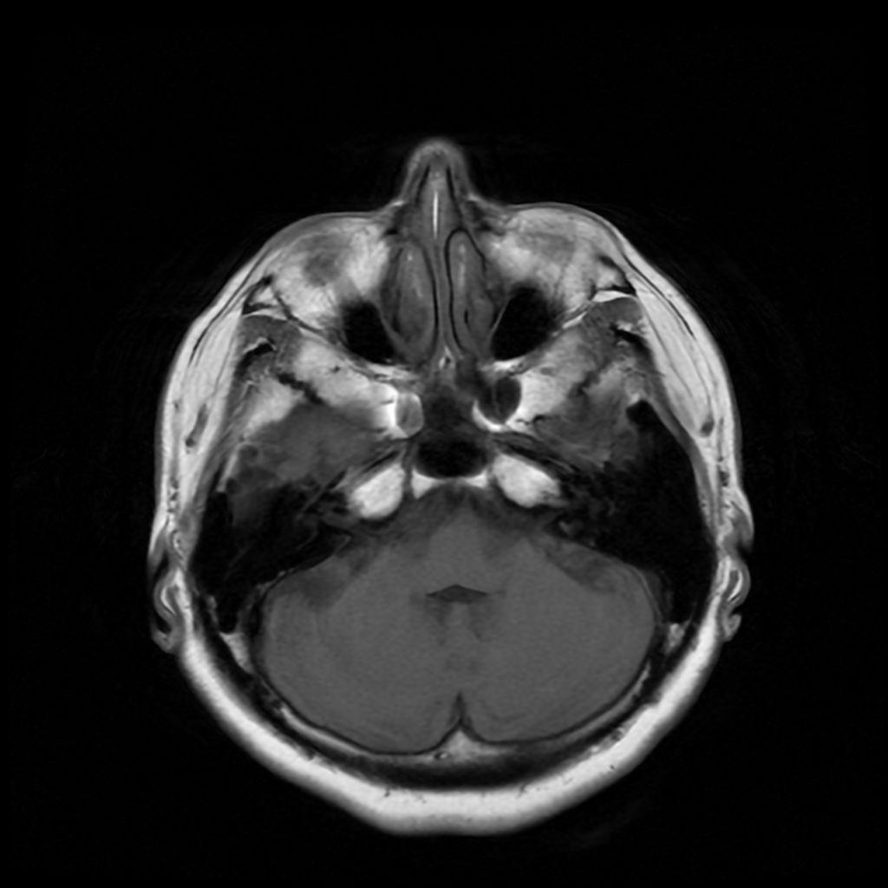
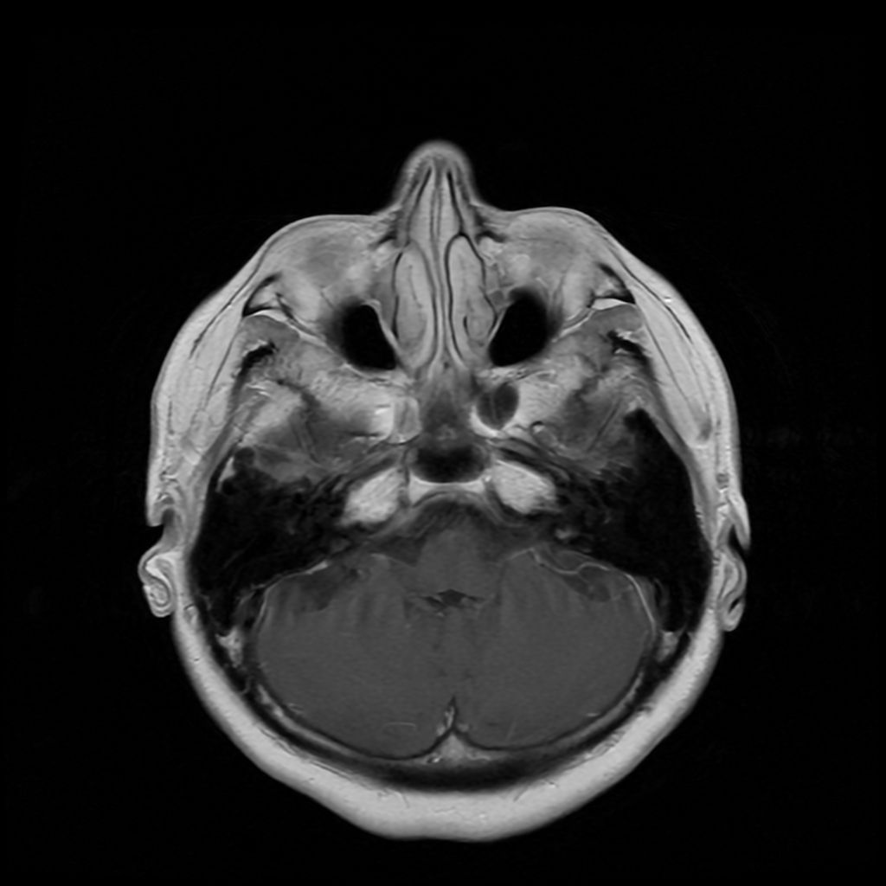
T1 Axial (Pre vs with Contrast)
7

Slide 30
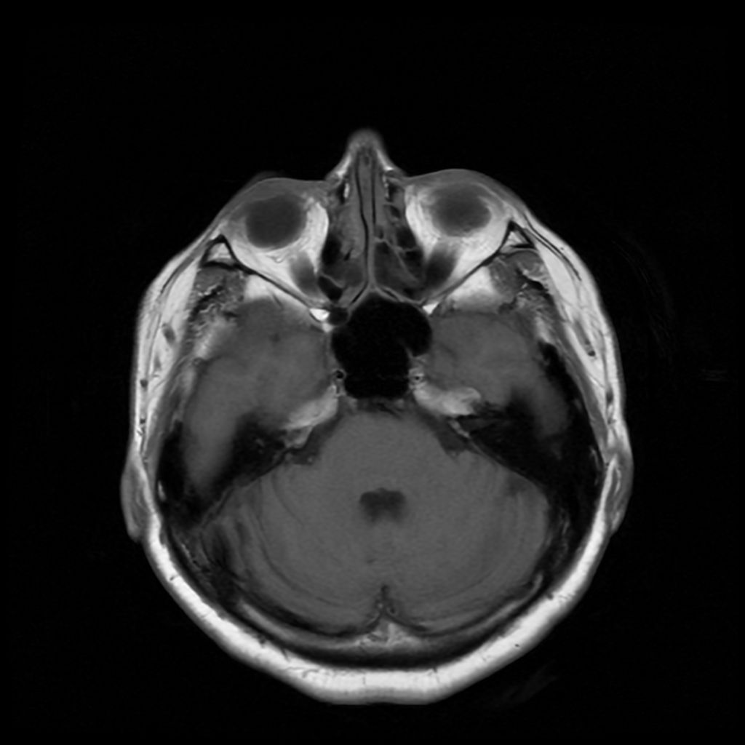
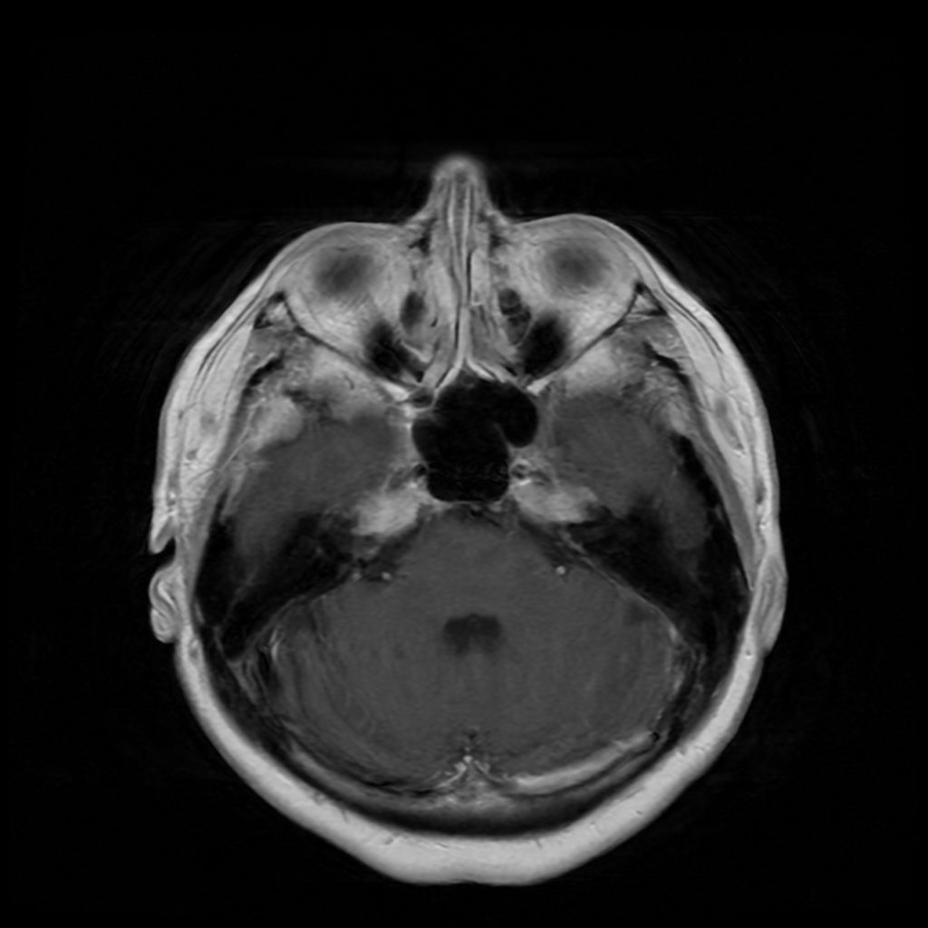
T1 Axial (Pre vs with Contrast)
8

Slide 31
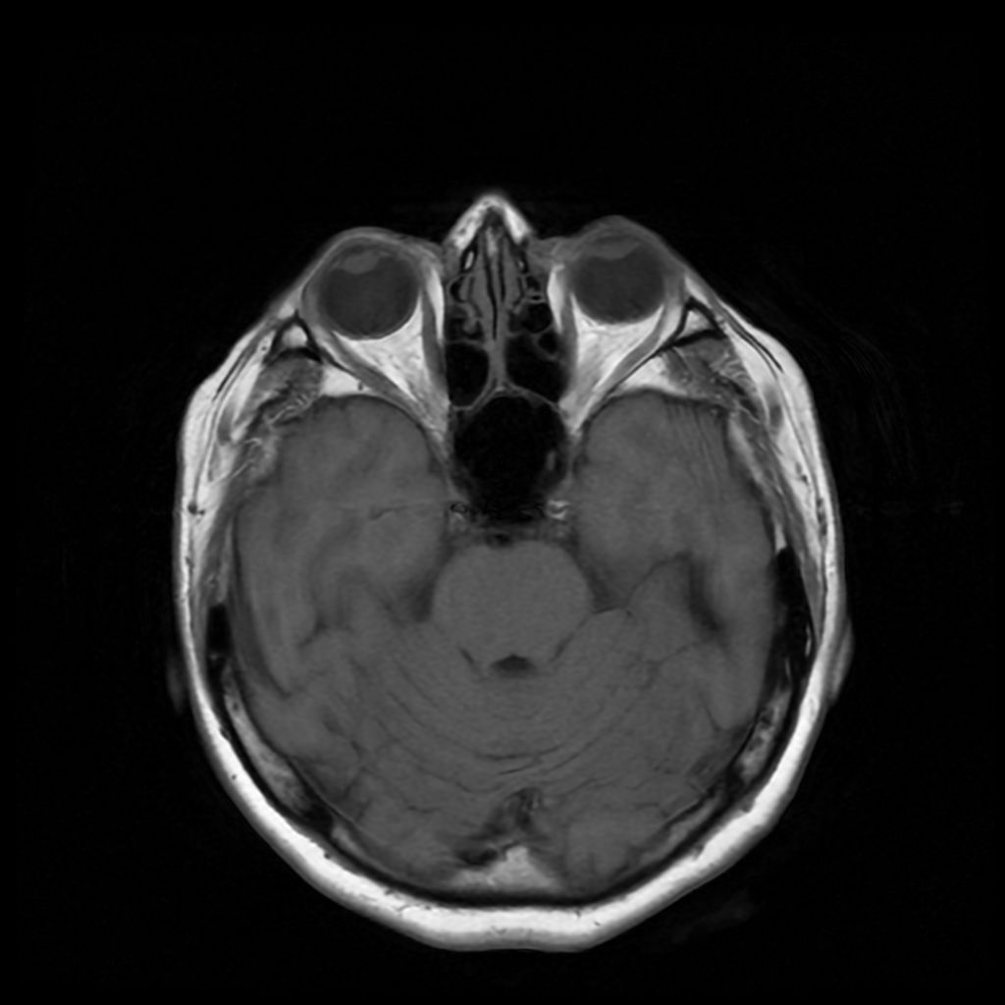
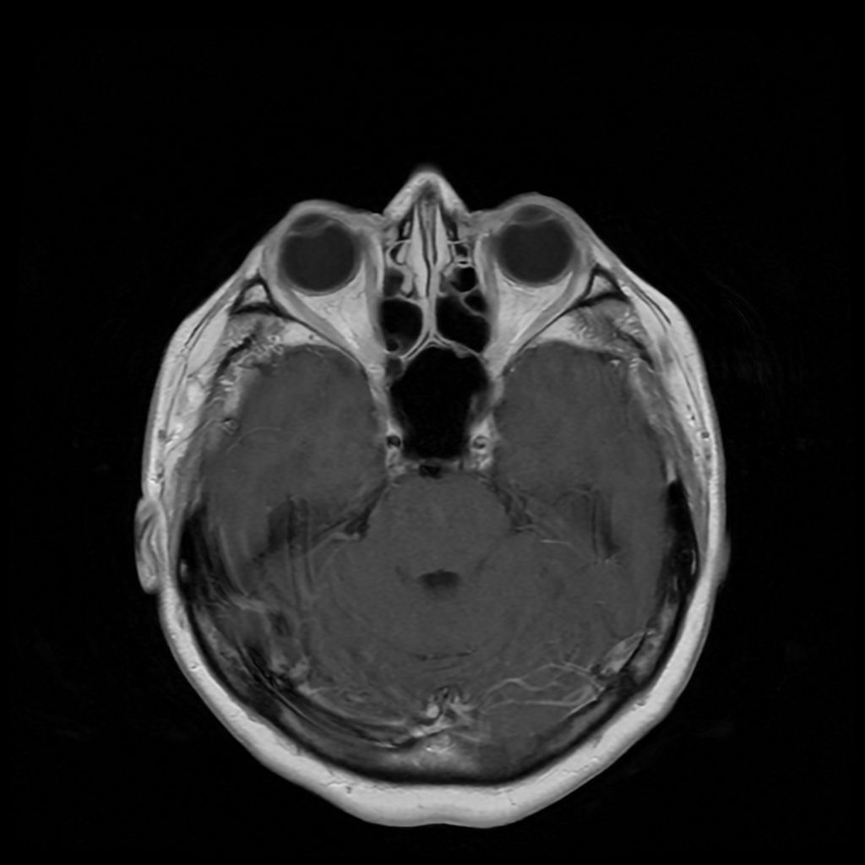
T1 Axial (Pre vs with Contrast)
9

Slide 32
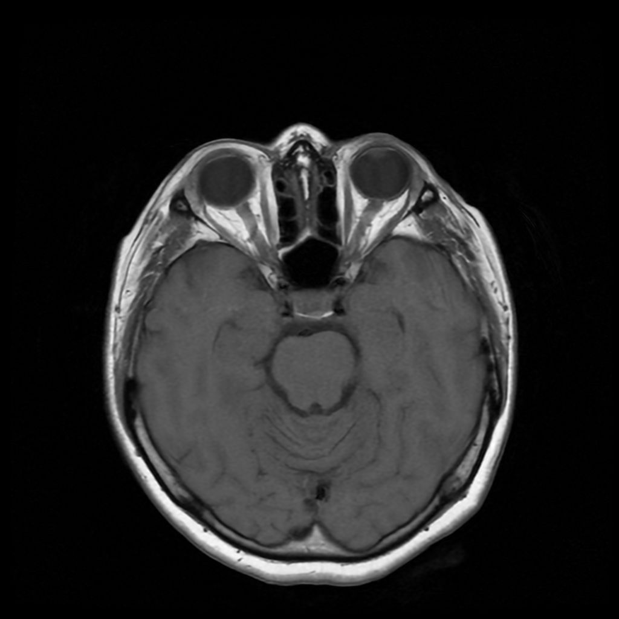
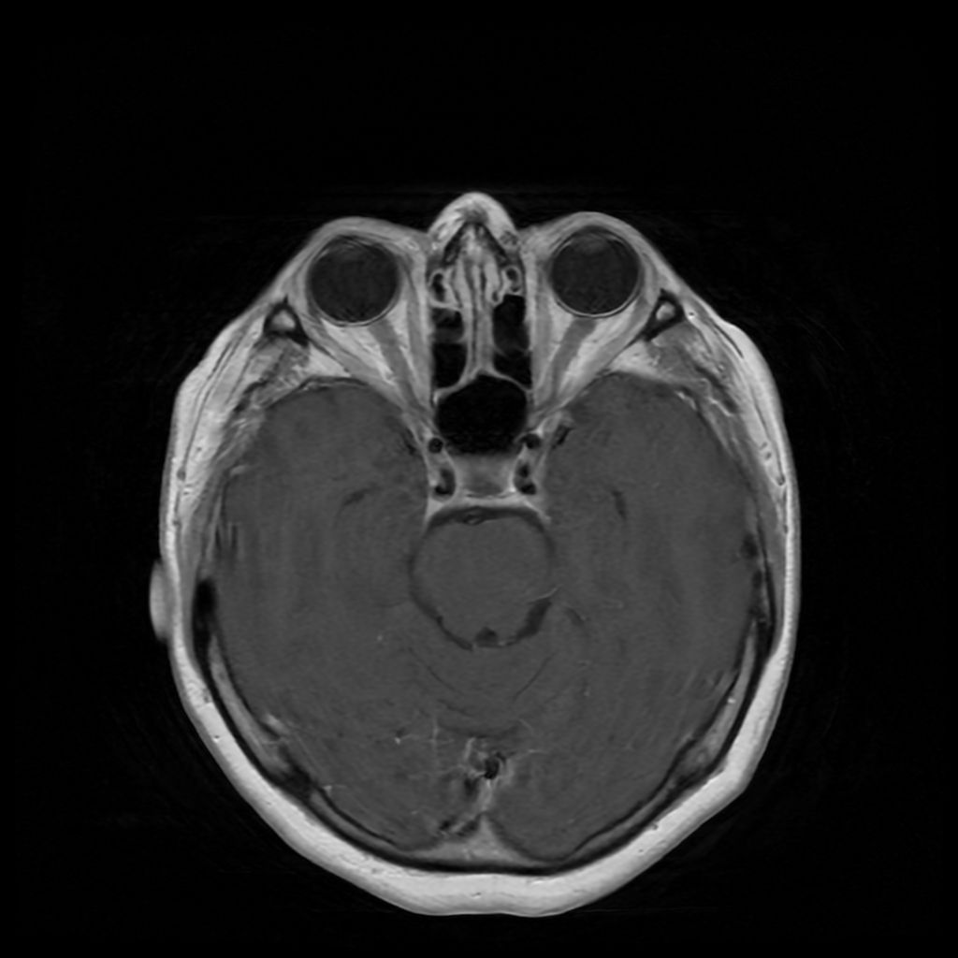
T1 Axial (Pre vs with Contrast)
10

Slide 33
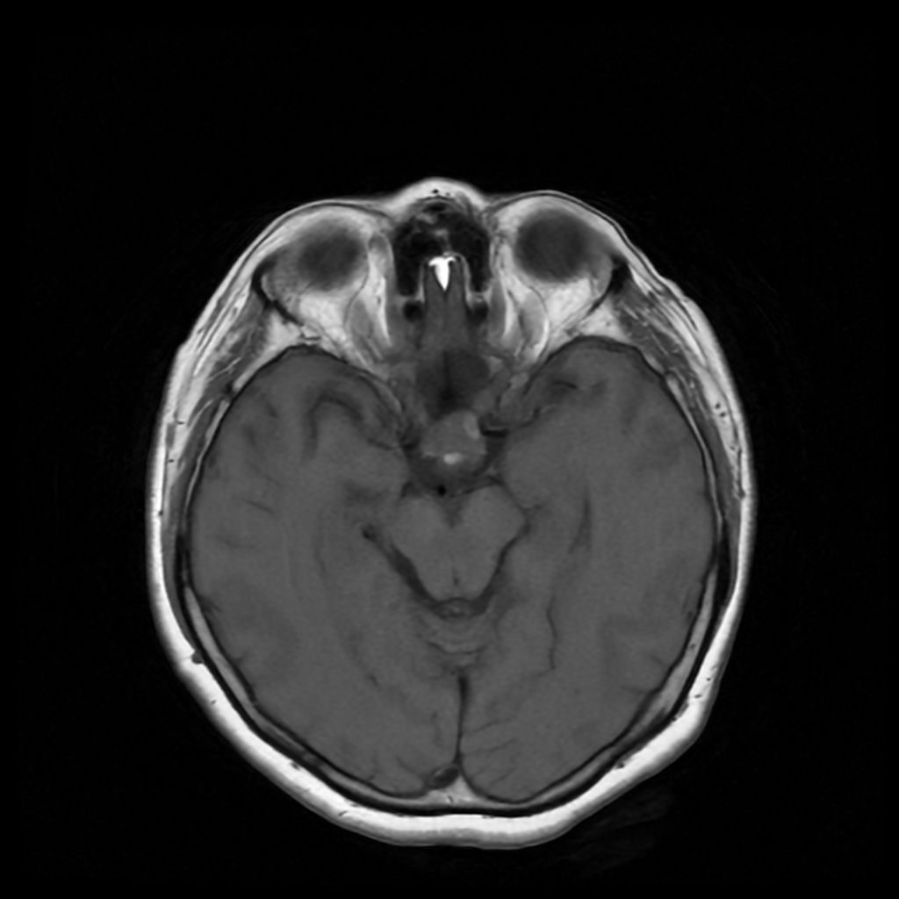
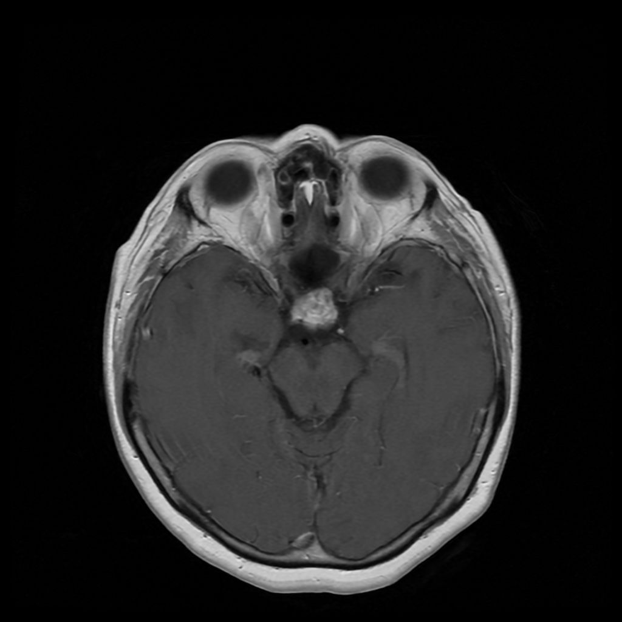
T1 Axial (Pre vs with Contrast)
11

Slide 34
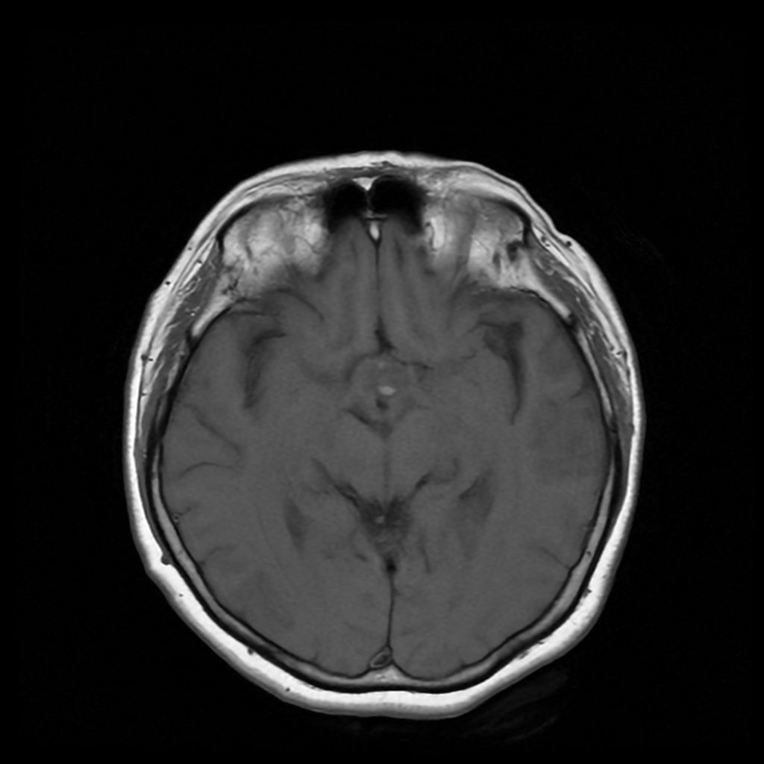
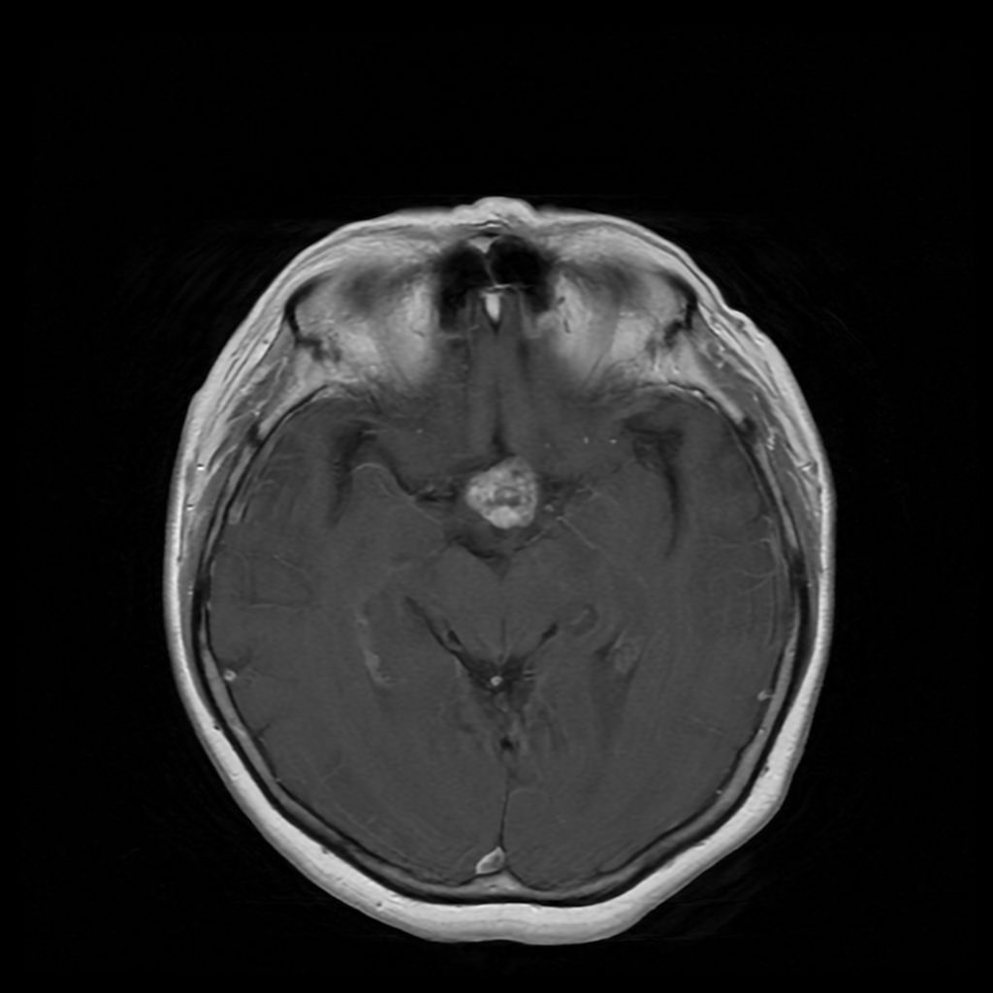
T1 Axial (Pre vs with Contrast)
12

Slide 35
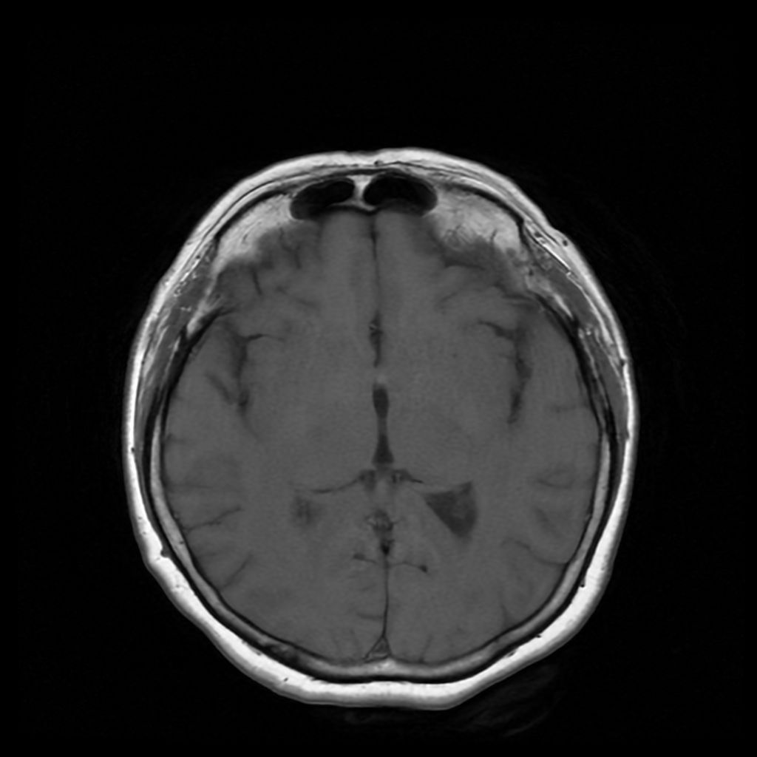
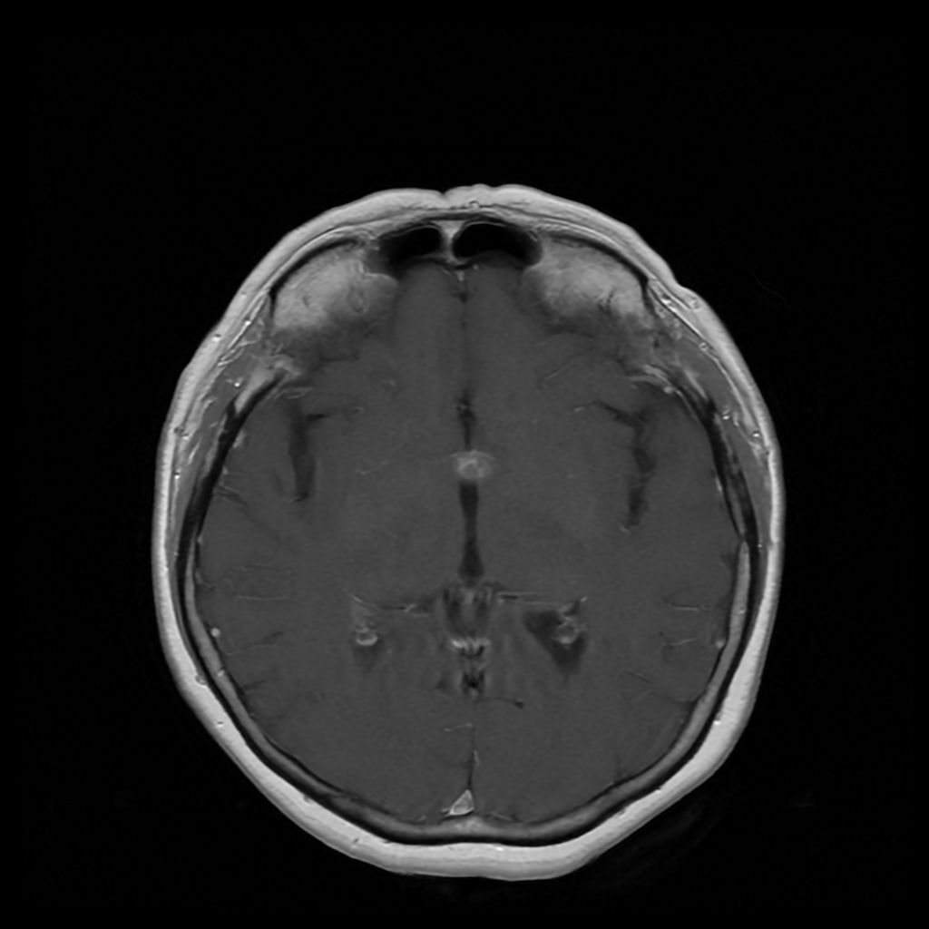
T1 Axial (Pre vs with Contrast)
13

Slide 36
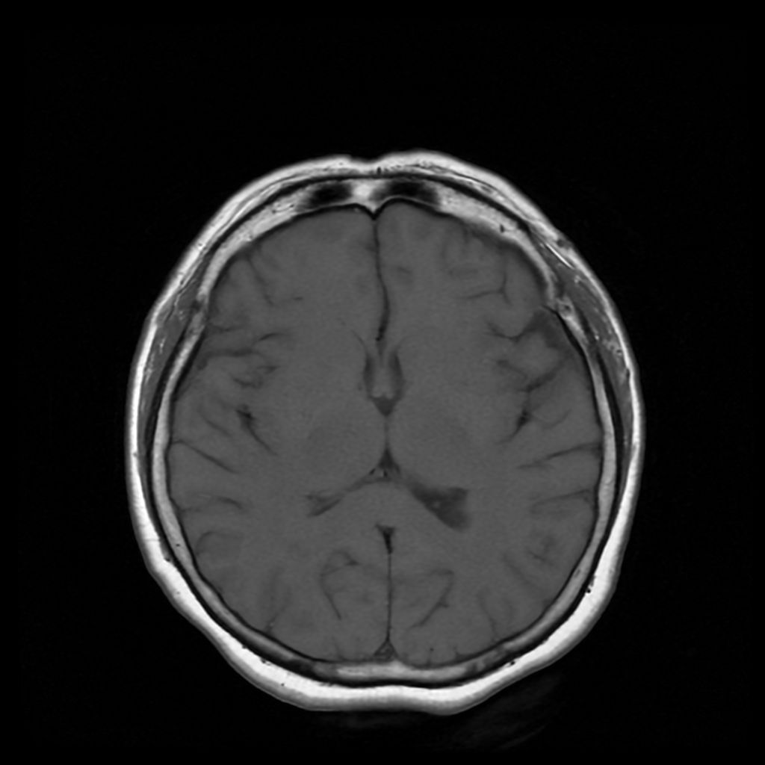
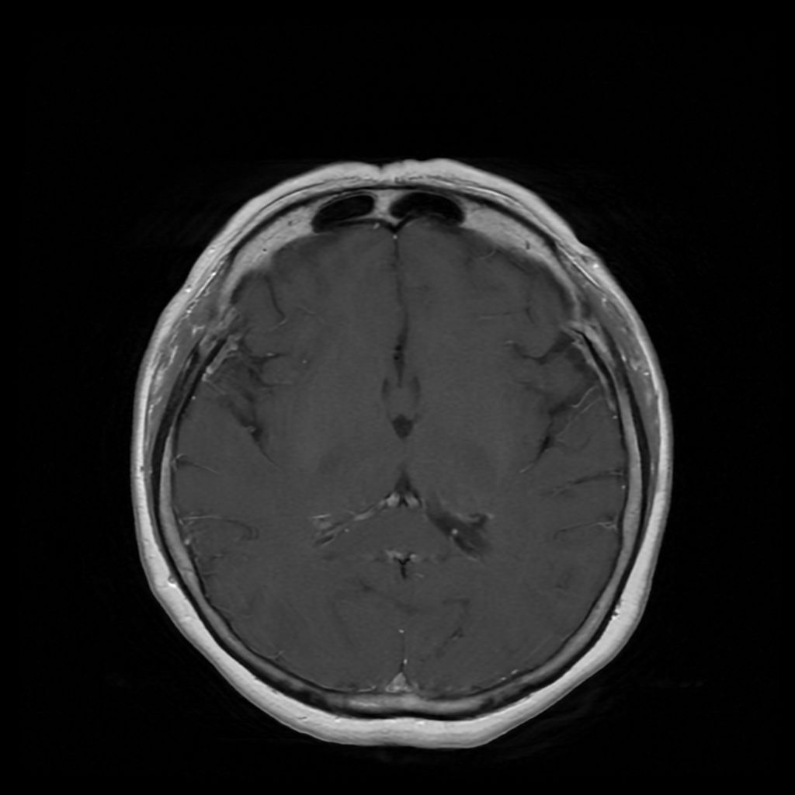
T1 Axial (Pre vs with Contrast)
14

Slide 37
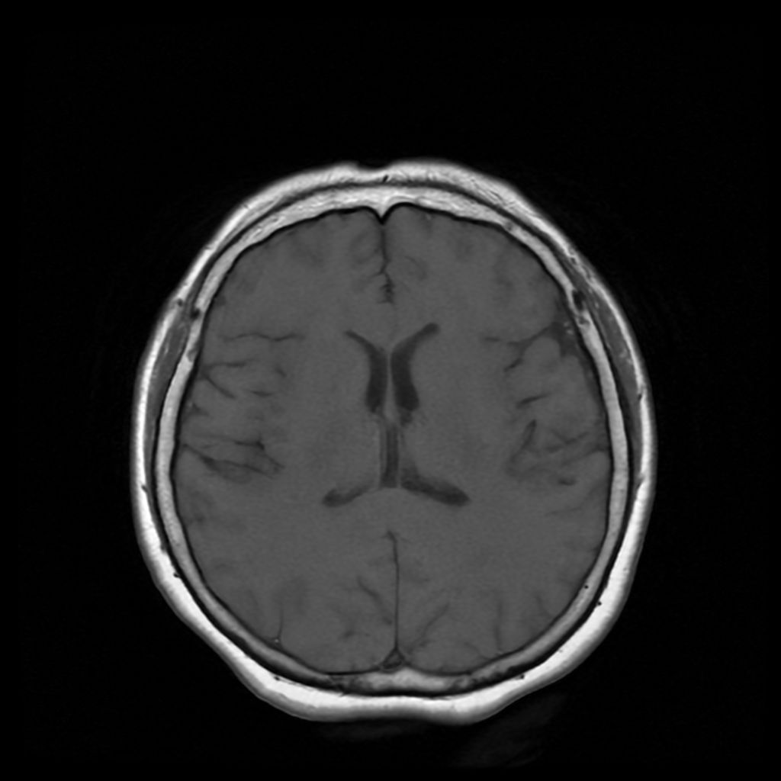
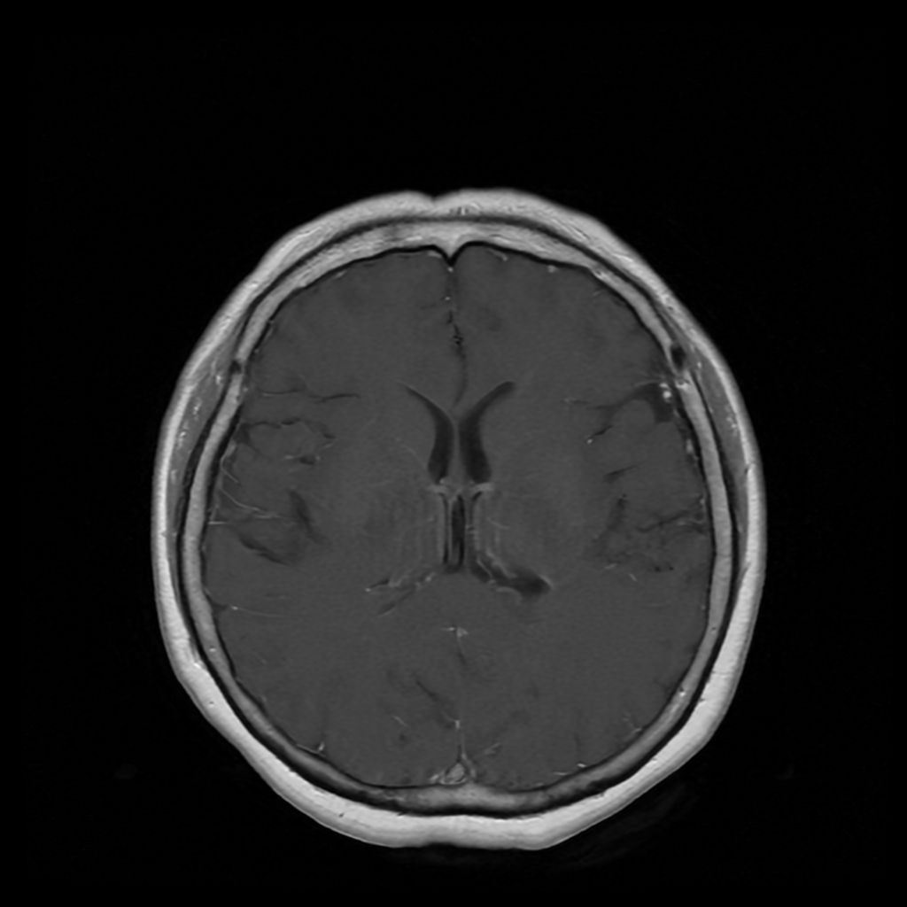
T1 Axial (Pre vs with Contrast)
15

Slide 38
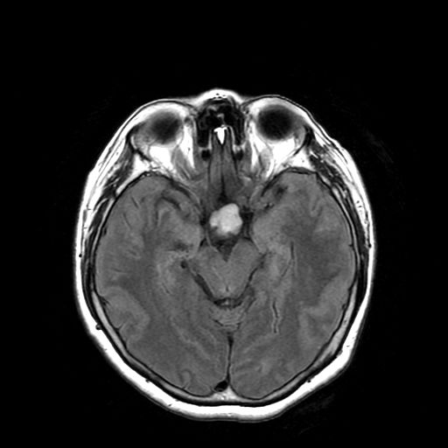
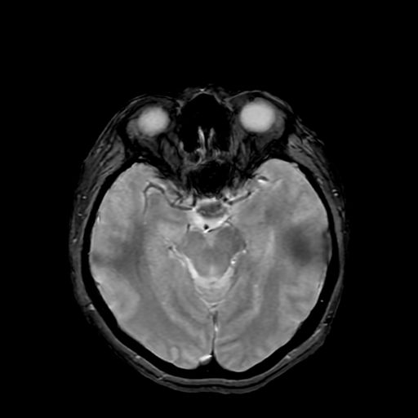
T2 FLAIR
(Suppresses CSF)
T1 Pre contrast
T1 With contrast
T2 Gradient Recalled Echo (GRE)
Sensitive to magnetic susceptibility differences making it excellent for detecting hemorrhage, calcifications, and iron deposition, which appear dark.
Notes:
GRE bottom right
Flair top right
T1 pre top left
T1 w/ contrast top left
Slide 11

Slide 39
Results and Management

Slide 40
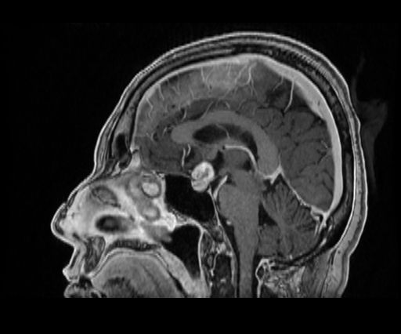
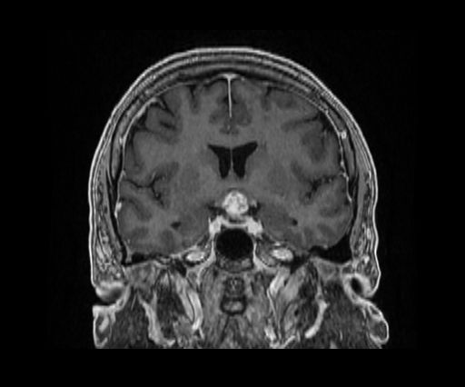
Radiometric Findings
MRI section scans: A 12x12x16 mm heterogenous mass centered on the suprasellar cistern. Pituitary gland is intrinsically unremarkable. Lesion appears to be sitting on top of the gland, effacing the stalk. Green arrow indicates the mass located superior to pituitary gland. Red arrow indicates the pituitary gland.

Slide 41
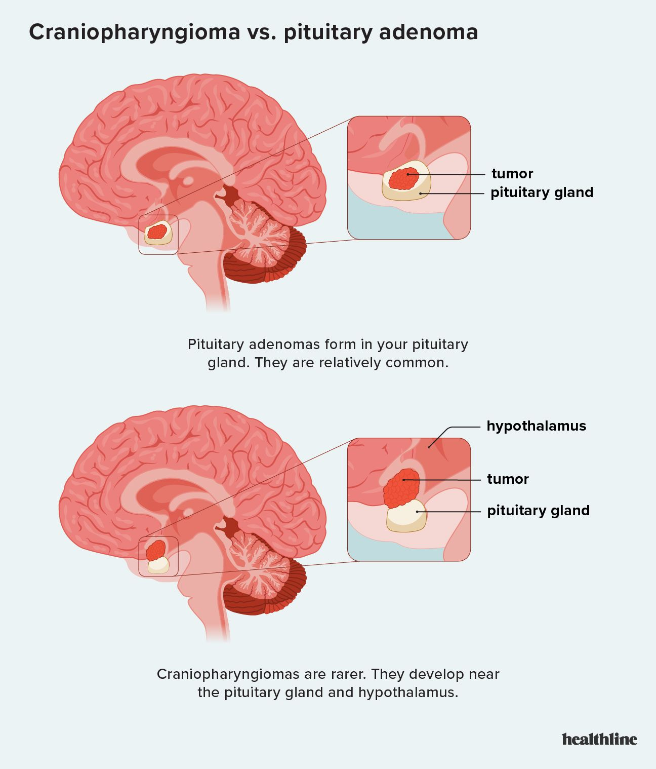
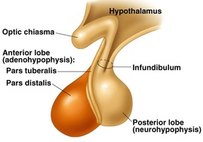
Craniopharyngioma
Craniopharyngioma
  Rare, slow growing tumor
  Two types:
  Adaminomatous: (85-95%)
    Affects kids ages 5-14, rarely adults
    Defining trait: combination of solid and cystic components, often containing calcium deposits (“calcification”)
  Papillary (5-10%)
    Almost exclusively adults
    More solid than Adaminomatous type
  Location: Sellar and Suprasellar region is most common for craniopharyngiomas
Maryam Nashi Alboqami, et al. “Craniopharyngioma: A Comprehensive Review of the Clinical Presentation, Radiological Findings, Management, and Future Perspective.”
Notes:
Craniopharyngiomas are benign, slow-growing tumors arising near the pituitary gland, believed to develop from embryologic remnants of the craniopharyngeal duct or Rathke’s pouch. These developmental remnants are remnants of the primitive mouth (stomodeum) that fail to involute properly during early fetal development. They typically form in the sellar/parasellar region.

Slide 42
Neurosurgery
Immediate referral to neurosurgery for consultation
  Prolonged growth can present with optic nerve atrophy and irreversible VF defects
Neurosurgery via a transendoscopic approach
  Puget’s Grade 0-2
    0-1: tumor is not invading/ still demarcated from hypothalamus
    2: tumor invades hypothalamus
  Lower tumor recurrence rates, better post-op visual improvement, and lower visual deterioration
Sacrificing the pituitary stalk to achieve total resection
  High risk of endocrine dysfunction without decreasing risk of recurrence
Maryam Nashi Alboqami, et al. “Craniopharyngioma: A Comprehensive Review of the Clinical Presentation, Radiological Findings, Management, and Future Perspective.”

Slide 43
Post-Surgical Care
Intraoperative pathological diagnosis was consistent with craniopharyngioma
Close neurological monitoring for possible cerebral fluid leaks, hemorrhages into the resection cavity
Hormonal deficiency management necessary
  The most common is the development of diabetes insipidus (70%).
  Children vs. adults
Recurrence very high: 39.1% in adults with a time frame of 45 months, most often at the primary site.
Maryam Nashi Alboqami, et al. “Craniopharyngioma: A Comprehensive Review of the Clinical Presentation, Radiological Findings, Management, and Future Perspective.”

Slide 44
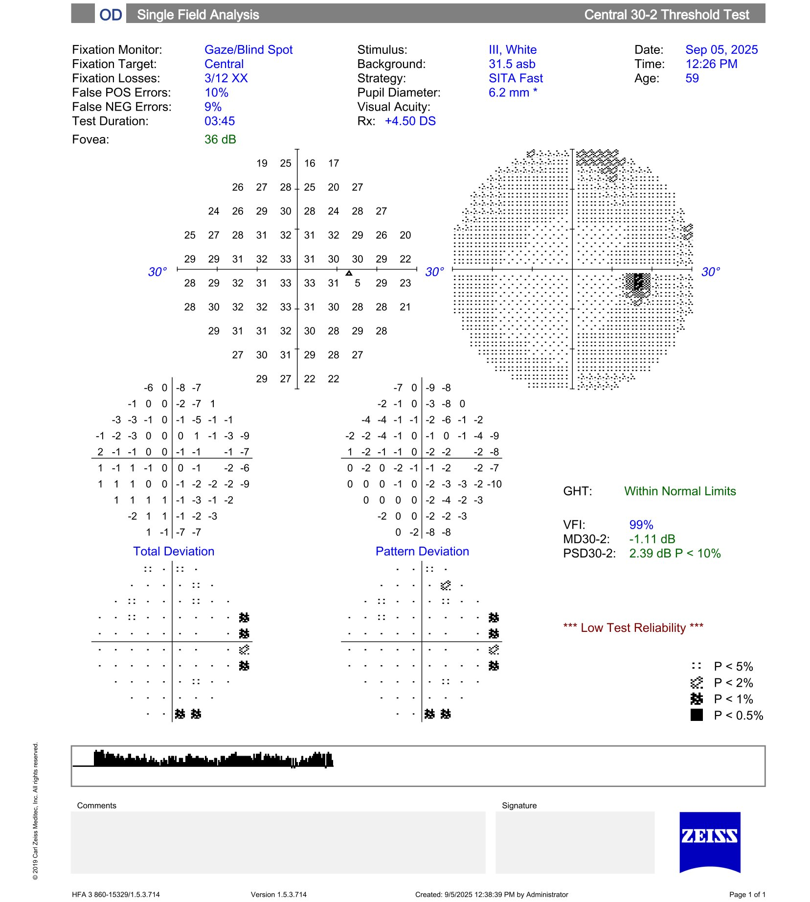
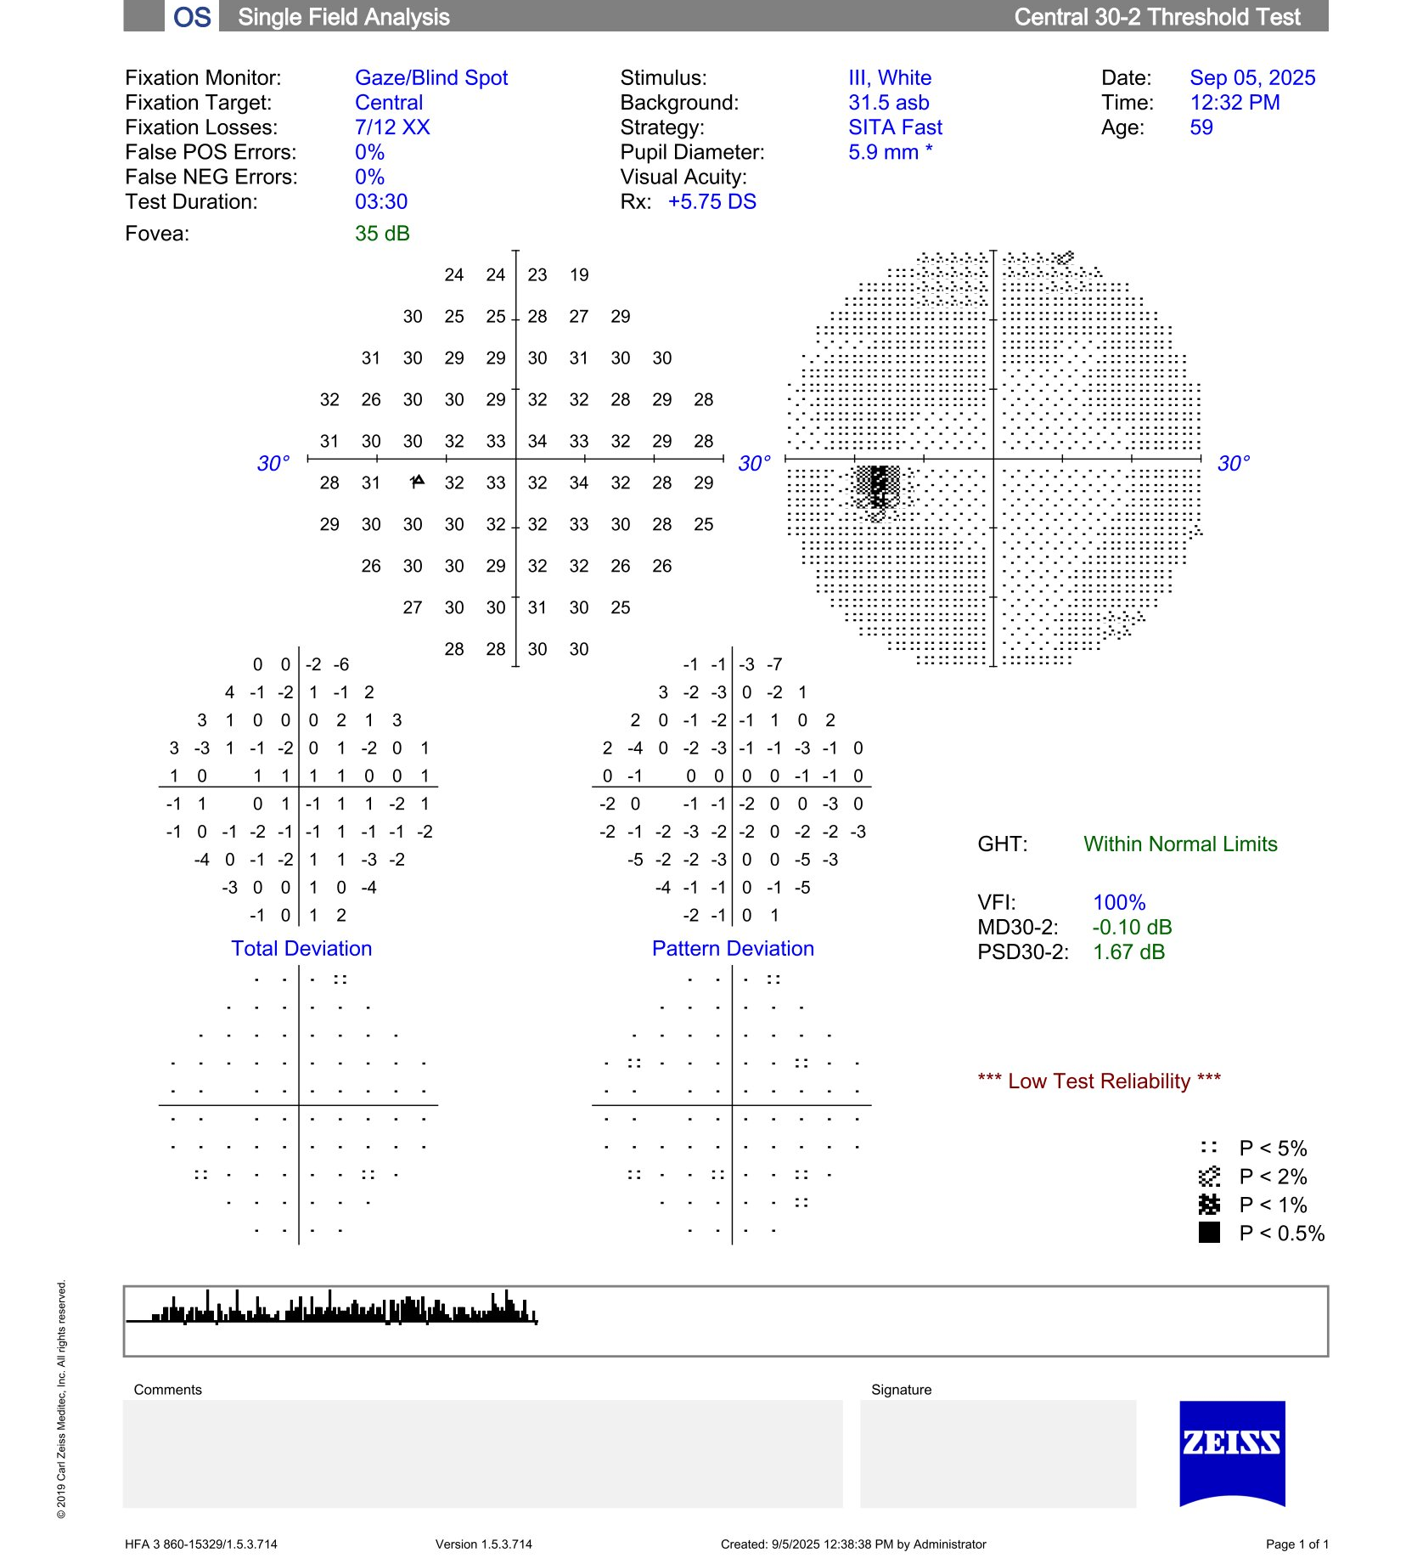
Visual Field 1-month Post-op
Great improvement of visual field findings compared to baseline

Slide 45
Clinical Pearls
Visual symptoms inconsistent with visual structural findings may have a neurological etiology
Visual field and OCT testing paramount to initial diagnosis of cranial tumors
Urgent referral to neurosurgery is required
Long-term observation and testing is mandatory given high recurrence

Slide 46
Case 2:
It’s More than Diabetes

Slide 47
Chief Complaint
37-year-old Hispanic male presents for a comprehensive eye exam. History of elevated blood sugar and blood pressure but was without insurance so was lost to follow-up and without medication for more than a year.
Left eye vision is very cloudy but still has a clear spot nasally that has been clear – reports that this has been going on for at least 4 months and the degree of blur has been increasing
Constant headaches. Pain with eye movement and perceives vision fog when he moves his eyes quickly.

Slide 48
History
MHx: Hypertension, Type 2 Diabetes (uncontrolled)
Medication: none
OHx: Myopia OU
  Seldomly wears glasses
  (2019) BCVA 20/20 OD, 20/20 OS
No FHx
No allergies
Former smoker

Slide 49
Clinical findings
BCVA:
  OD: 20/40
  OS: Hand motion
Pupils:
  OS: 2+ APD
Visual field:
  OS: general loss of visual field except for superior nasal quadrant
IOP:
  OD: 17
  OS: 16
DFE:
  OD: C/D 0.4. Deep cupping, pink. Retinal hemorrhage superior to ONH
  OS: C/D 0.55. ONH Pallor.

Slide 50
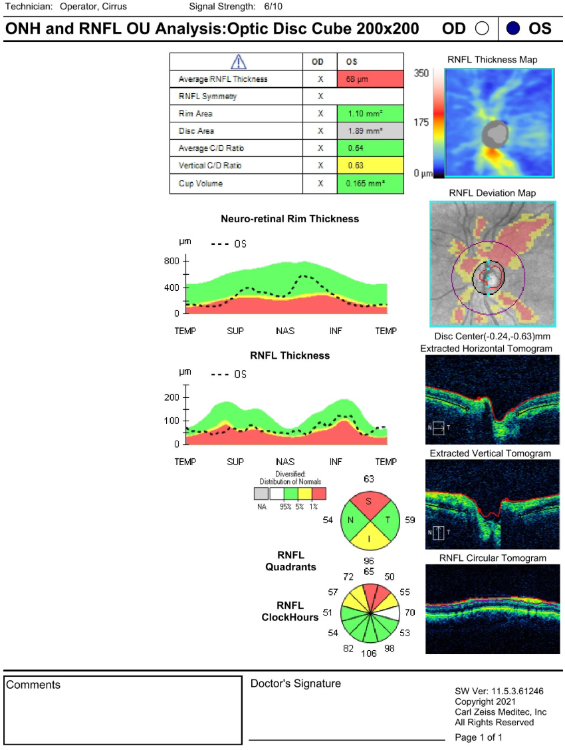
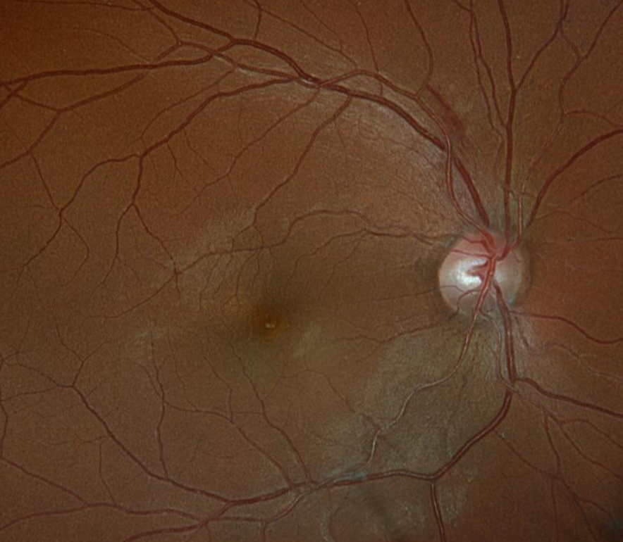

Ancillary Testing (01/15/26)
(Left) Retinal hemorrhage superior to ONH OD. Optic nerve head palor OS.
(Right) OCT-G of the left eye – decrease in RNFL thickness. Poor scans for the right eye.

Slide 51
Management (01/15/26)
Ordered blood tests:
  CBC with differential, metabolic panel, FBG, Hemoglobin A1C, Urinalysis panel
MRI:
  Brain and orbit with and without IV contrast.
Referred to neurology department at Hartford Hospital
Referred to Neuro-ophthalmology in Yale
Referred patient back to PCP
RTC in 5 days for additional testing

Slide 52



Ancillary Testing (01/20/26)
HVF 30-2 (left). Temporal hemianopia OD, devastating loss OS. Likely junctional defect
OCT-G OU (right). Decrease in RNFL OS S/N; OD WNL.

Slide 53

Blood Analysis
Test Name | Result | Reference range
Glucose | 128 (H) | 65-99 mg/dL
Hemoglobin A1C | 7.3 (H) | < 5.7%
AST | 93 (H) | 10-40 U/L
ASL | 132 (H) | 9-46 U/L
Ketones | TRACE | NEGATIVE
Protein | 1+ | NEGATIVE
Elevated blood sugar levels – referral to PCP
Elevated Aspartate aminotransferase (AST) and Alanine transaminase (ASL)
Elevated Ketones and Proteins
  Injury to liver, alcohol use, diabetes, hepatitis or exposure to hepatitis
  Cancer
Chen, Wangyang, et al. “Elevated AST/ALT Ratio Is Associated with All‐Cause Mortality and Cancer Incident.”
Giannini, E. G., et al. “Liver Enzyme Alteration: A Guide for Clinicians.”
Notes:
ALT (Alanine Aminotransferase) is an enzyme primarily found in the liver that helps convert proteins into energy. High ALT levels (typically >50 U/L for men, >40 U/L for women) indicate that liver cells are damaged, inflamed, or under stress, causing the enzyme to leak into the bloodstream. Common causes include fatty liver disease, alcohol use, viral hepatitis, or medications.

Slide 54
Red Flags?
Constant, irretractable headaches with somewhat recent initiation
Catastrophic reduction in vision and visual field in the left eye
Reduction in vision and temporal hemianopia in the right eye
Abnormal blood markers
Optic nerve atrophy OS
Retinal hemorrhage in OD

Slide 55
MRI

Slide 56

Radiometric Findings
“A large snow-man like hypointense in homogeneously enhancing tumor mass […] 4.2cm vertical, 2.8 transverse”
“Effacing the supracellar cistern and upwardly displaces the optic chiasm. “

Slide 57
Results and Management

Slide 58
Prolactinoma
Prolactinomas comprise 25-30% of all pituitary adenomas.
3x woman than in men
Three types:
  Microprolatinomas (< 10 mm in maximal diameter); most common
  Macroprolactinoma (≥ 10mm in maximal diameter)
  Giant Prolactinoma ( > 40 mm in maximal diameter)
Sporadic pathophysiology – familial cases are rare
Hyperprolactinemia
  ≠ Prolactinoma
  Must exclude pregnancy
  Drug induced hyperprolactinemia: Antipsychotic medications that block dopamine (Verapamil, metoclopramide)
  Compression due to secondary etiology – craniopharyngiomas, meningiomas, sarcoidosis (infiltrative)
Molitch, Mark E, et al. “Prolactinoma Management.”

Slide 59


Prolactinoma Treatment
Not all patients require treatment – periodic prolactin level monitor
Dopamine Agonist: Carbergoline, Bromocriptine, etc.
  Dopamine mimicker: dopamine controls how much prolactin the pituitary gland produces.
  Cabergoline 0.25mg usually first line treatment (unless rapid progression or recent tumor hemorrhage)
Visual typically starts improving within days of dopamine agonist therapy
  Must monitor with serial perimetry testing
40-50% of patients with stable prolactin levels can be tapered off cabergoline after 1-2 years
Potential side effects:
  CSF leaking due to rapid shrinking of large prolactinoma (rhinorrhea ~3.3 months)
  Pituitary apoplexy (prolactinomas more prone to bleeding; 1-6%)
  Macroprolactinoma treatment → optic chiasm herniation INTO the partial empty sella
Molitch, Mark E, et al. “Prolactinoma Management.”
Jones, Stephen, et al. “Optic Chiasmal Herniation - an under Recognized Complication of Dopamine Agonist Therapy for Macroprolactinoma.”

Slide 60
Prolactinoma Treatment Continued
Surgery:
  Nasal surgery: Transsphenoidal surgery
    Recurrence rates of 20 – 35%
  Craniotomy: large tumor affecting adjacent parts of the brain
    Fraught with complications and rarely curative
Radiation therapy usually administered when not responsive to medical or surgical treatment
GOAL:
  Normalize Prolactin levels; OR
  Levels to which gonadal/reproductive/sexual function is normalized
Follow-up schedule:
  Once normalized: monitor every 3-6 months for the first year, then every 6-12 months after.
  Visual field testing should be repeated until visual fields normalize and then do not need to be repeated (unless symptoms arise)
Notes:
Within 5 years?

Slide 61
Management (02/20/26) ~ 1 month
Testing | 01/15/26 | 02/20/26
VA OD | 20/40 | 20/40
VA OS | HM | CF@ 3ft
Pupils | 2+ OS APD | OS sluggish, no APD
Started on 0.25mg of Cabergoline 1 pill twice a week
Started on Metformin 500 mg 1 tablet PO QD by PCP
Comanaged between Neurology – PCP – Optometry – and endocrinologist
Reports left eye’s vision is getting better – spot nasally appears clearer
Will be getting a repeat MRI in mid April

Slide 62


Ancillary Testing (02/20/26)
01/15/26
02/20/26
Notes:
Talk about how this patient was given paid leave and how at this point, would you deem this patient to be safe to go back to work? No. I got him paid time off.

Slide 63

Ancillary Testing (02/20/26)
01/15/26
02/20/26
Notes:
Appears stable - Talk about how I got him some time off.
Visual field testing can show things that OCT cannot.

Slide 64


Ancillary Testing (03/31/26)
01/15/26
03/31/26
Increased cabergoline to 0.5mg 2x/week
Notes:
Talk about how this patient was given paid leave and how at this point, would you deem this patient to be safe to go back to work? No. I got him paid time off.

Slide 65
Clinical Pearls
History, history, history!
  Pregnant?
  Stressed?
Importance of blood work
Dopamine agonist typically the first line of treatment
Optic pallor and neuroplasticity
Stable: 3-6 month initial follow-ups with visual field testing, yearly as it stabilizes
Visual symptoms – may consider FMLA (up to 12 weeks, +2 if pregnant)

Slide 66
Case 3:
Seeing Cobwebs

Slide 67
Chief Complaint
First noted in 05/23/2023:
  Patient noted that her distance vision has been gradually worsening over the years. When looking at street signs, states seeing double images. There is a “fixed oval shaped visual disturbance” in her right eye, present for a couple years. Has been to 2 physicians but never received a definitive answer.
07/12/23 visit:
  Pt describes visual phenomenon as looking through “lace”.
12/19/25 visit:
  Follow-up for a optic atrophy observed in OD
  Pt still complains of constant blur in the right eye. Reports feeling like there is a film over her right eye.

Slide 68
History
MHx: Hypertension, Hypercholesteremia, Sleep apnea
Surgical history: Rotator cuff surgery
Medications: HCTZ, Lisinopril, Simvastatin, Metoprolol, AREDS BID PO
OHx:
  Diplopia OU, Subjective visual disturbance OD, Optic atrophy OD, Chorioretinal scar OD, Dry AMD OU, Hypertensive retinopathy OU, Cataracts OU, Anatomical narrow angles OU
  LPI OU
FHx:
  Diabetes, heart disease
No tobacco use
No known allergies

Slide 69
Clinical findings (12/19/25)
DVAcc:
  OD: 20/30 (no noted diplopia at this visit)
  OS: 20/40
Pupils: NO APD noted OD at this visit
FCF: WNL OD and OS. No abnormal loss noted
DFE:
  OD:
    Oval shaped circle of pigment on anterior capsule.
    Pallor, congested ONH. Small disc; pale disc, gliosis of nerve, sharp margins
  OS:
    Pallor
Something doesn’t add up…

Slide 70
Clinical findings (12/11/2024)
DVAcc:
  OD: 20/50+1, PH: NI (“Double VA”)
  OS: 20/60+, PH: 20/30
Pupils: OD (+) APD
FCF: WNL OD and OS. No abnormal loss noted
DFE:
  OD:
    Oval shaped circle of pigment on anterior capsule.
    Pallor, congested ONH. Small disc; pale disc, gliosis of nerve, sharp margins
  OS:
    Pallor
Diplopia, APD, FCF defects OD noted before…

Slide 71



Ancillary Testing
Figure 10 (Left): Optos (07/12/2023)
Figure 11 (Right): OCTG (06/20/2025)

Slide 72




Ancillary Testing
09/20/2023
12/19/2025
Pt reports worsening vision with demonstration of further constriction of VF; possible progression. Must r/o compressive lesion
Notes:
Pt reports

Slide 73
Red Flags?
Optic nerve pallor with corresponding unexplained subjective visual disturbance
(+) APD
Longstanding monocular diplopia
Enlargement and progression of visual field loss in the right eye

Slide 74
MRI

Slide 75


T1 Coronal (Pre and with Contrast)
5

Slide 76


T1 Coronal (Pre and with Contrast)
6

Slide 77


T1 Coronal (Pre and with Contrast)
7

Slide 78


T1 Coronal (Pre and with Contrast)
8

Slide 79


T1 Coronal (Pre and with Contrast)
9

Slide 80


T1 Coronal (Pre and with Contrast)
10

Slide 81


T1 COR Thin
T2 COR FS Thin
T1 COR FS + C
T1 AX FS + C
Notes:
Meningioas are generally better visualized on contrast-enhanced T1-weighted images compared to T2-weighted images because they exhibit avid, homogenous enhancement, which makes them stand out starkly against the adjacent brain parenchyma.
While T1-weighted images along (w/o contrast) usually show meningiomas as isointense, T2 also shows them as isointense to slightly hyperintense. I tis the post-contrast administration that makes T1 superior to Identification and surgical planning.

Slide 82
Results and Management

Slide 83

Radiometric Findings
“Extra-axial homogenously enhancing mass centered in the right aspect of the planum sphenoidale with involvement of the optic chiasm and extension into the right superior orbital fissure. There is a mass effect on the right clinoid and supraclinoid ICA with mild to moderate luminal narrowing”
Notes:
The patient was sent to neuro-ophthalmology for evaluation (end).

Slide 84

Meningioma
Meningiomas are the most common primary central nervous system tumors
Benign, slow growing neoplasms arising from the meningothelial (arachnoid) cells (MECs)
  Component of the pia mater, arachnoid mater, subarachnoid space.
  Provides physical barrier and acts as inflammatory mediator to CNS
Incidence of meningiomas increase with age.
Risk factors:
  IR radiation, obesity, occupational (pesticide/herbicide/diet)
  Neurofibromatosis Type 2 (NF2): >50% will develop at least one intracranial meningioma in their lifetime.
Can occur anywhere in the brain
  Most common in skull base and brain convexity
Di Muzio, Bruno. “Multiple Meningiomas and Schwannomas (NF2).”
Image from: Ogasawara, Christian, et al. “Meningioma: A Review of Epidemiology, Pathology, Diagnosis, Treatment, and Future Directions.”
Notes:
Location also differs if you have NF2, which it may occur parasagitally, near the falx cerebri – this is where the dura mater separating the two cerebral hemispheres are.

Slide 85

Presentation
World Health Organization (WHO) risk of recurrence and overall survival:
  I: 80.5%: benign histology and indolent behavior
  II and II: 17.7% and 1.7% respectively – more aggressive clinical course
Presentation is often non-specific – compression of brain structures → CN defects
  Headaches (33.3 – 36.7%), CN deficit (28.8 – 31.3%), hydrocephalus, papilledema, etc.
Lateral sphenoid meningioma
  Painless unilateral exophthalmos, followed by unilateral loss of vision
Anterior meningiomas:
  Impaired vision (54%), headache (48%), anosmia (40%), seizure (20%).
  Longstanding can cause optic atrophy
Tuberculum sellae:
  Insidious unilateral visual field loss, followed by scotomatous defects in the other eye.
Ogasawara, Christian, et al. “Meningioma: A Review of Epidemiology, Pathology, Diagnosis, Treatment, and Future Directions.”
Notes:
Anosmia = can’t smell

Slide 86
Presentation
Lateral sphenoid meningioma
  Painless unilateral exophthalmos, followed by unilateral loss of vision
Ogasawara, Christian, et al. “Meningioma: A Review of Epidemiology, Pathology, Diagnosis, Treatment, and Future Directions.”

Slide 87

Treatment
FRT, Fractionated Radiotherapy; GTR, Gross total resection; STR, Subtotal resection
5-year recurrence of WHO grade I, II, III after grade 1 GTR: 7-23%, 50-55%, and 72-78% respectively
Ogasawara, Christian, et al. “Meningioma: A Review of Epidemiology, Pathology, Diagnosis, Treatment, and Future Directions.”
Notes:
The “wait-and-see” observation approach is a common strategy used for patients with incidentally diagnosed meningiomas that are small (tumor diameter ≤3 cm) and asymptomatic. These patients are observed and followed with MRI scans until they become symptomatic or until their tumors are considered large enough to treat in order to prevent future symptoms. Some tumors will not progress. According to the European Association of Neuro-Oncology (EANO), after initial diagnosis they suggest performing a contrast enhanced MRI 6 months later to evaluate for tumor changes. If the patient remains asymptomatic, they can be followed up annually for 5 years and then every 2 years thereafter.
Surgical resection is the primary choice for symptomatic, observation failure meningiomas, or large tumors that are anticipated to causes symptoms soon. GTR can cure the majority (70–80%) of patients.
Metastasis is an exceedingly rare complication, estimated to occur in ~0.1% of meningiomas and most of which are WHO grade III. The most common sites of metastasis are lung (60%) and pleura, followed by the bone, liver, lymph nodes, and kidneys

Slide 88
Clinical Pearls
Don’t be afraid to recheck pre-testing: pupils, EOMs, VA (diplopia), FCF
Meningiomas are slow growing, usually benign tumors
Longstanding compression of the optic nerve may cause optic atrophy, increasing visual field loss
Meningiomas can be monitored
  Initial MRI → 6 months monitoring → yearly
Surgical intervention may be necessary if symptoms are present

Slide 89
Case 4
Is This Glaucoma?

Slide 90
Chief Complaint
78-year-old white female presents for a follow-up evaluation for ocular hypertension OU. She presents with blurred vision with her current correction. Using Latanoprost 1 gtt QHS OU as instructed.

Slide 91
History
MHx: h/o bronchitis, anemia, carcinoma in situ of uterine cervix, osteopenia, hypothyroidism
Surgical history: Hysterectomy, biopsy of breast, papilloma removal, Tubal ligation
Medications: Not pertinent to this case
OHx:
  Dry eye, epiretinal membrane OU, ocular hypertension OU, myopia OU, PVD OS
  Ocular surgery: PCIOL OU, s/p macular pucker surgery OD (2001)
FHx:
  Diabetes, heart disease
No tobacco use
No known allergies

Slide 92
Clinical Findings
BCVAcc:
  OD: 20/70; OS 20/20
Pupils: PERRL, (-) APD OU
IOP: 21/21→ within target
SL:
  OD: Dry eye, PCIOL, C/D: 0.2 - ONH pallor temporal
  OS: Dry eye, PCIOL, C/D: 0.2
HVF 24-2 SITA FAST:
  OD: SN scotoma – possible worsening of scotoma
  OS: INF defects – likely non specific

Slide 93
Ancillary Testing OD
07/02/2021
06/17/2022
01/21/2026

Slide 94
Red Flags?
Pallor of OD ONH
Patient is asymptomatic – insidious?
IOP 21/21 – within target
Visual field defect enhancing centrally in SN field, not extending centrally from periphery
H/o in situ carinoma of cervix
NAION, Inflammatory (e.g., Optic neuritis), compressive?

Slide 95






Let’s Think About This…
Patient sent to perform an MRI (results pending)
ERM OU with membrane peel in OD (2001)
02/05/2025
02/05/2025
12/16/2021

Slide 96


Membrane Peel Associated Visual Field Defects
Left: Akino, Kunihiko, et al. “Risk of Newly Developing Visual Field Defect and Neurodegeneration after Pars Plana Vitrectomy for Idiopathic Epiretinal Membrane.”
Right: Uemura, Akinori, et al. “Visual Field Defects after Uneventful Vitrectomy for Epiretinal Membrane with Indocyanine Green–Assisted Internal Limiting Membrane Peeling.”
Notes:
Left: post-operative visual field loss associated with membrane peel was seen prevalently. Most commonly, VF loss was nasally.
Right: post-operative visual field loss following ICG assisted ILM peel associated with visual field loss. Again, VF loss was more nasally.

Slide 97
Wrapping up

Slide 98
Conclusion
Obtain a good case history
Consider a compressive lesion etiology for unexplained visual field defects
Visual fields that do not match glaucomatous field loss should obtain an MRI
Referral to neuro-ophthalmologist, neurology, neuro-surgery, PCP, and endocrinology if findings are seen on MRI

Slide 99
Thank you

Slide 100
References
Akino, Kunihiko, et al. “Risk of Newly Developing Visual Field Defect and Neurodegeneration after Pars Plana Vitrectomy for Idiopathic Epiretinal Membrane.” The British Journal of Ophthalmology, vol. 105, no. 12, Dec. 2021, pp. 1683–1687, pubmed.ncbi.nlm.nih.gov/33020118/, https://doi.org/10.1136/bjophthalmol-2020-317478.
Chen, Wangyang, et al. “Elevated AST/ALT Ratio Is Associated with All‐Cause Mortality and Cancer Incident.” Journal of Clinical Laboratory Analysis, vol. 36, no. 5, 22 Mar. 2022, https://doi.org/10.1002/jcla.24356.
DelGiodice, Michael, and Christopher Suhr. “Neuroimaging 101 for the Optometrist.” Www.reviewofoptometry.com, 1 Oct. 2015, www.reviewofoptometry.com/article/neuroimaging-101-for-the-optometrist.
Di Muzio, Bruno. “Multiple Meningiomas and Schwannomas (NF2).” Radiopaedia, 29 Jan. 2024, radiopaedia.org/cases/multiple-meningiomas-and-schwannomas-nf2, https://doi.org/10.53347/rID-40356'.
Gai, Dayu. “Left Orbital Floor Fracture with Herniation.” Radiopaedia.org, 14 Feb. 2015, radiopaedia.org/cases/orbital-floor-fracture-with-herniation?lang=gb, https://doi.org/10.53347/rid-32046. Accessed 8 May 2025.
Ganapathy, Muthu Kuzhali, and Prasanna Tadi. “Anatomy, Head and Neck, Pituitary Gland.” PubMed, StatPearls Publishing, 2020, www.ncbi.nlm.nih.gov/books/NBK551529/.
Giannini, E. G., et al. “Liver Enzyme Alteration: A Guide for Clinicians.” Canadian Medical Association Journal, vol. 172, no. 3, 1 Feb. 2005, pp. 367–379, www.ncbi.nlm.nih.gov/pmc/articles/PMC545762/.
Jones, Stephen, et al. “Optic Chiasmal Herniation - an under Recognized Complication of Dopamine Agonist Therapy for Macroprolactinoma.” Clinical Endocrinology, vol. 53, no. 4, 1 Oct. 2000, pp. 529–534, https://doi.org/10.1046/j.1365-2265.2000.01039.x. Accessed 29 Aug. 2023.
Lever, Mael, et al. “Orbital Aspergillosis: A Case Report and Review of the Literature.” BMC Ophthalmology, vol. 21, no. 1, 8 Jan. 2021, https://doi.org/10.1186/s12886-020-01773-7.
Maryam Nashi Alboqami, et al. “Craniopharyngioma: A Comprehensive Review of the Clinical Presentation, Radiological Findings, Management, and Future Perspective.” Heliyon, vol. 10, no. 11, 31 May 2024, pp. e32112–e32112, www.sciencedirect.com/science/article/pii/S240584402408143X, https://doi.org/10.1016/j.heliyon.2024.e32112.
Molitch, Mark E, et al. “Prolactinoma Management.” Nih.gov, MDText.com, Inc., 30 Sept. 2018, www.ncbi.nlm.nih.gov/books/NBK279174/.
Ogasawara, Christian, et al. “Meningioma: A Review of Epidemiology, Pathology, Diagnosis, Treatment, and Future Directions.” Biomedicines, vol. 9, no. 3, 21 Mar. 2021, p. 319, www.ncbi.nlm.nih.gov/pmc/articles/PMC8004084/, https://doi.org/10.3390/biomedicines9030319.
“Optic Nerve, Visual Pathways, Oculomotor System, and Consequences of Intracranial Injury.” Ento Key, 12 July 2017, entokey.com/optic-nerve-visual-pathways-oculomotor-system-and-consequences-of-intracranial-injury/.
Rodriguez-Beato, Freddie Y., and Orlando De Jesus. “Compressive Optic Neuropathy.” PubMed, StatPearls Publishing, 2022, www.ncbi.nlm.nih.gov/books/NBK560583/.
“Sagittal Section through the Sella Turcica | MedLink Neurology.” MedLink Neurology, 2021, www.medlink.com/media/hypodl3. Accessed 16 Mar. 2026.
Townsend, Kelly A., et al. “Clinical Application of MRI in Ophthalmology.” NMR in Biomedicine, vol. 21, no. 9, Nov. 2008, pp. 997–1002, www.ncbi.nlm.nih.gov/pmc/articles/PMC2912145/, https://doi.org/10.1002/nbm.1247.
Uemura, Akinori, et al. “Visual Field Defects after Uneventful Vitrectomy for Epiretinal Membrane with Indocyanine Green–Assisted Internal Limiting Membrane Peeling.” American Journal of Ophthalmology, vol. 136, no. 2, 1 Aug. 2003, pp. 252–257, https://doi.org/10.1016/s0002-9394(03)00157-0. Accessed 22 Nov. 2023.

