Slide 1
Pain Management for the Optometrist
By: Susan Janik, OD

Slide 2
Disclosures
Speaker for EyePromise
Ad Board for Tarsus Pharmaceuticals
Contact Info: Susan Janik, OD SJanik@SolinskyEyeCare.com

Slide 3
Objectives
To discuss the opioid crisis in the United States and how to properly prescribe pain medication in the case of ocular pain.

Slide 4
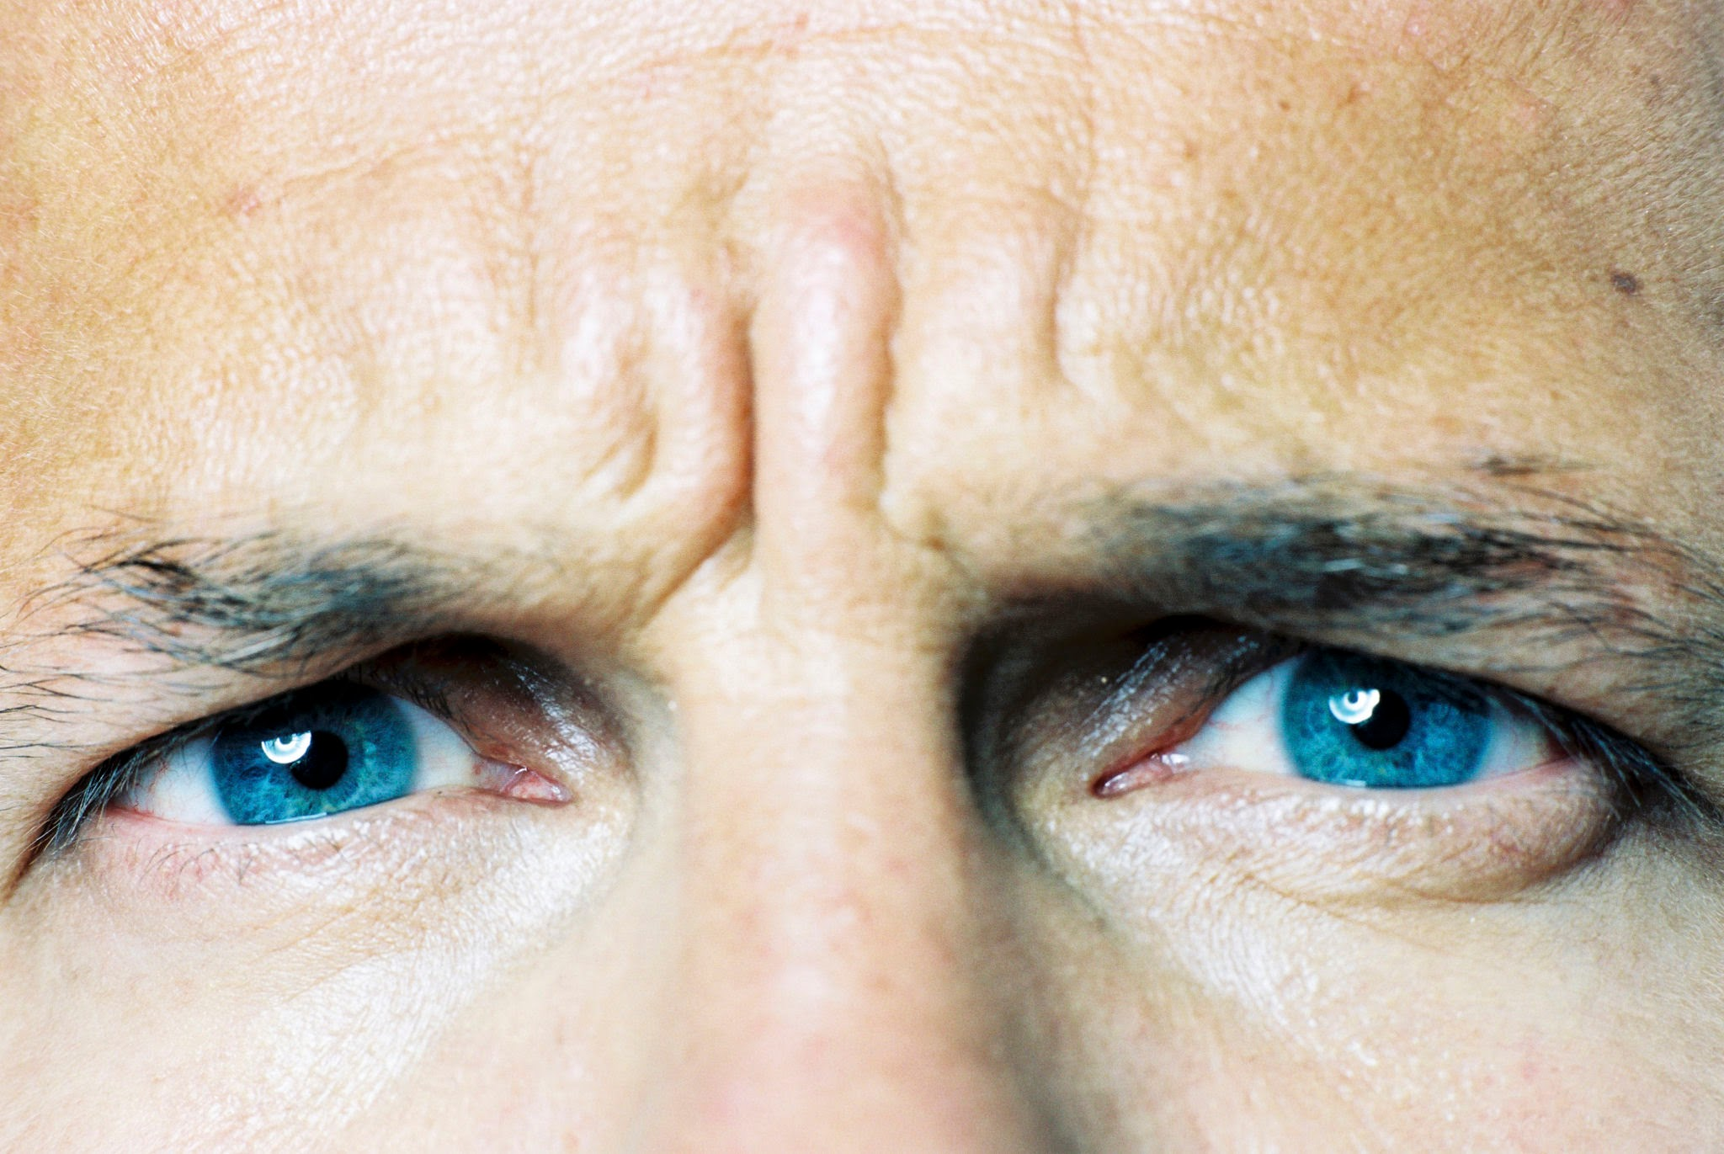
PAIN in the EYE
Intraocular Pain
  Injury
  Inflammatory
  Neuropathic from proximal nerve damage
  Infection
Retrobulbar Pain
  Inflammatory
  Infection
  Injury
  Neuropathic from proximal nerve damage

Slide 5
How Many Rx’s?
American Academy of Optometrist in 2021
Opioid Prescribing Patterns of Optometrist in the Medicare Part D Database
Results:
26,477 optometrist in the CMS database from 2013-2017 of which 5.9% prescribed opioids and of those, about 6 were written by them on average. The most, 24 per year.

Slide 6
Doctors of optometry applying for DEA license after 2023 will need must attest to 8hrs of education and training requirement for substance abuse identification and treatment.

Slide 7
Would we Ever Need to Rx Opioids?
Probably not!

Slide 8
Opioid Epidemic
In the US
  Opioids are a major contributor to drug overdose deaths, accounting for nearly 80% of all overdose fatalities in recent years. In 2023, approximately 80,000 of the 105,000 drug overdose deaths involved opioids, highlighting the severity of the opioid crisis. (WHO, CDC)
  217 people die PER DAY of opioid related overdose
  Around 75% of new heroin users used a prescription opioid before trying heroin

Slide 9
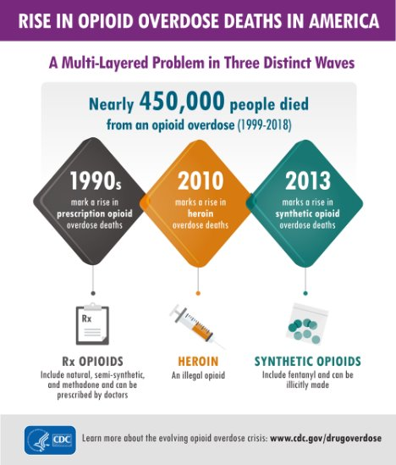
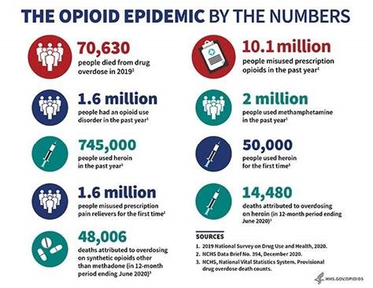
In the US 1999-2014
Ages: 25-54 highest death rate
Mostly White Men

Slide 10
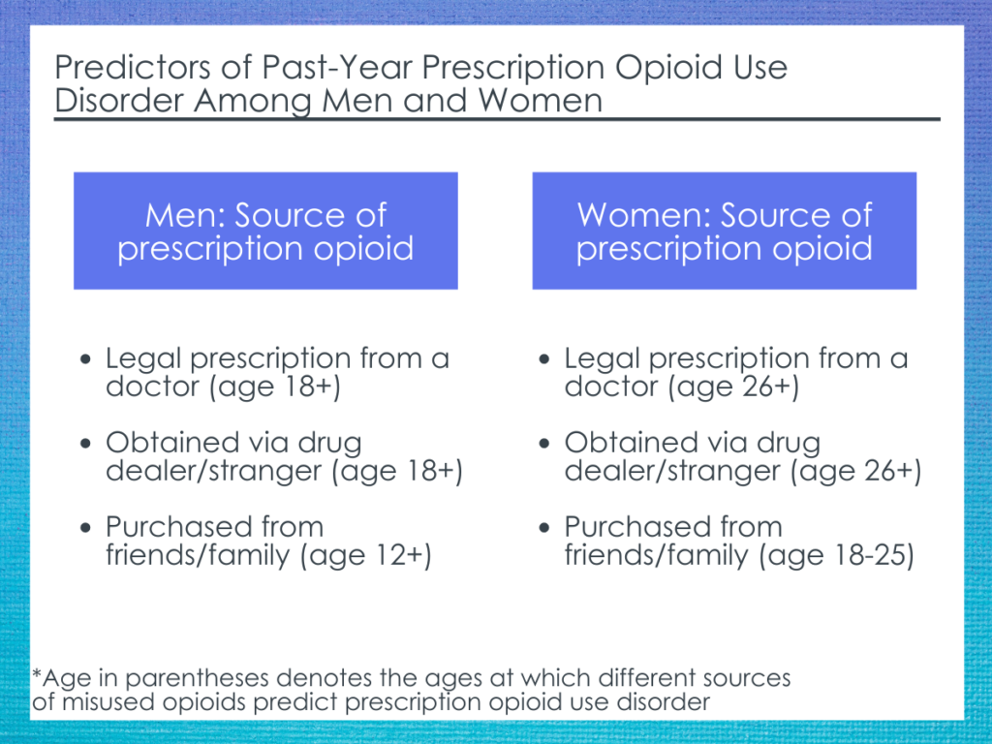
www.recoveryanswers.org

Slide 11
Opioid Epidemic
2017, HHS gave five priorities to address opioid crisis:
  Better Data
  Targeting of overdose-reversing drugs
  Better addiction, prevention, treatment, and recovery services
  Better research on pain and addiction
  Better practices for pain management

Slide 12
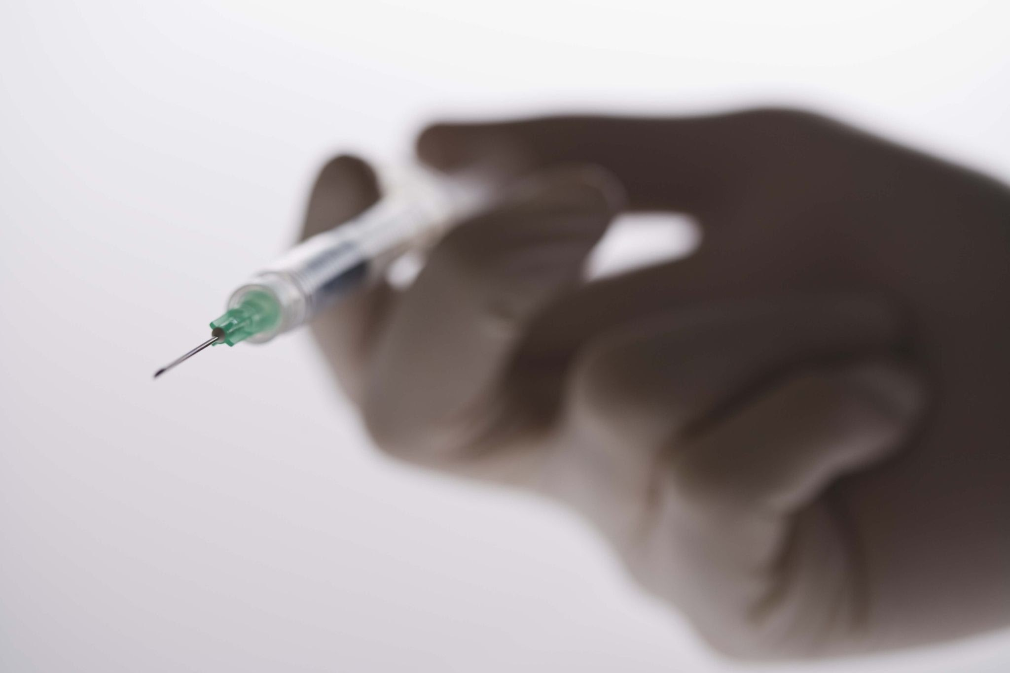
INFECTIOUS CONSEQUENCES OF THE OPIOID EPIDEMIC
• HIV
• Hepatitis C
• Hepatitis B
• Endocarditis
• Skin, bone, and joint infections

Slide 13
What IS PAIN?
The International Association for the Study of Pain (IASP) defines pain as:
  “An unpleasant sensory and emotional experience associated with, or resembling that associated with, actual or potential tissue damage.”
75 million suffer from chronic pain
⅓-½ require daily pain management

Slide 14
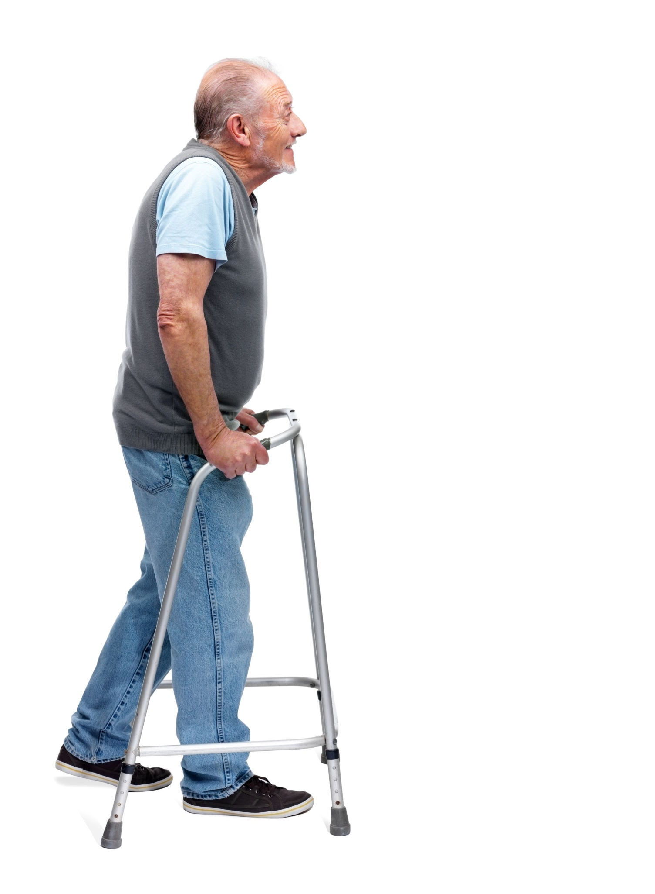
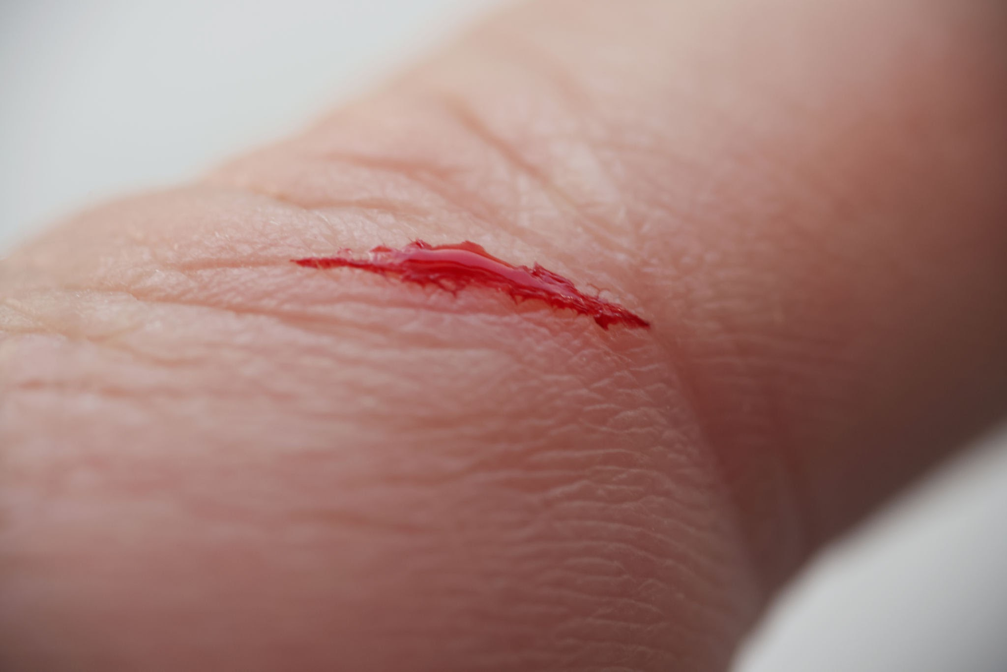
ACUTE vs. CHRONIC Pain
Acute pain is short-lived, usually lasting minutes to a few months, while chronic pain lasts for three months or more:
  Acute pain happens quickly and goes away when there is no cause
  Chronic pain lasts longer than 3-6 months and can even continue when the injury or illness has been treated

Slide 15
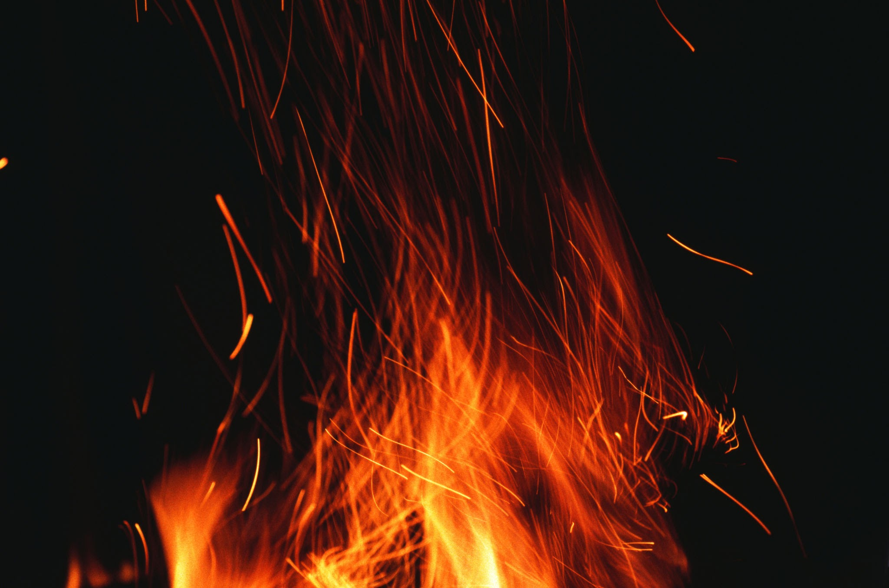
TYPES of PAIN
Pain–What Does it DO?
  Anxiety
  Tachycardia
  Systemic Hypertension
  Tachypnea
  Insomnia
  Unable to follow treatment plan

Slide 16
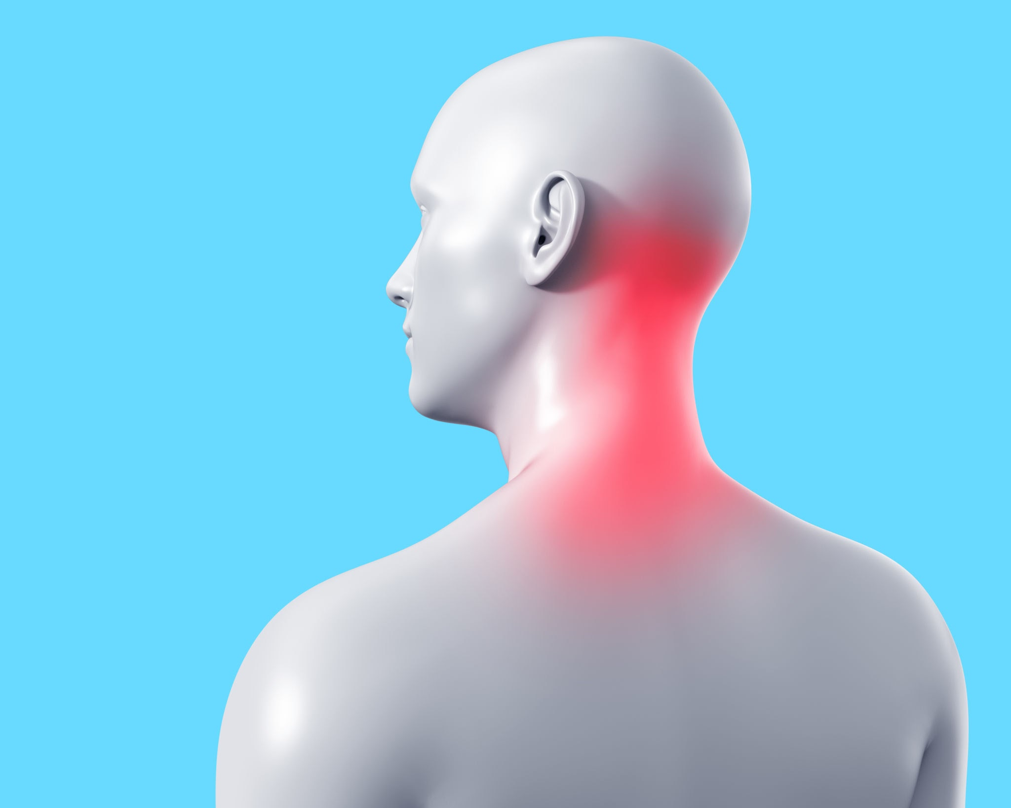
PAIN
Inflammation helps heal - but causes pain
Inflammatory pain:
Nociceptive pain → inflammatory mediators activate and sensitize nociceptors

Slide 17
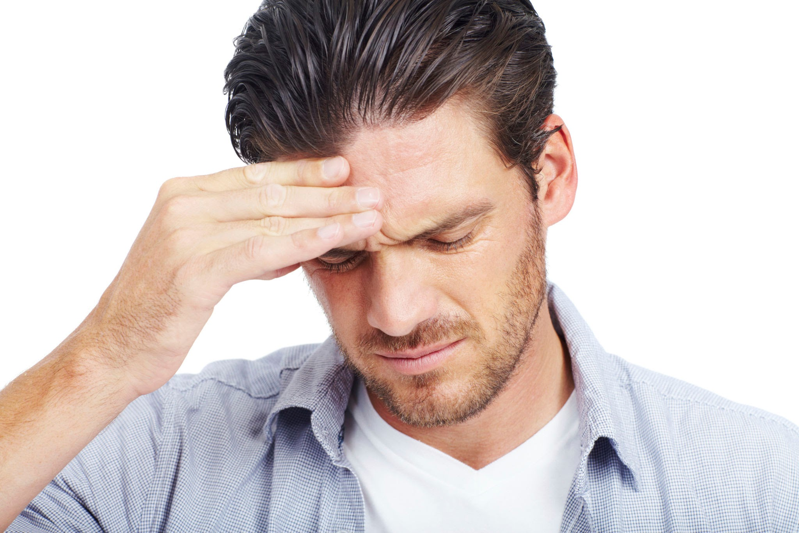
Pain
  Cell membrane damage → release of arachidonic acid → release of pro-inflammatory factors (COX) and lipoxygenase → release of prostaglandins and leukotrienes → lead to pain, swelling, redness, heat, platelet aggregation, and bronchoconstriction

Slide 18
Analgesics
Peripheral Acting
  Block peripheral nociceptors (pain receptors) from sending a signal
    NSAIDs
Anesthetics
  Block transmission from nociceptors to central opioid receptors → Interrupt messenger signaling between CNS and Peripheral nerves (proparacaine)

Slide 19
Analgesics
Central Acting
  Narcotics
  Acetaminophen
  NSAIDs
Directly block central opioid pain receptors - changes how you perceive and react to pain

Slide 20
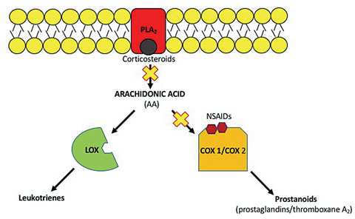
NSAIDs and Steroids
https://www.reviewofoptometry.com/article/antiinflammatories-sort-out-your-many-steroids-and-nsaids

Slide 21
Opioids and Pain
Endorphins are naturally occurring opioid neuropeptide neurotransmitters (messengers) produced in brain and pituitary glands
  Released in response to pain
  Neuroendocrine regulation
  Laughter
  Stress
  Exercise
  Breathing difficulty to produce analgesia
  Cardiovascular changes
Structurally similar to endorphins
https://www.ncbi.nlm.nih.gov/pmc/articles/PMC4432221/#:~:text=The%20majority%20of%20these%20cold,13%E2%80%A2%E2%80%A2%2C%2018%5D.

Slide 22
Recent Federal Laws
Anti-Drug Act (1986) - Regan
  Established 29 new mandatory minimums for drug offenses
  Started the D.A.R.E. program
  Drug convictions increase tremendously
Fair Sentencing Act (2010) - Obama
  Eliminated mandatory minimum for simple possession of crack cocaine
President Trump in 2025, reclassified marijuana from a Schedule 1 to a Schedule 3 drug, which allows for greater research in potential medical use, but does not legalize it for recreational use.

Slide 23
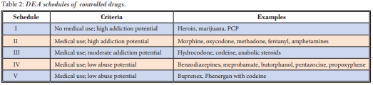
Schedule I
  No current accepted medical use in US with high potential for abuse
  Production, possession and supply limited to research - no one can lawfully possess Schedule 1 unless they obtain a rare, special licence.
  December 2025–Marijuana moved from Schedule 1 to Schedule 3

Slide 24
Drug Scheduling
Schedule II - NO REFILLS + Quantity Rx’ed limited to treat condition
  Has accepted medical use in US but HIGH potential for abuse
    May lead to severe psychological and/or physical dependence
  Most opioids and stimulants are classified schedule II

Slide 25
Schedule II
  Narcotic examples (q4-6 hours)
    Oxycodone, Hydrocodone, Fentanyl, Methadone
    Vicodin → Hydrocodone + Acetaminophen
    Lortab → Hydrocodone + Acetaminophen
    Dilaudid, Dilaudid, Percocet, Percodan
  IIN/2N - Stimulants (mainly for ADHD)
    Amphetamine, Methylphenidate

Slide 26
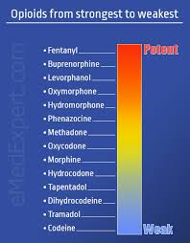
www.publichealth.com

Slide 27
Schedule III
  Low-Moderate risk of physical dependence and High risk of psychological dependence
  May not be filled or refilled more than 6 months after Rx date OR refilled more than 5 times, whichever comes first
    Codeine (<90mg per dose unit)
    Tylenol 3
      Codeine 30mg or 60mg + Acetaminophen 300mg
        Combination MOA of two analgesics leads to enhanced pain control
        Codeine → more nausea vs other narcotics

Slide 28
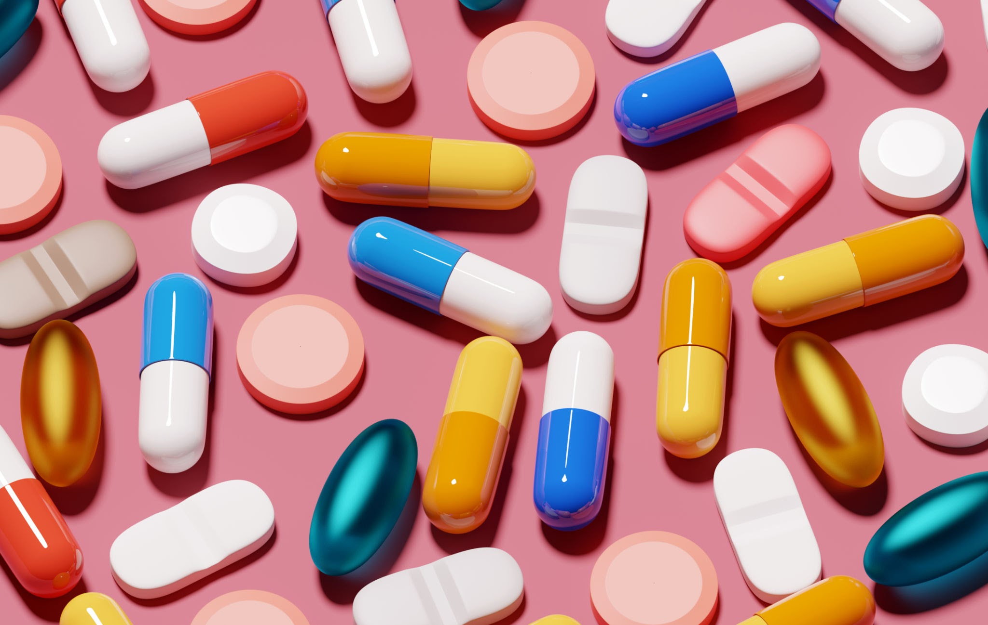
Schedule III
  Non-narcotic
    Ketamine
    Anabolic steroids
    Benzphetamine
    Testosterone

Slide 29
Drug Scheduling
Schedule IV
  Low potential for abuse and dependence
  Sedative + Anti-Anxiety medications like benzodiazepines
    Opioids
      Tramadol (Ultram)
      Darvon and Darvocet (propoxyphene) - recalled due to fatal heart problems

Slide 30
Schedule IV
    Sedative / Benzodiazepines
      Valium
      Ativan
      Ambien
      Klonopin
      Versed
      Xanax
    Anti-Anxiety
      Soma

Slide 31
Drug Scheduling
Schedule V
  Lowest potential for abuse and risk of dependence may be refilled
  Analgesic + antitussives + antidiarrheals + purposes
    Cough suppressants with no more than 200mg Codeine per 100mL or 100g
      Lyrica
      Parepectolin
      Lomotil

Slide 32
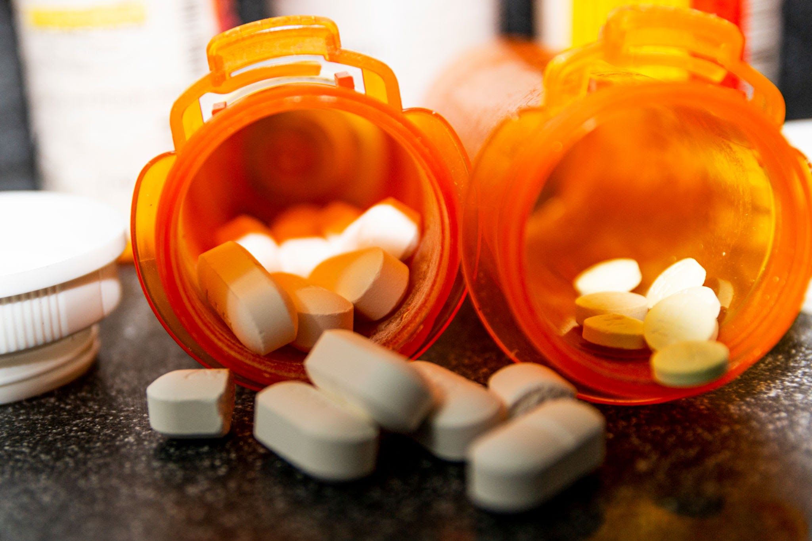
NON-Narcotic Analgesics
Prevent body from producing prostaglandins (lipid compound that causes pain, inflammation, fever) → block transmission of pain from nociceptors
  Acetaminophen
Act on CNS and PNS to block production of COX 1 and COX 2 in cell membranes and prevent production of prostaglandins
  Nonsteroidal Anti-Inflammatory Drugs (NSAIDS) -
RX or OTC
Good for mild-moderate pain

Slide 33
Acetaminophen / Tylenol
  Considered safest analgesic / antipyretic available (liver injury/toxicity with overdose)
    Safe in pediatric populations
    Pregnant (yes/no?)
    Nursing
    Caution hepatic disease, alcoholism
      Most common cause of liver failure

Slide 34
Acetaminophen / Tylenol
  No-little GI issues
  No greater effect with greater dose past 1000mg
    Maximum daily dose 3 grams
    Rebound pain/headache
  Commonly Rx’ed with narcotic

Slide 35

Aspirin and NSAIDS
    Analgesic
    Antipyretic
    Antiplatelet
    Anti-inflammatory
Decreases the synthesis and release of prostaglandins from cell membranes

Slide 36
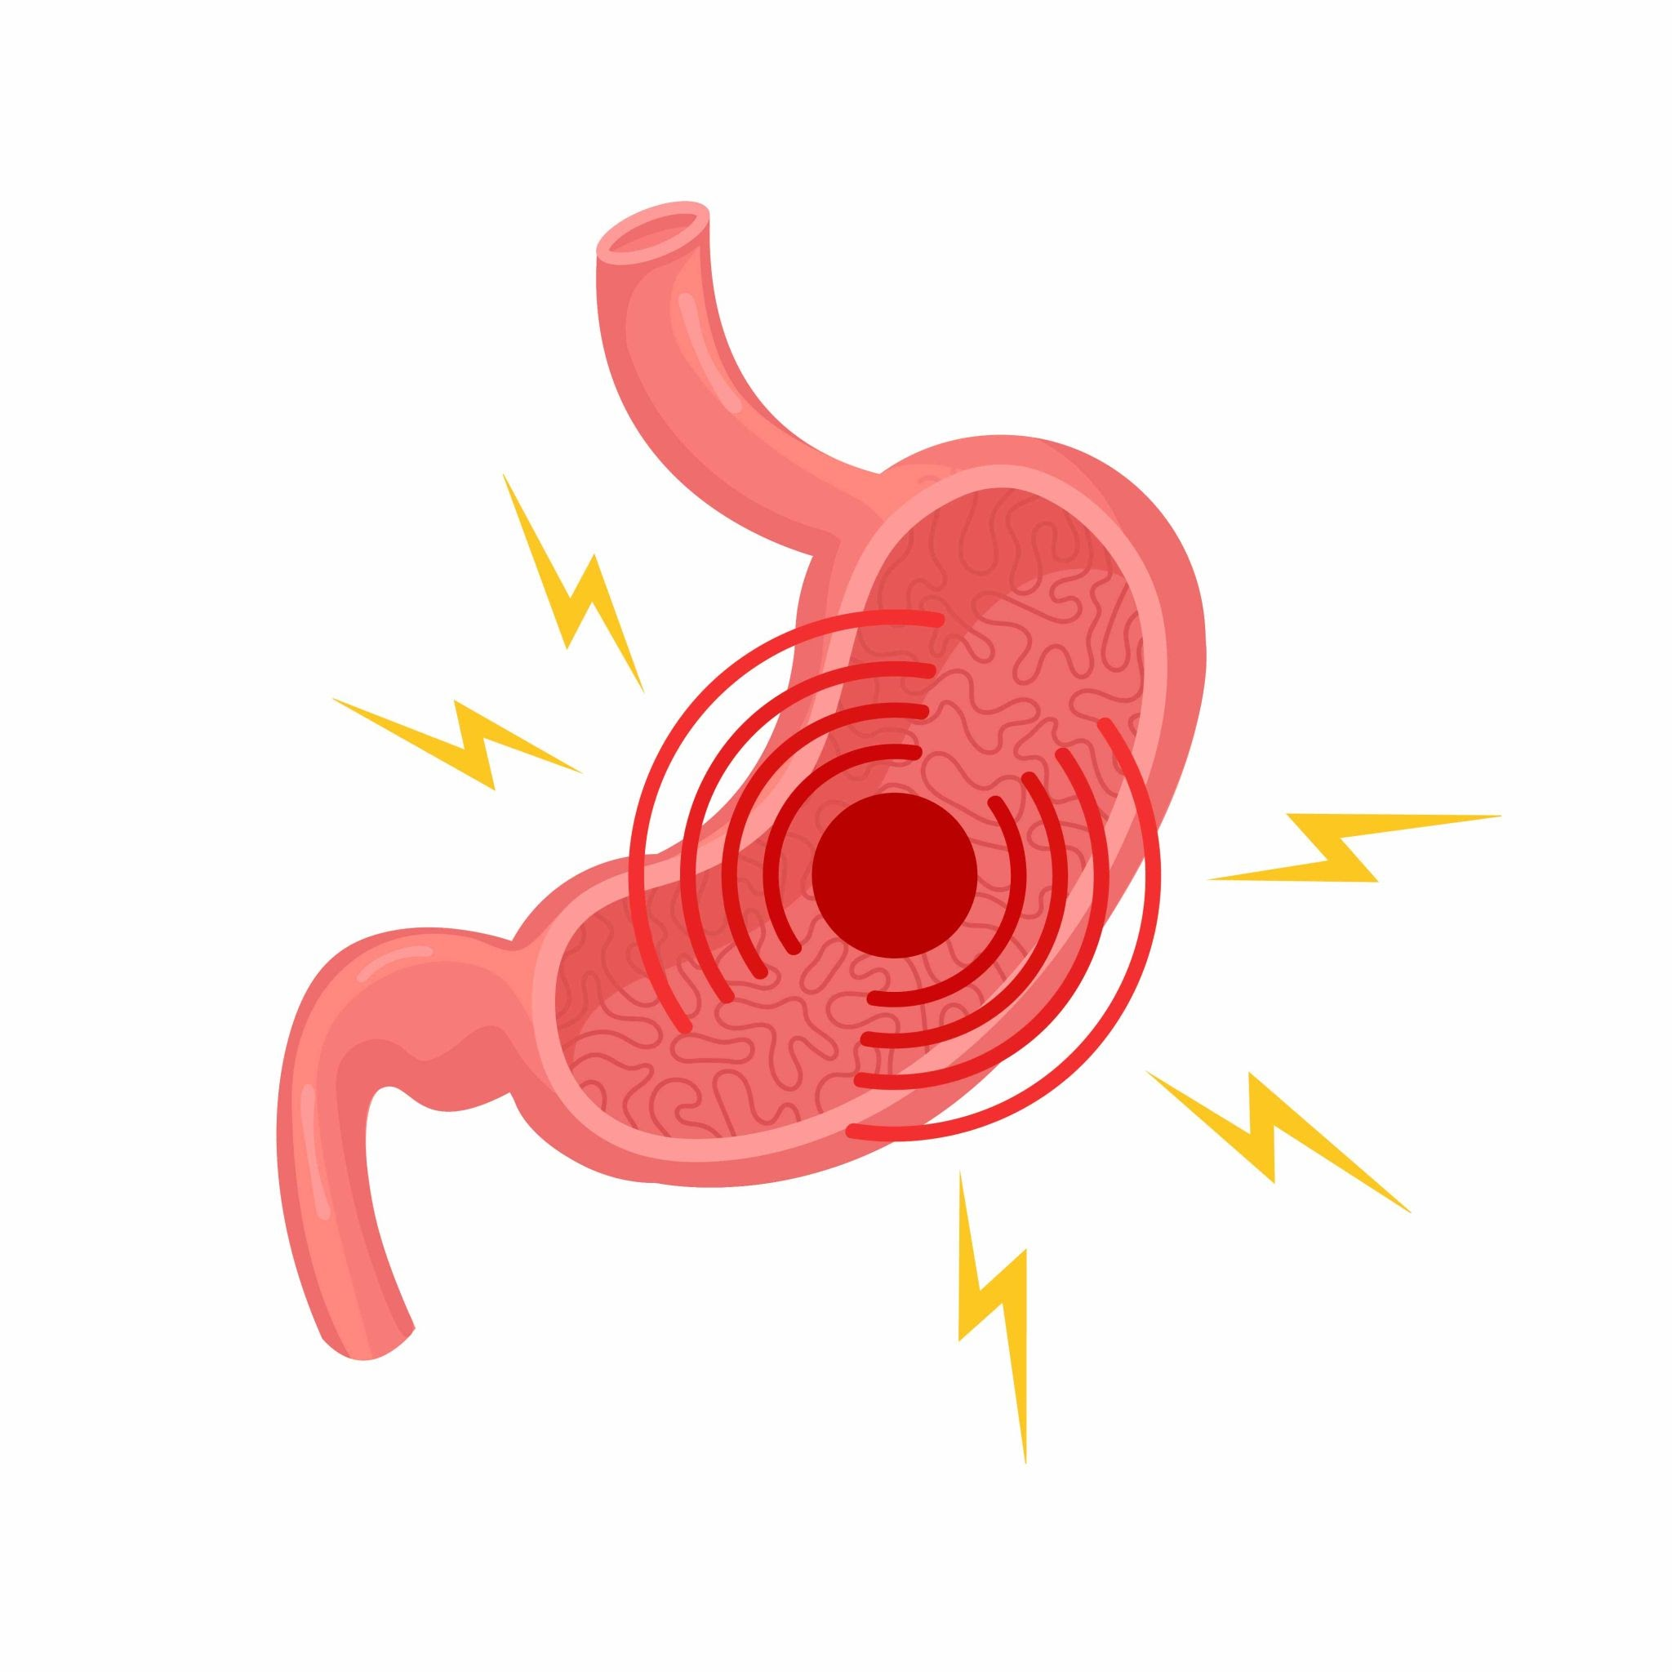
Aspirin and NSAIDS
Attacks CNS / PNS pain
        Reduces sensitivity of pain receptors in CNS
        Decreases COX 1&2 activity → block prostaglandin synthesis
      Aspirin not typically used for ocular pain
      Selective COX-2 inhibitors
        Celecoxib is the Rx only selective NSAIDs that DO NOT have antiplatelet activity and cause less GI problems

Slide 37
Asprin and NSAIDs
  Produces an anti-inflammatory effect
    Over 400mg, doesn’t help more
    Can be used with Tylenol
      If your allergic to one form of NSAID, allergic to all
    Rebound pain/headache
    GI issues/ulcers– must take with food
    Anticoagulant
    May increase risk of heart attack / stroke (except aspirin)
    Topical can delay wound healing and produce corneal melting
      Walkin clinics, ERs
  Can Rx with narcotic

Slide 38
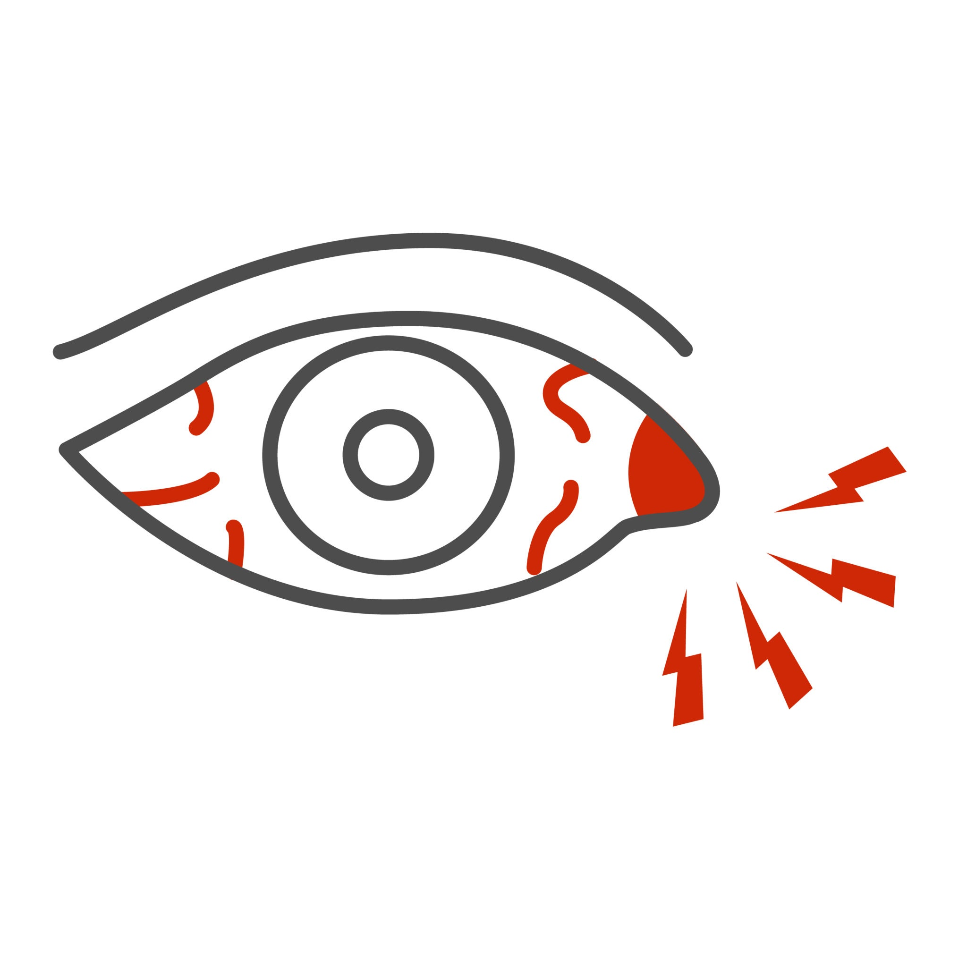
NSAID - Ibuprofen
  Typical dose 400-600mg q 4-6 hours
    Maximum analgesic dose 2400mg/day
Aleve (naproxen)
  220-410mg TID with Food OTC
  1250mg maximum daily dose
Indomethacin
Ketoprofen
Celecoxib
Ketorolac
Meloxicam
*Used for scleritis*

Slide 39
Anticonvulsants
  Lower neurotransmitter release and/or reduce firing leading to analgesia
Gabapentin (Neurontin):
    Postherpetic neuralgia
    Diabetic neuropathy
    PRK pain
Pregabalin (Lyrica):
    postherpetic neuralgia
    PRK
Lamotrigine (Lamictal) –for trigeminal neuralgia

Slide 40
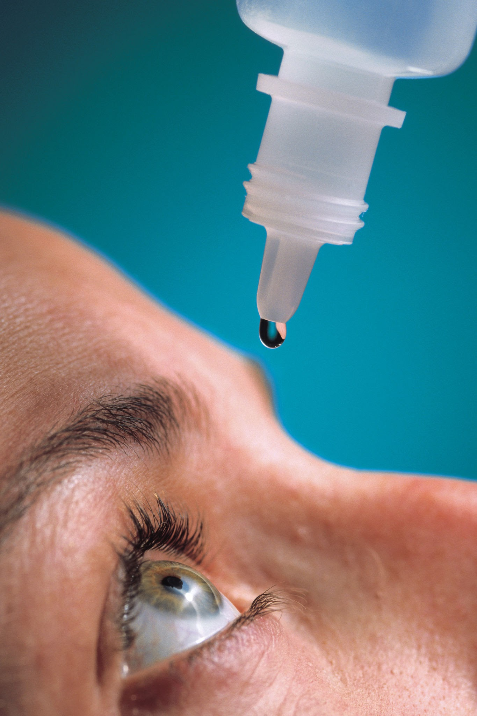
Neuropathic vs Neurotrophic
Neurotrophic is stain with no pain while Neuropathic is pain with little stain.
Neuropathic pain: How can you tell the difference between central and peripheral?
1 drop of proparacaine, if no relief, central, much harder to treat, pt needs a pain specialist

Slide 41
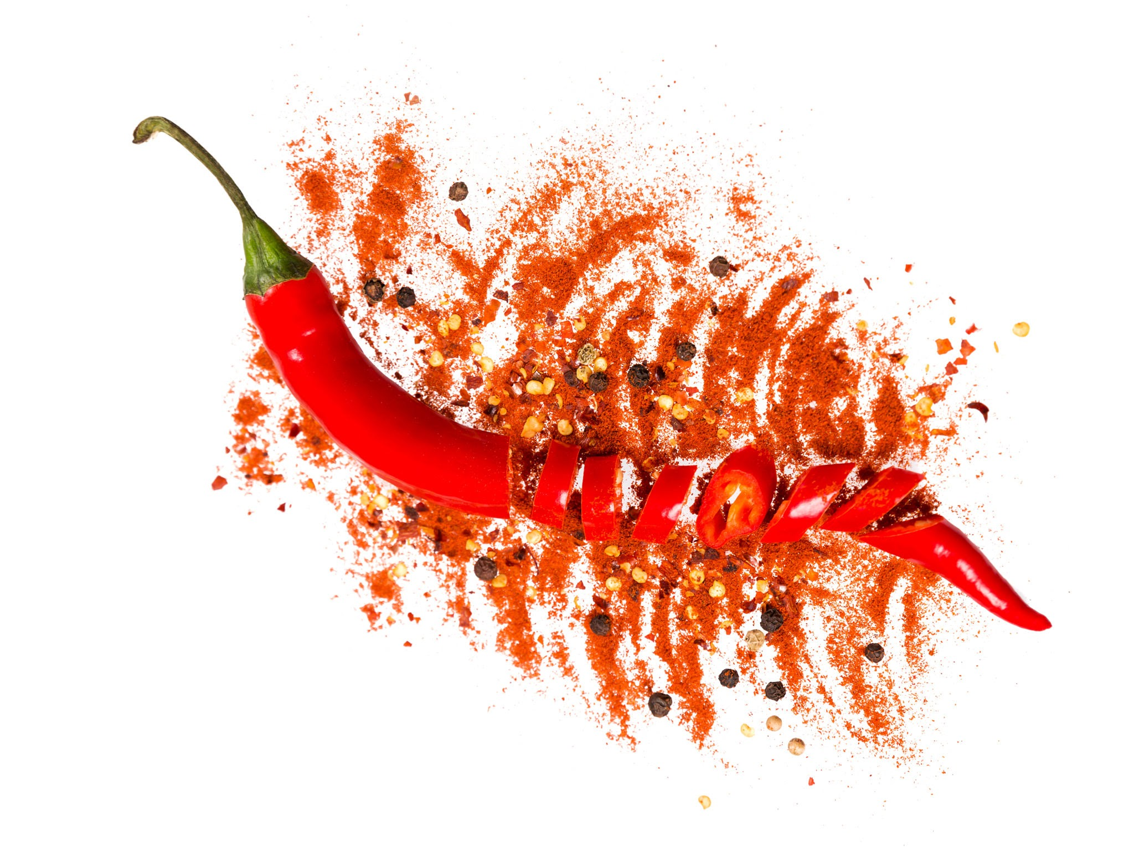
Topical Analgesics
  Lidocaine → blocks nerve signals that send feeling of pain to brain
  Capsaicin → chili pepper extract that depletes local neurons of substance P, required in transmission of nociceptive input
    Has anti-inflammatory effects
    Used in RA and Zoster pts

Slide 42
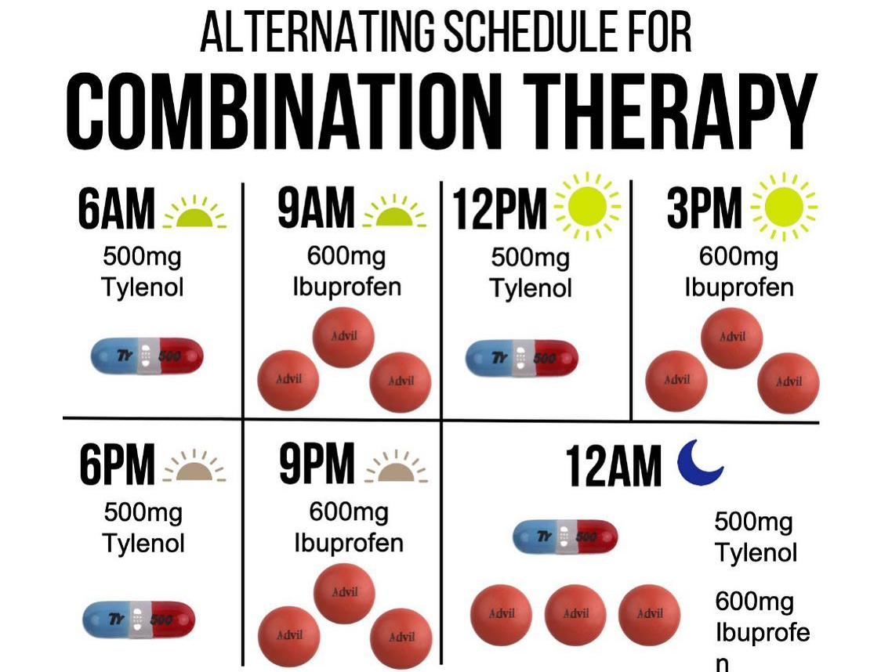
Combination Therapy!!!
  Acetaminophen and ibuprofen block the COX 1, 2, 3 enzymes at different locations
  When used together, acetaminophen and ibuprofen should be dosed every 3-6 hours alternatively without exceeding maximum daily recommended dose for either medication
  2017 study in JAMA found it worked as well as an oxycodone.
  Now Available as a combo drug OTC

Slide 43
NARCOTIC Analgesics
Narcotic refers to opium (natural and unnatural forms):
Natural form
Opium
morphine
codeine or
The poppy plant which produces poppy seeds, possess no opium
The opium is found in the milky white fluid that exudes from the pod when it is cut.
Opioids are used to provide relief from moderate-to-severe acute or chronic pain without a ceiling effect
  Heroine was used as a cough suppressant when it was first introduced and cocaine was once in Coke!

Slide 44
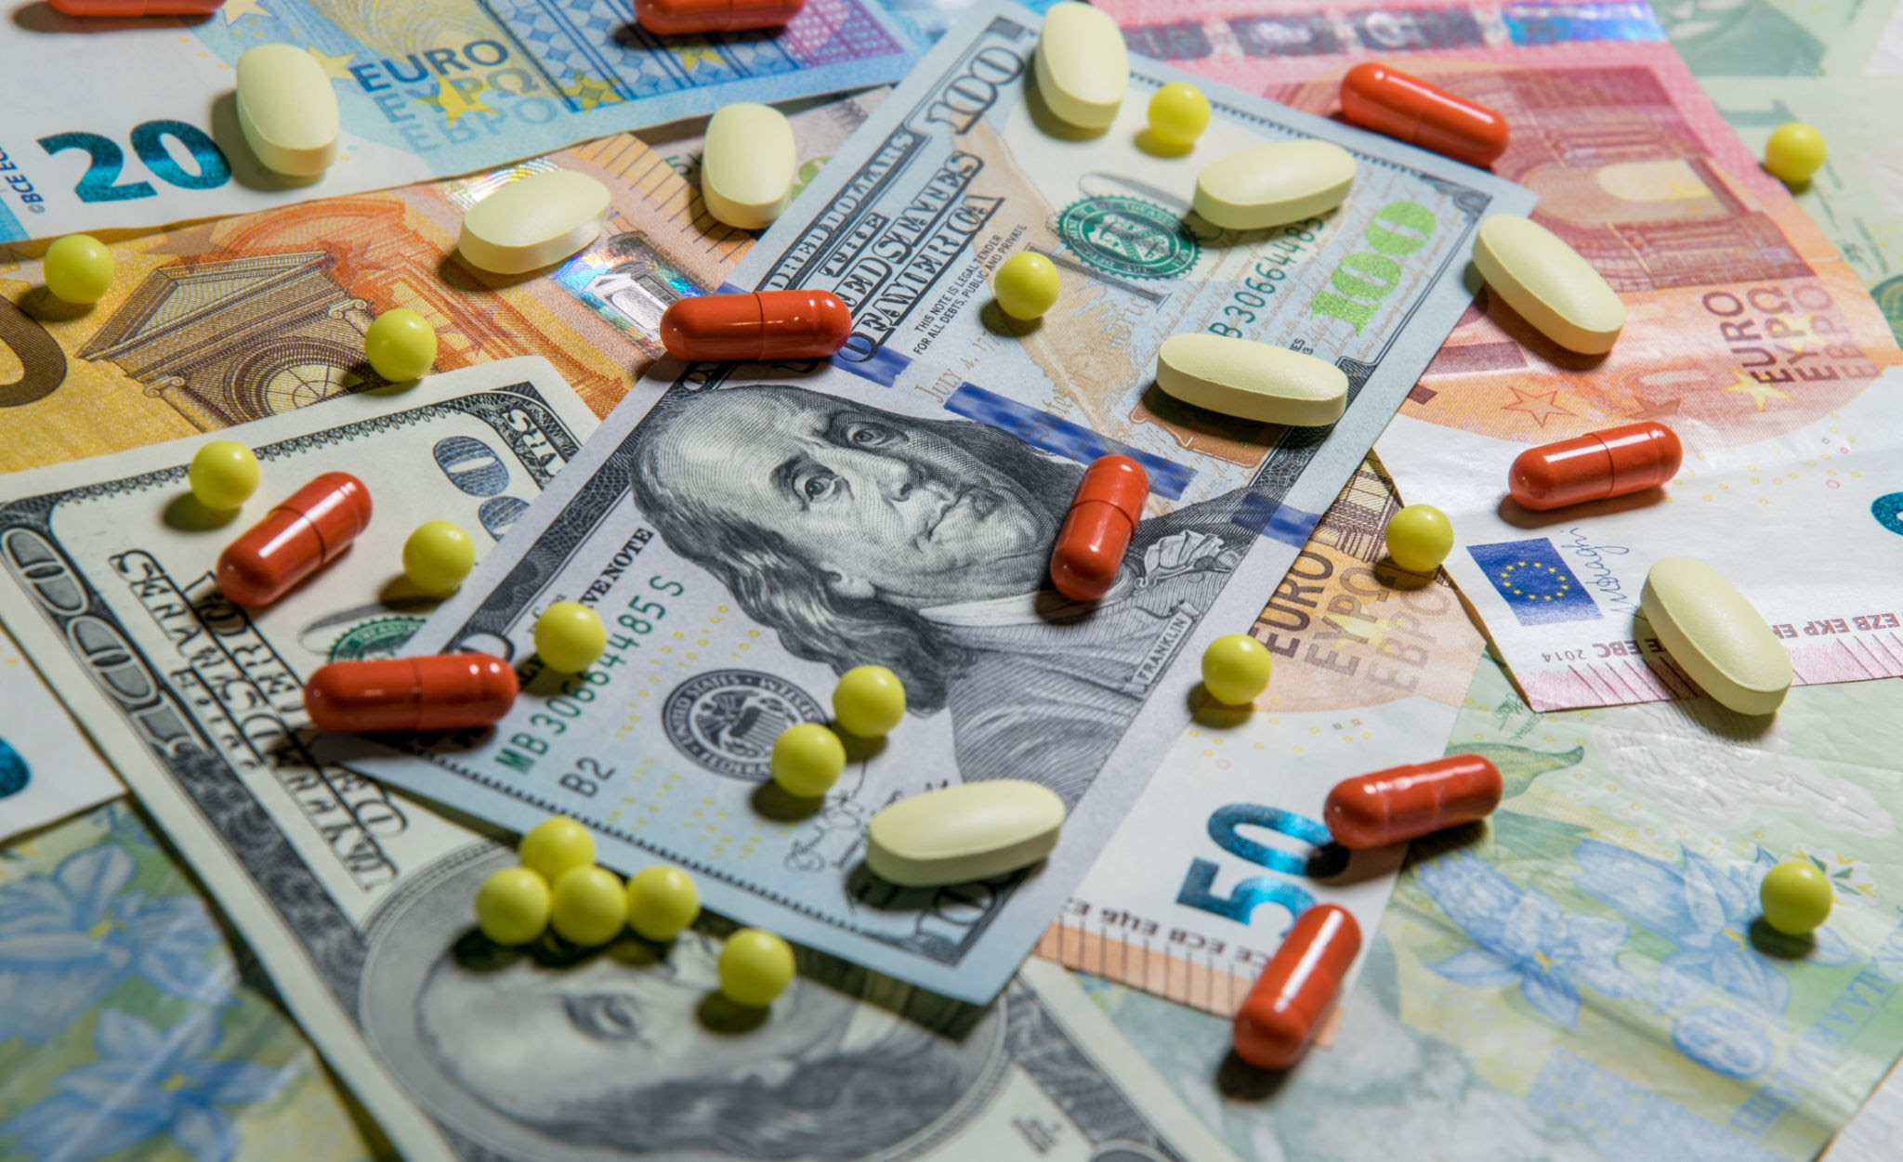
Narcotics Synthetic Form
Heroine
Methadone
Oxycodone
Hydrocodone
Fentanyl

Slide 45

Opiate vs. Opioid
Opiate
  Extracted from poppy plant: oopium, morphine, codeine
Can I fail a drug test is I eat a poppy seed bagel?
YES!!! Even though washed, traces can cause a false positive. Still Detectable 48 to 60 hrs later!
Opioid
  Synthesized from an opiate: methadone, heroin, hydrocodone, oxycodone

Slide 46
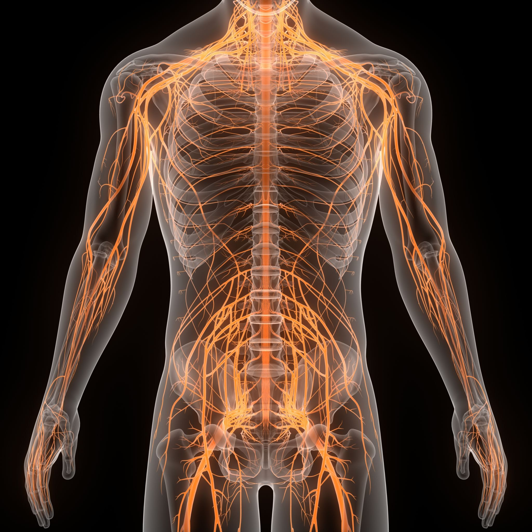
Endorphin: a chemical messenger / neurotransmitter produced by brain during stress, pain, pleasure, eating, exercise
→ bind to opioid receptors in brain
→ pain relief, stress reduction, euphoria

Slide 47
Opioid Narcotics
  Relieve pain by activating receptors in CNS and PNS controlled by endorphins
  Activation of opioid receptors stops transmission of pain signal through the spinal cord and brainstem →reduced effects of stress →releases large amounts of dopamine throughout the body

Slide 48
NARCOTIC Analgesics
For patients with severe pain and acute pain
  Pain is still there, pt can deal with it.
    Nociceptive pain from stimulation of peripheral pain receptors relieved better than pain produced by inflammation or damage of nerves (ie trigeminal neuralgia)
Causes sedation and respiratory depression, take with food
  Caution to not drive or use machinery
  No Alcohol with Tylenol
Usually pregnancy category C
Unlike Non-Narcotics, has no ceiling effect

Slide 49
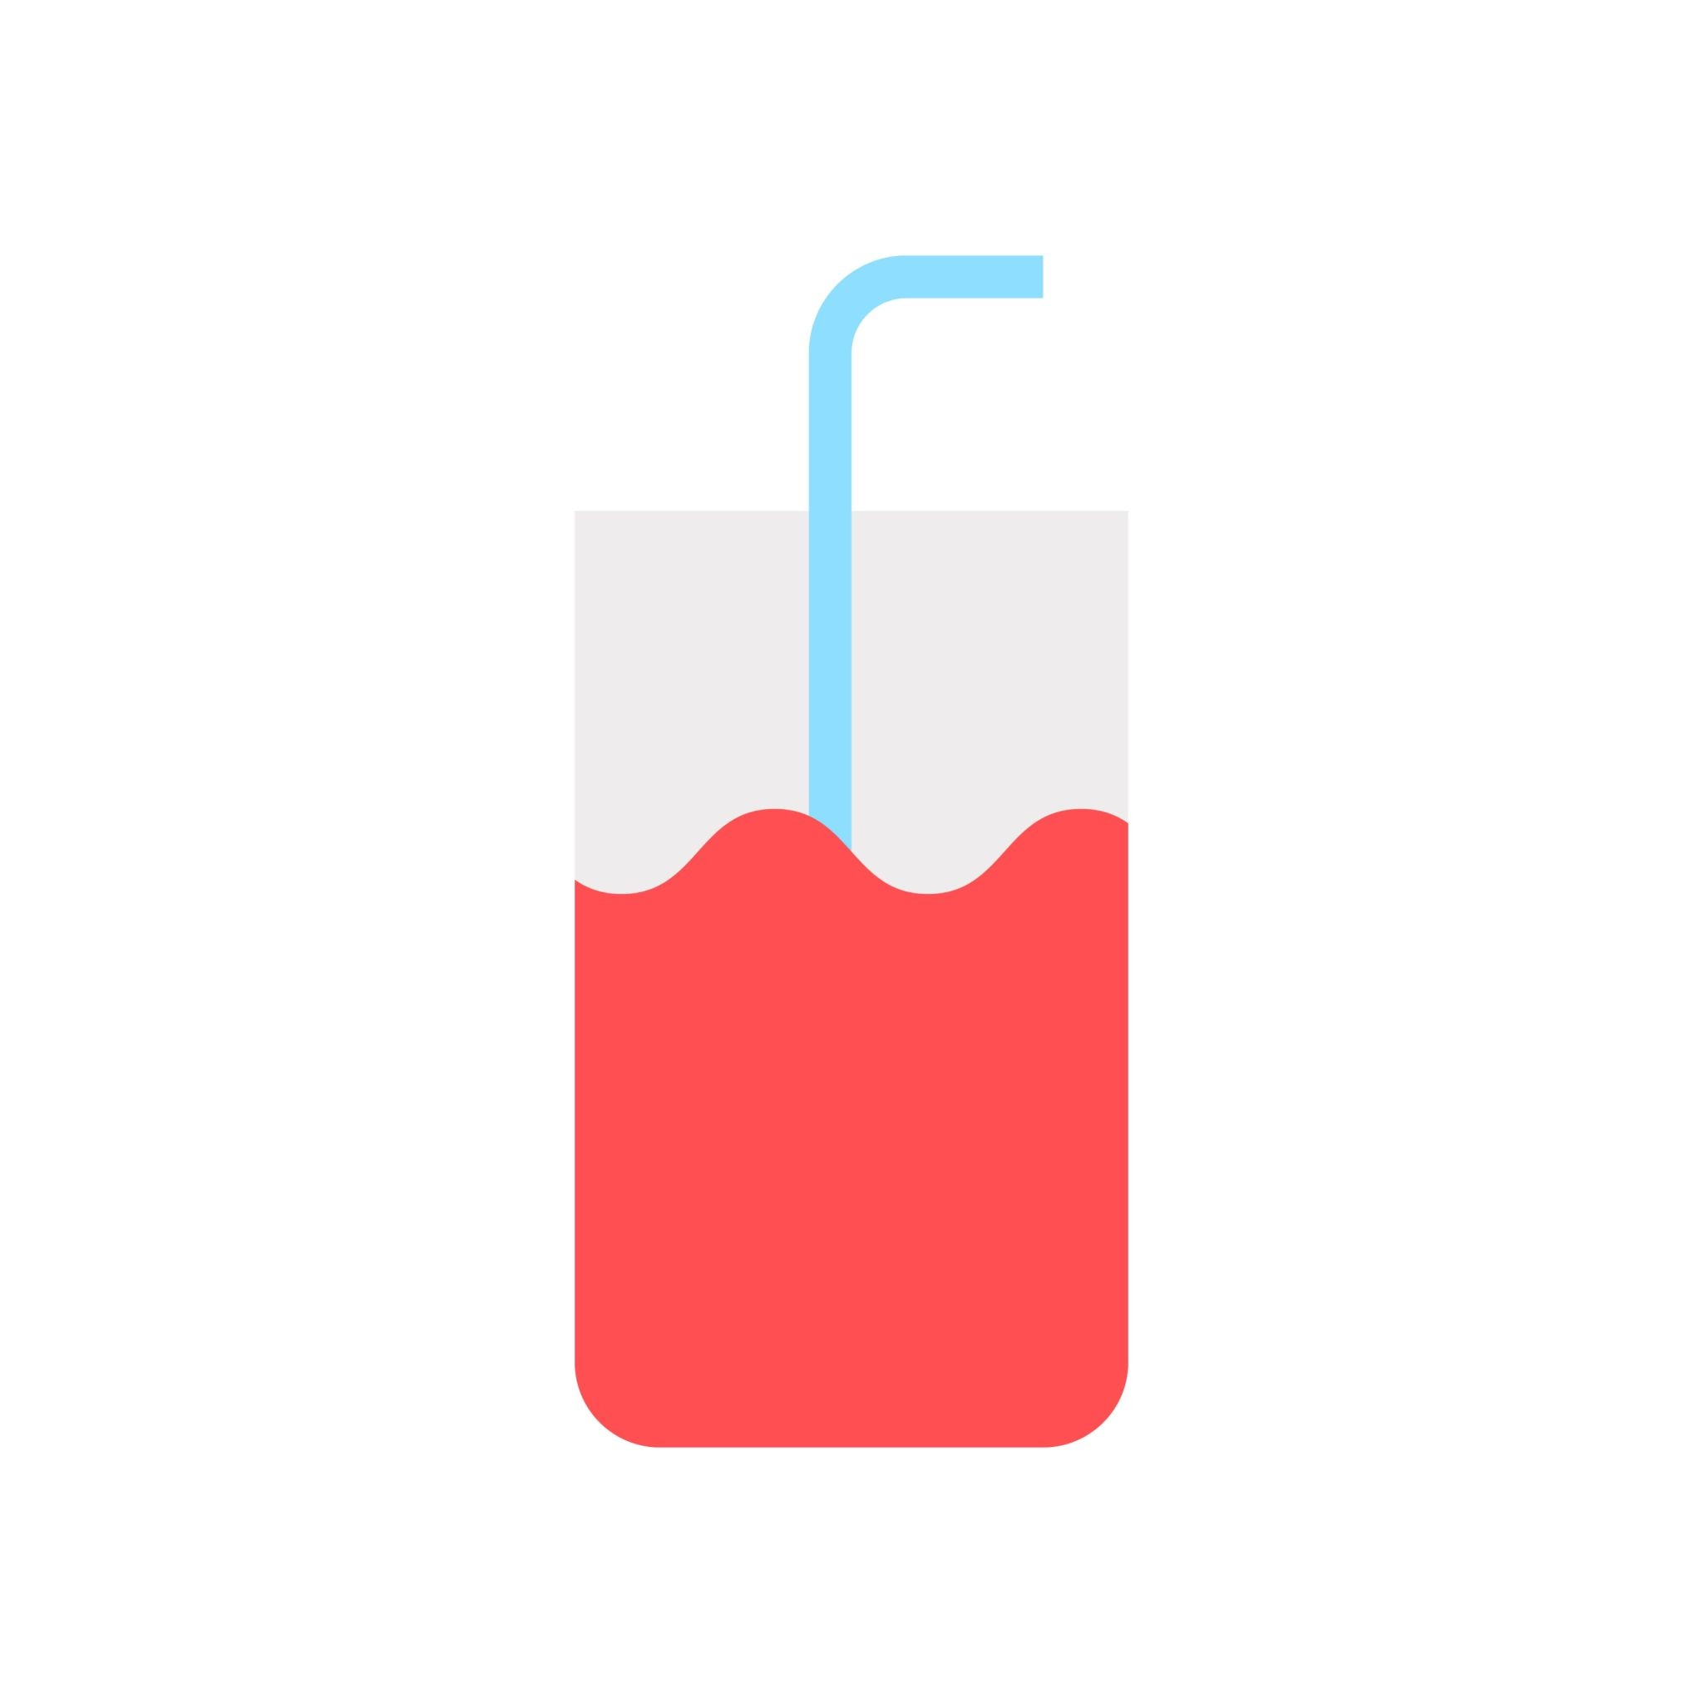
NARCOTIC Analgesics
Codeine
  Weak narcotic analgesic
  Rx’d as a cough suppressant
    Least addictive opiate drug
    Only for mild to moderate pain
  Sedates the patient, helps with pain
  Commonly abused

Slide 50
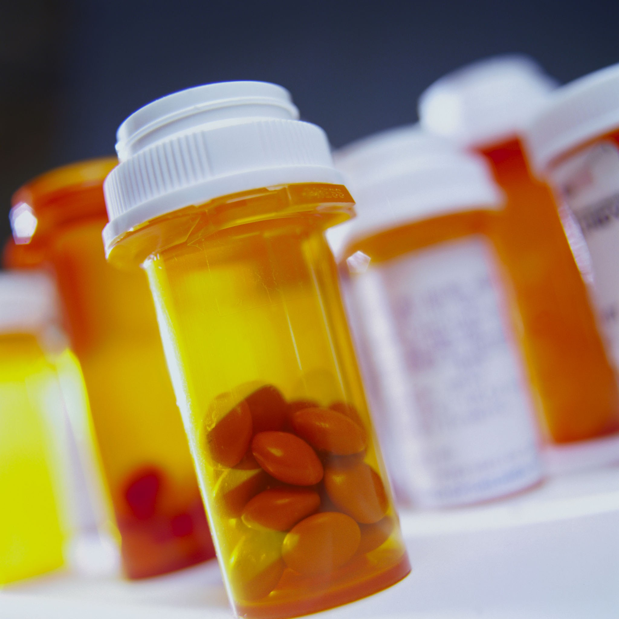
Definitions
Tolerance
  Pt needs higher / more frequent dose to get same effect
  2-3 weeks of continued use before it becomes an issue
    Higher doses at short intervals is the most dangerous

Slide 51

Prescribing TIPS
Opioids shouldn’t be 1st line therapy
Benefits of opioid use must outweigh risks
If opioids are necessary, need to be used with non-opioid pharmacologic therapy and /or non-pharmacologic therapy
CDC
Consider opioid therapy only if expected benefits for both pain and function will outweigh risks to patient
When opioids are used for acute pain, prescribe the lowest effective dose of immedia-release opioids
Prescribe no greater quantity than needed for the expected duration of pain severe enough to require opioids
Three days or less will often be sufficient

Slide 52
Prescribing Tips
Opioid use and a plan to D/C the meds need to be discussed prior to opioid prescribing
  Risks need to be verbally discussed, pamphlet / written info can be given in addition
The higher risk of overdose / misuse consider rxing Naloxone
Unused opioids should be taken to a hospital/pharmacy or flushed down the toilet (not in trash)

Slide 53
Narcotics / Prescribing Considerations
Prescription Drug Monitoring Program (PDMP) - statewide electronic database tracks all Rx for controlled substances
  Look to see if patient is receiving other opioids when starting therapy and re-evaluate periodically (3 mos) if using long term
    Urine drug testing recommended prior to starting opioid treatment for chronic pain
      Consider performing at least annually to assess for illicit drug use
Opioid Induced Constipation (OIC) → Pt edu on hydration, fiber, and stool softeners

Slide 54
Prescribing Tips
Know what you are treating - Do not treat controlled pain
  Be as conservative
  Use lowest dose
  No extended release, want immediate release
When to discontinue <3 days for acute pain
  O.D.s will very rarely Rx more than 3-5 day supply
Monitor closely
  Patient needs to understand potential abuse problems before to prescribing

Slide 55
Prescribing Tips
Guidelines to reduce narcotic misuse
  Use Electronic Rx
  If you have Rx pads, they need to be locked up
  Never sign Rx blanks
  Write out the exact amount of pills in number & word form
  Provide educational materials
Rx of controlled substance must include
  Patient’s full name and address
  Doctor’s full name, address, and DEA #
  Schedule II must be manually signed by doctor
Make sure you clearly document medication
  Name, strength, dosage, quantity, refills, instruction for use, alternatives, instructions for adverse effects

Slide 56
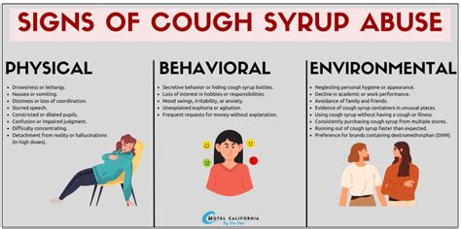
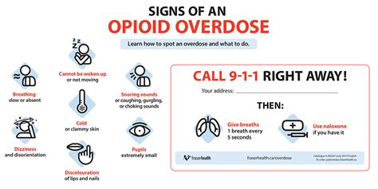
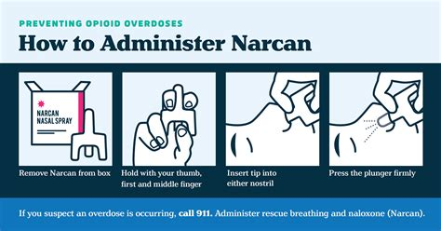
Opioid Overdose

Slide 57
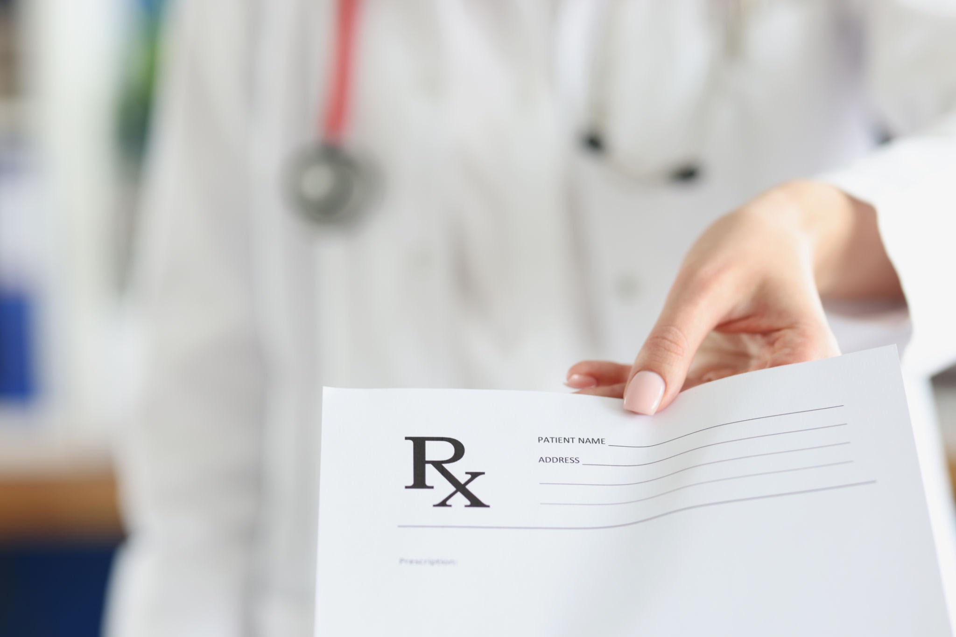
Prescribing Tips
Drug seeking behavior
  Severity of symptoms and history don’t match signs
  Refills: Frequent / early
  Calls because medication was lost or stolen
  Pt specifically asking for a certain opioid or dose

Slide 58
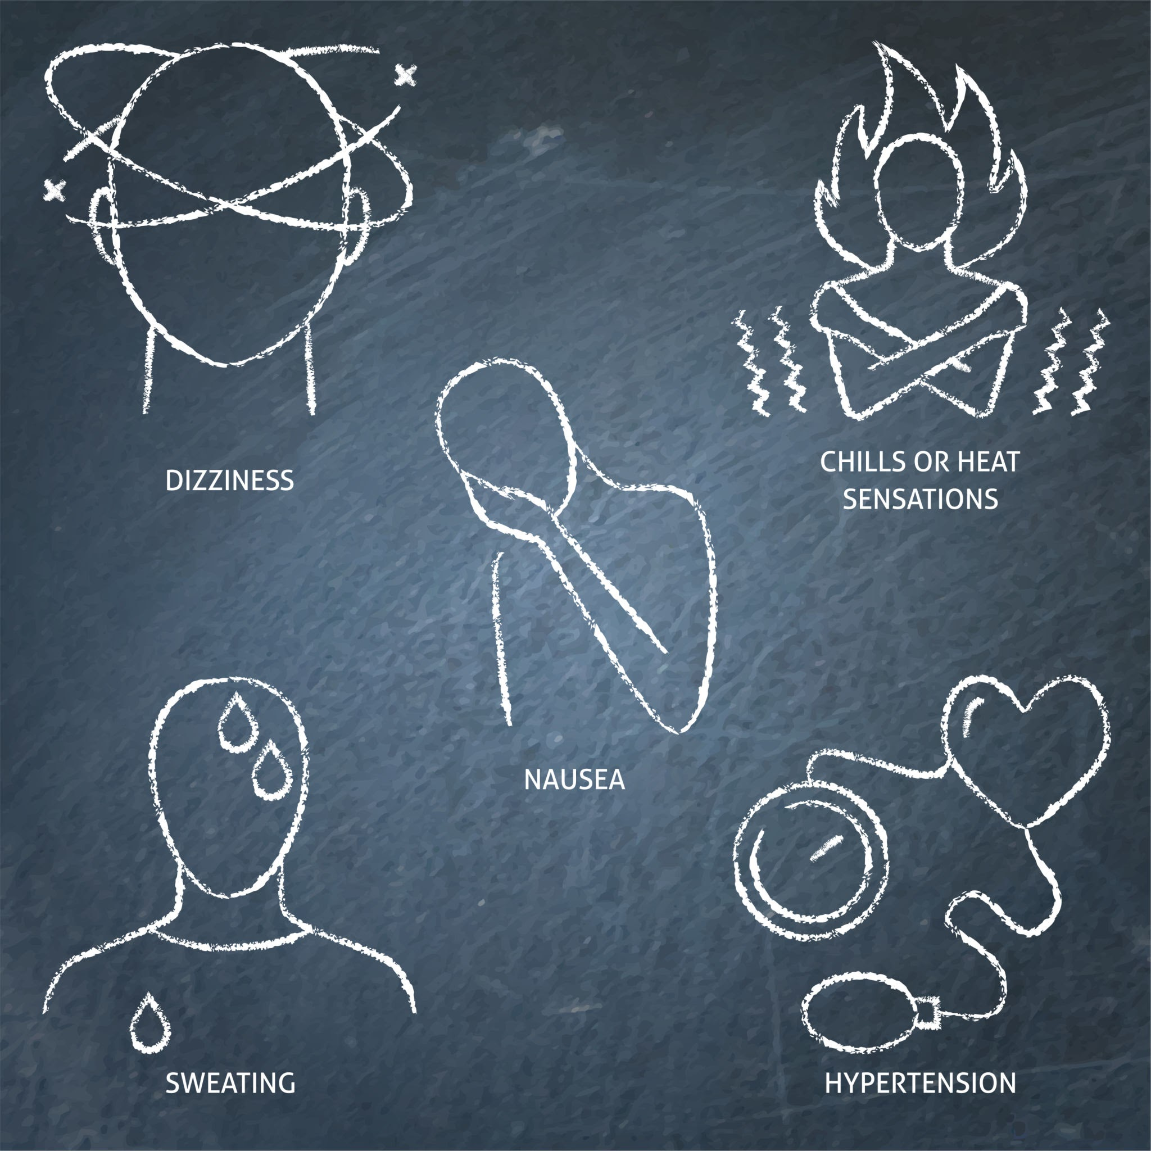
Symptoms of Withdrawal
    HTN
    Diarrhea/Stomach cramps
    Nausea/vomiting
    Chills
    Runny nose
    Teary eyes
    Shakiness
    Anxiety
    Dilated pupils
      Can be a sign of acute opioid withdrawal

Slide 59
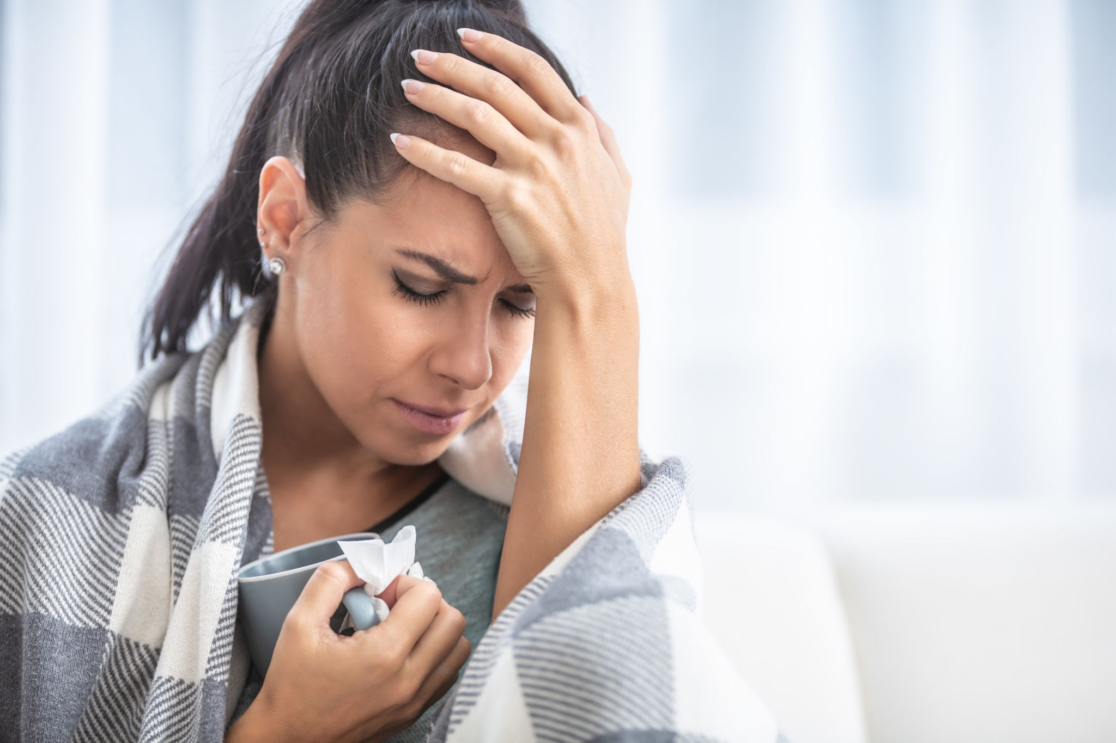
Withdrawals
People addicted to opioid medication who stop using the drug can have severe withdrawal symptoms - begin 4-6 hours after drug was last taken
  Muscle and bone pain
  Sleep problems
  Diarrhea and vomiting
  Cold flashes with goosebumps
  Uncontrollable leg movements
  Severe cravings

Slide 60
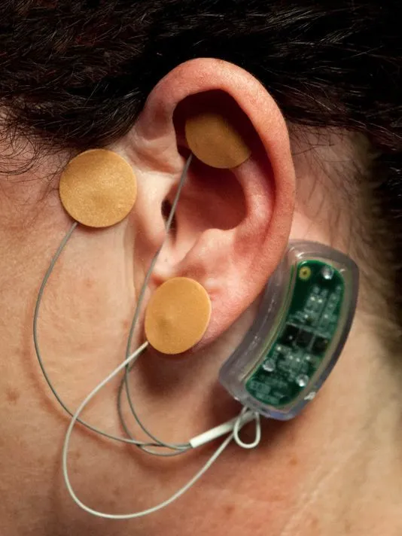
Reducing Withdrawal
Lofexidine - non-opioid used to reduce opioid withdrawal symptoms approved by FDA
NSS-2 Bridge - FDA approved device - small electrical nerve stimulator placed behind ear, can be used for up to five days during acute withdrawal phase

Slide 61
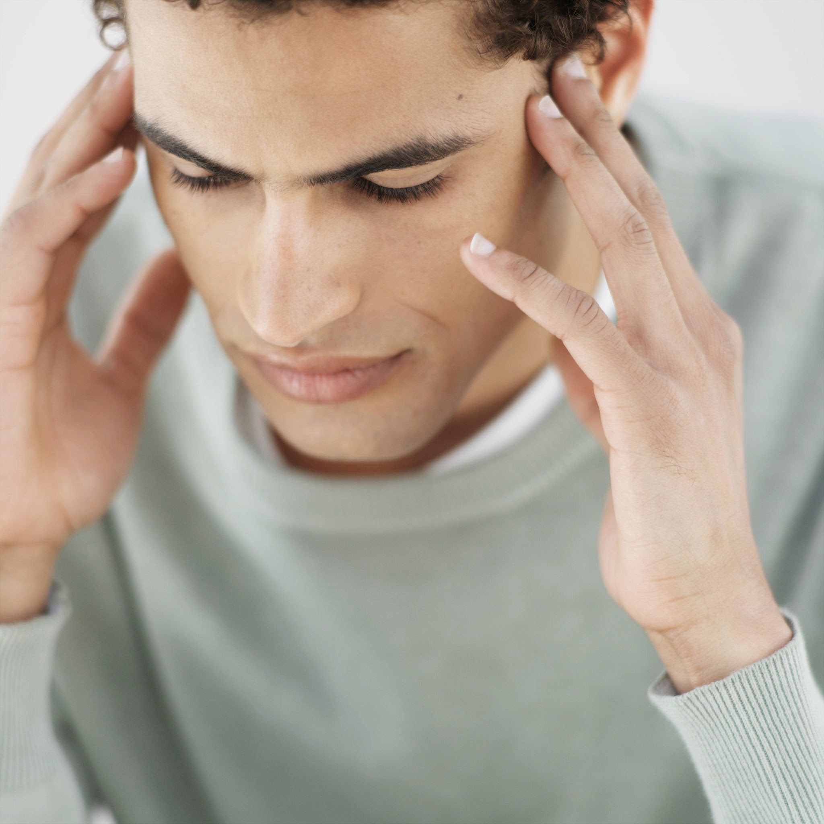
Overdose Signs
  Lethargy
  Nausea / vomiting
  Confusion
  Mood change
  Pupil miosis –pinpoint pupils
  Severe constipation
  Slow respiration

Slide 62
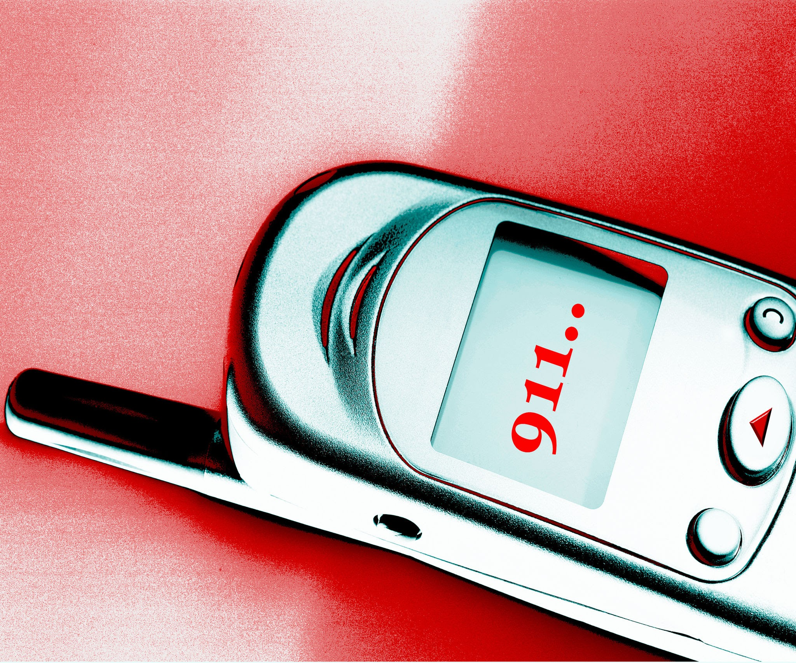
What to do During an Overdose
    Poor circulation → blue skin tone: That’s an emergency!
    Call 911 and use naloxone
      Okay to repeat dose every 2-3 min until respiration picks up
      Patient can become very aggressive or even agitated when regaining consciousness

Slide 63
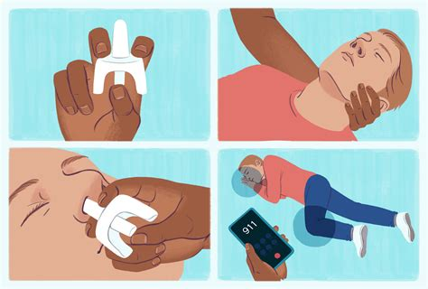
Naloxone
Naloxone reverses the chemical effects of opioid
  Rapidly binds to opioid receptors, prevents opioid from attaching to receptors, and blocks effects of opioid drug
      Methadone which can take 2-4 hours to reach peak effect
    Partially reverses alcohol intoxication
    Can cause rise in BP and pulmonary edema
Kernpublichealth.com

Slide 64
Naloxone
Available as injectable solution and nasal sprays
CT (not all states) allow pharmacists to dispense/sell naloxone without prescription
CT also has a Good Samaritan law that provides immunity from civil and criminal liability for individuals who administer naloxone
What’s the ER going to do? Stable BP and respiratory support

Slide 65
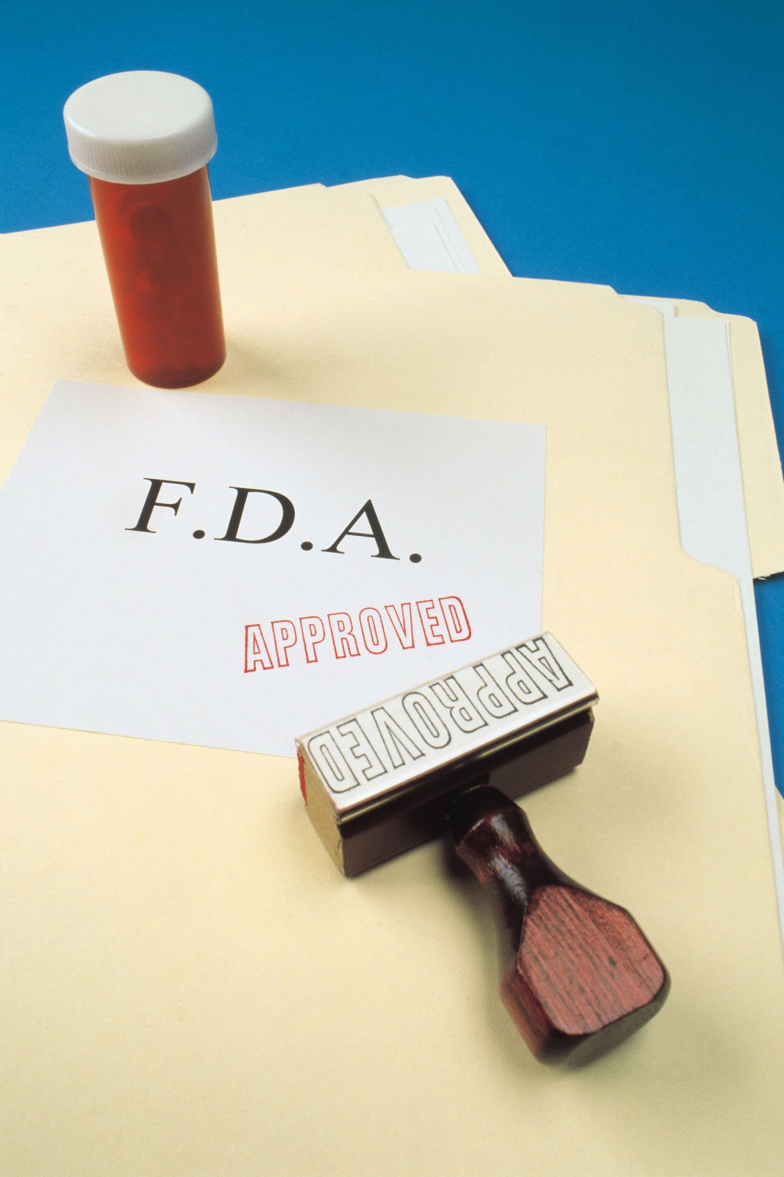
Resources
HHS Opioid Initiative
Substance Abuse and Mental Health Services
Food and Drug Administration
Centers for Disease Control and Prevention
Agency for Healthcare Research and Quality

Slide 66
Narcotics
Rx short duration, immediate release for acute pain
  Rx no greater quantity than should be used for treatment of acute pain - usually 1-3 DAYS with NO REFILL
    RARELY need more than 7 days of narcotic for treatment of acute pain

Slide 67
Ocular Conditions With Intense Pain
  Periorbital infection / Preseptal cellulitis / Dacryoadenitis
  Corneal or Conjunctival trauma / foreign body / abrasion / burn
  Recurrent corneal erosion
  Infectious corneal ulcer
  Inflammation / Keratitis / Anterior Uveitis/ Scleritis
  Increased IOP / Angle closure
  Pari / Post Surgery - PRK, PTK, PKP, CXL
  Trigeminal nerve pain / Post herpetic neuralgia (HSV/Zoster)

Slide 68
Where to Start?
  Topical NSAIDs
    Bromfenac, Diclofenac, Ketorolac, Nepafenac
      Common post PRK, cataract surgery dosage: 1 drop qid for at least 2 weeks.
        Ketorolac→Lots of SPK, typically D/C’d early
      Consider steroids, antihistamines
    Delays corneal wound healing
    K infection
    Sub-epi infiltrates
      Corneal melt concern, especially generic NSAIDs (generic diclofenac)

Slide 69
Pain Management for ODs
  Oral non-narcotic
    Rocking 500mg Ibuprofen with 800 mg acetaminophen every 3 hours
      Can use loading dose
  Cycloplegia to reduce spasm of ciliary body - 1% cyclopentolate BID - (sensitivity to light)
  PF Art Tears, Cold compresses, Amniotic membrane, Bandage CTL: Acuvue Oasys, Air Optix Night and Day

Slide 70
Pain Management for ODs
Topical Anesthetic
Topical tetracaine q 30min for 24 hours viable analgesic for acute corneal abrasions
    Less hydrocodone use needed for breakthrough pain
    Safe for short term use (Several studies).
Risk of toxicity, delayed epithelial healing, abuse
Better results with bandage CTL especially in PRK

Slide 71
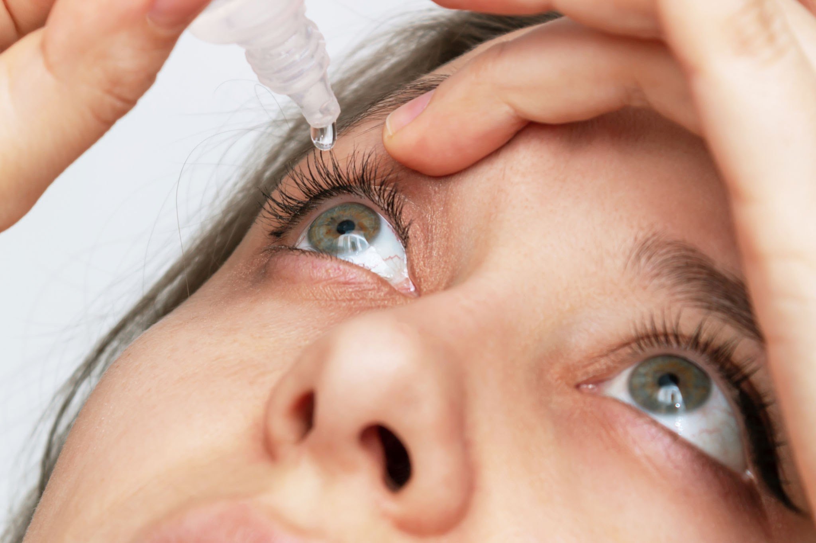
Pain Management
  Corneal Abrasions
    0.05% Proparacaine q15 min for first 12 hours then q 1 hr x 6 days or 0.5%
    1.0% tetracaine q30 min for 24hrs
    Short duration → no adverse effects reported, get potent pain control

Slide 72
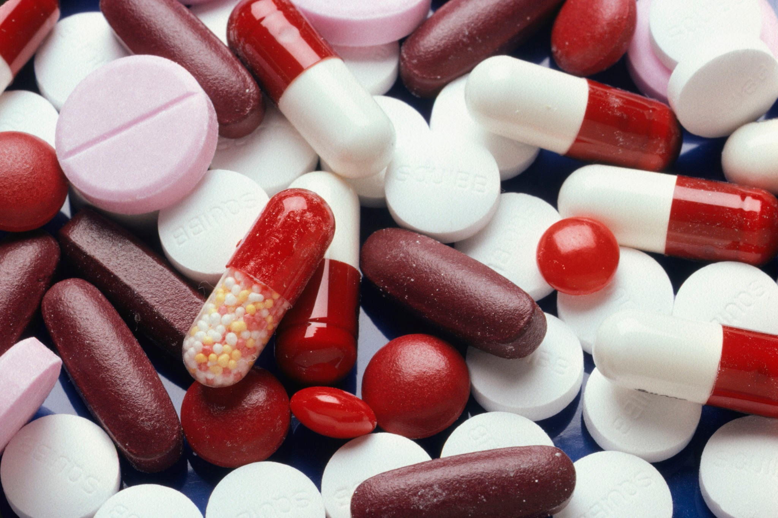
Pain Management
Oral pain meds: Immediate release only,
NO extended release
Opioids are best used in non-inflammatory breakthrough pain. Pain that is acute, persistent, and severe

Slide 73
Definitions
Analgesic: A drug that relieves pain selectively without blocking nerve impulses, alternating sensory perception, and not inducing unconsciousness.
Anti-inflammatory→ short-term pain
Opioids (once called narcotics because they induce sleep)-->short term or long term relief of severe pain

Slide 74
Acute Pain Management
  Mild Pain
    NSAIDS (Ibuprofen, Aleve) or Acetaminophen
    Rock NSAID and Acetaminophen
  Moderate Pain
    Rock NSAID and Acetaminophen
    Less potent narcotic and analgesic think Vicodin
  Severe Pain
    Rock NSAID and Acetaminophen
    Consider more potent narcotic and analgesic if pain not otherwise controlled → Vicodin or Tylenol with codeine

Slide 75
Corneal Abrasion
  Wexel sponge or Algae brush to remove loose epithelium
  Bandage CTL, cold compress
  Moxi QID
  ?Topical NSAID
  Oral
    Rock NSAID and Acetaminophen
      Opioid PRN for pain relief for 1-3 days

Slide 76
Max Daily Amount!
Acetaminophen: Max Daily Amount: 3000mg
Ibuprofen: Max Daily Amount:1200mg
Check to see which opioid contain Acetaminophen or Ibuprofen before rxing so you don’t go over the Max Daily Amount!

Slide 77
RCE
Large Recurrent Corneal Erosion
    MMP-9’s do not allow epithelial cells to fully settle down and bind so an MMP-9 inhibitor (Doxy) is an appropriate treatment
  Documented RCE treatment of choice
    Doxycycline 50mg BID x 2 months
    Topical Steroid TID x 1 month (FML, Lotemax or Pred forte 1%)

Slide 78
RCE
  Cycloplegia
  Topical antibiotic QID ( 4th generation fluoroquinolone ONLY like gatifloxacin or moxifloxacin)
  Bandage CTL, Cold compress, PF Art Tears
  Oral meds
    Rock NSAID and Acetaminophen
      Opioid PRN for pain relief for 1-3 days

Slide 79
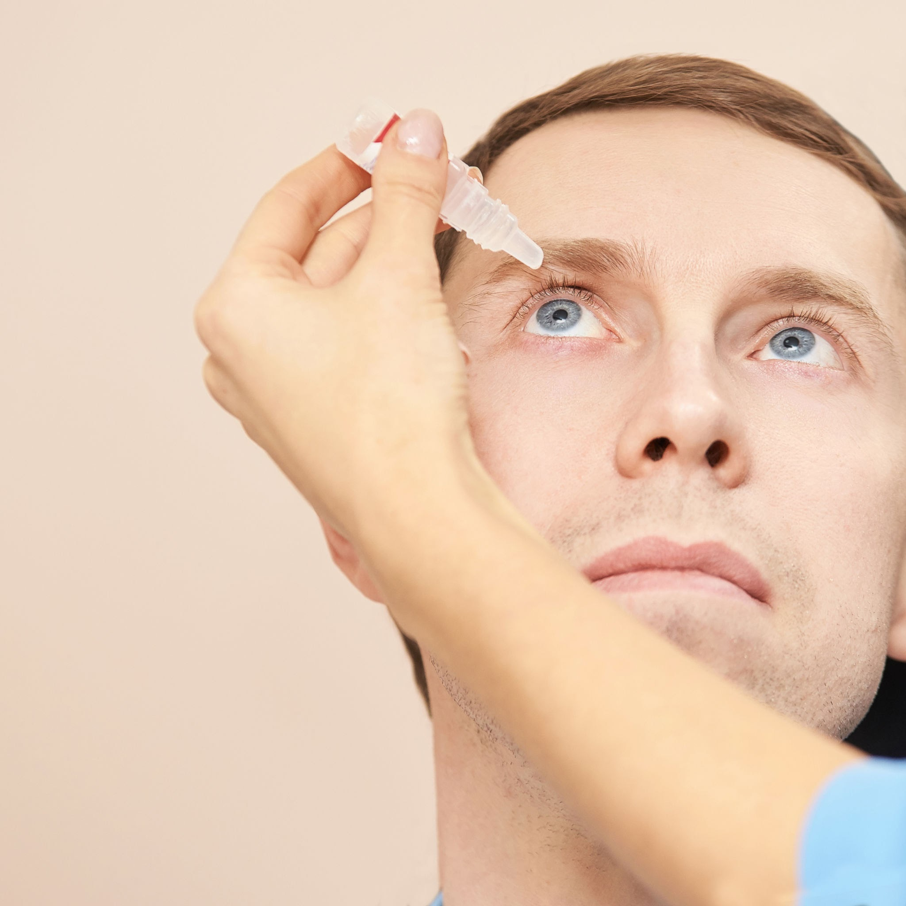
Anterior Uveitis/Scleritis
Anterior Uveitis / Scleritis
  Topical Steroid QID: Prednisolone 1% or difluprednate 0.05% (Durezol))--> Watch IOP spike
    Anterior Uveitis → Cycloplegia
  Cold compress

Slide 80
Anterior Uveitis/Scleritis con’t.
  Oral Meds:
    Naproxen (Aleve) 500 mg 2 times per day
      Can alternate with 975mg acetaminophen q3h if severe
      Opioid PRN for pain relief for 1-3 days -less effective for inflammatory pain
    Ibuprofen (Motrin) 600 mg 3 times per day
    Indomethacin (Rx only) 50 mg 3 times per day

Slide 81
Chemical Conjunctival/Corneal Burn
Chemical Conjunctival
  On phone? Send to Urgent Care. If not, flush at least 30 min
  Measure pH and restore to normal pH 7-7.2
    Re-measure in 15-30 min to ensure stabilized
  Corneal debridement (Wexel sponge)
  Mild burn
    Antibiotic ung (bacitracin, e-mycin)
    Steroid qid
    Cycloplegia/PF Art Tears

Slide 82
Corneal Burn
  Moderate-severe burn
    Steroid gtt q1h x 7-10 days with rapid taper
    Moxi qid to prevent infection
    Doxycycline 50mg bid to inhibit matrix metalloproteinases (MMP), reduce risk of corneal melting and Keeps the K clear
    Aqueous suppressant if IOP up: B-Blocker, CAI, Alpha2Agonist
  Amniotic membrane, cold compress, PF Art Tears, cycloplegia
  Pain Management
    Rock NSAID and Acetaminophen
      Opioid PRN for pain relief for 1-3 days

Slide 83


Any Questions? Thank you!!!

