Slide 1
Stop Rubbing Your eyes!
By: Susan Janik, O.D.

Slide 2
DISCLOSURES AND CONTACT INFORMATION
SUSAN B. JANIK, OD
  SPEAKER FOR Physician Recommended nutraceuticals
  SUSANJANIK@GMAIL.COM

Slide 3
COURSE OBJECTIVES
To discuss treatment and management of allergic disease including simple allergic conjunctivitis, Vernal KeratoConjunctivitis, phylectenular conjunctivitis, contact dermatitis, giant papillary conjunctivitis and atopic conjunctivitis.

Slide 4
Can Honey Help Allergies?
"Honey has been studied as a cough suppressant and may have anti-inflammatory effects. In addition, some experts point out that honey can contain traces of flower pollen — an allergen. And one treatment for allergies is repeated exposure to small amounts of allergens."
~Mayo Clinic

Slide 5


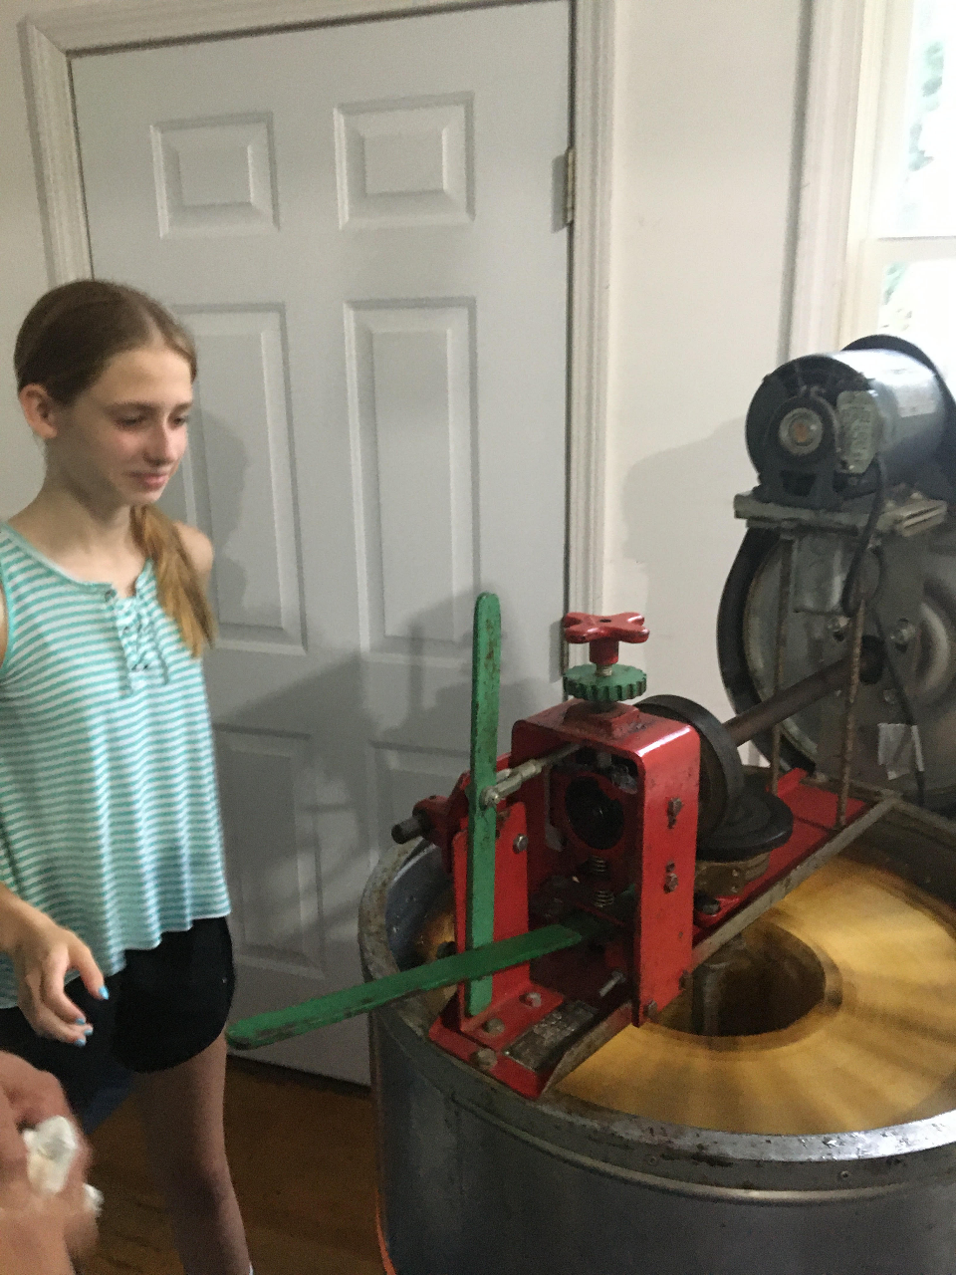
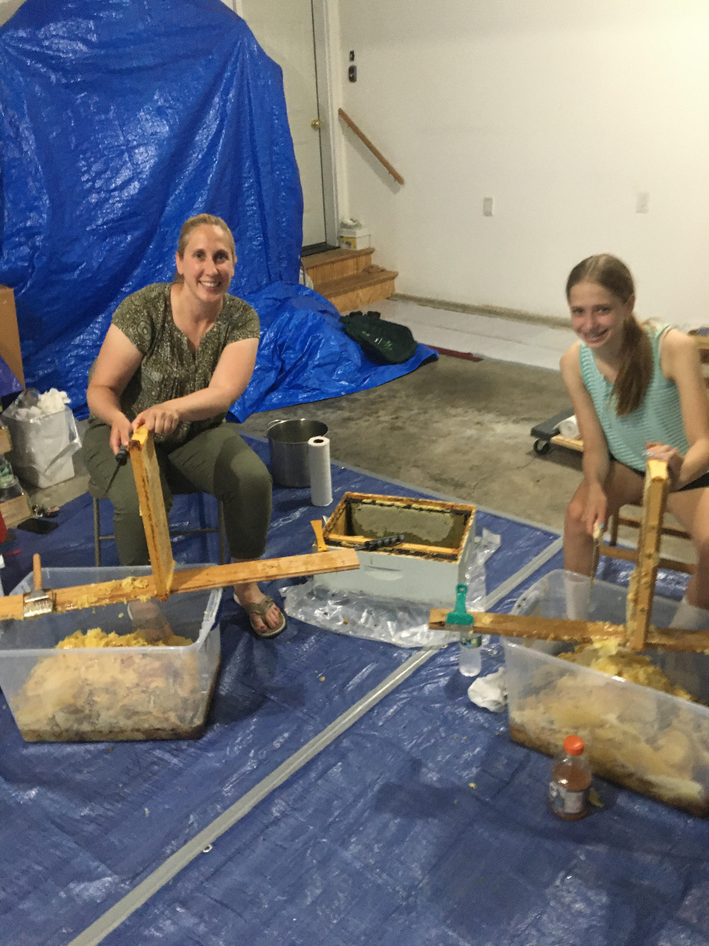

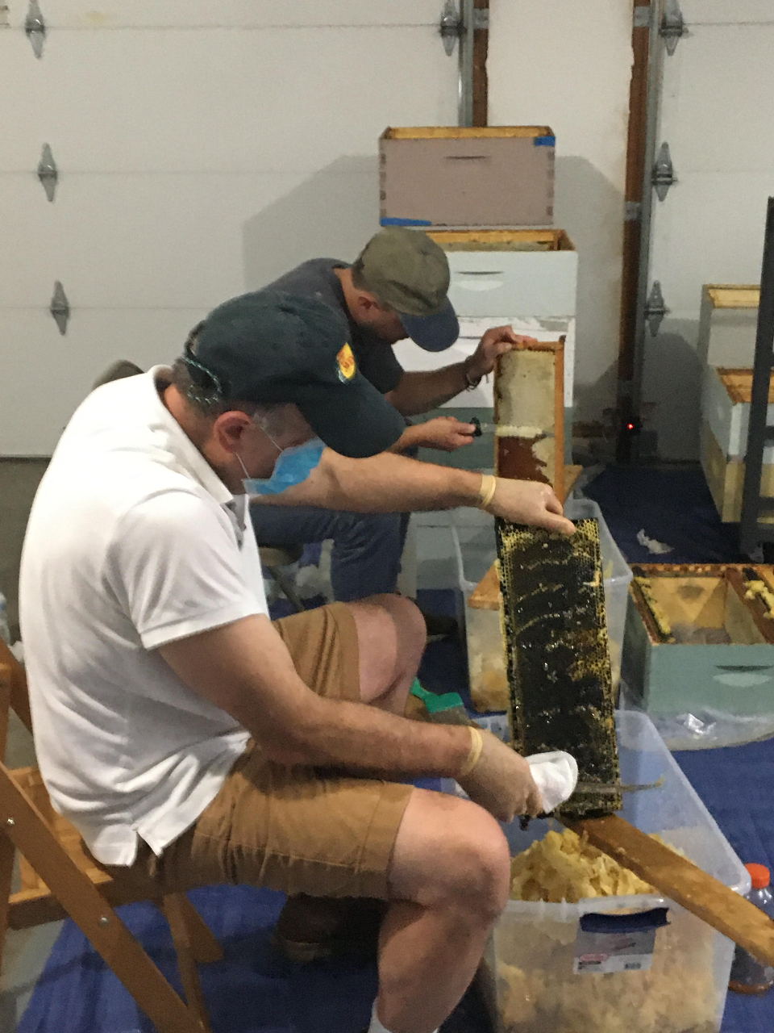
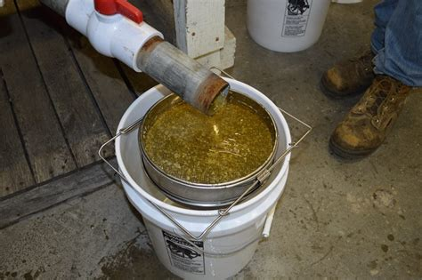
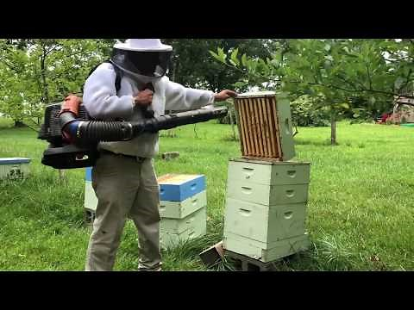
Honey Time

Slide 6

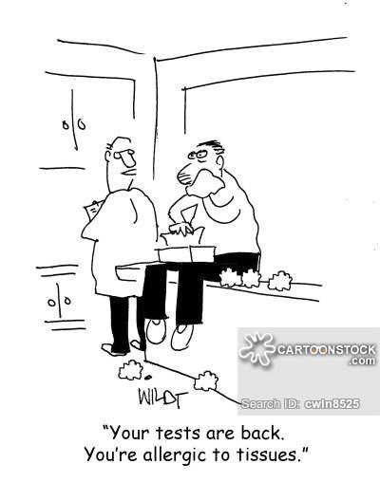
Ocular Allergic Conjunctivitis
Simple Allergic Conjunctivitis:
  Seasonal -SAC
  Perennial -PAC
Vernal Keratoconjunctivitis
Atopic
Giant Papillary Conjunctivitis
Contact Dermatitis
Phlyctenular

Slide 7

How many people have it?
50 million people in the US have seasonal allergies
Break down: 30% adults, 40% kids and the numbers are climbing every year
Over half have some form of ocular allergy!
A. Pitt and colleagues found that only 10% of patients with symptoms of allergic conjunctivitis sought medical attention for their condition

Slide 8
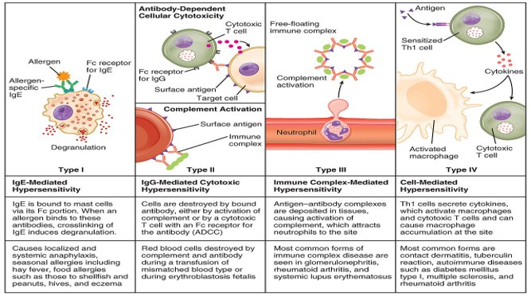
Simple Allergic Conjunctivitis:
Both SAC and PAC are caused by an
immunoglobulin E (IgE)
reaction to environmental allergens that are airborne and are Type I hypersensitivity reactions.
Notes:
VKC

Slide 9
Pathophysiology
In general, the allergic response begins when the body's immune system over-reacts to immunogens or allergens (foreign substances).
Response is either innate, or acquired
Either after multiple exposures to a particular antigen or just a singular one
The mast cell is KING!
It's function is not specific, but it is associated with:
Chemotaxis
Vasodilation
Anticoagulation
In the conjunctiva, there are 5,000 mast cells/mm
Each cell contains 5 to 10 picograms of histamine.

Slide 10
Pathophysiology
Type I allergic reaction starts when the patient is exposed to the offending antigen. Additional re-exposure begins an early-phase response and a subsequent late-phase response.
Break it down:
Mast cells----> interaction with specific allergens---->degranulate-----> discharging chemical mediators into the tissues---->causes the itching sensation---->makes people miserable!
Which is the biggest pre-formed chemical mediator?
Histamine: controls increased vascular permeability, vasodilation, bronchial smooth muscle contraction and increased secretion of mucus, as well as chemotactic factors for eosinophils and neutrophils (ECF-A and NCF).
Degranulation also releases arachidonic acid, the compound responsible for the production of leukotrienes. Both cause of long-term inflammation seen in the average allergic response.

Slide 11
Simple Allergic Conjunctivitis:
Mast cell degranulation results in:
Tearing, stringy white mucus
Lid and conjunctival chemosis, papillary response
Vasodilation (conjunctival hyperemia)
In some cases, rhinitis

Slide 12
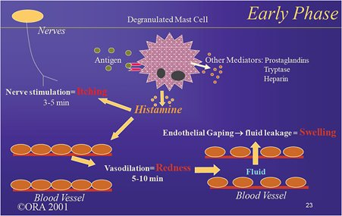
Simple Allergic Conjunctivitis:

Slide 13
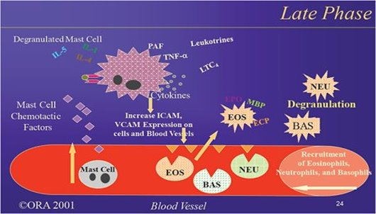
Simple Allergic Conjunctivitis:

Slide 14
Simple Allergic Conjunctivitis:
SAC and PAC, represent at least one third of all allergic conjunctivitis cases.
  Mainly affects the conjunctiva and the lids
  Share similar signs and symptoms.
The conjunctival injection is typically mild to moderate, with a moderate amount of chemosis. Itching is present in both conditions. Tearing, white mucus

Slide 15

Wait, is it Dry Eye?
Redness
Watery Eyes
Burning

Slide 16

Keep it Simple

Slide 17
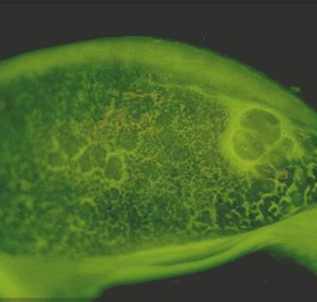

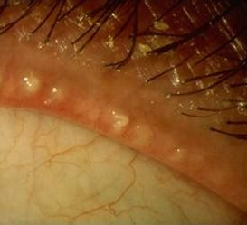

99% of the time, Just Two Questions to Answer
What time of year is it?
  Spring? Fall? Allergies
  Summer? Winter? Dry Eyes
How are the lids?
  Meibomian glands clogged? Dry Eyes
  Papillaries? Allergies

Slide 18
Can Both Happen at the Same Time?
Of course they can!
In 2015 researches reviewed 3.4 mill visits that occurred at the Veteran Affairs eye clinics between 2006 and 2011.
Both pollen counts and dry eye cases reached a yearly peak in April, when nearly 21 percent of patients seen were diagnosed with dry eye.
Overall seasonal spikes occurred each spring, when 18.5 percent of patients were diagnosed with dry eye, with another spike in winter, most likely due to low humidity caused by indoor heating.
The prevalence of dry eye was lowest in summer at 15.3 percent.

Slide 19
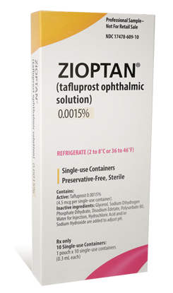
Ocular Surface Medicamentosa or Just Allergies?
Ocular Surface Medicamentosa (OSM) is also known as toxic conjunctivitis and presents the same as Ocular Allergies.
Most common cause of OSM? Preservatives in medications—BAK (most toxic), chlorobutanol, Sodium perborate and stabilized oxychloro complex (SOC) (least toxic)
Where are these preservatives most commonly found?
    In generic CTL solutions --even once in a while is a bad idea. Try Clear Care.
    Artificial Tears –using it more than 4 times a day will reverse any good it is doing
    Ocular Medications --Glaucoma drops are the most well known but genatmycin, tobramycin, anti-virals like viroptic but not ZIrgan. Some PF options for glaucoma now.
Signs and Symptoms of OSM, ocular allergies and dry eyes are all about the same with subtle differences. Best way to distinguish between all of them is the HISTORY!

Slide 20
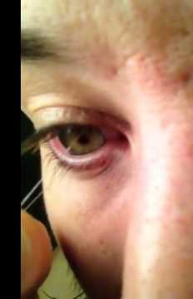
Mucus Fishing Syndrome
Usually starts with some type of irritant
Stop touching your eyes!
Histamine blocker/mast cell stabilizer
Anything else?
  Off-label use of N-acetylcysteine solution, a mucolytic agent used for respiratory conditions.
  Solution is diluted to10% and transferred into an ophthalmic dropper. Start at q.i.d. and taper it over a month until it’s used only when the patient notices the mucus.
Notes:
N-acetylcysteine solution, a mucolytic agent used for respiratory conditions. For mucus fishing syndrome, the solution is diluted to 10% and transferred into an ophthalmic dropper. Start at q.i.d. and taper it over a month until it’s used only when the patient notices the mucus. Along with histamine blocker/mast cell stabilizer.

Slide 21
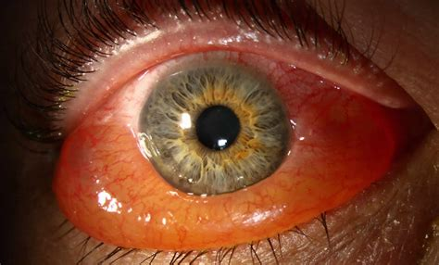
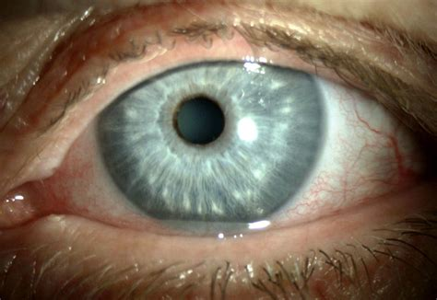
Chemosis-->Acute -->Zertec
Chalasis-->Chronic -->Surgery

Slide 22
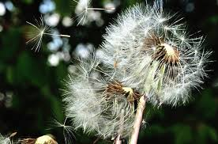
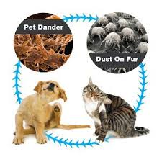
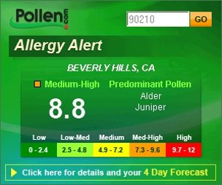
What's the Difference?
The difference between SAC and PAC:
SAC is usually caused by weed, tree and grass pollen present at certain times of the year (usually spring or summer)
PAC is caused by mites, mold or animal dander present throughout the year.
Notes:
Tree Pollen in the spring, grass pollen in the summer and ragweed pollen in the fall.
quercetin, a natural occurring substance that is found in plant pigments called flavonoids that give many fruits, flowers, and vegetables their colors. It is known to inhibit the release of histamine which is said to be responsible for the symptoms of allergies in addition to having antioxidant and anti-inflammatory effects. Food rich in quercetin include berries, apples, onions and peppers.

Slide 23

Treatment
Mast cell stabilizer/ anti-histamine—Bepreve, Pazeo
OTC----Alaway, Zaditor
Loteprednol etabonate 0.2% and 0.5%
Oral antihistamine—Zyrtec, Claritin
Cold compresses
Preventative
Allergy shots
Wash hands
Wash hair
No shoes in the house!
Air conditioning
https://www.allergycontrol.com
Notes:
Epicutaneous immunotherapy may transform allergy treatment. Patch on the skin, currently used with peanut allergies
Wrap around sunglasses.

Slide 24
Treatment
Topical decongestants (i.e. tetrahydrozoline, Visine; naphazoline, Naphcon-A) Vasoconstriction: reduces signs and symptoms
-decreases hyperemia, chemosis
-small reduction in itching
Concern: rebound hyperemia, dry eye
Antihistamines (i.e. ketotifen fumarate, Zaditor; ketotifen, Alaway)
Stops the inflammatory effects of histamine
Often used with decongestants
Systemic antihistamines can control the symptoms of rhinoconjunctivitis but only has a partial effect on ocular symptoms
Causes dry eyes

Slide 25
Treatment
Mast cell stabilizers (i.e. lodoxamide tromethamine, Alomide; pemirolast, Alamast; cromolyn sodium, Crolom address both the early and late phases of the allergic response.
Prevents:
- degranulation of mast cells
-release of preformed inflammatory mediators
-the production of more inflammatory mediators
They are most effective when administered before the allergic reaction and should be used prophylactically, but patients may notice improvements in signs and symptoms within 1 to 2 days if the drops are used following allergen exposure.

Slide 26
Treatment
Dual action antihistamine⁄mast cell stabilizer agents olopatadine, Pataday, Pazeo; alcaftadine, Lastacaft (pregnant pts) and bepotastine besilate, Bepreve.
-Inhibiting mast cell degranulation
-competitive H1 receptor binding to block histamine binding
Rapid onset of action, usually within minutes following instillation
Require only once-a-day or twice-a-day dosing
Can be used for longer-term treatment.
Notes:
NSAIDs may cause stinging and burning upon instillation.

Slide 27
Treatment
Side effects are very mild and rarely include:
headache,
cold-like symptoms,
ocular burning and stinging,
and possible transient bitter taste.

Slide 28
Treatment
NSAIDs -reduce mucus secretion, cellular infiltration, redness, and swelling, which results in the relief of ocular itching, although improvement in conjunctival hyperemia, inflammation, and swollen eyes may also be seen. Ketorolac tromethamine, Acular has a Food and Drug Administration (FDA)-approved indication for the treatment of allergic conjunctivitis.
In general, NSAIDs are used in the management of postoperative pain and inflammation after cataract surgery but not as a first-line therapy for ocular allergies.

Slide 29
Treatment
The most effective treatment? Corticosteroids because they manage all of the symptoms!
Have to worry about side effects but loteprednol etabonate (I.e. Alrex, Lotemax) was specifically studied in patients with signs and symptoms of allergic conjunctivitis prior to obtaining marketing approval.
Stronger topical steroids can be added to the treatment regimen in a brief pulse fashion during the acute phase of an allergic attack.
Avoid certain ophthalmic preservatives like BAK for patients who appear to be sensitive, particularly those suffering from chronic dry eye and glaucoma pts because their ocular surface may already be compromised.

Slide 30
Treatment
Allergic rhinitis treatment with allergen-specific immunotherapy (SIT) has prevented progression of other atopic conditions. Immunotherapy has not been proven for allergic conjunctivitis. SIT can be effective for patients with severe allergic conjunctivitis/rhinoconjunctivitis.
The predicted increase in pollen count because of climate change over the next several years will likely increase in ocular allergies.
The majority of patients with allergic conjunctivitis will self-diagnose and self-medicate.

Slide 31
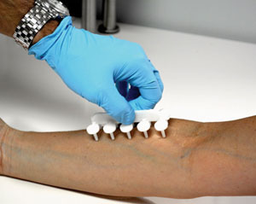
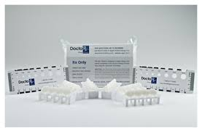
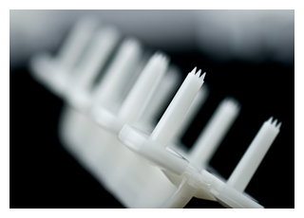
Doctor's Rx Allergy Formula
Notes:
results in 5-10 minutes

Slide 32
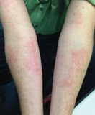
Doctor's Rx Allergy Formula
Non-invasive skin testing includes positive and negative controls
58 allergens that are regionally specific for practice’s and patient’s geographic location.
The test is covered and reimbursed by all major medical insurances and Medicare using well-established billing codes.
Patients aren't allowed to take certain medications 3 days prior

Slide 33
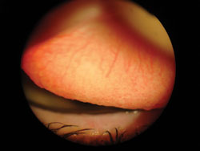
Giant Papillary Conjunctivitis
Primary and secondary forms, all at least partially caused by chronic ocular allergy
Secondary form causes:
For mild-to-moderate cases of GPC discontinues lens wear for about 2-4weeks, topical antihistamine/mast-cell stabilizer is prescribed along with a topical (NSAID) or a soft steroid such as loteprednol etabonate ophthalmic suspension 0.5%
After 1 month, if the condition has begun to resolve, the steroid and NSAID usually will be discontinued and the patient can begin wearing a daily disposal while continuing the allergy eye drop.
Contact lenses​​
Ocular prostheses​​
Exposed sutures

Slide 34
GPC
Patients refrain from lens wear for a minimum of 2 weeks
Prednisolone acetate eye drops four times a day for 1 week then begin the taper
Pts end up in a daily wear lens Since they typical don't cause GPC— WHY?
typically caused by deposits or allergens. Hydrogen peroxide base solution is necessary
Environmental factors may also play a role: air quality, heat, AC leads to
drier eyes--- more irritation and exacerbate allergies

Slide 35
Vernal Keratoconjunctivitis
Primary form of GPC
Morning misery!
The discomfort occurs upon awakening.
Vernal means spring!
Seasonal increase in signs and symptoms, high prevalence in hot, arid environments; disease flares occur during spring months, but can have signs and symptoms year round.
Most common and severe in the Mediterranean basin, West Africa, and the Indian subcontinent.
Reported that while VKC can be found in both northern and southern Europe, a higher prevalence is in the southern countries

Slide 36
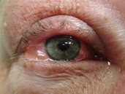
Vernal Keratoconjunctivitis
More common in males although less absolute in tropical climates.
Gender discrepancy, improvement seen during puberty suggests a hormonal influence
Associated with asthma and eczema
Age range from 1 to 22 years old may present with signs and symptoms of VKC. The disease usually lasts 4 to 10 years and resolves after puberty.
3 subtypes:
  Conjunctival
  Limbal
  Mixed presentations
Disease severity is milder in limbal VKC
GPC---off shoot

Slide 37
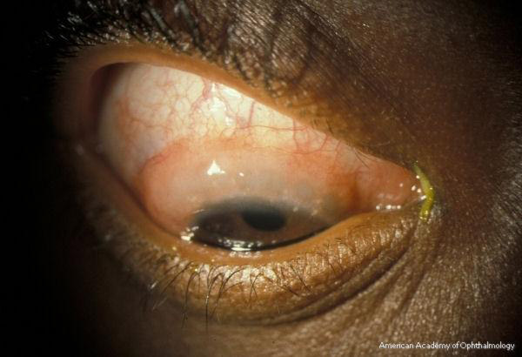
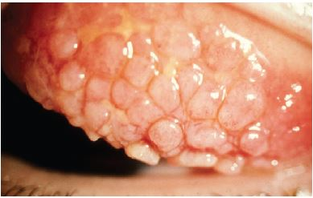
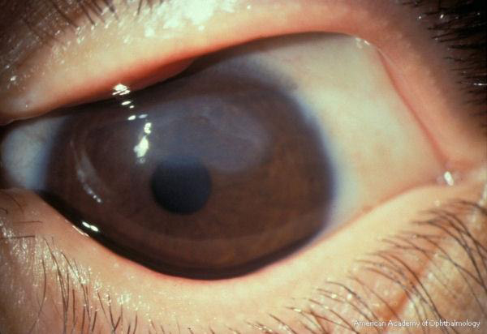
Signs and Symptoms
Eye itching
Tearing
Discharge
Irritation
Redness
Blepharospasm
Photophobia
Notes:
Horner-Trantas dots Shield ulcer Giant papillae The photophobia can be quite severe

Slide 38
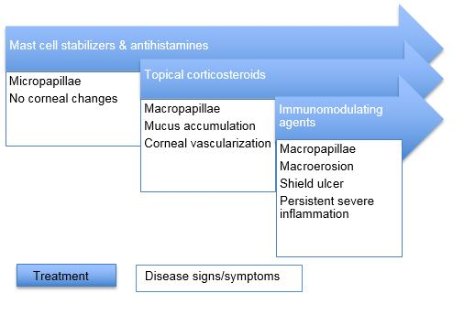
Treatment
Complications of chronic steroid use, including steroid-induced cataracts and glaucoma, have been described in up to 20% of patients.
Notes:
Type 1 hypersensitivity IgE

Slide 39
Finally, Something New!
Verkazia --cyclosporine ophthalmic emulsion) 0.1% is a calcineurin inhibitor immunosuppressant
FDA approved
Dosing is 1 drop 4 times a day
Better than steroids, 12% of pts had eye pain

Slide 40
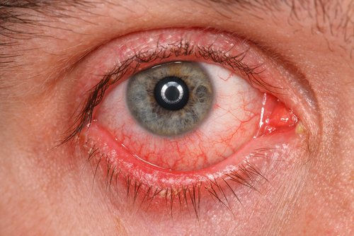
Atopic Keratoconjunctivitis
Primary form of GPC---Adult version of VKC----Mean age 35 ----History of Eczema and Asthma
Atopic keratoconjunctivitis (AKC) occurs in 20 to 43% of patients with atopic dermatitis
Can have flares of ocular surface inflammation without the dermatitis.
The corneal complications of AKC can lead to sight-threatening blindness
The lower palpebral conjunctiva is more affected than in VKC, and giant papillae can sometimes be seen in the inferior conjunctiva (never occurs in VKC).
Thickening of both the inferior and superior palpebral conjunctiva
Punctal edema or stenosis is another complication and can worsen the clearance of inflammatory mediators from the ocular surface ----> vicious cycle.
Corneal disease manifests in about 70% of patients with AKC; punctate epitheliopathy is the most common pathology and is usually greatest in the superior and inferior peripheral cornea, most likely from conjunctival and lid margin changes.
Cataracts: Posterior Subcapsular Cataracts and ASC
Severe cases can go on to limbal stem cell deficiency

Slide 41
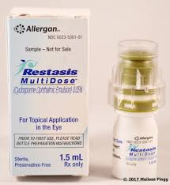
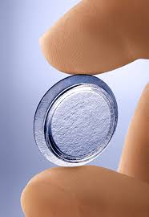
Atopic Keratoconjunctivitis
Neovascularization develops in about 60% of patients, usually severe and can be progressive enough that it leads to the visual axis
Horner-Trantas dots sometimes seen at the limbus
Increased prevalence of herpetic blepharitis (if bilateral look for atopic)and keratitis
Chronic patients who need topical steroids to control disease could also use topical cyclosporine 0.05% (Restasis, Allergan)
Antihistamines/mast cell stabilizers can help the milder form of disease--primary symptom is itching
Moderate conjunctival inflammation with corneal epithelial involvement or corneal neovascularization---> corticosteroid therapy and/or cryopreserved amniotic membrane. If a patient requires chronic corticosteroid therapy, they should also be on topical cyclosporine (calcineurin inhibitors).
Severe cases may require systemic corticosteroids

Slide 42
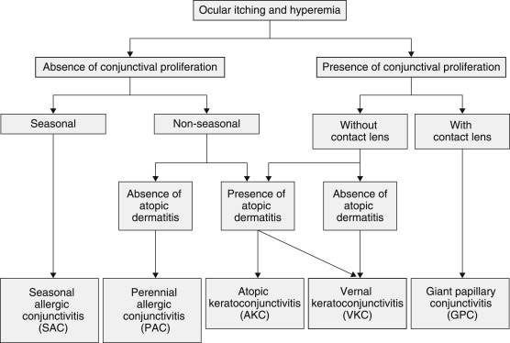
Which ONE is it?

Slide 43

Contact Dermatitis
Delayed hypersensitivity reactions --> Type IV
Skin of the eyelid has a thin epidermis, small amount of fat and high vascularity makes it more sensitive to allergens and irritants.
Upper and lower eyelids. The patient usually presents with itching, burning and red and scaly eyelids, often quickly following exposure to a noxious substance. When contact dermatitis is persistent, the eyelids typically thicken.
Most common culprits:
Ophthalmic solutions—BAK, Glaucoma meds, Maxitrol
Cosmetics—make up brushes, Cocamidopropyl betaine (CAPB),fake eyelashes, glue
Nails—artificial nails
Metals--nickle
Hair Dye--paraphenylenediamine (PPD)
Also, soaps, detergent
Notes:
IV

Slide 44
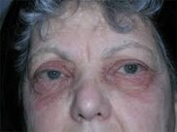
Contact Dermatitis
Treatment:
Topical steroids The most appropriate treatment vehicle in mild to moderate contact dermatitis is cream or ointment.
Examples include the ointment forms of Lotemax or FML
Maxitrol (neomycin and polymyxin B sulfates and dexamethasone)-->Some pts allergic
Oral steroids: Severe contact dermatitis is most often responsive to a short course of oral corticosteroids.
Oral prednisolone is an option but methylprednisolone may work best plus it is available as a six-day Medrol 4mg dose-pack.
Notes:
Type IV hypersensitivity reaction at the cornea or conjunctiva, following re-exposure to an infectious antigen that the host has been previously sensitized to.
0.1% triamcinolone cream. The frequency of application is proportional to the severity of the expression, but is usually t.i.d. for two to three days, then b.i.d. for two or three days, then q hs for two to three days. Triamcinolone comes in a large 15gm tube and is inexpensive.

Slide 45
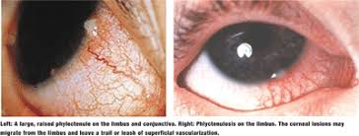
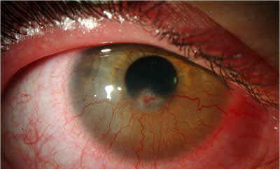
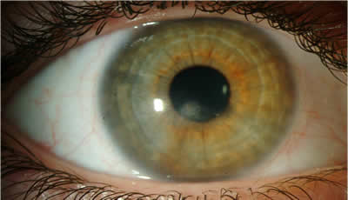
Phlyctenular Keratoconjunctivitis
Phlyctenular keratoconjunctivitis is a nodular inflammation of the cornea and conjunctiva. Type IV hypersensitivity reaction to a foreign antigen​
In the United States, microbial proteins of Staphylococcus aureus are the most common causative antigens. Also associated with TB, Herpes simplex, Chlamydia and Streptococcus​
Risk factors for S. aureus exposure include chronic blepharitis
Delayed cell-mediated reaction. May have an association with ocular rosacea, asthma and allergies. ​
Phlyctenular nodules can lead to ulceration, scarring and mild to moderate vision loss.
Notes:
12yo prednisolone acetate 1% which was initially used every 2 hours while awake. She was treated with a 1 week course of topical gatifloxacin drops four times daily (to prevent infection at the epithelial defect) and a 3 week course of TobraDex® ointment at bedtime. Management of chronic blepharitis was achieved by reinstating a strict program of lid hygiene and warm compresses, along with reinstituting doxycycline 100 mg orally twice daily for one month and then once daily thereafter.

Slide 46
Phlyctenular Keratoconjunctivitis
Treatment:
Topical steroids (which one depends on severity)
Cyclosporine A
Corneal ulceration-- Fluoroquinolones, Cryopreserved amniotic membrane
In addition to treating the inflammatory response, it is important to decrease the source of antigens inciting the inflammation.
This usually requires treating the associated blepharitis or underlying infectious process. In cases of blepharitis, lid hygiene with warm compresses (masks) and lid scrubs should be started. BlephEx, LIdPro, pure o.o1% hypochlorous acid (HOCl) (Avenova), Terpinen-4-ol--active ingredient in tea tree oil (Cliradex, Cliradex light)
Notes:
Daily lens with bleph ex
Adjunctive treatment with oral doxycycline may also be of benefit. In children under the age of 8, erythromycin is preferred to prevent dental discoloration from tetracycline use

Slide 47
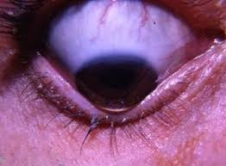
Really, don't scratch that itch!
Clinician and researcher Damien Gatinel, PhD, MD, strongly believes that keratoconus is caused by patients rubbing their eyes and sleeping with their faces against the pillow.
In his experience: "KCN progression has only been observed in patients who admit to being unable to abandon their eye rubbing habit. This is strong indirect evidence that eye rubbing is the root cause of the KCN. Documentation of each of these cases are accessible through the following website: https://defeatkeratoconus.com/."

Slide 48
X-Linking
All k-conus pt
Cold compresses
Antihistamine
PT EDU
Not to rub eyes and family history

Slide 49


