Slide 1

Guiding OUR Cataract Patients
By: Alan Solinsky, MD

Slide 2
Disclosures and Contact Information
I do not have any disclosures.
Alan Solinsky, MD
AlanSolinsky@SolinskyEyeCare.com

Slide 3
Objectives
The objective of this course is to discuss the best IOL options for our patients who are getting cataract surgery.

Slide 4


All About our patients
What's the Patient’s personality Type —Easy going or Type a?
the patient’s visual goals help to select the appropriate IOL:
  Is it more important for the patient to see distance, intermediate and/or near?
  Do they no longer want to wear glasses for some activities? Or, just here and there?
Knowing their hobbies and INTERESTS will narrow down the iol choices.

Slide 5

Working Distance
EDOF(extended depth of focus) lenses: Works better for taller patients where the patient’s working distance will be farther out.
Multifocal lenses: Works better for shorter patients since the reading distance will be much closer.

Slide 6
Preop Refractive Error
Hyperopic patients are typically happy no matter the IOL because they’re already depending on glasses for things far away and up close.
Moderate myopes (between -2 and -4 D) take off their glasses to read. Take away their near vision they'll be very upset with you!
High myopes wear glasses all the time. They have a lot of options:
Monofocal set for near
EDOF set for -1 D --gives them some distance blur but more range up close
Trifocal set for plano where they’ll still get that 20/20 distance and near vision.

Slide 7


Younger iol Patients
Younger cataract patients or young refractive lens exchange patients --must think of the future when selecting an IOL.
EDOFs would be a good option since they prevent glare and halos.
If they develop an epiretinal membrane, macular edema or diabetic retinopathy. Those patient would still be able to function with an EDOF.

Slide 8
Pathology and IOL selection
Corneal pathology?
  Due to the pathology, light will scatter before it hits the IOL.
  Quality of the light leaving the lens is poor and won’t focus properly
  Monofocal IOLs and LAL (light adjustable lens) IOLs would be the best choice.
Posterior pathology?
  The retina doesn’t sense light appropriately because there is less activity of the photoreceptors.
  If you inplant a multifocal lens in these patients, it splits it into multiple focal points (less light for each focal point).
  Monofocal is the best choice, but those patients can do well with an EDOF lens.

Slide 9

Patient education
The more the preoperative biometry and topography measurements match, the easier it is to select the lens; the less they match, harder it is to select the proper lens.
The IOL selections that are the most difficult? They are the ones who don’t want to wear glasses and want full spectacle independence but also have pathology
These patients require extra time!!!
  1) Can the pt tolerate the loss of near vision?
2) Can the pt tolerate a little bit of monovision?
3) Can the pt tolerate both eyes having a slight distance blur (make them a low myope) but near vision?
There are no perfect lenses, and that’s where all of the preoperative counseling comes in.

Slide 10
Previous Refractive Surgery
LASIK, RK and RGPs can change the shape of the cornea:
Will cause a small loss of contrast sensitivity
Significant when the patient ages
It causes an issue if a multifocal IOL is used because the multifocal IOL decreases contrast sensitivity
Decreasing contrast sensitivity decreases quality of vison –Can make the patient very unhappy!
Post refractive surgery:
Patients either have normal topography or irregular astigmatism
With irregular astigmatism --Eyes won’t refract light properly
Just like the corneal pathology patients, monofocal IOL or LAL would be the best.

Slide 11

The 5 W’s!
WHO: The Patient has a problem
WHAT: With vision, glare, halos
WHERE: Outside, inside on the beach, night
WHEN: Driving, reading, sewing, golfing
WHY: To see better

Slide 12

Managing Expectations
All patients have:
“My BFF”
My Best Friend can see perfectly without glasses!
You have to set realistic expectations for them based on their history & anatomy

Slide 13

Managing Expectations
Today’s patients want to see great the next day:
Read
Use the computer
Drive
Golf

Slide 14

Based on the History and Exam
Educate the patient for their best option
Astigmatism correction with toric
Multifocal Correction
Multifocal with Toric correction

Slide 15
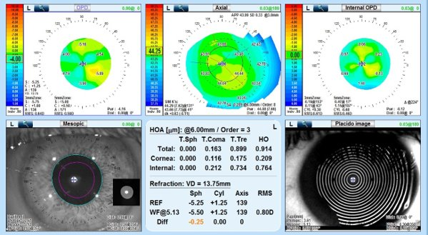
Good Multifocal Candidate

Slide 16
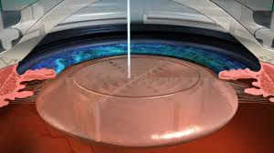
Patient videos
While dilating, show the patient videos and give them brochures for the treatment that they will best benefit from:
Laser Assisted Cataract Surgery
LAL
Astigmatism LRI or Laser AK correction
Toric
Multifocal
Multifocal Toric
Mono or blended vision

Slide 17
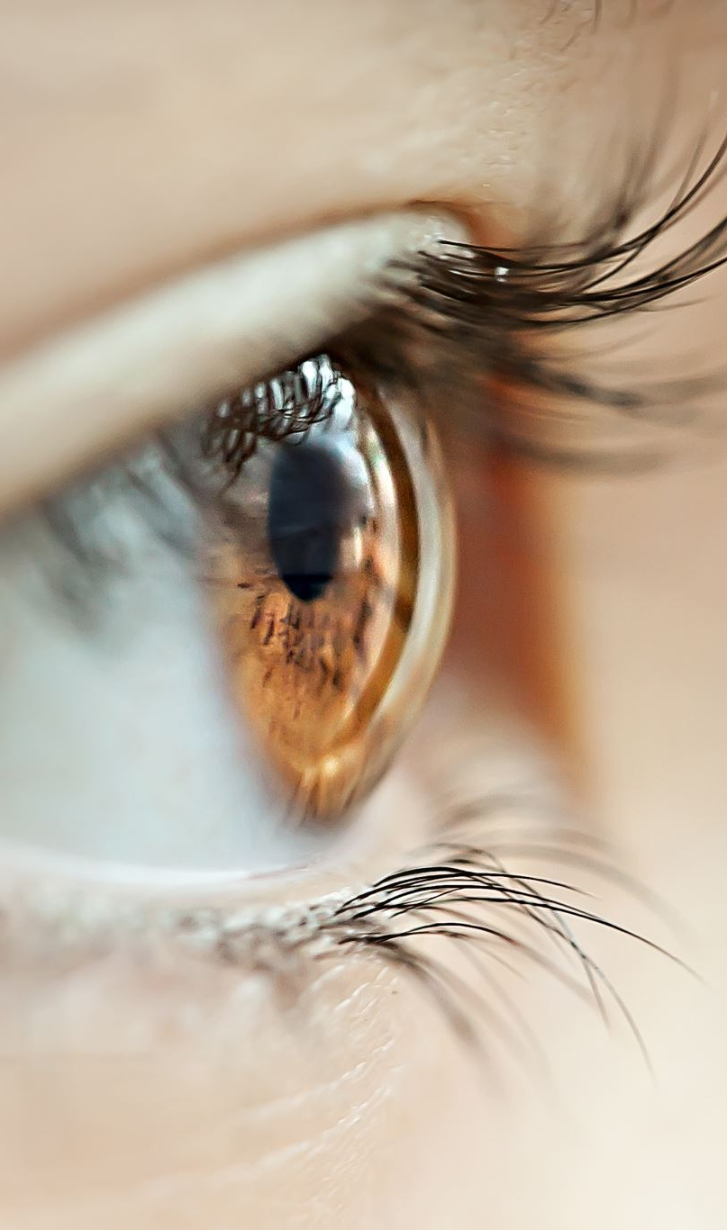
Look for Dry eye
Symptoms:
Let patients know that they have OSD.
They Need to understand that OSD symptoms will likely be exacerbated by the surgery but that it is not from the cataract surgery.
Infection:
Treating blepharitis & eradicating the bacterial load around the eye is extremely important pre & post-operatively for patients.
Educate on the role of infection prophylaxis when it comes to normalizing the ocular surface before cataract surgery.

Slide 18
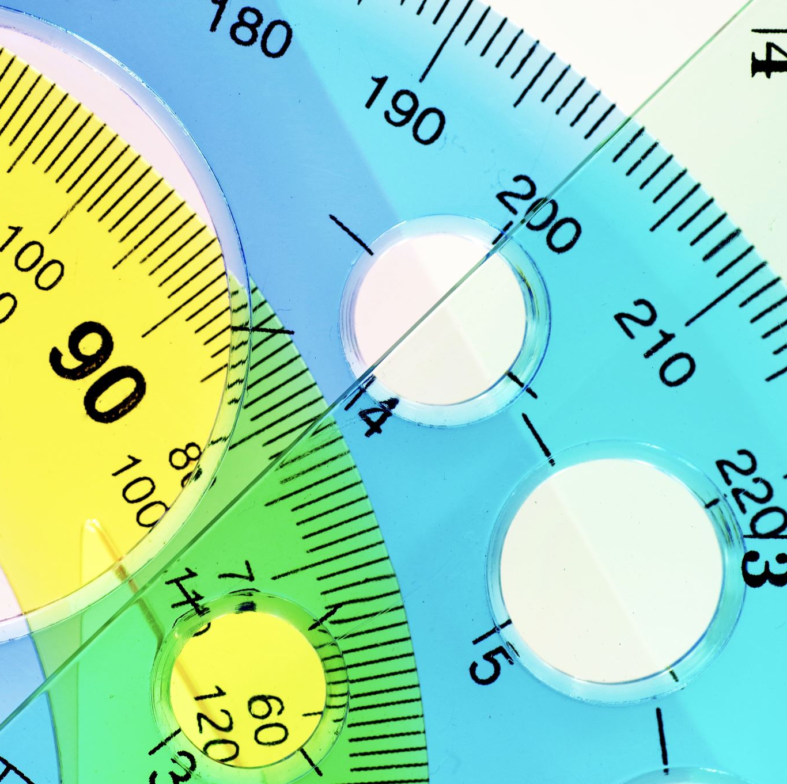
DRY EYE
Measurements:
To ensure both accurate surgical measurements & the IOL power calculations, the ocular tear film must be healthy.
The tear film affects the accuracy of the sphere power & astigmatic measurements.

Slide 19
Prior to referral
What ODs should do:
Stain either with lissamine green/fluorescein and measure tear breakup time to evaluate stability of the lipid layer.
Look at and under the lids, push on the meibomian glands, and perform tear film analysis (ie TearLab) and InflammaDry.
Consider Miebo, Tryptyr, Cequa, Omega 3s, lipiflow, IPL/RF
IN SEVERE PATIENTS, A SHORT COURSE OF STEROIDS (ie, EYSUVIS, LOTEMAX, FLAREX) TO QUICKLY RESOLVE TEAR FILM INFLAMMATION & PREPARE THE OCULAR SURFACE FOR SURGERY.

Slide 20
Pre-Op assessments
WHAT THE SURGEON WILL DO:
WILL LOOK FOR IRREGULARITIES ON TOPOGRAPHY SINCE THEY CAN HAVE AN IMPACT ON THE CYLINDER MEASUREMENTS. Another option would be to wait and repeat measurements after dry eye treatment.
IF THE OCULAR SURFACE IS SUFFICIENT AND THE TOPOGRAPHY IS CLEAR, THEN WE CAN OFFER PREMIUM IOLS TO THE PATIENT AND BE CONFIDENT IN THE RESULTS. IF PATIENTS HAVE MEASUREMENTS THAT ARE SUBOPTIMAL, THEN I WILL RECOMMEND A MONOFOCAL IMPLANT or LAL.
PATIENTS WHO ARE NOT CANDIDATES FOR PREMIUM TECHNOLOGY TYPICALLY INCLUDE THOSE WITH CHRONIC PUNCTATE KERATITIS — USUALLY A RESULT OF SEVERE AUTOIMMUNE DISEASE.

Slide 21
Pre-Op assessments
Patients need to know that their eyes aren't ideal. Corneal issues, macular issues, and refractive errors, can all contribute to unsatisfied patients.
Wait and repeat measurements after dry eye treatmentst
Surgeons evaluate surgical patients for astigmatism, corneal dystrophies or corneal irregularities due to scarring or trauma; and diseases such as glaucoma, macular degeneration, or epiretinal membrane in the posterior segment.

Slide 22
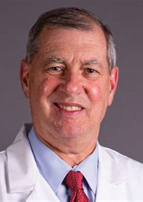
Words to remember
"If you find the problem before you operate, it is the patient's problem; if you find it after you operate, it is your problem!"
~Eric Donnenfeld, MD

Slide 23
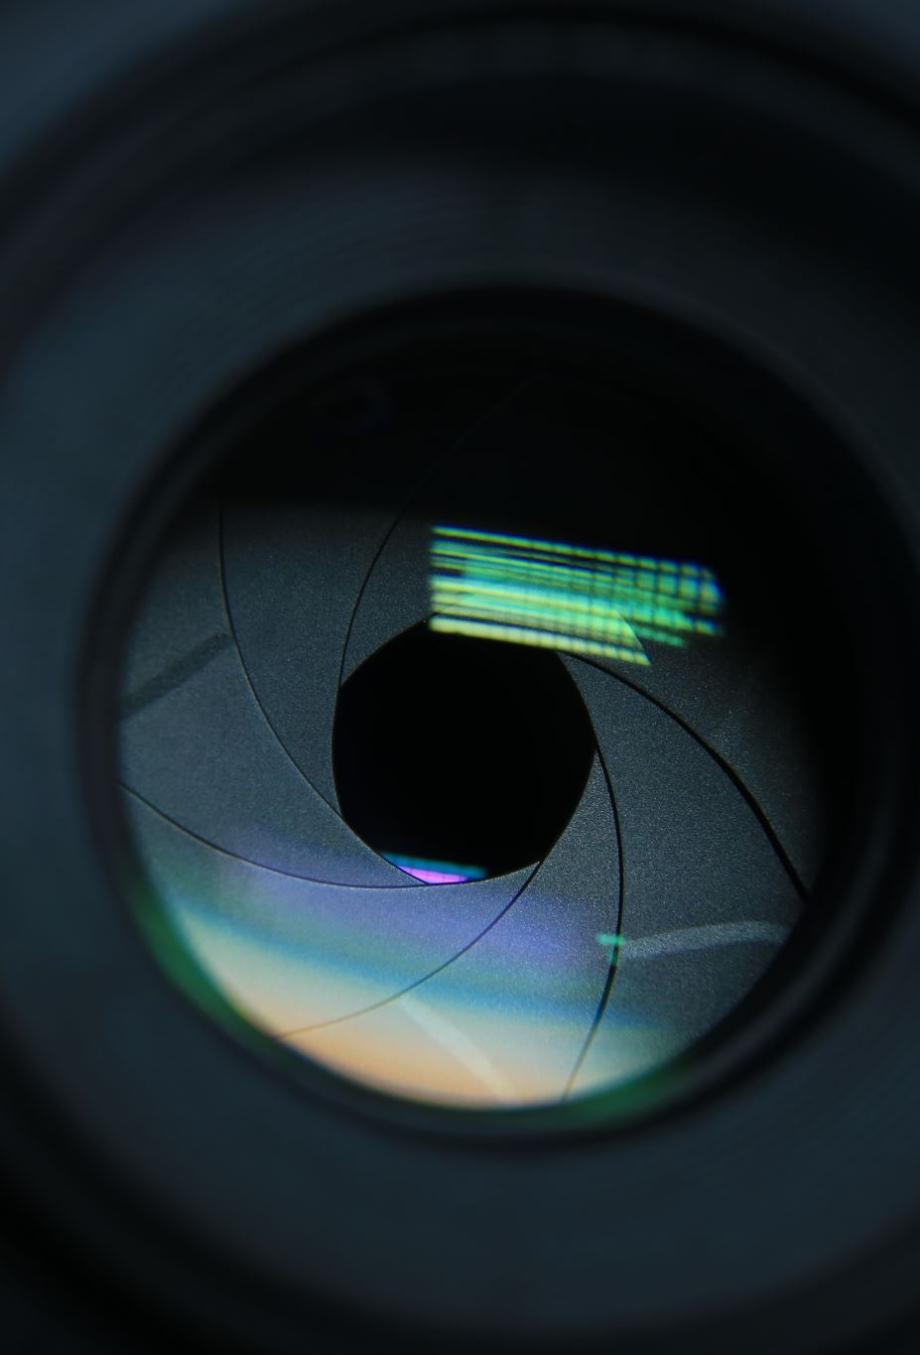
IOL OPTIONS
Pan Optix Trifocal Lens (Alcon)
Vivity IOL (Alcon)
Eyhance Tecnis IOL (J&J)
Odyssey IOL (J&J)
Apthera Lens (B&L)
Accurasee
Clearview
Light Adjustable Lens

Slide 24
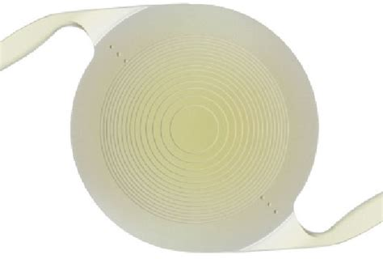
Pan Optix Trifocal Lens (Alcon)
Replaces the ReStor lenses
Available as a toric lens
Provides excellent distance, intermediate and near vision
Works as a multifocal lens

Slide 25
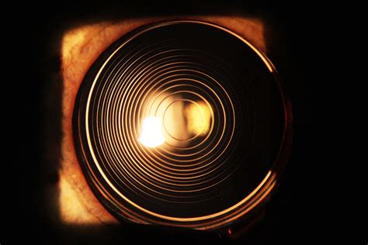
Pan Optix Trifocal Lens (Alcon)
Side effects:
  Glare
  Rings
  Starbursts
  Reduced contrast sensitivity
Minimize side effects by measuring angle alpha, kappa, coma

Slide 26
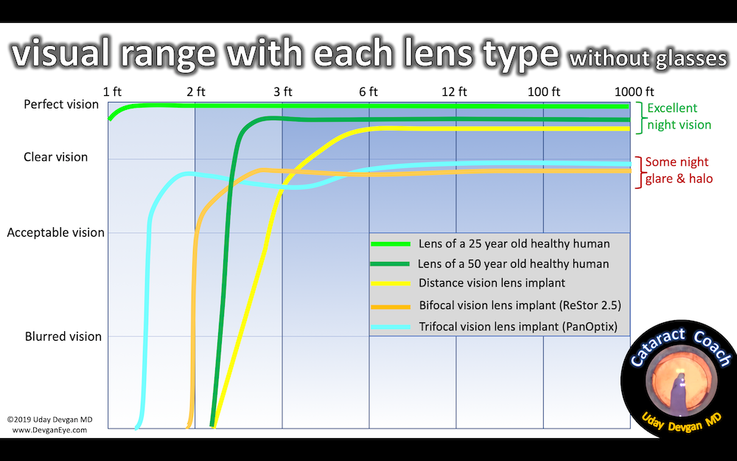
Pan Optix Trifocal Lens (Alcon)
99% of people with PanOptix would have it implanted again
98% of people with PanOptix would recommend it to a friend
80.5% never wear glasses
11.4% rarely use glasses

Slide 27
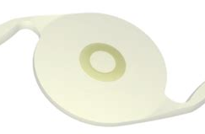
Vivity Intraocular Lens (Alcon)
Distance and intermediate (some near)
Extended vision
Available as a toric
Does not use rings (not a multifocal)
Fewer side effects of:
  glare
  halos
  starbursts

Slide 28
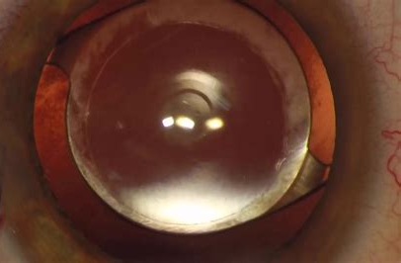
Vivity Intraocular Lens (Alcon)
Extended focus is achieved through wavefront -shaping technology on the anterior surface
Bends light rays to focus on the cornea
Not depended on Angle kappa or coma (a more forgiving lens)
Intermediate 20/25 or better: 37% vs 9% monofocal blended vision
Intermediate 20/40 or better: 40% vs 10% monofocal blended vision

Slide 29
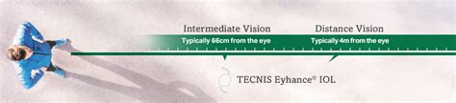
Eyhance Tecnis IOL (J&J)
Distance and intermediate
Enhanced intermediate
Not a multifocal
Available as a toric
Low incidence of:
  Glare
  Halo
  Starburst
  Comparable on monofocals

Slide 30
Odyssey IOL (J&J)
Combination multifocal and extended depth of focus technologies
Continuous distance and intermediate vision
Broad range of continuous vision
Eliminate visual gaps
Superior contrast sensitivity and low-light performance
Compared to similar IOLs, new design decreases:
  glare
  halos
  starbursts

Slide 31
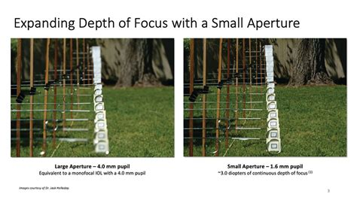
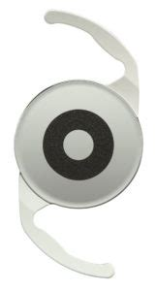
B&L APTHERA Lens
Extended depth of focus
Small aperture mitigates the effects of presbyopia and lessen the impact of corneal aberrations in cataract patients, improving vision in eyes with corneal irregularities, scars, or iris damage
The wavefront-filtering, small aperture design, channels central light rays to the retina and filters out stray and unfocused peripheral light that degrades image quality. Minimizing the impact of corneal aberrations, providing an increased range of vision from far to near with more than 2.5D of extended depth of focus

Slide 32
AccuraSee™
AccuraSee™ is an intraocular pseudophakic contact lens (IOPCL) used to improve near vision in patients with macular degeneration.
The AccuraSee™ lens implant is placed to help magnify images and allow patients to use parts of the retina that are not affected by macular degeneration. It is placed on top of an existing posterior chamber intraocular lens implant for patients who have had previous cataract surgery.
The AccuraSee™ IOPCL is under clinical investigation in the U.S. (approved IDE) for an early feasibility study (EFS). The intraocular pseudophakic contact lens (IOPCL) is an investigational device. Limited by Federal (or United States) law to investigational use.

Slide 33
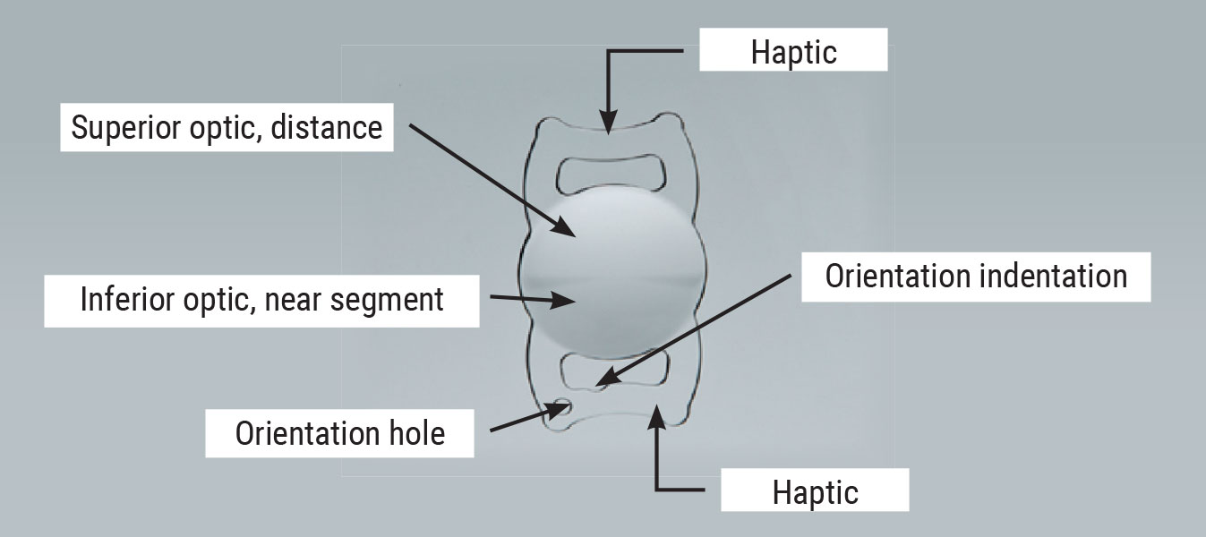
ClearView IOL

Slide 34
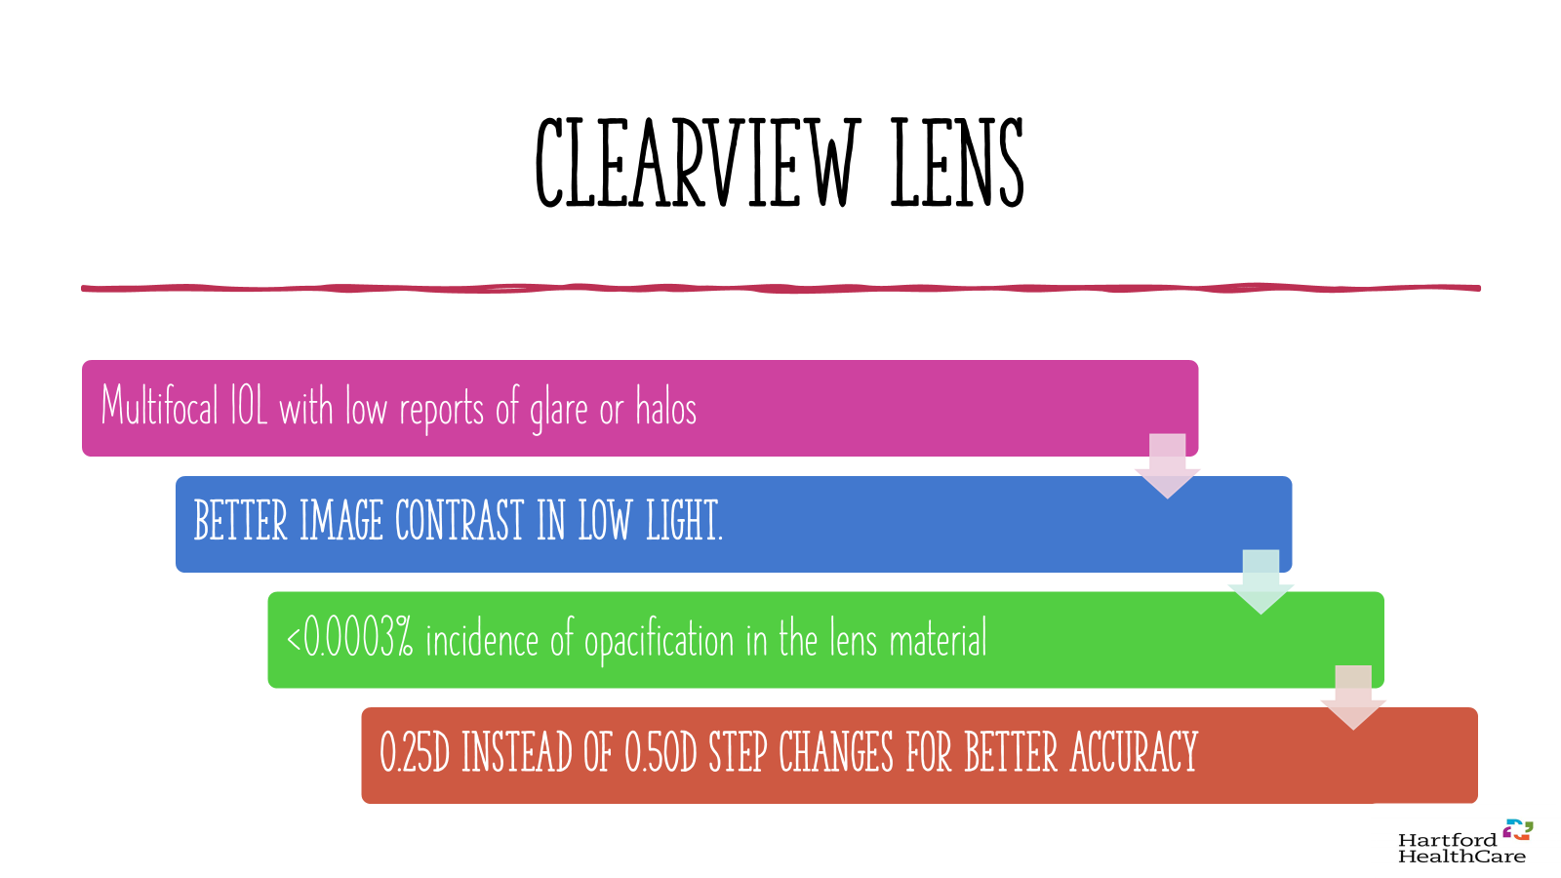

Slide 35
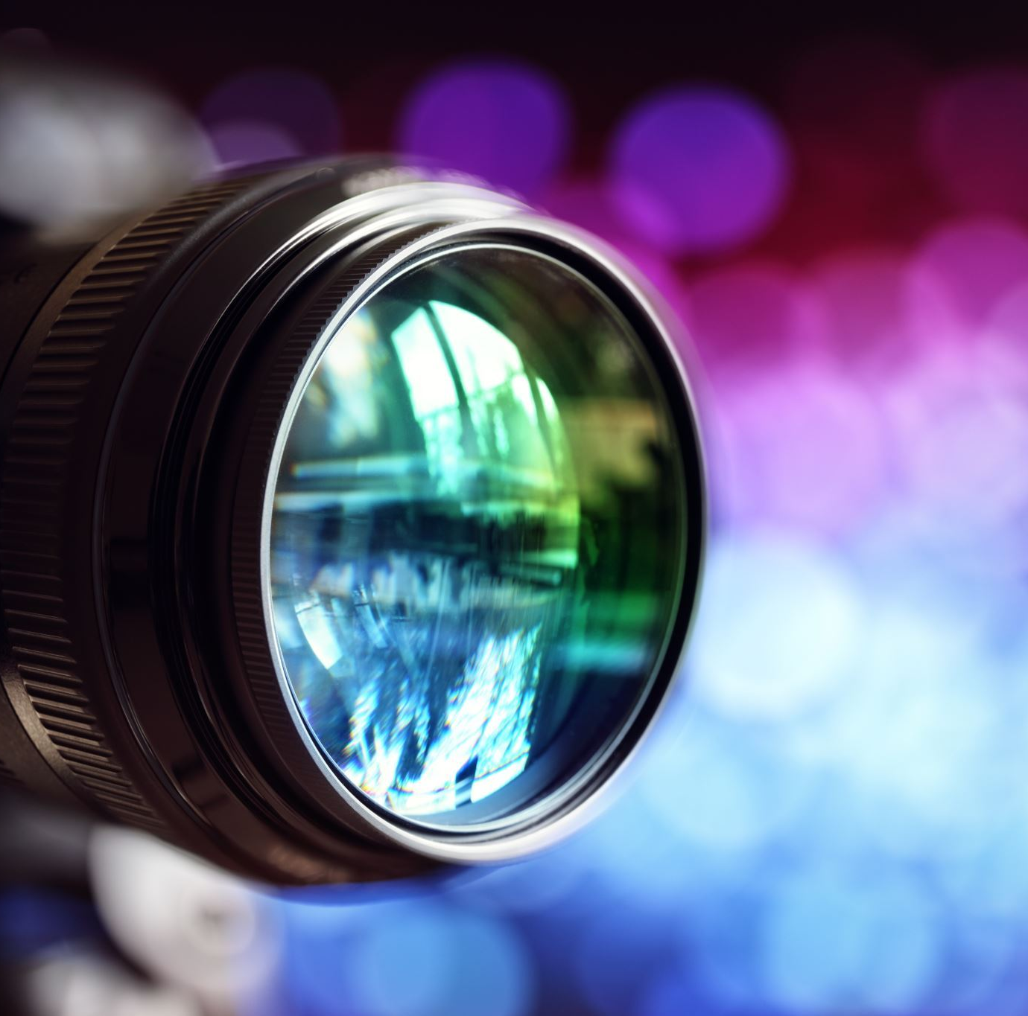
Light Adjustable Lens (LAL)
The Light Adjustable Lens (LAL) is the only IOL that enables the doctor to trial, and then customize the patient's vision after cataract surgery.

Slide 36
Pupil size
The pupil size is important for multifocal and aperture-type lenses. If a patient’s pupil is smaller than the central zone of the optic, the patient may not get as much effect from the IOL’s multifocality, depending on the type of lens. Knowing the pupil size helps in the decision making process.
For LAL, patients need a pupil size of about 6 mm or more. Having adequate pupil size with the LAL is important for adjusting the entire surface area of the lens.

Slide 37
Who Would Benefit from LAL?
Post RK
Post Lasik
Corneal scarring
Hypermature cataracts
Previous Monovision CTL patients (who were successful)
Long time RGP wearers
Very fussy patients

Slide 38
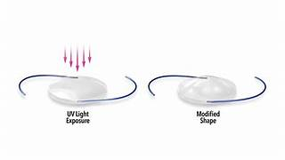
Fixed vs. Adjustable
Fixed: The patient decides upon their vision goals before vision restoration surgery. The IOL power is calculated using predictions regarding individual vision requirements
Adjustable: The patient and surgeon choose the vision goal after surgery and after vision is restored. Patient gets to trial their new vision after surgery and decides what works best for their lifestyle
There are now two categories of lenses—fixed and adjustable
The Light Adjustable Lens is the only adjustable lens—all other lenses are fixed
§Fixed lenses Include:
§Multifocal
§EDOF
§Toric
§Monofocal

Slide 39
How the Light Adjustable Lens Works
The Light Adjustable Lens is made of a special photosensitive material that changes the shape and power of your implanted lens in response to ultraviolet (UV) light to optimize your vision
The Light Delivery Device™ (LDD™) non-invasively delivers this UV light to precisely reshape your lens based on the visual correction that is needed to target your custom prescription
RxSight offers two lenses in the Light Adjustable Lens platform: the Light Adjustable Lens and the Light Adjustable Lens+. Your doctor will determine the lens that is best suited to your eyes
Both the LAL and LAL+ provide the same opportunity to customize your vision with your doctor after surgery

Slide 40
LAL Options
RxSight offers two lenses in the Light Adjustable Lens platform: the Light Adjustable Lens and the Light Adjustable Lens+.
LAL plus which functions as an EDOF gives intermediate VA
Both the LAL and LAL+ provide the same opportunity to customize your vision with your doctor after surgery

Slide 41
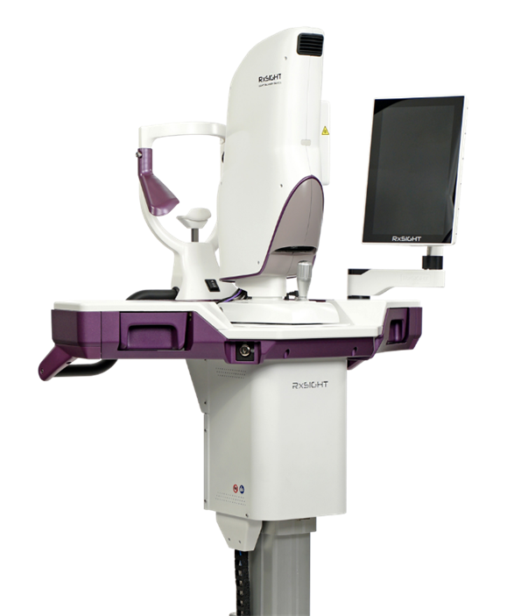
Light treatments are painless, non-invasive, and take approximately 90 seconds.
Initial Light Treatment
At least 17 days after surgery
Secondary Light Treatment
At least 3 days after initial light treatment
Additional Light Treatments
As desired. At least 3 days after each prior light
treatment

Slide 42
What to Expect After Surgery
About three weeks after your cataract surgery, you’ll visit your doctor’s office to begin the light treatments to customize your vision
During these visits, you and your doctor work together to achieve the best possible visual outcome—the vision that’s best for you and your lifestyle
Studies have shown that patients who received the Light Adjustable Lens and the recommended post-surgery treatments were almost twice as likely to achieve 20/20 vision or better without glasses compared to cataract patients who have standard lens implants²
2. RxSight P160055: FDA Summary of Safety and Effectiveness Data. 2017.

Slide 43
What to Expect After Surgery
RGP pts should have three consistent pre op measurements two weeks apart
After surgery the cornea continues to revise its shape and the LDD treatments can treat it.
RK pts have to wait at least 5 weeks to adjust after two consistent refractions.

Slide 44
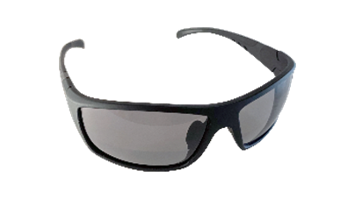
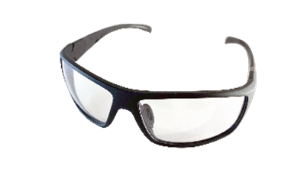
UV Protection
While your vision is still in the adjustment phase, you will be required to wear glasses that prevent UV light from altering your lens to protect it before the final lock-in.
There are two ways you will be protected:
UV glasses: protect the Light Adjustable Lens from UV light sources. Only needed prior to rx being locked in.
ActivShield: UV protective layer built into the Light Adjustable Lens that protects against incidental sunlight exposure and automatically opens for light treatments and closes when complete
3. RxSight P160055: FDA Summary of Safety and Effectiveness Data. 2017

Slide 45
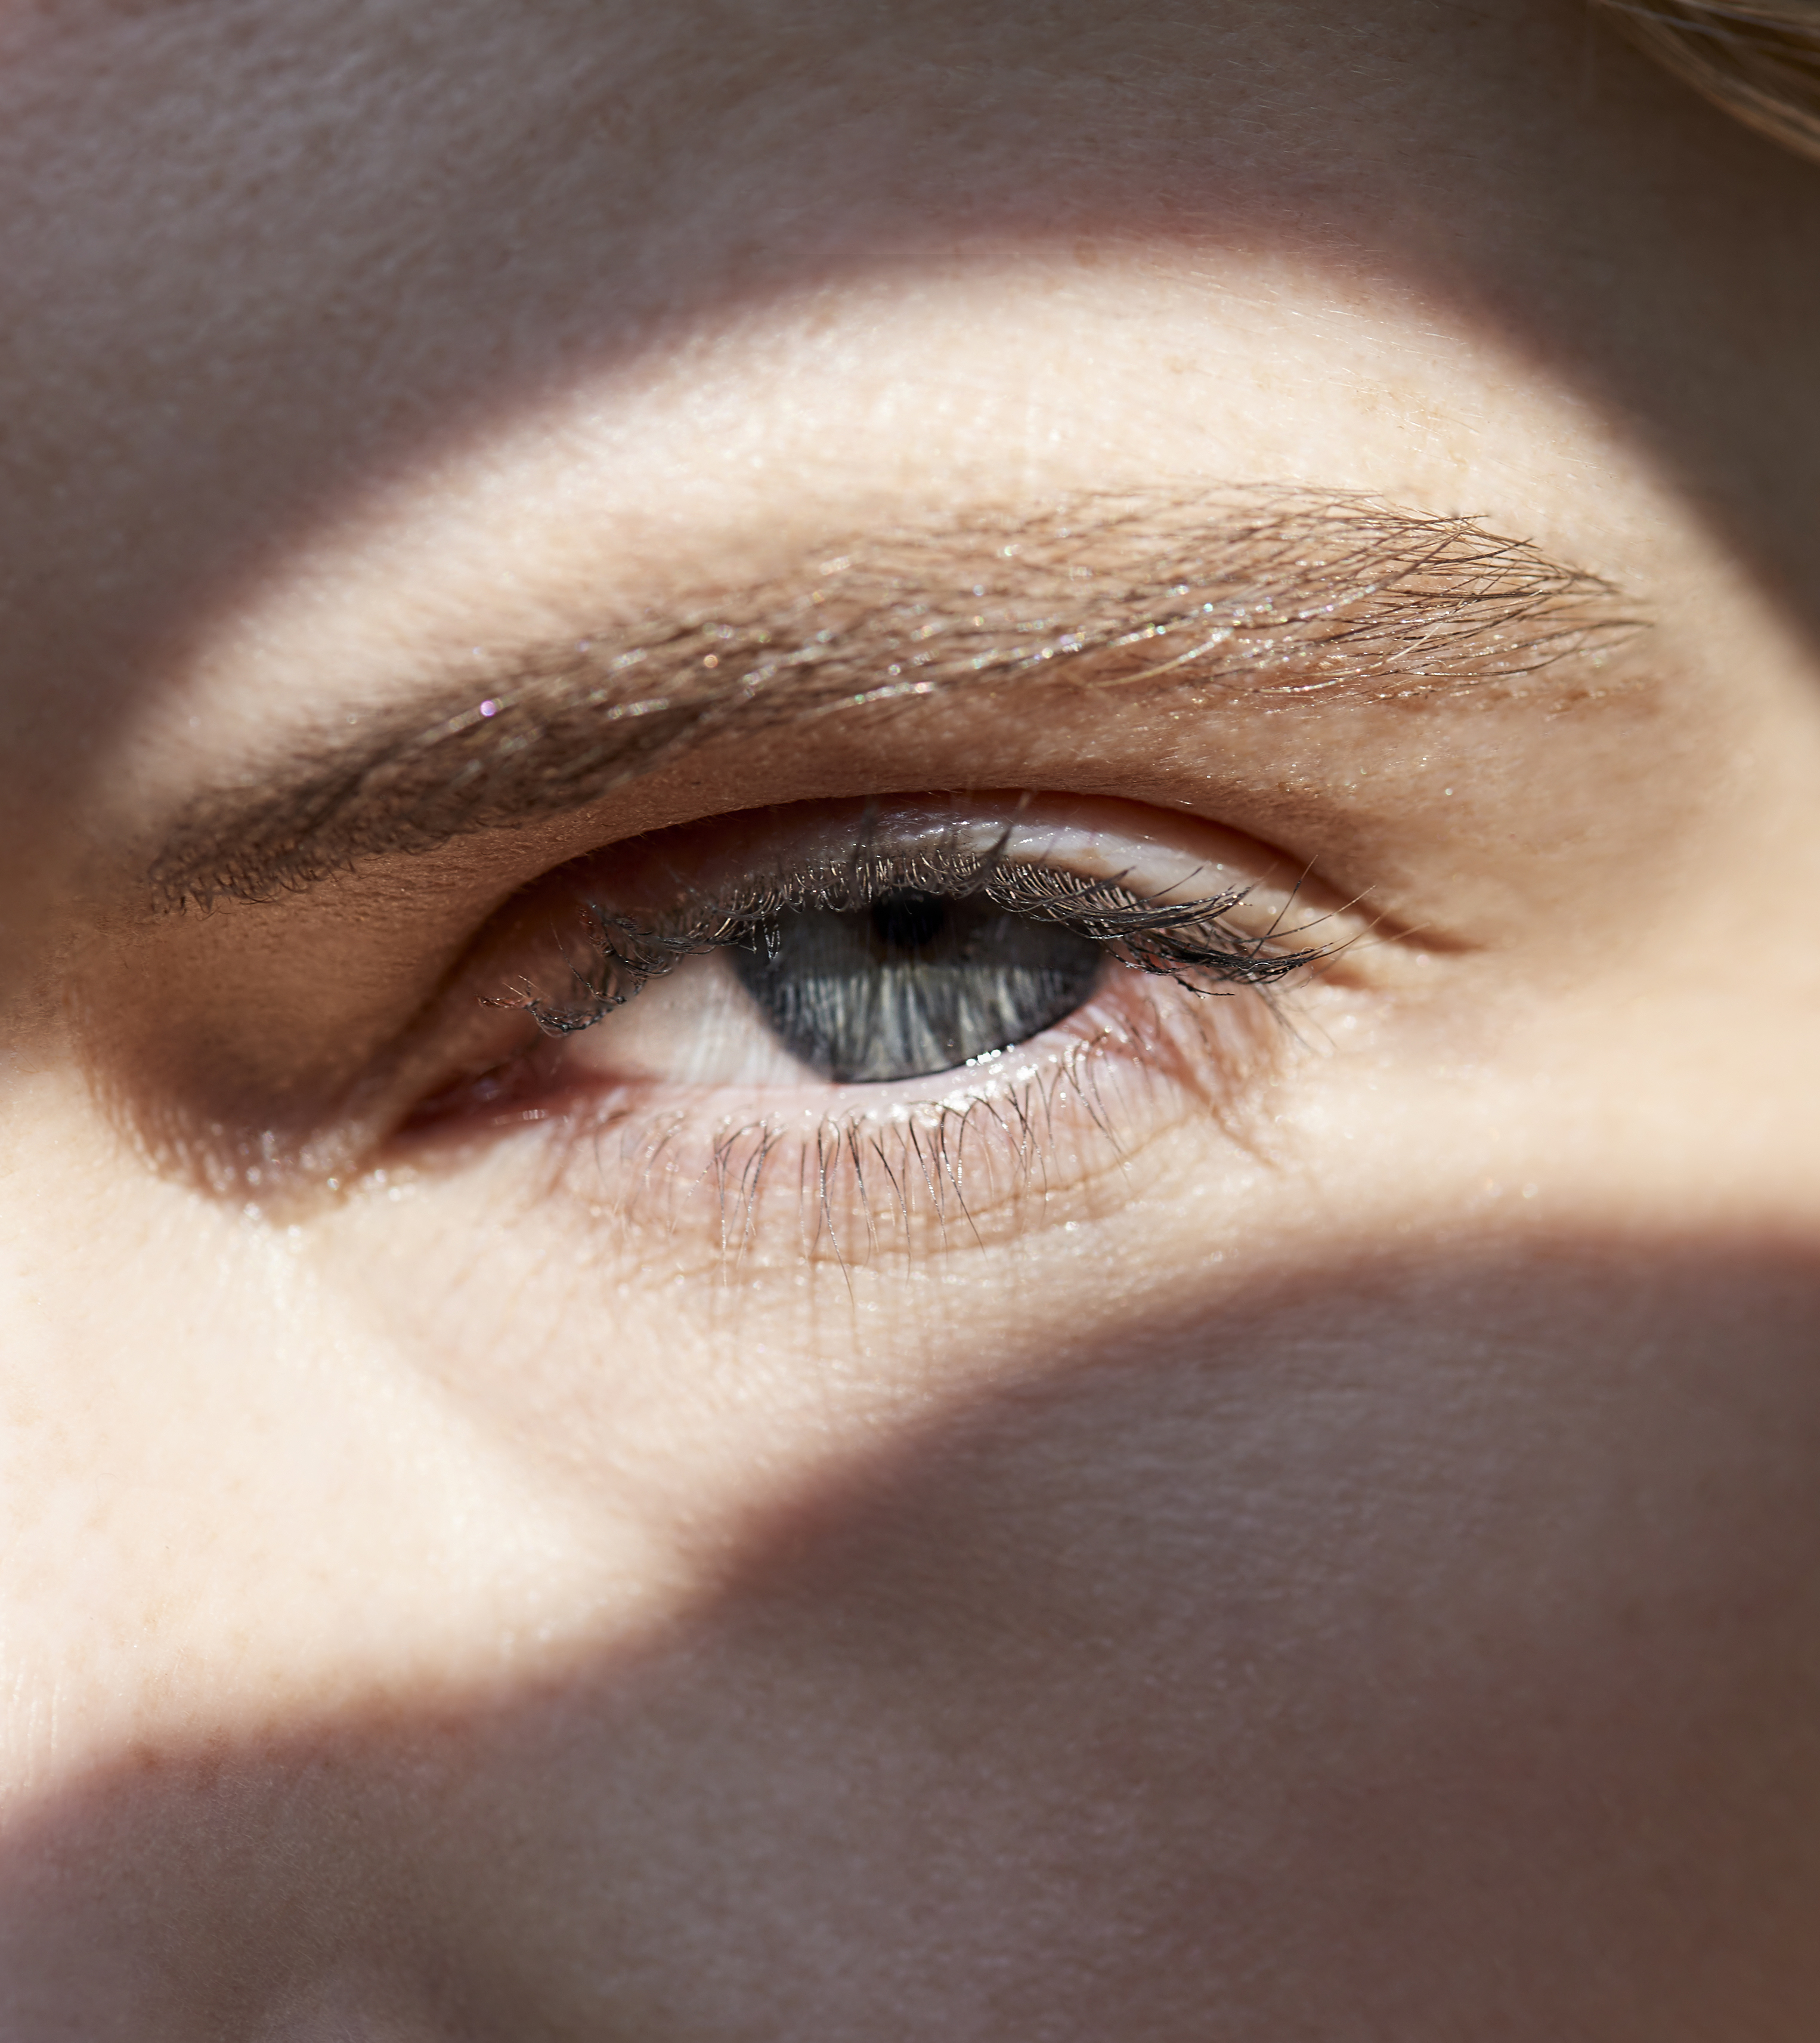
Light Adjustable Lens
--> The Light Adjustable Lens can be adjusted by the LDD up to THREE times!
--> Additionally, the Light Adjustable Lens receives A lock-in treatment to finalize the power

Slide 46

POST-OP CARE

Slide 47
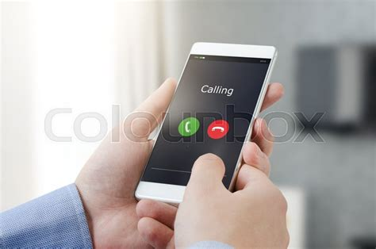
Not Normal for the Patient
When to call the surgeon:
Increased pain and/or redness
Decreased vision

Slide 48
Normal but NOT to the Patient
Reassure:
Vision should start to return the eye within a few hours of surgery, but it may take a few days for vision to fully return.
It's normal for the patient to have:
Grittiness
Watering
Blurred vision
Double vision
Red or bloodshot eye
These side effects usually improve within a few days, but it can take 4 to 6 weeks to recover fully.

Slide 49
The 6 C’s For The Unhappy Post-Op patient
Cornea
Cylinder
Centration
Capsule
CME
Condensation
~Eric Donnenfeld, MD

Slide 50
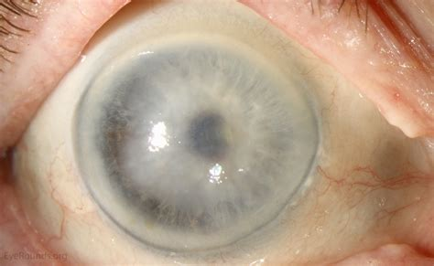
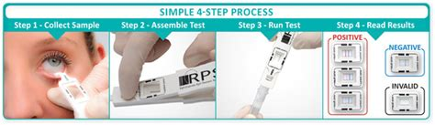
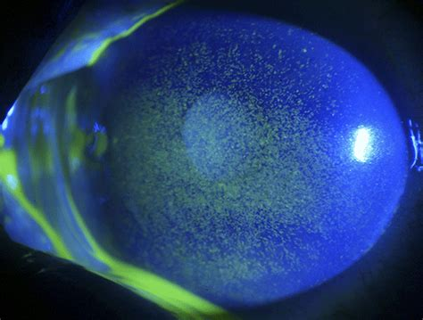
Cornea
History: Does vision fluctuate with blinking, is there burning and tearing
Check the layers of the cornea
Check the tear film at the slit lamp
Check tearlab and inflammadry

Slide 51
Cylinder
Check vision
Pinhole
Refract
OPD Retroillumination
One degree of rotation will decrease toric power by 3%
Refer back to surgeon to rotate toric lens or LASIK touch up.

Slide 52
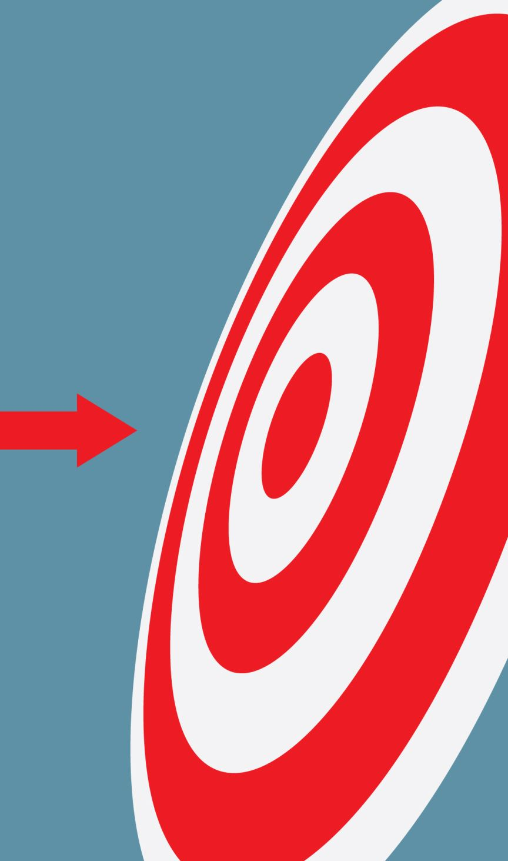
Importance of Hitting Target with Toric IOLs
1 degree rotation = 3.3% loss of effect
10 degree rotation = 33% loss of effect
30 degree rotation = 100% loss of effect
More than 30 degree rotation induces new astigmatism

Slide 53
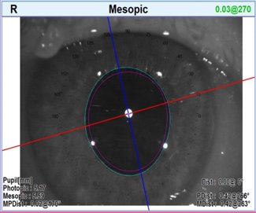
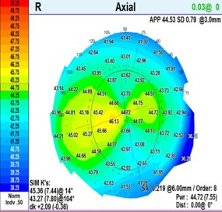
Toric Alignment

Slide 54
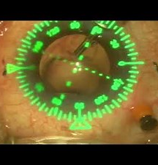
Centration
Is the lens centered?
Is it on axis?
OPD and I-trace retroillumination
Dilate

Slide 55

Capsule
Is the capsule cloudy?
History, was vision clear and now getting cloudy and glare and halos are back?
Dilate to find out why!

Slide 56
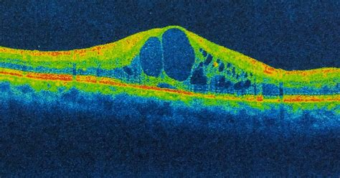
CME
CME --cystoid macular edema
History: Was vision good and recently decreased and fluctuating?
Did the patient finish their steroids and NSAID too soon?
Is the patient diabetic?
DO an OCT r and dilate

Slide 57
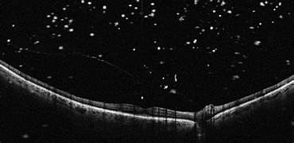
Condensation
Condensation of the vitreous
  Seen below on OCT after a retinal tear

Slide 58

QUESTIONS?

