Slide 1
LUMPS AND BUMPS
Lyndon Lee, M.D.

Slide 2
No financial disclosures

Slide 3
GOALS
Review common and some potentially dangerous eyelid lesions
Discuss diagnostic and treatment options for these lesions

Slide 4
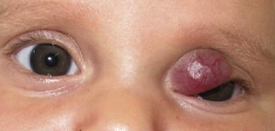
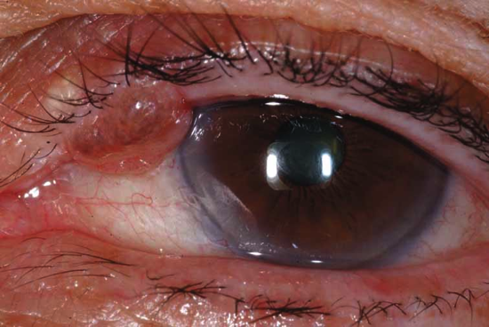
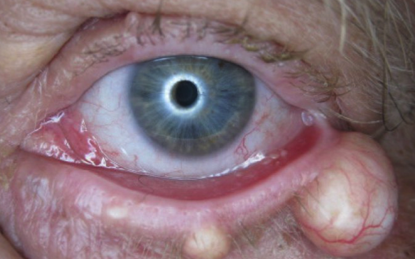
WHAT IS A “DANGEROUS” EYELID LESION?
Threat to vision
Obstruction or ptosis
Astigmatism (WTR)
Ectropion
Ocular surface irritation

Slide 5
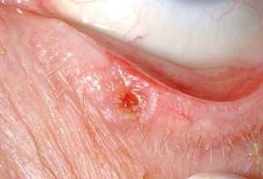
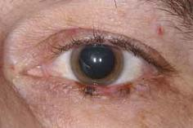
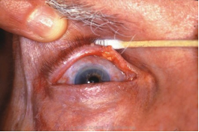
WHAT IS A “DANGEROUS” EYELID LESION?
Threat to regional anatomy
Threat to life (malignancies)
Notes:
More specifically, these lesions exhibit persistent, invasive growth which can lead to destruction of local tissues or even more distant structures

Slide 6
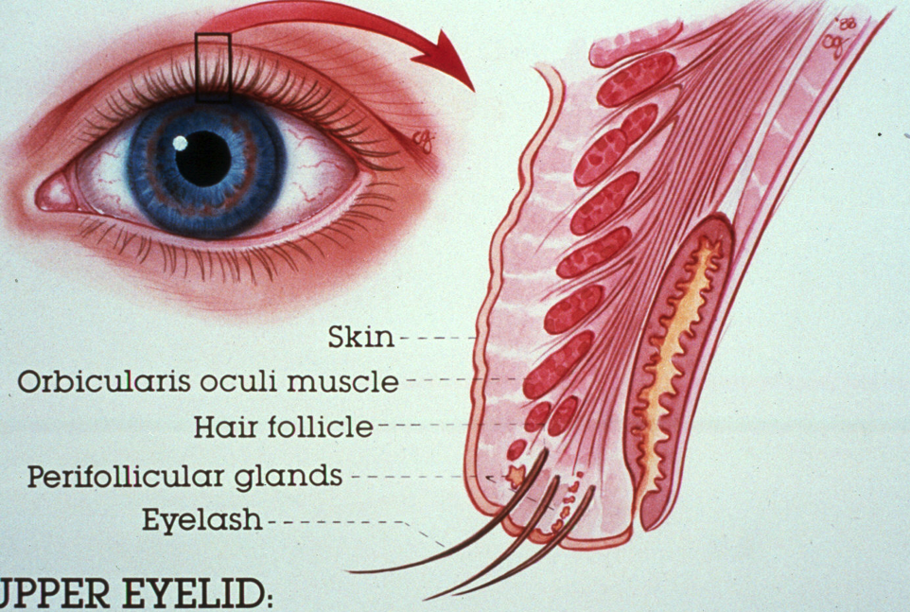
EYELID ANATOMY
Notes:
Before jumping in to discuss specific lid lesions, I’d like to take a moment to review some anatomy.
This drawing is one we’ve all seen before. The eyelid is divided into anterior lamella consisting of skin and orbicularis muscle, and posterior lamella made up of tarsus and conjunctiva.
We also recognize specialized structures such as the meibomian glands and the lacrimal outflow system.
The eyelid margin contains a mucocutaneous junction just posterior to the meibomian gland orifices. Here, the keratinized stratified squamous epithelium of the skin becomes the nonkeratinized stratified squamous epithelium of the conjunctiva. This marks the transition from eyelid skin to eyelid mucosa.
Eyelid

Slide 7
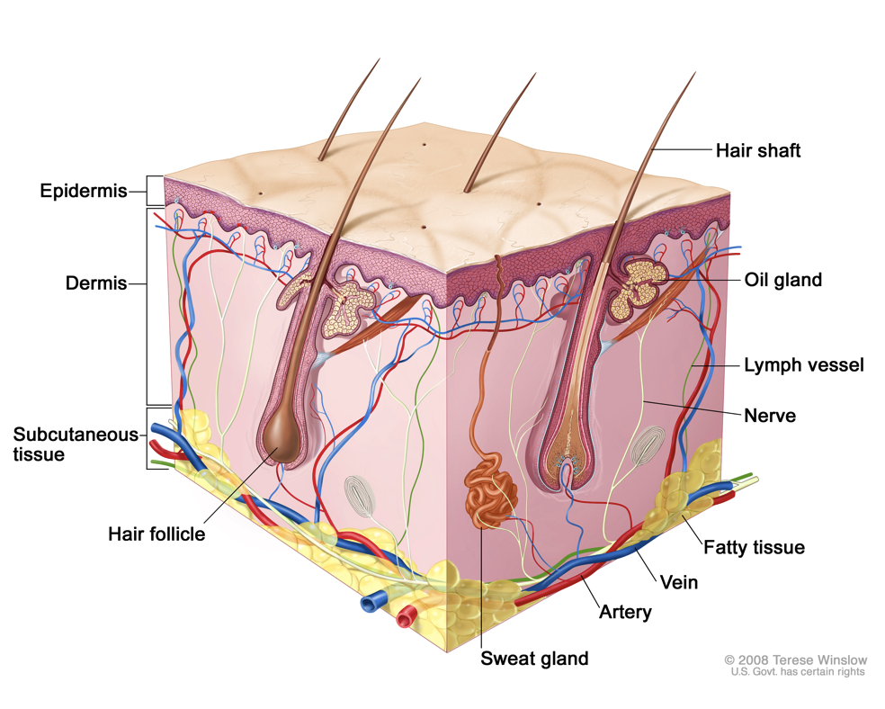
SKIN ANATOMY
Notes:
Here we see a representation of the general anatomy of the skin. It’s not necessary to memorize or know the specifics, but a basic understanding of the various structures helps when thinking about how to categorize lid lesions.
Overall, eyelid skin is similar to skin in other areas, but there are some notable differences. One is that it is among the thinnest in the body. Eyelid skin contains no subcutaneous fat which contributes to its thin profile.
However, eyelid skin Is still susceptible to dermatologic and systemic conditions that affect skin elsewhere. These include conditions such as eczema, psoriasis, and lupus among others.
The dermis of the eyelid is very thin and is composed mostly of loose collagenous fibers and an elastic fiber network. There are a few glands and hair follicles in the eyelid dermis.

Slide 8
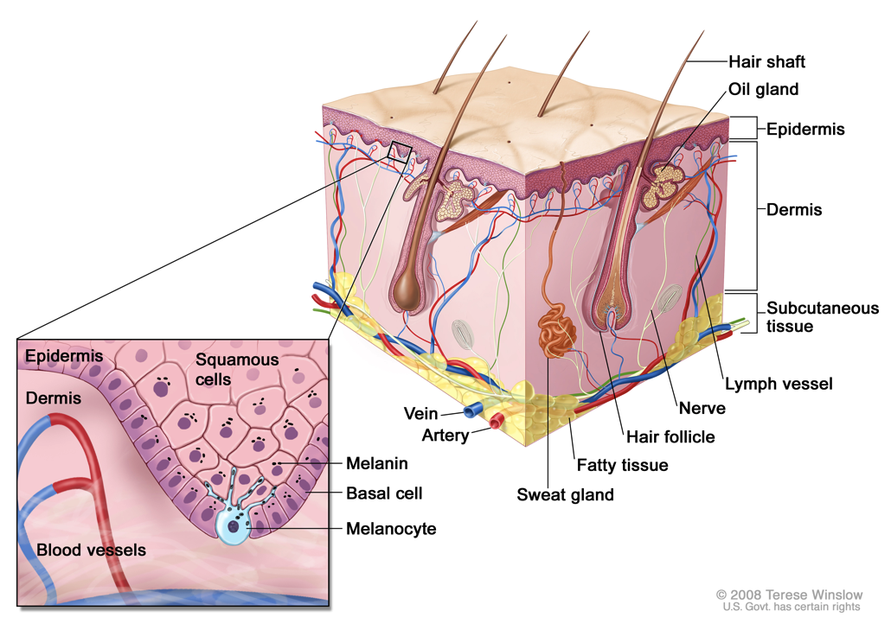
SKIN ANATOMY
Notes:
Histologically, the eyelid skin is composed of keratinized stratified squamous epithelium that sits on a basement membrane with underlying subcutaneous connective tissue.
The epidermis is the outermost section of the skin. It consists of several layers of cells that are constantly moving towards the surface and ultimately being shed. The skin cells that are lost are, in turn, replaced by newer skin cells. The basal layer of the epidermis is a single row of proliferative keratinocytes that continuously replicates and provides the constant supply of daughter skin cells.
[Daughter cells are displaced superficially and accumulate keratin as they move towards the surface. The most external layer is the stratum corneum which consists of keratinocytes that have lost their nuclei. This keratin layer prevents dehydration of the skin and also protects against mechanical trauma.]
The epidermis also contains two types of dendritic cells:
- Melanocytes produce the pigment melanin which is taken up by the surrounding keratinocytes. This melanin is responsible for what we recognize as skin color and is thought to help protect skin cells against UVB radiation.
- Langerhans cells are antigen-presenting cells that help initiate the immune reaction in the skin.

Slide 9
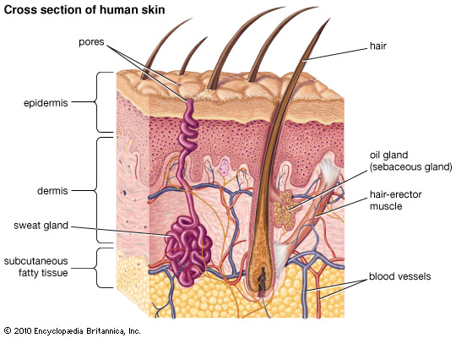
SKIN ANATOMY
Notes:
Glandular structures within the eyelid include sebaceous glands, sweat glands on the skin side, and accessory lacrimal glands on the conjunctival side.
Many of the eyelid lesions we encounter involve the sebaceous and sweat glands, so we’ll focus on those.
Sebaceous glands within the eyelid include the glands of Zeis (which empty into the eyelash follicles) and the meibomian glands within the tarsus. Glands of Zeis produce oil that serves to stop the eyelashes from becoming brittle, so healthy eyelashes should have a mild sheen.
Interestingly, eyelid skin contains the greatest concentration of sebaceous glands in the body.
Sweat glands within the eyelid include eccrine sweat glands (sweat pores) and apocrine sweat glands (empty into eyelash follicles)

Slide 10
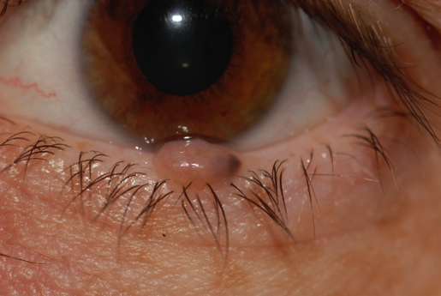
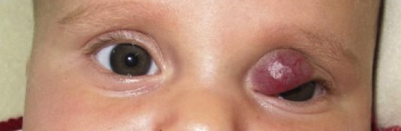
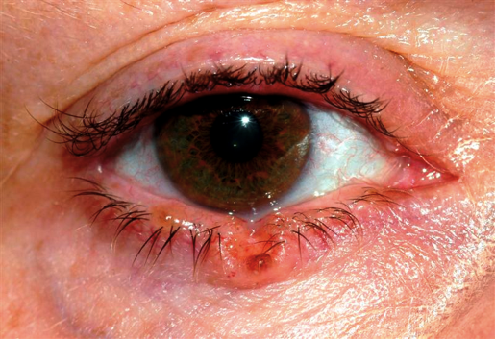

Slide 11
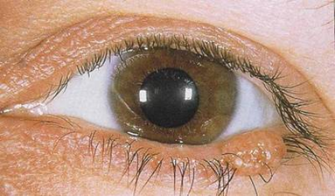
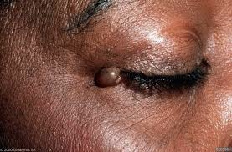
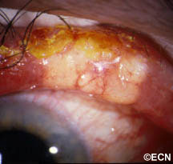

Slide 12
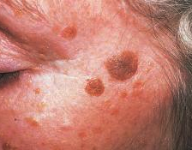
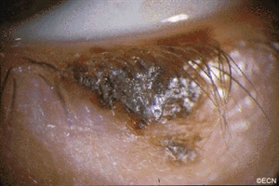
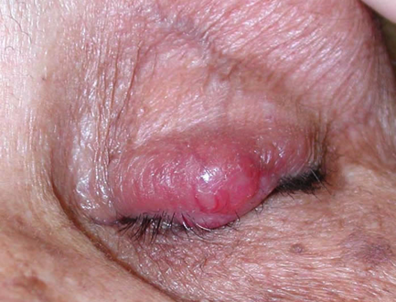

Slide 13
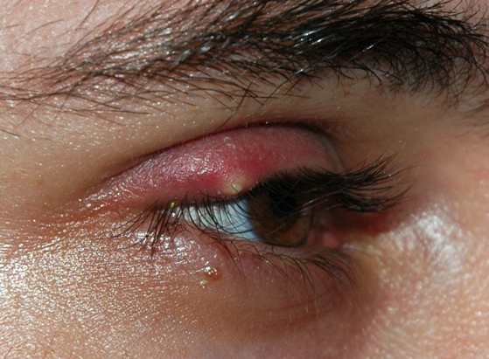
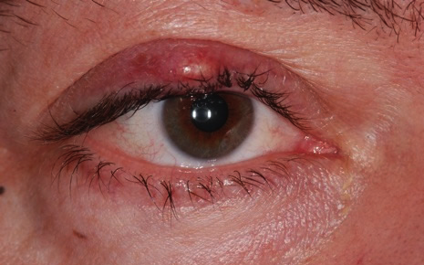
HORDEOLUM
Acute inflammation of the sebaceous glands of the eyelid
  External - Glands of Zeis
  Internal - Meibomian glands
Staphylococcal species, ? Demodex
May be associated with blepharitis, seborrheic dermatitis, and rosacea
Notes:
A hordeolum is an acute inflammation of the sebaceous glands of the eyelid typically caused by S. epidermidis or S. aureus. These can be further categorized between those originating from an eyelash follicle and the sebaceous glands of Zeis or Moll (external), and those arising from a meibomian gland (internal). They may be associated with blepharitis, seborrheic dermatitis, and rosacea.
Clinical signs include eyelid edema, erythema, and tenderness.

Slide 14
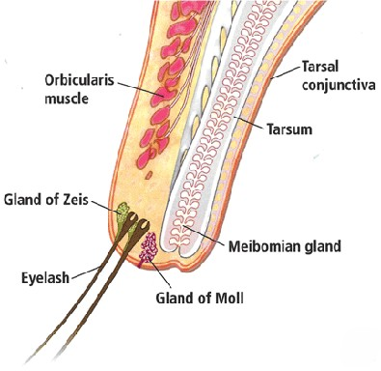
EXTERNAL HORDEOLUM
The glands of Zeis are sebaceous glands associated with eyelash follicles.
Acute infections of these glands are typically centered around these structures.
Notes:
The typical clinical appearance for an external hordeolum will be one of erythema around the root of an eyelash. Purulent material sometimes exudes from the eyelash line.

Slide 15
INTERNAL HORDEOLUM
When a blocked Meibomian gland becomes inflamed with or without infection

Slide 16
TREATMENT
May resolve spontaneously
For external hordeola, epilation of the associated eyelash can promote drainage of the affected gland
Hot compresses to promote dilation of the blocked pore can be curative
Notes:
In many cases, styes will resolve on their own. Most eventually point and drain by themselves.
If the lesion points at a lash follicle, removal of that one eyelash hair may promote drainage and healing.
Hot compresses are the mainstays of treatment with the recommended duration being 10-15 minutes at a time, 3 to 4 times a day.
Topical antibiotics such as tobramycin or bacitracin ointment are rarely indicated as they have not been shown statistically to improve resolution over conservative measures. They may be used when the inflammation has spread beyond the immediate area of the hordeolum, when there is active draining, and for recurrent lesions but
Surgical drainage of pointed lesions can facilitate the healing process. If the hordeolum is pointing externally, careful horizontal external stab incisions with a large gauge needle or 11 blade will promote drainage. Care should be taken to avoid making incisions very large which can risk scarring.
Antibiotics are rarely indicated, only when inflammation has spread beyond the immediate area of the hordeolum.
Should resolve within 1-2 weeks.

Slide 17
TREATMENT
Topical antibiotics
Limited evidence for accelerating healing compared to warm compresses
May be used for actively draining lesions
Tobramycin, bacitracin
Topical steroids
Can be effective in reducing associated swelling and inflammation
Typically combined with topical antibiotic
Intense pulsed light
Has been shown to be effective in treating hordeolum
May work via thermal effects to promote lipid secretion, bactericidal properties, and inhibition of inflammatory factors
Notes:
In one randomized, prospective study, complete resolution rates were low in each of three treatment groups: hot compresses alone, hot compresses plus tobramycin drops and ointment, and hot compresses plus tobramycin/dexamethasone drops and ointment
Surgical drainage of pointed lesions speeds the healing process. If the hordeolum is pointing externally, careful horizontal external stab incisions with a large gauge needle or 11 blade will promote drainage. Care should be taken to avoid making incisions very large which can risk scarring.
Medical therapy is recommended for lesions that are moderate or associated with secondary infection.
Antibiotics are not indicated for the treatment of a chalazion, but what about a hordeolum? Antibiotics are thought to shorten the duration and severity of a hordeolum, but the data do not support this. The addition of an antibiotic, regardless of formulation, to conservative measures was not associated with a significant difference in treatment success.
Oral doxycycline and topical erythromycin were the most commonly prescribed antibiotics. The most commonly prescribed topical steroid/antibiotic combination was neomycin/polymyxin B sulfates/dexamethasone ophthalmic ointment. Neither class of oral antibiotics was associated with a higher rate of treatment success or lower rate of recurrence relative to other oral antibiotics.
Conversely, in a meta-analysis, medical management was associated with a 75.9% success rate among patients diagnosed with chalazia and 93.5% with hordeola.
Given the inflammatory etiology of a chalazion, antibiotics are generally not considered to be an aspect of their management, and the use of conservative measures is typically the mainstay of therapy.
IPL: thermal effects of IPL and bactericidal action along with the ability to clear glandular obstructions and promote lipid secretion, inhibit inflammatory factors

Slide 18
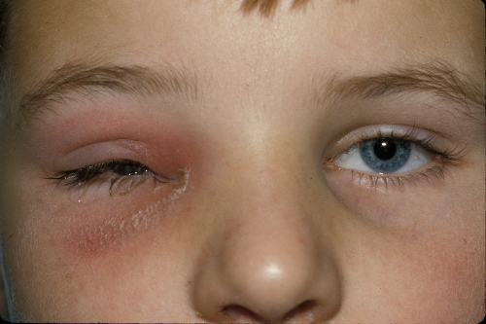
HORDEOLUM
PRESEPTAL CELLULITIS
These lesions can potentially progress to a superficial cellulitis, or even more rarely, a true abscess of the eyelid.
In these cases, systemic antibiotics for skin flora and/or surgical drainage is indicated
Notes:
In extreme cases, the infection can spread to involve the entire lid and even the periorbital tissues. Such cases do not respond to normal hordeolum management and must be managed as periorbital cellulitis.
Constitutional signs and symptoms are inconsistent with a hordeolum diagnosis, so in patients with fever, chills, malaise, etc, must consider preseptal cellulitis.
Systemic antibiotics are indicated if signs of bacteremia are present (fever, chills, etc.) or if the patient has tender preauricular lymph nodes. I like doxycycline but in children under 8, I will prescribe amoxicillin. For children with allergies, azithromycin is a good alternative.
Doxycycline is also effective for associated meibomian gland dysfunction or rosacea.

Slide 19
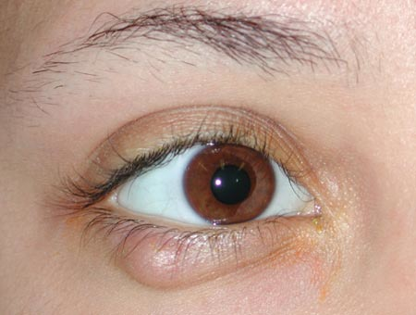
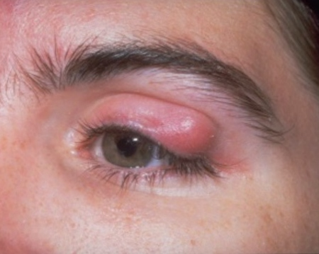
CHALAZION
Caused by an obstructed meibomian gland
Can be associated with rosacea, chronic blepharitis
Characterized histopathologically by lipogranulomatous inflammation
Notes:
A chalazion is a subacute, sometimes tender nodule arising from an obstructed meibomian gland. It may start as an internal hordeolum.

Slide 20
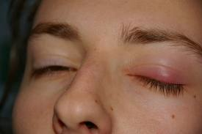
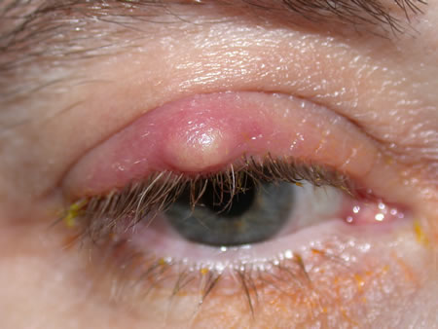
CHALAZION
Plugged due to excessive keratin, make-up, chronic inflammation, etc
Contents of the gland are released into the tarsus and surrounding eyelid soft tissue
Incites an acute inflammatory response often accompanied by eyelid edema, erythema, and pain
Within a few days the inflammation subsides and leaves behind a firm nodule in the eyelid
Can cause astigmatism in children when in upper eyelid
Notes:
chronic lipogranulomatous material that accumulates due to leakage of sebum from an obstructed meibomian gland
may develop from an internal hordeolum. Small chalazia usually resolve with time without any intervention, and hot compresses can be effective at encouraging drainage. Persistent lesions may be surgically removed by incision and curettage.
When the Meibomian gland becomes obstructed, retained sebaceous secretions cause enlargement and local irritation with secondary inflammation and accumulation of lipogranulomatous material within the affected gland.
Initially, there may be little to no pain but as it enlarges, secondary inflammation or infection may occur causing eyelid edema, erythema, and tenderness.
Chalazia are typically painless and do not present with acute inflammation, which distinguishes them from hordeola, which are acute. Chalazia are chronic and often follow the resolution of a hordeolum.
Sometimes as they become inflamed with or without infection they may burst through to the external (skin) or internal (tarsal conjunctiva) surface.

Slide 21
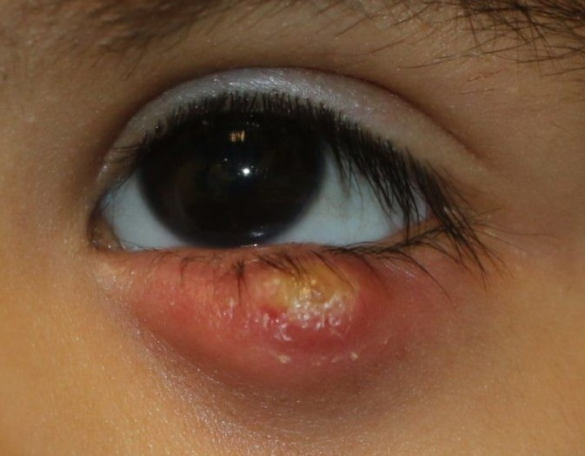
CHALAZION
Acute inflammatory phase
Warm compresses, eyelid hygiene, and eyelid massage
    Dilate obstructed pore
    Remove inciting debris
  Topical antibiotic and anti-inflammatories may have some benefit in resolving acute, but not chronic, chalazion
Notes:
The findings from this randomized, multi-center clinical study demonstrate similar rates of resolution among: hot compresses alone, hot compresses plus tobramycin drops and ointment, and hot compresses plus tobramycin/dexamethasone drops and ointment.

Slide 22
CHALAZION
  Chronic phase
    Becomes firm, nodular, and cyst-like
  Treatment
    Intralesional steroids
        For persistent, non-infected chalazia (not for active, purulent infections)
        Temporary depigmentation of overlying skin (may take several months to year to resolve)
Intense Pulsed Light
As effective as for hordeolum?
    May work via thermal effects to promote lipid secretion, bactericidal properties, and inhibition of inflammatory factors
Notes:
Interestingly, the authors speculated that patients whose chalazion has been present for 2 months or less could be started on a trial of conservative treatment first, whereas those with lesions present greater than 2 months should undergo I&C or TA injection as first line treatment.
Occasionally, the inflammation is more prominent anteriorly – in these cases, incision through skin, orbicularis, and tarsus is possible

Slide 23
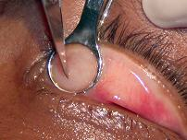
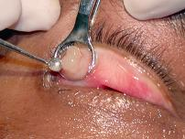
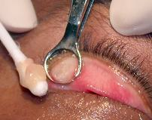
CHALAZION
  Chronic phase
    Becomes firm, nodular, and cyst-like
    Surgical drainage
Notes:
Typically, a vertical incision through tarsus and conjunctiva allows for removal of the inflammatory and necrotic material
Care should be taken near the eyelid margin to reduce risk of notching, and near the punctum to avoid injury to this structure
A complication of surgical excision is the formation of a pyogenic granuloma at the incision site that can arise within a few weeks. This may be reduced with the use of steroid-containing medications post-operatively
Occasionally, the inflammation is more prominent anteriorly – in these cases, incision through skin, orbicularis, and tarsus is possible

Slide 24
CHALAZION
  Patients with chronic meibomian gland dysfunction or inflammation, such as associated with ocular rosacea, may benefit from systemic doxycycline or tetracycline, or azithromycin eye drops.
Recurrent or atypical chalazia may be sent for histopathologic examination due to the possibility of a masquerading lesion such as sebaceous cell carcinoma.

Slide 25
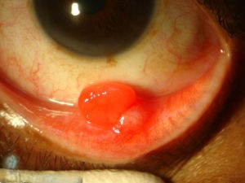
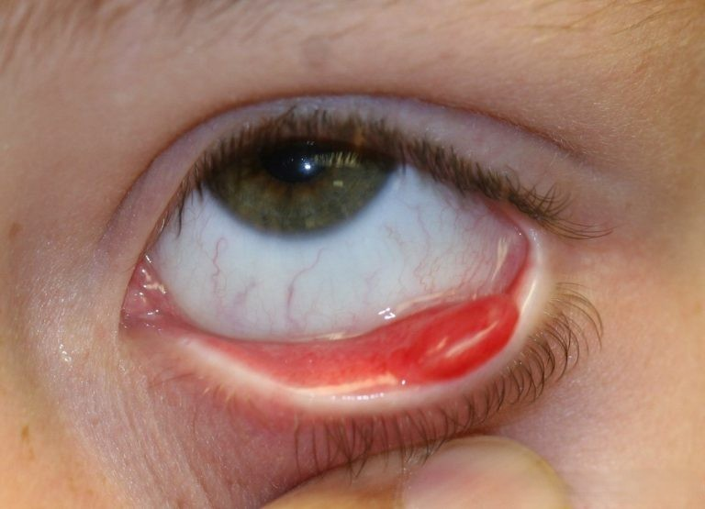
PYOGENIC GRANULOMA
Neither pyogenic nor a granuloma
Notes:
Despite the name, these lesions are neither “pyogenic” nor are they truly “granuloma.” Typically arise from a chalazion that has ruptured posteriorly.
Treatment is excision along with excision of the underlying chalazion.

Slide 26
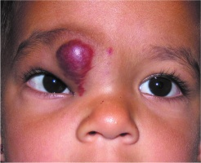

Slide 27
CAPILLARY HEMANGIOMA
Congenital anomaly
High blood flow vascular tumor
Most common benign periorbital tumor of childhood, present in 1-2% of all births
More common in girls (3:1) and premature infants

Slide 28
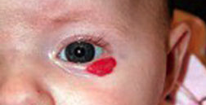
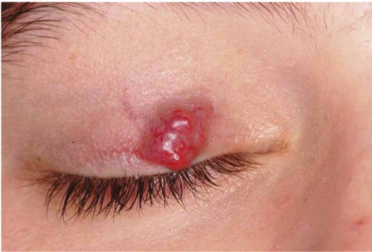
CAPILLARY HEMANGIOMA
Appears as an elevated red discoloration with a dimpled texture
Involvement can be cutaneous, subcutaneous, or with orbital extension
Tendency to occur in upper eyelid and in medial canthal region

Slide 29
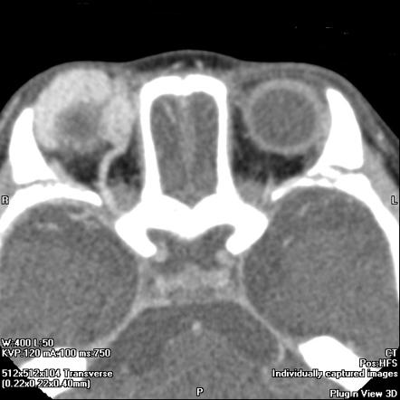
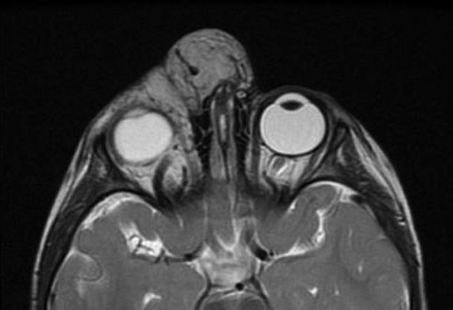
CAPILLARY HEMANGIOMA
Imaging can help determine extent of orbital involvement
        CT with contrast
        MRI with gadolinium
        Ultrasound
Notes:
The CT appearance is that of a strongly enhancing lobulated mass. The enhancement is typically homogeneous.
The MRI appearance of capillary hemangioma is usually slightly hypo-intense on T1, iso- to hyper-intense on T2 with multiple serpiginous flow voids. Enhancement is homogenous with gadolinium with marked enhancement of intra-tumoral vessels. Its lobulated appearance with thin septa is characteristic.

Slide 30

CAPILLARY HEMANGIOMA
Often not apparent at birth, but appear over first weeks or months of life
Increase in size until about 12 months of age after which it begins to involute
Decrease in size over next 4-5 years
40% completely involute by age 4; 80% by age 8
Notes:
Typical course is occurrence within a few weeks after birth, increase in size sometimes dramatically until about 12 months of age, then decrease over next 4-5 years.
Begins to involute after 1st year; 75% of lesions resolve during next 4 years of life

Slide 31
CAPILLARY HEMANGIOMA
Indications for treatment
Amblyopia (astigmatic anisometropia or occlusion of visual axis)
Optic nerve compression
Exposure keratopathy
Severe cosmetic defect
Beta-blocker – 1st line
Propranolol (systemic, for deeper lesions) or Timolol (topical, for smaller, superficial lesions)
May work by vasoconstriction, inducing apoptosis, and reducing angiogenesis
Contraindicated in patients with asthma
Notes:
Propranolol is typically initiated as a hospital inpatient under the care of a pediatrician or pediatric cardiologist to monitor for bradycardia. The dose is ramped up over 2-3 days, and if the patient tolerates the recommended dosage, treatment as an outpatient is begun. Treatment may last for several months until resolution or for as long as the hemangioma responds to therapy.

Slide 32
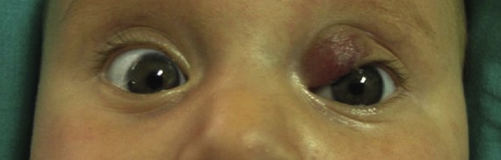
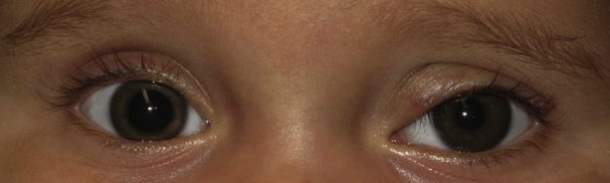
Presentation
Treatment with topical timolol gel
1 month
4 months
Fernández-Ballesteros et al. Infantile hemangioma of the eyelid treated with timolol gel. Actas Dermosifiliogr. 2012 Jun;103(5):444-6

Slide 33
CAPILLARY HEMANGIOMA
Corticosteroids
        Intralesional when limited to the eyelid, systemic when more widespread
        Injection risks eyelid necrosis, embolic retinal vascular occlusion from anastomosing vascular network, adrenal suppression
Surgical excision for well-circumscribed lesions
Cutaneous laser ablation – for superficial lesions (1-2 mm depth); will not penetrate deeply enough to affect a visually disabling lesion

Slide 34
EYELID NEOPLASMS
Numerous benign or malignant neoplasms may arise in the periocular region from the epidermis, dermis, or ocular adnexal structures
Most lesions develop from the epidermis which is the most superficial layer of the skin and the site of the highest cellular turnover
The most critical distinction we are trying to make in cases of eyelid lesions is to determine the likelihood of malignancy
In general, any lesion suspicious for malignancy should be biopsied as histopathologic inspection is much more accurate than clinical diagnosis

Slide 35
EYELID NEOPLASMS

Slide 36
EYELID NEOPLASMS
Notes:
Histologically, the eyelid skin is composed of keratinized stratified squamous epithelium that sits on a basement membrane with underlying subcutaneous connective tissue.
The basal layer is a single row of proliferative keratinocytes. Daughter cells are displaced superficially and accumulate keratin as they move towards the surface. The most external layer is the stratum corneum which consists of keratinocytes that have lost their nuclei. This keratin layer prevents dehydration of the skin and also protects against mechanical trauma.
The epidermis also contains two types of dendritic cells:
- Melanocytes produce the pigment melanin which is taken up by the surrounding keratinocytes. This melanin is responsible for what we recognize as skin color.
- Langerhans cells are antigen-presenting cells that help initiate the immune reaction in the skin.

Slide 37


EYELID NEOPLASMS
Specific considerations
History of prior skin cancer
Previous radiation therapy, especially to the head and neck region
History of smoking
Immunosuppression
Excessive sun exposure – cumulative sun exposure over lifetime
Fair skin
Slow, painless growth
Ulceration with a history of intermittent drainage, bleeding, or crusting
Notes:
Clinical evaluation of eyelid tumors begins, of course, with a good history.
History of prior skin cancer – this is an often overlooked question, but a simple one that can be very helpful
Immunosuppression – genetic condition, induced by medications such as chemotherapy
Asking if the lesion has bled spontaneously can be an important clue.
UV exposure or other mutagenic exposures (stepwise approach to accumulating mutations and co-opted signaling pathways as explained in Mukurjhee’s book)

Slide 38
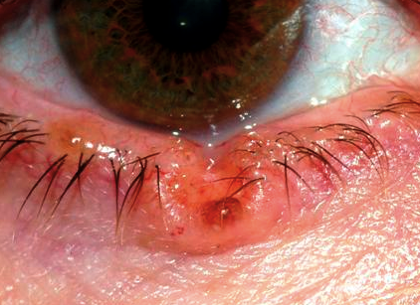
EYELID NEOPLASMS
Exam findings suggestive of malignancy
Irregular pigmentary changes
Destruction of normal eyelid architecture and loss of eyelashes
Fine telangiectasias
Loss of fine, cutaneous wrinkles

Slide 39
EYELID NEOPLASMS
Palpable induration beyond visible margins suggests infiltration into the dermis and subcutaneous tissue
Palpate large lesions for evidence of fixation to underlying structures
If near the punctum, the lacrimal system should be evaluated for involvement
Regional lymph nodes should be examined in cases of suspected malignancy

Slide 40
EYELID NEOPLASMS
Restriction of ocular motility, proptosis, or other orbital signs in association with an eyelid malignancy suggests orbital extension
Assess the function of cranial nerves V and VII as these are particularly vulnerable to perineural invasion by cutaneous malignancies of the eyelids and face
Document exam findings with photographs or drawings of the lesion prior to any treatment

Slide 41
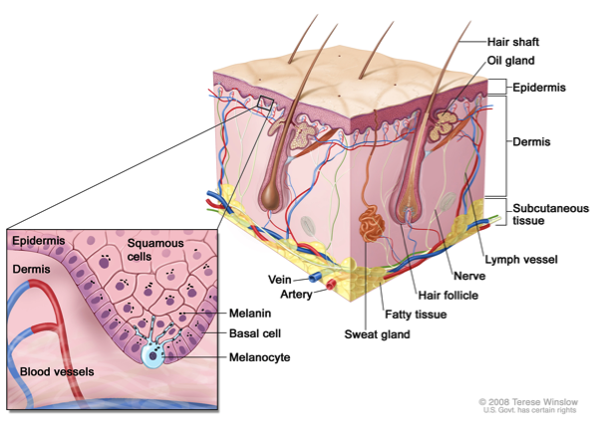
EPITHELIAL HYPERPLASIAS
Proliferative lesions of the epithelium
Clinically and histopathologically, these lesions have overlapping features
Typically managed with simple shave excision
Simply shaving these does not remove the entire lesion. At the base of the excision, portions of the lesion will invariably remain. In some cases, the lesion may recur
        Seborrheic keratosis
        Acrochordon
        Verruca vulgaris
        Cutaneous horn
Notes:
As they are located superficially, they are typically managed with simple shave excision at the dermal-epidermal junction.
It is important to remember, however, that simply shaving these does not remove the entire lesion. At the base of the excision, portions of the lesion will invariably remain. In some cases, the lesion may recur, though this can take months to manifest.

Slide 42
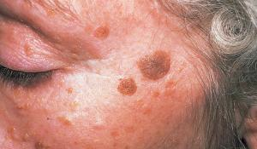
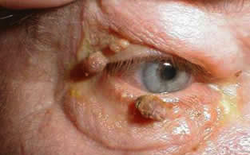
SEBORRHEIC KERATOSIS
Affects middle-aged and older patients
From sessile to pedunculated with varying degrees of pigmentation
On the face, can appear as a smooth, “greasy, stuck-on” lesion
On thinner eyelid skin, can be more lobulated, papillary (finger-like projections), or pedunculated
Even when large, these lesions remain superficial
Shave excision at the dermal-epidermal junction
Notes:
Variable clinical appearance from sessile to pedunculated with varying degrees of pigmentation

Slide 43
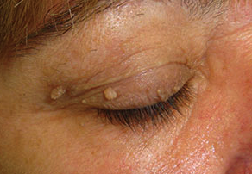
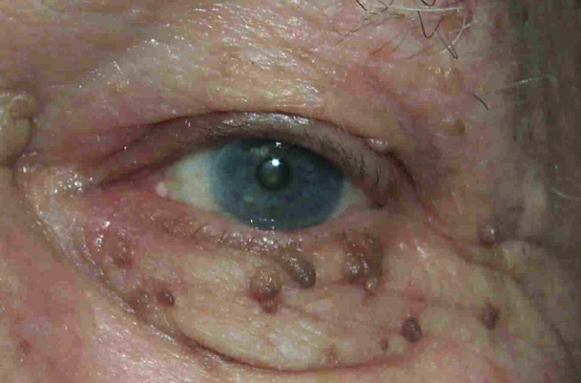
ACROCHORDON
“Skin tag,” fibroepithelial polyp
Squamous papilloma
Shave excision

Slide 44
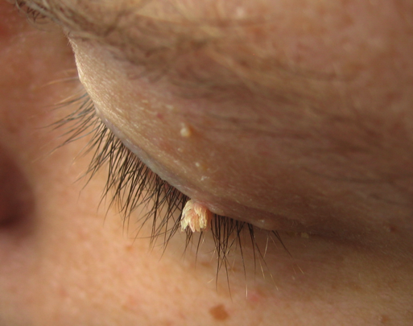
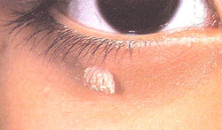
VERRUCA VULGARIS
“Wart”
Caused by epidermal infection of the human papillomavirus (type 6 or 11)
Can be treated with shave excision and cryotherapy to the residual base to limit viral spread

Slide 45
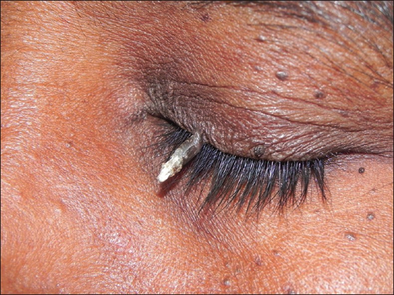
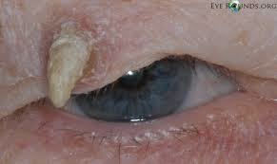
CUTANEOUS HORN
Descriptive term for excessive keratin production
Suggests chronicity
Can be associated with a variety of benign or malignant lesions including verrucae, seborrheic keratosis, and squamous or basal cell carcinoma
Biopsy must include the base of the horn to get meaningful tissue for diagnosis
Notes:
Cutaneous horn – descriptive term that describes exuberant hyperkeratosis (excessive keratin production)

Slide 46
EPIDERMAL EYELID CYSTS
Cysts of the epidermis are a second major type of benign cutaneous eyelid lesion
True cysts have an inner lining consisting of a layer of epithelium
Complete removal these lesions requires removal or destruction of this epithelium
        Epidermal inclusion cyst
        Pilar, or trichilemmal, cyst

Slide 47


EPIDERMAL INCLUSION CYST
Arise from hair follicle, usually spontaneously
Slow-growing, elevated, round, smooth
Typically have a central pore which is 2/2 a duct of the hair follicle
Sometimes called sebaceous cysts, but these lesions are filled with keratin, not sebum
Rupture of the cyst wall may result in an inflammatory foreign body reaction
Cyst may become secondarily infected

Slide 48


EPIDERMAL INCLUSION CYST
Treatment
Small cysts – marsupialization of the cyst, which is basically unroofing it. The cyst is excised along the periphery of the cyst, but the base of the lesion is left behind to serve as the new surface epithelium
Larger/deeper cysts – may require complete excision with attempts to remove the lesion with the cyst wall intact to prevent leaving behind any epithelium and potential for recurrence

Slide 49



EPIDERMAL INCLUSION CYST
Multiple, small epidermal inclusion cysts = milia.
May appear spontaneously, after trauma, or during healing from a bullous skin disorder
Commonly seen in newborns
Often resolves spontaneously, but can be marsupialized if persistent with a needle; can also be treated with topical retinoic acid cream

Slide 50


PILAR, OR TRICHILEMMAL, CYST
Appear identical to epidermal inclusion cysts but occur in areas with large and numerous hair follicles. In the periorbital region, these are found in the eyebrows.
Filled with desquamated epithelium
Cyst wall is thicker than in epidermal inclusion cysts allowing removal in one solid piece

Slide 51



MOLLUSCUM CONTAGIOSUM
Caused by a viral infection of the epidermis
Often involves the eyelid in children
Can occur in clusters in adults with AIDS
Appear as waxy, nodular lesions with a central umbilication
Can induce a follicular conjunctivitis
Treatment consists of excision, curettage, or cryotherapy

Slide 52


XANTHELASMA
Yellowish plaques that tend to occur in the medial canthal region of the upper and sometimes lower eyelid
Collections of lipid-laden macrophages in the dermis
Usually with normal cholesterol levels, but can be associated with hypercholesterolemia
Treatment with excision, or CO2 laser ablation if very broad
Lesions may recur

Slide 53
ADNEXAL LESIONS
Involve skin appendages located within the dermis that communicate through the epidermis to the surface
Oil glands
  Meibomian glands
  Glands of Zeis
  Sebaceous glands within the pilosebaceous units of skin hair
Sweat glands
  Eccrine sweat glands
  Glands of Moll
Hair follicles
Notes:
Adnexal lesions refer to lesions involving skin appendages that are located within the dermis but communicate through the epidermis to the surface. These structures include oil glands, sweat glands, and hair follicles. In the periorbital region, specialized oil glands include the meibomian glands within the tarsus, the glands of Zeis associated with eyelash follicles, and normal sebaceous glands that are part of the pilosebaceous units in the skin hair. Sweat glands include eccrine sweat glands (found throughout the body) and the glands of Moll, a special type of eccrine gland

Slide 54
ADNEXAL LESIONS
Notes:
Glandular structures within the eyelid include sebaceous glands, sweat glands, and accessory lacrimal glands.
Many of the eyelid lesions we encounter involve the sebaceous and sweat glands, so we’ll focus on those.
Sebaceous glands within the eyelid include the glands of Zeis (which empty into the eyelash follicles) and the meibomian glands within the tarsus.
Interestingly, eyelid skin contains the greatest concentration of sebaceous glands in the body.
Sweat glands within the eyelid include eccrine sweat glands (sweat pores) and apocrine sweat glands (empty into eyelash follicles)

Slide 55


SEBACEOUS GLAND HYPERPLASIA
Multiple small yellow papules that occur on the forehead and cheeks typically in patients older than 40 yrs old
May resemble basal cell carcinoma (BCCa) with central umbilication and fine telangiectasias
Unlike BCCa, these lesions are soft on palpation and cream-colored from the sebum contained within

Slide 56


SEBACEOUS GLAND HYPERPLASIA
Can result from chronic dermatitis or pts with rosacea
Multiple acquired sebaceous gland adenomas or BCCa’s with sebaceous differentiation can be associated with malignancy of the GI tract as part of a condition called Muir-Torre syndrome
Involvement of the meibomian glands can cause thickening and ectropion of the eyelids. Care should be taken to evaluate for sebaceous cell carcinoma
Chen CS et al. Muir-Torre syndrome and early detection of internal malignancy. Med J Aust. 2003 Apr 21;178(8):368.

Slide 57


ECCRINE HIDROCYSTOMA
Common cystic lesions 1-3 mm in size that tend to occur in clusters around the lower eyelids and lateral canthi
These are actually ductal retention cysts rather than a true neoplasm
Can enlarge in conditions that stimulate perspiration such as heat and increased humidity
Treat with excision

Slide 58

APOCRINE HIDROCYSTOMA
Common solitary smooth cyst arising from the glands of Moll along the eyelid margin
A true adenoma of the secretory cells of the gland
Translucent; will transilluminate
Often extend deep beneath the surface, especially in the medial canthal region
Superficial cysts may be treated with marsupialization
Deeper cysts require complete excision of the cyst wall
Notes:
(vs the retention cyst in an eccrine hidrocystoma)
Can be multiple

Slide 59


SYRINGOMA
Multiple small, waxy, pale yellow nodules 1-2 mm in diameter on the lower eyelids of young females
More apparent during puberty
Because these lesions are located within the dermis, shave excision can be inadequate and complete excision is preferred. If numerous, this can be done in a staged fashion

Slide 60

TRICHOBLASTOMA
Benign, typically solitary nodular lesion
Arises from the hair germ cells within the follicle
Notes:
rare, benign, typically solitary skin tumor that appears as a firm nodule, papule, or plaque. Arises from the hair germ cells within the follicle. It is often misdiagnosed as basal cell carcinoma. Surgical excision is usually curative though asymptomatic lesions may be left alone. Prognosis is excellent.

Slide 61

BENIGN MELANOCYTIC LESIONS
Arise from 2 cell types
Melanocytes (dermal or epidermal)
Nevus cells
Notes:
Melanocytes - normally distributed throughout the skin at the dermal-epidermal junction; produce melanin
Nevus cells - Incompletely differentiated melanocytes that are larger than melanocytes and lack dendrites. Also unlike melanocytes, nevus cells tend to be arranged in clusters.

Slide 62
BENIGN MELANOCYTIC LESIONS
Typically thought of as “pigmented lesions,” BUT:
Lesions of melanocytic origin do not necessarily have any visible pigmentation
  Dermal nevus in Caucasians typically has no pigmentation
Virtually any type of lesion can be pigmented
  Seborrheic keratosis is a benign lesion that is typically pigmented

Slide 63


MELASMA
Diffuse eyelid skin hyperpigmentation
Women who are pregnant or using oral contraceptives
In families with a dominantly inherited trait
Patients with chronic atopic eczema, rosacea, and other inflammatory skin conditions
Notes:
Laser treatment is an option to improve appearance, but it doesn’t completely eliminate the pigmentation

Slide 64



NEVUS
Arise from nevus cells that are found in clumps in the epidermis and dermis
Nevi are not apparent at birth but appear during childhood and often develop increased pigmentation at puberty
All nevi tend to evolve through 3 stages, each with different histopathologic and clinical characteristics

Slide 65


NEVUS
Junctional nevus
Initial stage, found in children
Typically a flat, pigmented macule
Histopathologically located in the basal layer of the epidermis at the dermal-epidermal junction

Slide 66

NEVUS
Compound nevus
Second stage, patients in their second decade or beyond
Appear as elevated, pigmented papules
Later in life, the epidermal pigmentation is lost and the lesion remains elevated but is minimally pigmented or even amelanotic
Histopathologically located in the junctional zone, extending up into the epidermis and down into the dermis

Slide 67


NEVUS
Dermal nevus
Final stage, usually by around age 70, nearly all nevi have become dermal nevi and have lost pigmentation
Histopathologically, we see involution of the epidermal component of the nevus and persistence of the dermal component

Slide 68

NEVUS
Frequently found on the eyelid margin, characteristically molded to the ocular surface
Asymptomatic benign nevi require no treatment
Symptoms can be from rubbing on the ocular surface or enlarging and obstructing vision. These are managed with shave excision or a full thickness wedge resection of the involved eyelid
In rare instances, junctional or compound nevi can undergo malignant transformation

Slide 69

LENTIGO SIMPLEX
“Lentigo” from the Latin word “lens”, “lentil”
Flat pigmented spots larger in diameter (few mm) than freckles
Not related to sun exposure
In contrast to freckles, contains an increased number of epidermal melanocytes
No treatment necessary, but melanin-bleaching treatments may improve appearance
Eyelid lentigo may be associated with autosomal dominant polyposis of the GI tract (which in turn, increases risk of GI cancer)
Notes:
Hyperplasia of melanocytes in a linear fashion along the basement membrane of the epidermis where melanocytes normally reside (in contrast to nevi in which nests of melanocytes are found above and below this epidermal basement membrane)

Slide 70


SOLAR LENTIGO
In older adults, multiple “solar” lentigines can occur in which case they are called senile lentigo or “liver spots”
Uniformly pigmented macules that result from chronic sun exposure
Contains an increased number of melanocytes which makes it a lentigo, not a freckle
Dorsum of hands and forehead are most commonly affected areas
Melanin-bleaching treatments may fade some of the pigmentation

Slide 71


DERMAL MELANOCYTOSIS, OR NEVUS OF OTA
Diffuse, congenital blue nevus of the periocular skin that most often affects women of African, Hispanic, or Asian descent
Dermal melanocytes proliferate in the region of the 1st and 2nd dermatome of cranial nerve V, resulting in pigmentation over the forehead and malar region
5% of cases are bilateral
Malignant transformation may occur especially in white patients with dermal melanocytosis but no prophylactic treatment is recommended

Slide 72



DERMAL MELANOCYTOSIS, OR NEVUS OF OTA
Oculodermal melanocytosis
When patchy slate gray pigmentation also appears on the episclera and uvea
Occurs in 2/3’s of patients
Associated with uveal melanoma such as choroidal melanoma at about 1 in 400
Screening for intraocular tumors is important in patients with oculodermal melanocytosis

Slide 73

EYELID MALIGNANCIES
Premalignant
Actinic keratosis (pre-squamous cell carcinoma)
Lentigo maligna (pre-melanoma)
Malignant
    Carcinoma in situ
    Carcinoma
Basal cell
Squamous cell
Sebaceous cell
    Melanoma
    Kaposi Sarcoma
Merkel cell
Notes:
Eyelid malignancies make up 5-10% of all skin cancers

Slide 74

EYELID MALIGNANCIES

Slide 75



ACTINIC KERATOSIS
Most common precancerous skin lesion
Most commonly in elderly patients with fair complexion and a history of chronic sun exposure
Scaly, keratotic plaques that have a texture like sandpaper
Constantly changing as they increase in size and darken with sunlight exposure and shrink with reduced sun exposure
Up to 25% of individual actinic keratosis lesions can resolve spontaneously over 12 months, but new lesions tend to develop continually

Slide 76

ACTINIC KERATOSIS
Risk of malignant transformation to squamous cell carcinoma (SCC)
In an individual lesion about 0.24% per year
In aggregate and over an extended period, a patient with multiple lesions has about a 12-16% chance of transformation
SCC arising from actinic keratosis is felt to be less aggressive than those arising de novo
Incisional or excisional biopsy is recommended. Cryodestruction may be used. Extensive lesions may be treated with topical 5-fluorouracil cream
Notes:
Liquid nitrogen used to destroy tumor tissue by freezing

Slide 77


SQUAMOUS CELL CARCINOMA IN SITU OF THE SKIN
“Bowen disease”
Elevated, non-healing erythematous lesions
May present with scaling, crusting, or pigmented keratotic plaques
Histopathologically show full-thickness epidermal atypia without invasion into the underlying dermis, i.e., the atypical cells do not violate the epidermal basement membrane
In 5% of patients, this SCC in situ develops into invasive squamous cell carcinoma. Thus, complete excision is recommended

Slide 78


KERATOACANTHOMA
Best thought of as a low grade squamous cell carcinoma
Begins as a flesh-colored papule on the lower eyelid that develops rapidly into a dome-shaped nodule with a central keratin-filled crater and elevated rolled margins
Increased incidence in immunosuppressed patients
Can involute over the course of months possibly 2/2 a localized inflammatory reaction caused by the abundant keratin production
Incisional biopsy followed by complete excision is recommended

Slide 79


LENTIGO MALIGNA
Flat, irregularly shaped, unevenly pigmented, slowly enlarging lesion in older white patients
Show significant pigmentary variation, irregular borders, and progressive enlargement (vs. senile or solar lentigo)
Progress to nodules of invasive melanoma in 30-50%
Histopathologically, these lesions frequently extend beyond the visible pigmented borders of the lesion
Excision with wide margins is recommended

Slide 80

BASAL CELL CARCINOMA
Most common eyelid malignancy (90-95% of malignant eyelid tumors)
50-60% located on lower eyelid (more sun exposure)
25-30% near medial canthus
15% upper eyelid
Risk factors
Fair skin, blue-eyed, red-haired or blond; Scandinavian, English, or Irish descent
History of prolong sun exposure during first 2 decades of life (UVB > UVA)
Cigarette smoking
Prior history of basal cell ca
Notes:
Increasingly seen in younger patients.

Slide 81

BASAL CELL CARCINOMA
Basal cell nevus syndrome (Gorlin syndrome)
Uncommon autosomal dominant multisystem disorder
Multiple nevoid basal cell carcinomas appear early in life
Associated with skeletal anomalies of the mandible, maxilla, and vertebrae
Xeroderma pigmentosum
Autosomal recessive disorder
Extreme sensitivity to sun damage due to a defective repair mechanism for UV light-induced DNA damage in skin cells
Notes:
Young patients and those with a positive family history should be asked about possible systemic associations

Slide 82



BASAL CELL CARCINOMA
Clinical subtypes – descriptive classification
Nodular
  - Most common clinical appearance
  - Firm, raised, pearly nodule that may be associated with telangiectasia and central ulceration
Morpheaform, or fibrosing
  - Less common but more aggressive
  - Margins indeterminate by clinical examination
Superficial
  - Can resemble chronic blepharitis
  - Can extend silently along the eyelid margin

Slide 83



BASAL CELL CARCINOMA
** Important signs **
Loss of normal local eyelid architecture
Loss of eyelashes (madarosis)
Displacement of surrounding tissues
Special concerns
Medial canthal lesions
More likely to be deeply infiltrative
Lacrimal drainage system may be involved and have to be sacrificed
Orbital invasion
Inadequately treated tumors (radiation therapy, e.g.)
Clinically neglected tumors
Morpheaform subtype
Exenteration of orbital contents often required in these cases

Slide 84
BASAL CELL CARCINOMA
** Important signs **
Loss of normal local eyelid architecture
Loss of eyelashes (madarosis)
Displacement of surrounding tissues
Special concerns
Medial canthal lesions
More likely to be deeply infiltrative
Lacrimal drainage system may be involved and have to be sacrificed
Orbital invasion
Inadequately treated tumors (radiation therapy, e.g.)
Clinically neglected tumors
Morpheaform subtype
Exenteration of orbital contents often required in these cases

Slide 85

BASAL CELL CARCINOMA
Management
    Photograph or drawing
    Biopsy of any suspicious lesion
Incisional
Incomplete removal
Includes normal, uninvolved tissue at the margin of the biopsy to show extent
Excisional
For small lesions that do not involve the eyelid margin or when away from medial canthus or lacrimal punctum
Important to confirm that the margins of the biopsy are free of tumor
If there is residual tumor, may follow closely for recurrence or be sent for definitive management with Mohs surgery
Notes:
**Get a picture of incisional biopsy technique
Should be directed vertically in the lower eyelid to reduce risk of vertical traction

Slide 86
BASAL CELL CARCINOMA
  Treatment of choice is surgical excision
  High rate of cure achieved with Mohs micrographic surgery (>97%)
Mohs micrographic surgery
Technique in which segments of tissue are excised and examined by a pathologist for cancer cells
Surgeon (dermatologist with specialty training) performing the procedure is also the pathologist reading the specimen slides
Provides precise removal of cancerous tissue while healthy tissue is spared
Typically reserved for treatment of skin cancers where tissue preservation is of utmost importance (ex: face, hands)

Slide 87

MOHS SURGERY
Notes:
Technique developed by Dr. Frederic Mohs, a general surgeon, in which segments of tissue are excised and examined by a pathologist for cancer cells
In this technique, the surgeon performing the procedure is also the pathologist reading the specimen slides (typically a dermatologist with Mohs surgery training and pathology training)
Because the Mohs procedure is micrographically controlled, it provides precise removal of the cancerous tissue, while healthy tissue is spared
Mohs surgery is reserved for the treatment of skin cancers in anatomic areas where tissue preservation is of utmost importance (ex: face, hands)

Slide 88
MOHS SURGERY
Cure rate
Between 97% and 99.8% for primary basal cell carcinoma (BCCa)
Greater than 94% for squamous cell carcinoma (SCCa)
Recurrent basal cell cancer ~94%
  Melanoma-in-situ 77% to 98% (depends on surgeon)
  Only 52% for melanoma
  Different pattern of spread for melanocytic lesions makes it more difficult to get clear margins when examining tissue sections (pagetoid spread)

Slide 89
EYELID RECONSTRUCTION
After micrographic excision of the tumor, reconstruction may be performed on the same day or the following day
Notes:
This is beyond the scope of this talk, but here are a few examples of techniques used to reconstruct various eyelid defects.
The choice of technique depends on the specific region, depth and extent of surgical excision.

Slide 90
EYELID RECONSTRUCTION
Examples of techniques used to reconstruct various eyelid defects:
Spontaneous granulation (small; medial canthal region)
Cutaneous advancement flap
Direct closure
Hughes tarsoconjunctival flap
Skin graft
Notes:
This is beyond the scope of this talk, but here are a few examples of techniques used to reconstruct various eyelid defects.
The choice of technique depends on the specific region, depth and extent of surgical excision.

Slide 91
EYELID RECONSTRUCTION
After micrographic excision of the tumor, reconstruction may be performed on the same day or the following day
Examples of techniques used to reconstruct various eyelid defects:
Spontaneous granulation (small; medial canthal region)
Cutaneous advancement flap
Direct closure
Hughes tarsoconjunctival flap
Skin graft
Notes:
This is beyond the scope of this talk, but here are a few examples of techniques used to reconstruct various eyelid defects.
The choice of technique depends on the specific region, depth and extent of surgical excision.

Slide 92


EYELID RECONSTRUCTION
No reconstruction necessary

Slide 93




EYELID RECONSTRUCTION
5 days post-op
4 months post-op

Slide 94



EYELID RECONSTRUCTION
19 days post-op
5 weeks post-op

Slide 95




EYELID RECONSTRUCTION
6 weeks post-op
6 months post-op

Slide 96


EYELID RECONSTRUCTION
4 days after full thickness skin graft

Slide 97
BASAL CELL CARCINOMA
Radiation therapy
For tumors that are difficult to manage surgically; for patients in poor health
Cure rate ~90%
Histologic margins cannot be evaluated following radiation therapy
Recurrence more difficult to manage surgically because of the altered healing of previously irradiated tissues
Several treatments per week over a few weeks
Cryotherapy
Typically reserved for patients who are unable to tolerate surgery
Cure rate 85-90%
Histologic margins cannot be evaluated following cryotherapy
Notes:
Getting back to treatment options for BCCa, in addition to surgery, there are other, typically less preferred treatment options.

Slide 98
BASAL CELL CARCINOMA
Topical medications
Imiquimod 5% cream or 5-fluorouracil 5% ointment
For superficial tumors
Stimulates immune response against tumor cells
Cure rates 80-90%
Treatment period 6 weeks or longer
Systemic medical therapy (oral)
Hedgehog pathway inhibitors (vismodegib, sonidegib)
Palliative treatment for metastatic (rare) or locally invasive tumors

Slide 99

SQUAMOUS CELL CARCINOMA
2nd most common type of skin cancer
40 times less common than BCCa
More aggressive than BCCa
May arise spontaneously or from actinic keratosis

Slide 100
SQUAMOUS CELL CARCINOMA
Risk factors
    History of substantial UV light exposure over a lifetime
    Fair skin, light hair, and blue, green, or gray eyes
    More common in men
    Age usually greater than 50 yrs
Can arise in burns, scars, ulcers, and long-standing sores (any chronic infection or skin inflammation)
Sites of previous irradiation or chemical exposure (arsenic, petroleum by-products)
Immunodeficient states such as AIDS, chemotherapy, and anti-rejection drugs used in organ transplantation can increase risk of SCCa

Slide 101


SQUAMOUS CELL CARCINOMA
Variable clinical appearance
        Often appears as a thick, rough, scaly red patch; open sore; or elevated growth with a central depression
        Ulcer or reddish skin plaque that is slow-growing
        Can resemble a wart
May crust or bleed spontaneously or when bumped
Lower lid most common
Notes:
Clinical appearance is highly variable
Open sore or wart that crusts or bleeds and persists for weeks
** get a better photo

Slide 102
SQUAMOUS CELL CARCINOMA
Preferred treatment
Mohs surgery and reconstruction (>94% cure rate)
Other options
Radiation (~85-95% cure rate)
Topical medications (Imiquimod, 5-FU) – superficial tumors only
Cryotherapy
Notes:
Radiation
For tumors that are difficult to manage surgically; for patients in poor health
Histologic margins cannot be evaluated following radiation therapy
Recurrence more difficult to manage surgically because of the altered healing of previously irradiated tissues
Usually requires several treatments per week over a few weeks
Topical medications
Imiquimod 5% cream or 5-fluorouracil 5% ointment
For superficial tumors only
Treatment can last for 6 weeks or more
Cryotherapy
physician destroys the tumor tissue by freezing it with liquid nitrogen, using a cotton-tipped applicator or spray device. There is no cutting or bleeding, and no anesthesia is required. The procedure may be repeated several times at the same session to help ensure destruction of all malignant cells. The growth becomes crusted and scabbed, and usually falls off within weeks. Redness, swelling, blistering and crusting can occur following treatment, and in dark-skinned patients, some pigment may be lost. Inexpensive and easy to administer, cryosurgery may be the treatment of choice for patients with bleeding disorders or intolerance to anesthesia. However, it has a lower overall cure rate than the surgical methods. Depending on the physician's expertise, the 5-year cure rate can be 95 percent or higher with selected, generally superficial squamous cell carcinoma; but cryosurgery is not often used today for invasive squamous cell carcinoma because deeper portions of the tumor may be missed and because scar tissue at the cryotherapy site might obscure a recurrence

Slide 103
SQUAMOUS CELL CARCINOMA
Higher potential for distant metastasis than BCCa
Rate of metastasis: ~2 – 10%
        Lymphatic transmission
        Hematogenous transmission
        Direct extension along cranial nerves
Retrograde
Numbness, tingling, pain, esp. CN V1 distribution

Slide 104

SEBACEOUS CELL CARCINOMA
Highly malignant and potentially lethal tumor
0.2 - 0.7% of all eyelid tumors
May arise from any sebaceous gland
        Meibomian glands (~66%)
        Glands of Zeis
        Sebaceous glands of the caruncle (2%)
Originates more often in the upper eyelid (up to 75%)
Multicentric origin is common
6-8% of patients have separate upper and lower lid tumors
Notes:
** what is the prevalence of sebaceous cell ca??

Slide 105
SEBACEOUS CELL CARCINOMA
More frequent in women
Patients usually over 60 yrs old
If younger (< 40 yo) can often elicit a h/o radiation to face
Features to look for:
    Effacement of the meibomian gland orifices with destruction of the eyelash follicles
    Madarosis
    Yellow coloration as a result of the lipid material within the tumor cells

Slide 106


SEBACEOUS CELL CARCINOMA
Often masquerades as other eyelid conditions
Chronic, recurrent chalazion (most common)
Chronic, inflammatory blepharitis
Ocular cicatricial pemphigoid
Pannus
Suspicious lesions that might warrant biopsy
Chalazion that presents late in life without a prior h/o chalazia
Chalazion that causes madarosis and destruction of the meibomian gland orifices
Solid material from a chalazion that has been surgically excised more than once
Any chronic unilateral blepharitis
Notes:
A chalazion that presents late in life without a prior history or a recurrent chalazion is quite suggestive. Further investigation is also warranted for inflammatory presentations such as blepharitis or keratoconjunctivitis that are unresponsive or only partially responsive to treatment. Clues on physical exam that should raise suspicion include a diffuse lesion or thickening and madarosis.

Slide 107

SEBACEOUS CELL CARCINOMA
Pagetoid spread (44 - 80%)
When individual cells or small clumps of tumor cells migrate up to the epithelial surface and form patchy, skip lesions separate from the original tumor mass
Results in multifocal involvement
This intraepithelial growth can result in tumor spreading over palpebral and bulbar conjunctiva
Causes marked conjunctival inflammation and injection
May resemble blepharoconjunctivitis or keratoconjunctivitis

Slide 108
SEBACEOUS CELL CARCINOMA
Full-thickness eyelid biopsy required to capture tarsal tissue
Map biopsies of all areas of the conjunctiva to identify potential pagetoid spread
Treatment consists of wide surgical excision
    Mohs surgery or a frozen section technique may be used to identify tumor margins, HOWEVER:
Not reliable in detecting intraepithelial spread due to suboptimal detail
May be inadequate due to skip areas and the multicentric nature of these lesions
Permanent section technique with excision over a few days is an option
Notes:
** Photo of full thickness eyelid biopsy
The preferred method of confirming margins is through permanent sections. So, most oculoplastic surgeons conduct the excisions over a few days and postpone the reconstruction for later.
Before performing any surgery, however, conjunctival map biopsies are recommended. This is a way of determining the extent of the lesion and detecting pagetoid spread. These conjunctival map biopsies are recommended irrespective of the clinical picture even if there is no blepharoconjunctivitis-like picture that would suggest intraepithelial spread. The procedure involves sampling representative areas throughout the conjunctiva. Usually 4 biopsies are taken from the tarsal conjunctiva, 6 from the bulbar conjunctiva and 1-4 are taken from the limbus. The biopsies are small and should not require sutures. Each biopsy should be placed in a separate container and accompanied by a diagram or map of where the biopsy was taken. If intraepithelial spread is detected, management is controversial. The options include either exenteration or more tissue sparing alternatives such as cryotherapy or topical chemotherapy with Mitomycin C.
If there is orbital invasion or diffuse, bulky lesions on both eyelids, exenteration is indicated.

Slide 109
SEBACEOUS CELL CARCINOMA
If pagetoid spread is present
Excision of involved conjunctiva plus cryotherapy to lesion borders
Topical chemotherapy (mitomycin C, e.g.)
Orbital exenteration
Tumors that are large or have invaded posterior to the orbital septum
Orbital exenteration
Radiation (palliative)
Metastatic spread is typically via regional lymph nodes (preauricular, parotid, and cervical lymph nodes)
Notes:
The preferred method of confirming margins is through permanent sections. So, most oculoplastic surgeons conduct the excisions over a few days and postpone the reconstruction for later.
Before performing any surgery, however, conjunctival map biopsies are recommended. This is a way of determining the extent of the lesion and detecting pagetoid spread. These conjunctival map biopsies are recommended irrespective of the clinical picture even if there is no blepharoconjunctivitis-like picture that would suggest intraepithelial spread. The procedure involves sampling representative areas throughout the conjunctiva. Usually 4 biopsies are taken from the tarsal conjunctiva, 6 from the bulbar conjunctiva and 1-4 are taken from the limbus. The biopsies are small and should not require sutures. Each biopsy should be placed in a separate container and accompanied by a diagram or map of where the biopsy was taken. If intraepithelial spread is detected, management is controversial. The options include either exenteration or more tissue sparing alternatives such as cryotherapy or topical chemotherapy with Mitomycin C.
If there is orbital invasion or diffuse, bulky lesions on both eyelids, exenteration is indicated.
Since regional metastases are possible it is important to check for lymph node involvement through fine needle aspiration biopsy and to continue monitoring for submandibular, preauricular and cervical lymphadenopathy.

Slide 110

MELANOMA
5% of cutaneous cancers, but less than 1% of eyelid malignancies
May arise de novo or from preexisting melanocytic nevi or lentigo maligna
Should be suspected in any patient with a newly acquired pigmented lesion beyond the first 2 decades of life
Causes the most skin cancer-related deaths

Slide 111

MELANOMA
Risk factors
Exposure to UV radiation (sun exposure, tanning beds)
Fair skin
Number of moles on the skin
Prior history of skin cancer
Positive family history

Slide 112
MELANOMA
Arise from pigment-producing melanocytes in the basal layer of the epidermis
Variable pigmentation with darker and lighter hues within the lesion
Typically black or brown
May also be skin-colored, pink, red, purple, blue or white
Irregular borders
May ulcerate and bleed

Slide 113
MELANOMA
Asymmetry
Borders - irregular, scalloped
Color variation
Diameter - usually larger than 6 mm
Evolution
        Change in size, shape, color, or elevation
        Any new symptom such as bleeding, itching or crusting

Slide 114

MELANOMA

Slide 115



MELANOMA
Subtypes that affect the eyelid:
Lentigo maligna melanoma
Invasive vertical malignant growth phase that occurs in 10-20% of patients with lentigo maligna
Nodule formation within the broader flat tan-brown irregular macule of the lentigo maligna
Surgical excision recommended
Nodular melanoma
    Rare in the eyelid
    By the time these present, there is likely to already be deeper extension of the tumor into the subcutaneous tissues

Slide 116
MELANOMA
Identify subtype (biopsy)
Biopsy does not increase the risk of metastatic spread
Stage the tumor
Thickness (Breslow classification), degree of ulceration, degree of spread
Stage 1 and 2 are localized
Stage 3: spread beyond original tumor site or to regional lymph nodes
Stage 4: spread to distant lymph nodes or to internal organs (lung, liver, brain)
Lesions less than 0.75 mm deep confer a 5-yr survival rate of 98%
Lesions thicker than 4 mm with ulceration confer a 5-yr survival rate of less than 50%

Slide 117

MELANOMA
Treatment consists of wide surgical excision and possible sentinel lymph node biopsy
Extent of excision depends on depth of melanoma invasion
Tumors with thickness greater than 1.5 mm should undergo a metastatic workup prior to excision
More recently, special stains using immunohistochemical techniques have allowed better identification of melanoma cells
Surgeons are using Mohs micrographic surgery to excise certain melanomas
Notes:
In recent years, however, efforts to improve and refine the Mohs surgeon’s ability to identify melanoma cells have resulted in the development of special stains that highlight these cells. These special stains are known as immunocytochemistry or immunohistochemistry (IHC) stains and use substances that preferentially stick to pigment cells (melanocytes), where melanoma occurs, making them much easier to see with the microscope.

Slide 118


KAPOSI SARCOMA
Caused by human herpesvirus 8
Frequently manifests in patients with AIDS
Chronic erythematous to violaceous dermal mass; can also be seen as a macule, plaque, or nodule
Localized cutaneous disease can be treated with cryotherapy, intralesional injections of vinblastine, radiotherapy, topical immunotherapy, or surgical excision. Optimization of immune status in AIDS patients may also help

Slide 119


MERKEL CELL CARCINOMA
Rare and highly aggressive skin cancer
The Merkel cell is a type of cell that resides in the skin and is thought function as a slowly adapting mechanoreceptor mediating the sense of touch.

Slide 120


MERKEL CELL CARCINOMA
Manifest as painless erythematous nodules with overlying telangiectasia. Can mimic other malignant lesions.
Recurrence after excision about 30%
High rate of metastasis
5 year survival is 38%
Treatment should be aggressive with surgical resection and post-operative radiation or chemotherapy

Slide 121
EYELID MALIGNANCIES - PREVENTION
Sunblock – SPF 15+
For optimal protection, a physical blocker containing zinc oxide or titanium dioxide, and/or chemical blockers such as avobenzone, oxybenzone or Mexoryl should be used
Prescription glasses / Sunglasses
Crown glass absorbs most UVA and UVB
Plastic polycarbonate absorbs light in the UVB and part of the UVA spectrum
Plastic polymethyl methacrylate absorbs little or no UV light

Slide 122
Capillary hemangioma
Nevus
Basal Cell Carcinoma

Slide 123
Squamous papilloma
Apocrine hidrocystoma
Sebaceous cell carcinoma

Slide 124
Seborrheic keratosis
Melanoma
Merkel cell carcinoma

Slide 125
THANK YOU !

